Slide 1


Program Control Statements
Control statements enable us to specify the flow of program control. There are three categories of program control statements: selection statements, which are the if and the switch; iteration statements, which consist of the for, while, do-while, and foreach loops; and jump statements, which include break, continue, goto, return, and throw.

Slide 2
Selection statements
if Statement
If else Statement
if-else-if Ladder
Nested ifs
Switch

Slide 3

The if Statement
The complete form of the if statement is
where the targets of the if and else are single statements. The else clause is optional.

Slide 4
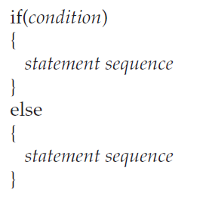
The if Statement
The targets of both the if and else can be blocks of statements. The general form of the if using blocks of statements is
If the conditional expression is true, the target of the if will be executed; otherwise, if it exists, the target of the else will be executed.

Slide 5
Nested ifs
A nested if is an if statement that is the target of another if or else.
The main thing to remember about nested ifs in C# is that an else clause always refers to the nearest if statement that is within the same block as the else and not already associated with an else.

Slide 6
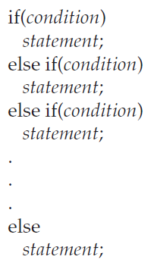
The if-else-if Ladder
A common programming construct that is based upon the nested if is the if-else-if ladder.

Slide 7
The if-else-if Ladder
The conditional expressions are evaluated from the top downward. As soon as a true condition is found, the statement associated with it is executed, and the rest of the ladder is bypassed.
If none of the conditions is true, then the final else clause will be executed. If there is no final else and all other conditions are false, then no action will take place.

Slide 8
The switch Statement
The switch provides for a multiway branch. Thus, it enables a program to select among several alternatives. Although a series of nested if statements can perform multiway tests, for many situations the switch is a more efficient approach.
It works like this: The value of an expression is successively tested against a list of constants. When a match is found, the statement sequence associated with that match is executed.
The switch expression must be of an integer type, such as char, byte, short, or int, of an enumeration type, or of type string. Thus, floating-point expressions, for example, are not allowed.

Slide 9
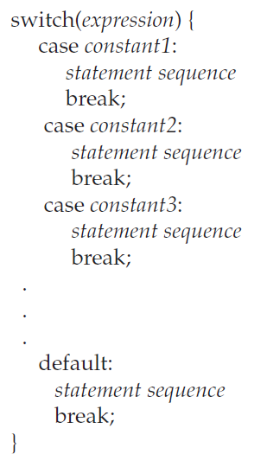
The switch Statement
The case constantsmust be of a type compatible with the expression. No two case constants in the same switch can have identical values.
The default sequence is executed if no case constant matches the expression. The default is optional; if it is not present, no action takes place if all matches fail.

Slide 10
Nested switch Statements
It is possible to have a switch as part of the statement sequence of an outer switch. This is called a nested switch. The case constants of the inner and outer switch can contain common values and no conflicts will arise.

Slide 11
Iteration statements
for Loop
while Loop
do-while Loop
foreach Loop

Slide 12
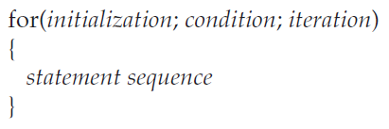
The for Loop
The general form of the for loop for repeating a single statement is
For repeating a block, the general form is
The initialization is usually an assignment statement that sets the initial value of the Loop control variable, which acts as the counter that controls the loop. The condition is a Boolean expression that determines whether the loop will repeat. The iteration expression defines the amount by which the loop control variable will change each time the loop is repeated.

Slide 13
Some Variations on the for Loop
Using Multiple Loop Control Variables
The for loop allows you to use two or more variables to control the loop. When using multiple loop control variables, the initialization and increment statements for each variable are separated by commas.
The Conditional Expression
The conditional expression controlling a for loop can be any valid expression that produces a bool result. It does not need to involve the loop control variable.
Missing Pieces
In C#, it is possible for any or all of the initialization, condition, or iteration portions of the for loop to be empty.

Slide 14
Some Variations on the for Loop
The Infinite Loop
You can create an infinite loop (a loop that never terminates) using the for by leaving the conditional expression empty.
Loops with No Body
In C#, the body associated with a for loop (or any other loop) can be empty. This is because an empty statement is syntactically valid.
Declaring Loop Control Variables Inside the for Loop
Often the variable that controls a for loop is needed only for the purposes of the loop and is not used elsewhere. When this is the case, it is possible to declare the variable inside the initialization portion of the for.

Slide 15

The while Loop
The general form of the while loop is
where statement can be a single statement or a block of statements, and condition defines the condition that controls the loop and may be any valid Boolean expression. The statement is performed while the condition is true. When the condition becomes false, program control passes to the line immediately following the loop.

Slide 16
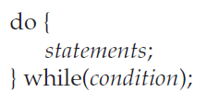
The do-while Loop
The third C# loop is the do-while. Unlike the for and the while loops, in which the condition is tested at the top of the loop, the do-while loop checks its condition at the bottom of the loop. This means that a do-while loop will always execute at least once.
The general form of the do-while loop is
Although the braces are not necessary when only one statement is present.

Slide 17
The foreach Loop
The foreach loop is examined in next unit, when arrays are discussed.

Slide 18
Jump statements
break
continue
goto
return
throw

Slide 19
break
Using break to Exit a Loop
It is possible to force an immediate exit from a loop, bypassing any code remaining in the body of the loop and the loop’s conditional test, by using the break statement.
When a break statement is encountered inside a loop, the loop is terminated, and program control resumes at the next statement following the loop.

Slide 20
continue
Using continue
It is possible to force an early iteration of a loop, bypassing the loop’s normal control structure.
The continue statement forces the next iteration of the loop to take place, skipping any code in between.
Thus, continue is essentially the complement of break.

Slide 21
return
The return statement causes a method to return. It can also be used to return a value.

Slide 22
The goto
The goto is C#’s unconditional jump statement.
When encountered, program flow jumps to the location specified by the goto.
The goto requires a label for operation. A label is a valid C# identifier followed by a colon. The label must be in the same method as the goto that uses it and within scope.
The goto can also be used to jump to a case or default statement within a switch. Technically, the case and default statements of a switch are labels. Thus, they can be targets of a goto. However, the goto statement must be executed from within the switch. That is, you cannot use the goto to jump into a switch statement.

Slide 23
Thank You

