Slide 1

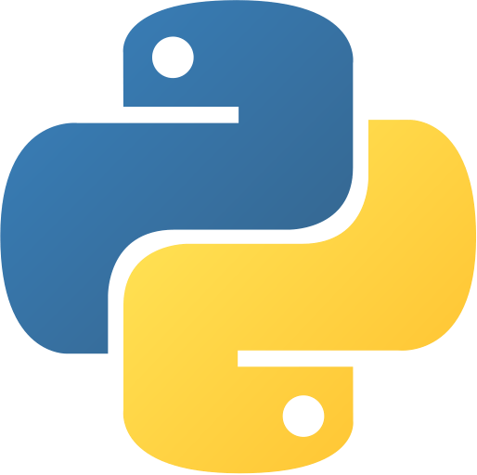
Installation Basic Programming with Python
Co Curricular Course
C.S. & I.T. Department
Atmiya University - Rajkot

Slide 2
Installation
Visit https://www.python.org

Slide 3
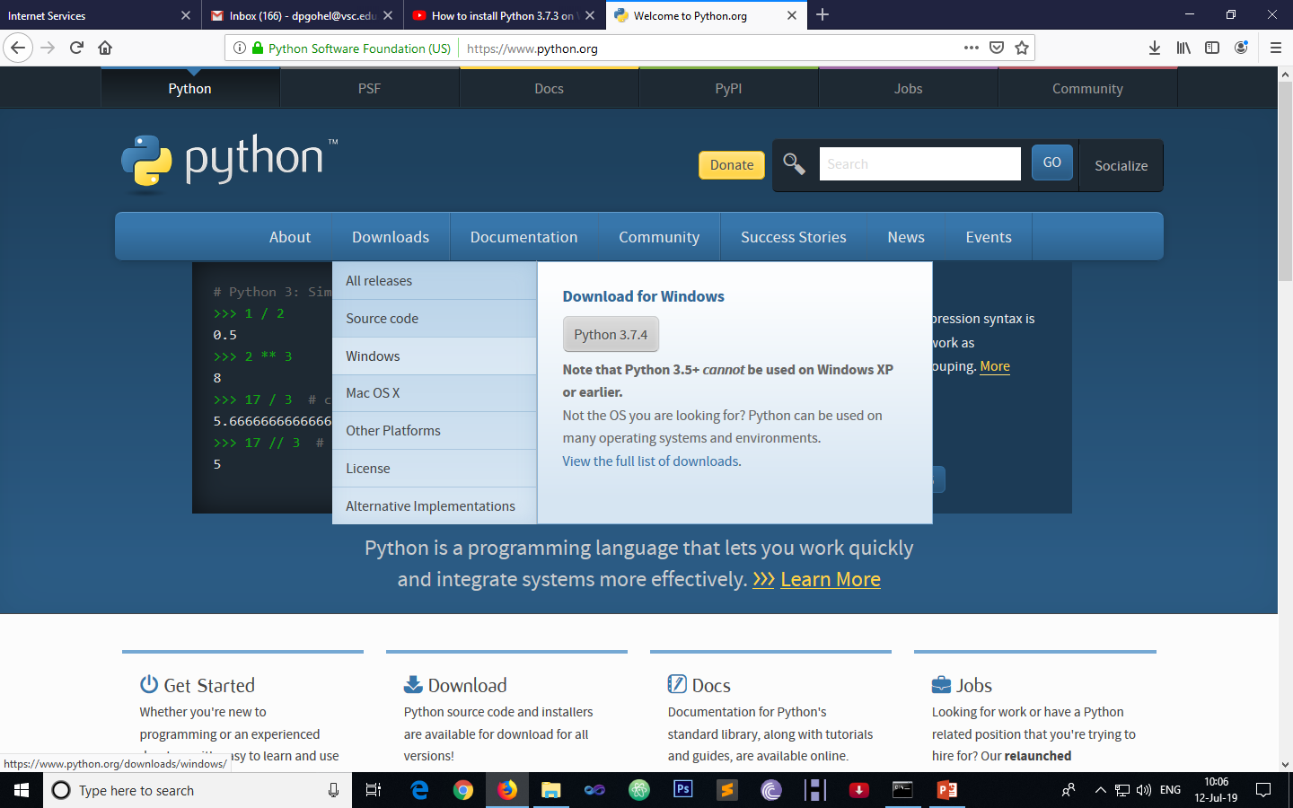
Installation
Click Here

Slide 4
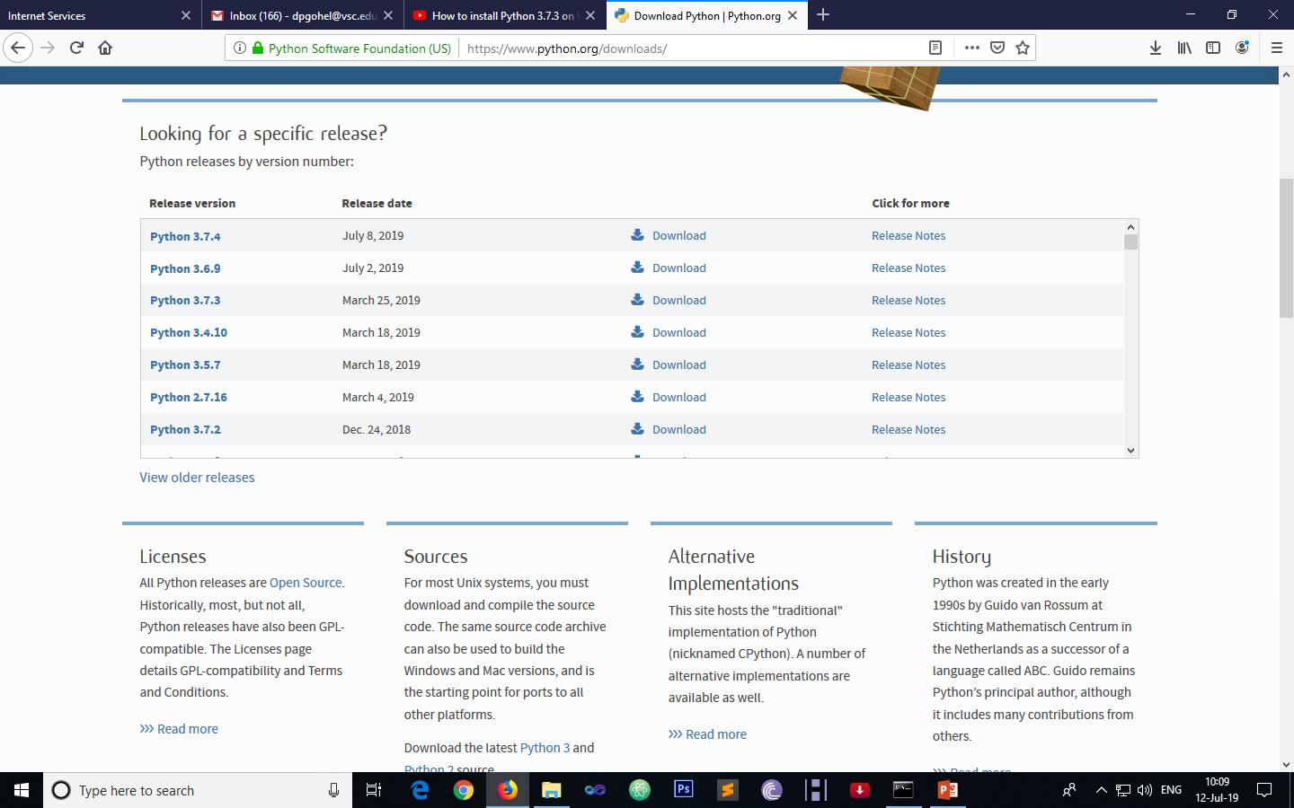
Installation
Select required version

Slide 5
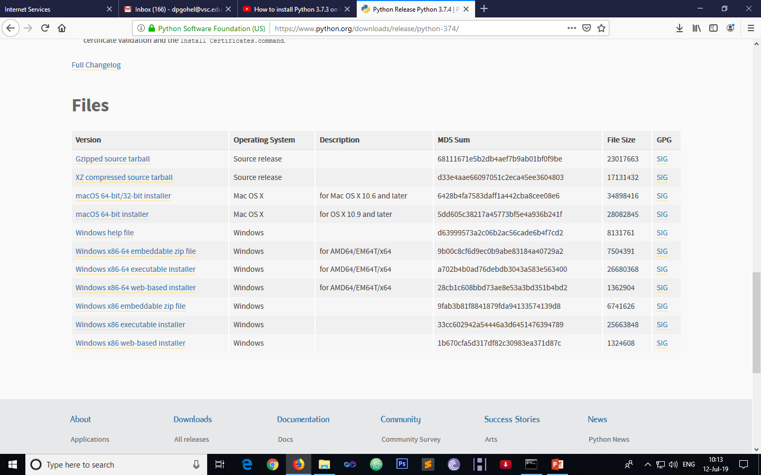
Installation
Select required files and download it

Slide 6
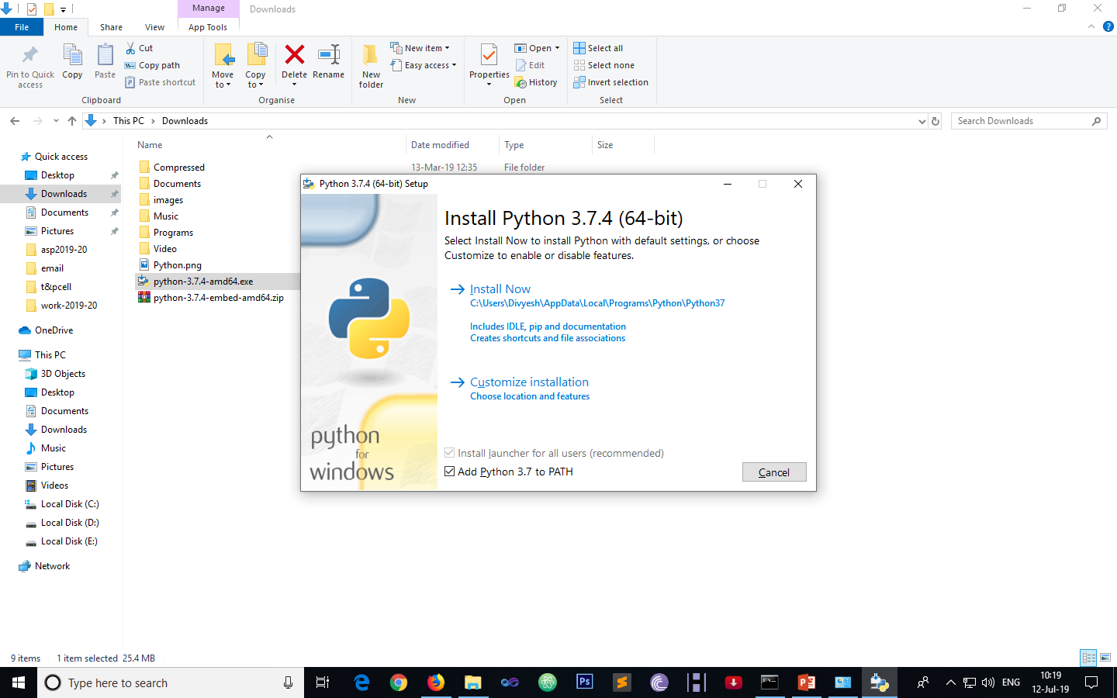
Installation
Check this and click on Install Now link

Slide 7

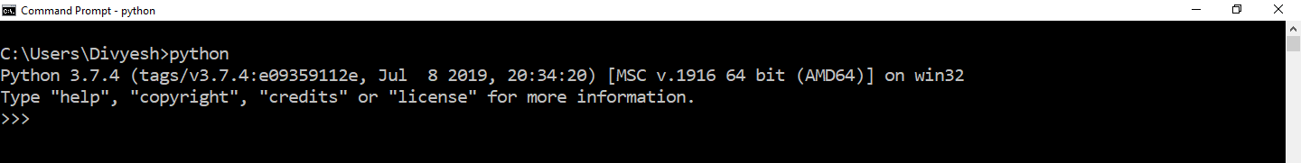
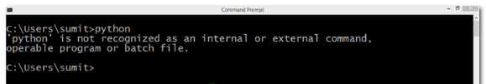
Installation
Open a command prompt and check python successfully install or not?
If you face the error, then set environment variable in system variable section like

Slide 8
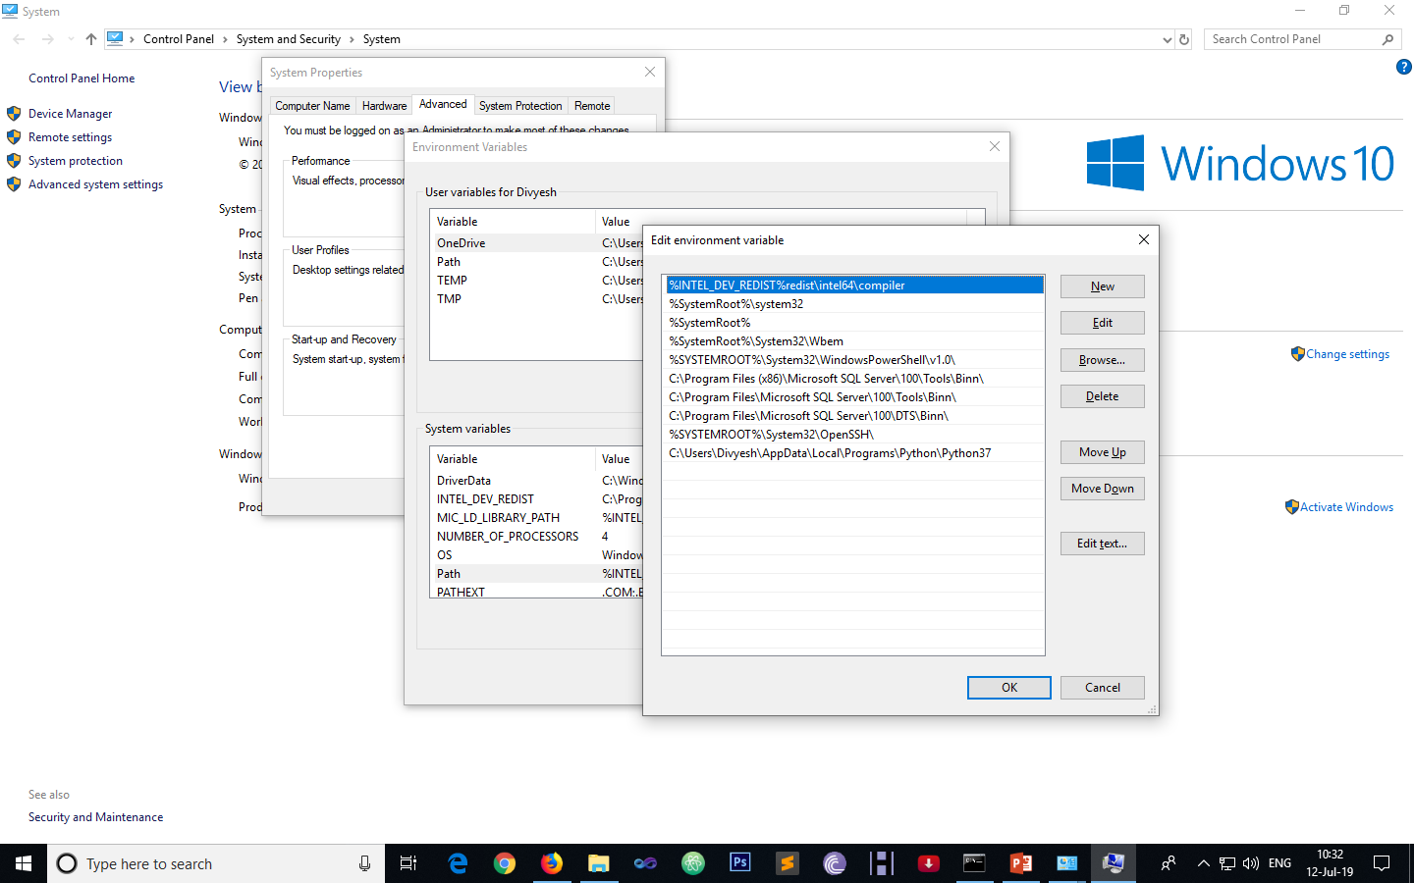
Installation

Slide 9
Thank You

