Slide 1


ADO.NET Architecture

Slide 2
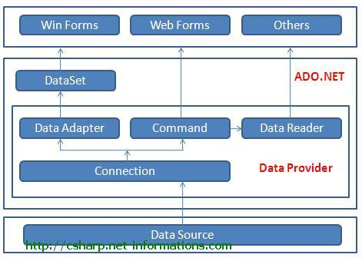
Introduction
ADO.NET is a data access technology from Microsoft .Net Framework , which provides communication between relational and non-relational systems through a common set of components. ADO.NET consist of a set of Objects that expose data access services to the .NET environment. ADO.NET is designed to be easy to use, and Visual Studio provides several wizards and other features that you can use to generate ADO.NET data access code.

Slide 3
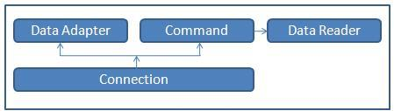
Data Providers and DataSet
The two key components of ADO.NET are Data Providers and DataSet . The .Net Framework includes mainly three Data Providers for ADO.NET. They are the Microsoft SQL Server Data Provider , OLEDB Data Provider and ODBC Data Provider . SQL Server uses the SqlConnection object , OLEDB uses the OleDbConnection Object and ODBC uses OdbcConnection Object respectively.

Slide 4
Data Providers and DataSet
The four Objects from the .Net Framework provides the functionality of Data Providers in the ADO.NET. They are Connection Object, Command Object , DataReader Object and DataAdapter Object. The Connection Object provides physical connection to the Data Source. The Command Object uses to perform SQL statement or stored procedure to be executed at the Data Source. The DataReader Object is a stream-based , forward-only, read-only retrieval of query results from the Data Source, which do not update the data. Finally the DataAdapter Object , which populate a Dataset Object with results from a Data Source .

Slide 5
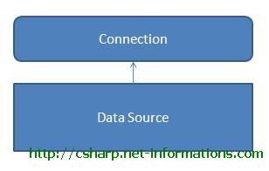
C# ADO.NET Connection
The Connection Object is a part of ADO.NET Data Provider and it is a unique session with the Data Source. The Connection Object is Handling the part of physical communication between the C# application and the Data Source.

Slide 6
C# ADO.NET Connection
The Connection Object connect to the specified Data Source and open a connection between the C# application and the Data Source, depends on the parameter specified in the Connection String . When the connection is established, SQL Commands will execute with the help of the Connection Object and retrieve or manipulate data in the Data Source.
Once the Database activity is over , Connection should be closed and release the Data Source resources.
In C# the type of the Connection is depend on which Data Source system you are working with.

Slide 7
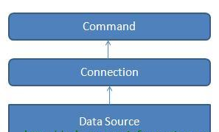
C# ADO.NET Command
The Command Object in ADO.NET executes SQL statements and Stored Procedures against the data source specified in the C# Connection Object. The Command Object requires an instance of a C# Connection Object for executing the SQL statements.

Slide 8
C# ADO.NET Command
In order to retrieve a resultset or execute an SQL statement against a Data Source , first you have to create a Connection Object and open a connection to the Data Source specified in the connection string. Next step is to assign the open connection to the connection property of the Command Object . Then the Command Object can execute the SQL statements. After the execution of the SQl statement, the Command Object will return a result set . We can retrieve the result set using a Data Reader.
The Command Object has a property called CommandText , which contains a String value that represents the command that will be executed against the Data Source. When the CommandType property is set to StoredProcedure, the CommandText property should be set to the name of the stored procedure.

Slide 9
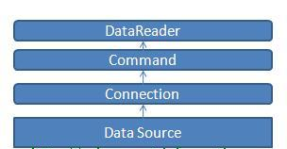
C# ADO.NET DataReader
DataReader Object in ADO.NET is a stream-based , forward-only, read-only retrieval of query results from the Data Sources , which do not update the data. The DataReader cannot be created directly from code, they can created only by calling the ExecuteReader method of a Command Object.

Slide 10
C# ADO.NET DataReader
The DataReader Object provides a connection oriented data access to the Data Sources. A Connection Object can contain only one DataReader at a time and the connection in the DataReader remains open, also it cannot be used for any other purpose while data is being accessed. When we started to read from a DataReader it should always be open and positioned prior to the first record. The Read() method in the DataReader is used to read the rows from DataReader and it always moves forward to a new valid row, if any row exist .
Usually we are using two types of DataReader in ADO.NET. They are SqlDataReader and the OleDbDataReader . The System.Data.SqlClient and System.Data.OleDb are containing these DataReaders respectively

Slide 11
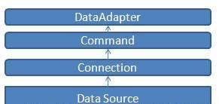
C# ADO.NET DataAdapter
DataAdapter is a part of the ADO.NET Data Provider. DataAdapter provides the communication between the Dataset and the Datasource. We can use the DataAdapter in combination with the DataSet Object. DataAdapter provides this combination by mapping Fill method, which changes the data in the DataSet to match the data in the data source, and Update, which changes the data in the data source to match the data in the DataSet. That is, these two objects combine to enable both data access and data manipulation capabilities.

Slide 12
C# ADO.NET DataAdapter
The DataAdapter can perform Select , Insert , Update and Delete SQL operations in the Data Source. The SelectCommand property of the DataAdapter is a Command Object that retrieves data from the data source. The InsertCommand , UpdateCommand , and DeleteCommand properties of the DataAdapter are Command objects that manage updates to the data in the data source according to modifications made to the data in the DataSet.

Slide 13
Advantages of ADO.Net
ADO stands for ActiveX Data Objects and it relies on COM whereas ADO.NET relies on managed providers defined by the .NET CLR (Common Language Runtime). ADO.NET provides consistent access to data sources such as SQL Server, as well as data sources exposed through OLE DB and XML. The following are some Advantages of ADO.Net.
ADO.NET can have separate Objects that represent connections to different data sources. In ADO.NET you can create multiple data provider namespaces to connect specifically with a particular data source, making access faster and more efficient and allowing each namespace to exploit the features of its targeted data provider.

Slide 14
Advantages of ADO.Net
ADO.NET gives you the choice of either using client side or server side cursors.
ADO.NET introduces a new way of getting a single value from a query's results when you expect only one row and one column to return. The ADO.NET command object has an ExecuteScalar method which returns the first row and column's value from its associated query.
ADO.Net dataset represents in memory representation of a database.
ADO.Net datasets can hold data from various sources and integrate the data and write it back to one or several data sources.
The ADO.NET Framework supports two models of Data Access Architecture, Connection Oriented Data Access Architecture and Disconnected Data Access Architecture.

Slide 15
Thank You

