Slide 1


Indexers and Properties
This topic examines two special types of class members that have a close relationship to each other: indexers and properties. Each expands the power of a class by enhancing its integration into C#’s type system.

Slide 2
Indexers
Indexers provide the mechanism by which an object can be indexed like an array.
As you know, array indexing is performed using the [ ] operator. It is possible to define the [ ] operator for classes that you create, but you don’t use an operator method. Instead, you create an indexer.
An indexer allows an object to be indexed like an array.
The main use of indexers is to support the creation of specialized arrays that are subject to one or more constraints.
However, you can use an indexer for any purpose for which an array-like syntax is beneficial. Indexers can have one or more dimensions. We will begin with onedimensional indexers.

Slide 3
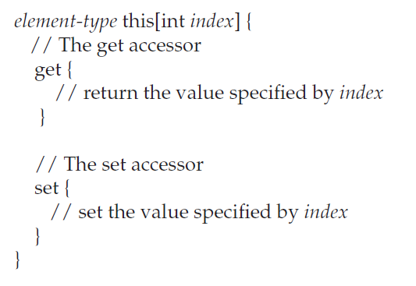
Creating One-Dimensional Indexers
A simple one-dimensional indexer has this general form:
Here, element-type is the element type of the indexer. Thus, each element accessed by the indexer will be of type element-type.

Slide 4
Creating One-Dimensional Indexers
The parameter index receives the index of the element being accessed. Technically, this parameter does not have to be of type int, but since indexers are typically used to provide array indexing, using an integer type is quite common.
Inside the body of the indexer two accessors are defined that are called get and set. An accessor is similar to a method except that it does not declare a return type or parameters.
The accessors are automatically called when the indexer is used, and both accessors receive index as a parameter.
If the indexer is on the left side of an assignment statement, then the set accessor is called and the element specified by index must be set. therwise, the get accessor is called and the value associated with index must be returned.

Slide 5
Creating One-Dimensional Indexers
The set method also receives an implicit parameter called value, which contains the value being assigned to the specified index.
One of the benefits of an indexer is that you can control precisely how an array is accessed, heading off improper access.

Slide 6
Multidimensional Indexers
You can create indexers for multidimensional arrays, too.

Slide 7
Indexers Can Be Overloaded
An indexer can be overloaded. The version executed will be the one that has the closest type-match between its parameter and the argument used as an index.
Like functions, Indexers can also be overloaded. In C#, we can have multiple indexers in a single class. To overload an indexer, declare it with multiple parameters and each parameter should have a different data type. Indexers are overloaded by passing 2 different types of parameters. It is quite similar to method overloading.

Slide 8
Properties
Properties offer a streamlined way to manage access to a class’ instance data.
Another type of class member is the property. a property combines a field with the methods that access it.
Properties are similar to indexers. A property consists of a name along with get and set accessors. The accessors are used to get and set the value of a variable. The key benefit of a property is that its name can be used in expressions and assignments like a normal variable, but in actuality the get and set accessors are automatically invoked. This is similar to the way that an indexer’s get and set accessors are automatically used.

Slide 9
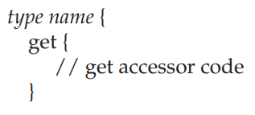
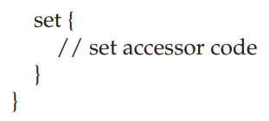
Properties
Here, type specifies the type of the property, such as int, and name is the name of the property. Once the property has been defined, any use of name results in a call to its appropriate accessor. The set accessor automatically receives a parameter called value that contains the value being assigned to the property.

Slide 10
Properties
It is important to understand that properties do not define storage locations. Instead, a property typically manages access to a field. It does not, itself, provide that field. The field must be specified independently of the property.

Slide 11
Auto-Implemented Properties
it became possible to implement very simple properties without having to explicitly define the variable managed by the property. Instead, you can let the compiler automatically supply the underlying variable. This is called an auto-implemented property.
It has the following general form: type name { get; set; }
Here, type specifies the type of the property and name specifies the name. Notice that get and set are immediately followed by a semicolon. The accessors for an auto-implemented property have no bodies. This syntax tells the compiler to automatically create a storage location that holds the value. This variable is not named and is not directly available to you. Instead, it can be accessed only through the property

Slide 12
Auto-Implemented Properties
Unlike normal properties, an auto-implemented property cannot be read-only or write only. Both the get and set must be specified in all cases.
Although auto-implemented properties offer convenience, their use is limited to those cases in which you do not need control over the getting or setting of the backing field.
Remember, you cannot access the backing field directly. This means that there is no way to constrain the value an auto-implemented property can have. Thus, auto-implemented properties simply let the name of the property act as a proxy for the field, itself.

Slide 13
Use Object Initializers with Properties
When using object initializers, you specify initial values for the fields and/or properties that you want to initialize. Furthermore, the object initializer syntax is the same for both properties or fields.
the object initializer syntax is most useful when working with anonymous types generated by a LINQ expression. In most other cases, you will use the normal constructor syntax.
Properties have some important restrictions. First, because a property does not define a storage location, it cannot be passed as a ref or out parameter to a method. Second, you cannot overload a property. Finally, a property should not alter the state of the underlying variable when the get accessor is called. Although this rule is not enforced by the compiler, violating it is semantically wrong. A get operation should be nonintrusive.

Slide 14
Use Access Modifiers with Accessors
By default, the set and get accessors have the same accessibility as the indexer or property of which they are a part.
For example, if the property is declared public, then by default the get and set accessors are also public. It is possible, however, to give set or get its own access modifier, such as private.
There are a number of reasons why you may want to restrict the accessibility of an accessor. For example, you might want to let anyone obtain the value of a property, but allow only members of its class to set the property. To do this, declare the set accessor as private.

Slide 15
Thank You

