Slide 1


Inheritance
In object-oriented programming, inheritance is the mechanism of basing an object or class upon another object or class, retaining similar implementation. Also defined as deriving new classes from existing ones such as super class or base class and then forming them into a hierarchy of classes.

Slide 2
Introduction
Inheritance is one of the three foundational principles of object-oriented programming because it allows the creation of hierarchical classifications. Using inheritance, you can create a general class that defines traits common to a set of related items. This class can then be inherited by other, more specific classes, each adding those things that are unique to it.
In the language of C#, a class that is inherited is called a base class. The class that does the inheriting is called a derived class. Therefore, a derived class is a specialized version of a base class. It inherits all of the variables, methods, properties, and indexers defined by the base class and adds its own unique elements.

Slide 3
Inheritance Basics
C# supports inheritance by allowing one class to incorporate another class into its declaration. This is done by specifying a base class when a derived class is declared.
The general form of a class declaration that inherits a base class is shown here:
class derived-class-name : base-class-name
{ // body of class}
This syntax can be generalized. Whenever one class inherits another, the base class name follows the name of the derived class, separated by a colon. In C#, the syntax for inheriting a class is remarkably simple and easy to use.

Slide 4
Inheritance Basics
You can specify only one base class for any derived class that you create. C# does not support the inheritance of multiple base classes into a single derived class. (This differs from C++, in which you can inherit multiple base classes. Be aware of this when converting C++ code to C#.)
You can, however, create a hierarchy of inheritance in which a derived class becomes a base class of another derived class. (Of course, no class can be a base class of itself, either directly or indirectly.)
In all cases, a derived class inherits all of the members of its base class. This includes instance variables, methods, properties, and indexers.

Slide 5
Inheritance Basics
A major advantage of inheritance is that once you have created a base class that defines the attributes common to a set of objects, it can be used to create any number of more specific derived classes. Each derived class can precisely tailor its own classification.

Slide 6
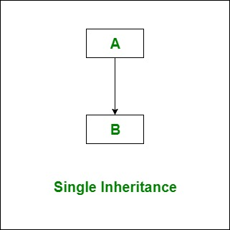
Types of Inheritance in C#
Single Inheritance: In single inheritance, subclasses inherit the features of one superclass. In image below, the class A serves as a base class for the derived class B.

Slide 7
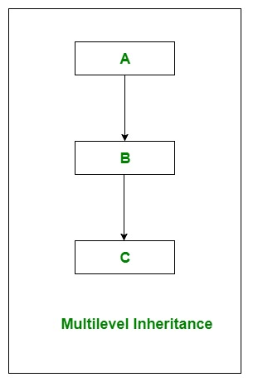
Types of Inheritance in C#
Multilevel Inheritance: In Multilevel Inheritance, a derived class will be inheriting a base class and as well as the derived class also act as the base class to other class. In below image, class A serves as a base class for the derived class B, which in turn serves as a base class for the derived class C.

Slide 8
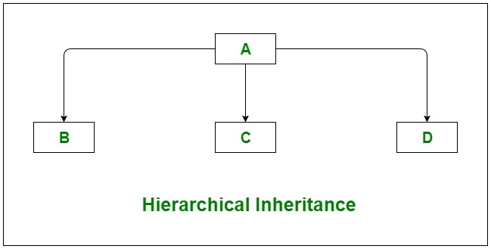
Types of Inheritance in C#
Hierarchical Inheritance: In Hierarchical Inheritance, one class serves as a superclass (base class) for more than one subclass. In below image, class A serves as a base class for the derived class B, C, and D.

Slide 9
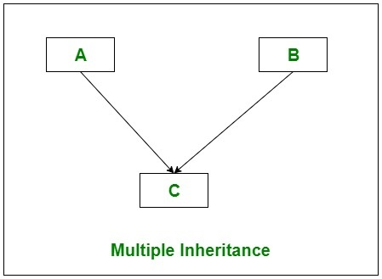
Types of Inheritance in C#
Multiple Inheritance(Through Interfaces):In Multiple inheritance, one class can have more than one superclass and inherit features from all parent classes. Please note that C# does not support multiple inheritance with classes. In C#, we can achieve multiple inheritance only through Interfaces. In the image below, Class C is derived from interface A and B.

Slide 10
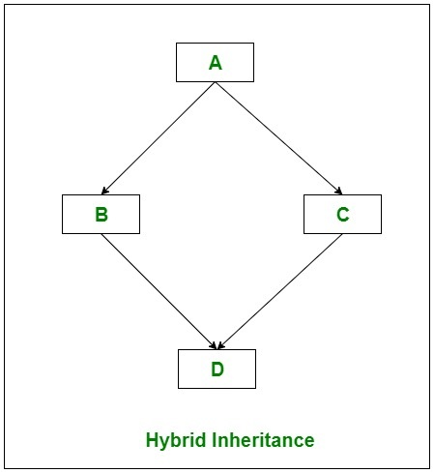
Types of Inheritance in C#
Hybrid Inheritance(Through Interfaces): It is a mix of two or more of the above types of inheritance. Since C# doesn’t support multiple inheritance with classes, the hybrid inheritance is also not possible with classes. In C#, we can achieve hybrid inheritance only through Interfaces.

Slide 11
Using Protected Access
A private member of a base class is not accessible to a derived class. This would seem to imply that if you wanted a derived class to have access to some member in the base class, it would need to be public. Of course, making the member public also makes it available to all other code, which may not be desirable. Fortunately, this implication is untrue because C# allows you to create a protected member. A protected member is public within a class hierarchy, but private outside that hierarchy.
A protected member is created by using the protected access modifier.

Slide 12
Constructors and Inheritance
In a hierarchy, it is possible for both base classes and derived classes to have their own constructors. This raises an important question: What constructor is responsible for building an object of the derived class? The one in the base class, the one in the derived class, or both?
Here is the answer: The constructor for the base class constructs the base class portion of the object, and the constructor for the derived class constructs the derived class part. This makes sense because the base class has no knowledge of or access to any element in a derived class. Thus, their construction must be separate.

Slide 13
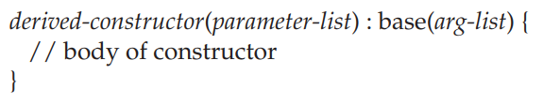
Constructors and Inheritance
When only the derived class defines a constructor, the process is straightforward: Simply construct the derived class object. The base class portion of the object is constructed automatically using its default constructor.
When both the base class and the derived class define constructors, the process is a bit more complicated because both the base class and derived class constructors must be executed. In this case, you must use another of C#’s keywords, base, which has two uses. The first use is to call a base class constructor. The second is to access a member of the base class that has been hidden by a member of a derived class.

Slide 14
Inheritance and Name Hiding
It is possible for a derived class to define a member that has the same name as a member in its base class. When this happens, the member in the base class is hidden within the derived class. While this is not technically an error in C#, the compiler will issue a warning message. This warning alerts you to the fact that a name is being hidden. If your intent is to hide a base class member, then to prevent this warning, the derived class member must be preceded by the new keyword. Understand that this use of new is separate and distinct from its use when creating an object instance.

Slide 15
Using base to Access a Hidden Name
There is a second form of base that acts somewhat like this, except that it always refers to the base class of the derived class in which it is used. This usage has the following general form:
base.member
Here, member can be either a method or an instance variable.

Slide 16
Using base to Access a Hidden Name
There is a second form of base that acts somewhat like this, except that it always refers to the base class of the derived class in which it is used. This usage has the following general form:
base.member
Here, member can be either a method or an instance variable.

Slide 17
When Are Constructors Called?
In the foregoing discussion of inheritance and class hierarchies, an important question may have occurred to you: When a derived class object is created, whose constructor is executed first? The one in the derived class or the one defined by the base class?
The answer is that in a class hierarchy, constructors are called in order of derivation, from base class to derived class. Furthermore, this order is the same whether or not base is used. If base is not used, then the default (parameterless) constructor of each base class will be executed.

Slide 18
Thank You

