Slide 1


Authentication and Authorization in ASP.NET

Slide 2
Authentication in ASP.NET
This article will discuss how to implement ASP.NET authentication and authorization. This article initially starts with authentication and authorization concepts and later explains the three important ways of doing authentication and authorization i.e. windows, forms and passport. As the article moves ahead it explains basic, digest and integrated authentication in depth. This article also dives in depth on how forms authentication can be used to implement custom authentication and single-sign on authentication. One of the important concepts this article touch bases is ticket generation in cookies and how ASP.NET membership and role can help us to increase productivity.

Slide 3
Authentication and Authorization
Before proceeding ahead we need to understand four important vocabularies which you will see in this article again and again: - authentication, authorization, principal and identity. Let’s first start with authentication and authorization. If you search in www.google.com for the dictionary meaning of authentication and authorization, you will land up with something below:-
Authentication: - prove genuineness
Authorization: - process of granting approval or permission on resources.
The same dictionary meaning applies to ASP.NET as well. In ASP.NET authentication means to identify the user or in other words its nothing but to validate that he exists in your database and he is the proper user.

Slide 4
Authentication and Authorization
Authorization means does he have access to a particular resource on the IIS website. A resource can be an ASP.NET web page, media files (MP4, GIF, JPEG etc), compressed file (ZIP, RAR) etc.
So the first process which happens is authentication and then authorization. Below is a simple graphical representation of authentication and authorization. So when the user enters ‘userid’ and ‘password’ he is first authenticated and identified by the user name.
Now when the user starts accessing resources like pages, ASPDOTNETauthentication, videos etc, he is checked whether he has the necessary access for the resources. The process of identifying the rights for resources is termed as ‘Authorization’.

Slide 5
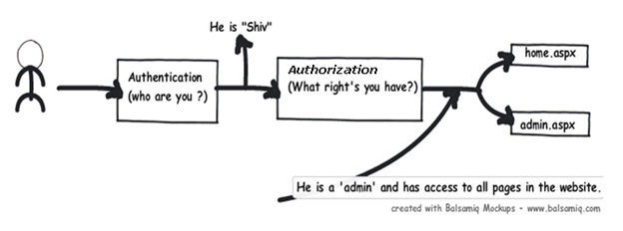
Authentication and Authorization
To put it in simple words to identify “he is shiv” is authentication and to identify that “Shiv is admin” is authorization.

Slide 6
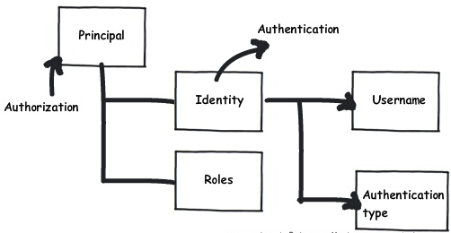
Detecting authentication and authorization: - The principal and identity objects
At any moment of time if you want to know who the user is and what kind of authentication type he using you can use the identity object. If you want to know what kind of roles it’s associated with then we need to use the principal object. In other words to get authentication details we need to the identity object and to know about authorization details of that identity we need the principal object.

Slide 7
Types of authentication and authorization in ASP.NE
There are three ways of doing authentication and authorization in ASP.NET:-
Windows authentication:- In this methodology ASP.NET web pages will use local windows users and groups to authenticate and authorize resources.
Forms Authentication:- This is a cookie based authentication where username and password are stored on client machines as cookie files or they are sent through URL for every request. Form-based authentication presents the user with an HTML-based Web page that prompts the user for credentials.

Slide 8
Types of authentication and authorization in ASP.NE
Passport authentication:- Passport authentication is based on the passport website provided
by the Microsoft .So when user logins with credentials it will be reached to the passport website ( i.e. hotmail,devhood,windows live etc) where authentication will happen. If Authentication is successful it will return a token to your website.
Anonymous access:- If you do not want any kind of authentication then you will go for Anonymous access.
GenericPrincipal and GenericIdentity objects represent users who have been authenticated using Forms authentication or other custom authentication mechanisms. With these objects, the role list is obtained in a custom manner, typically from a database.
FormsIdentity and PassportIdentity objects represent users who have been authenticated with Forms and Passport authentication respectively.

Slide 9
Thank You

