Slide 1


Custom Error Handling in ASP.NET

Slide 2
Introduction
Structured exception handling is a fundamental part of the CLR and provides .Net programmers a great way of managing errors. In addition to CLR exception system, ASP.Net also provides ways of handling errors.
When a runtime or design-time error occurs in an application, ASP.Net shows a default error page that gives a brief description of the error along with the line number on which the error occurred. A developer would wish to view this default error page, during the testing of the application since the description helps him in rectifying the error. But he would never want a user trying to access his application, to view this error page. The user would be least bothered to know about the error. Instead of showing the default error page, it would be more sensible to show a customized error page that would let the user send notification of the error to the administrator.

Slide 3
Explanation
Consider an example of an ASP.Net application that generates an error intentionally to show how ASP.Net detects it and shows the default error page. The below given webform contains a label and a button server control. In the eventhandler for the button click event, the user will be redirected to another webform "Trial.aspx". Since the page being redirected to, is missing ASP.Net will show the default error page indicating it is a runtime error.
Unlike classic ASP, ASP.Net separates the code for the business logic from the content (i.e HTML and interface logic). The sample application has two files named "webform1.aspx" containing the content and "webform1.aspx.vb" containing the code.

Slide 4
Customizing Error Page
To customize the default error page, one will have to change the default configuration settings of the application.
There are three error modes in which an ASP.Net application can work:
Off Mode
On Mode
RemoteOnly Mode
The Error mode attribute determines whether or not an ASP.Net error message is displayed. By default, the mode value is set to "RemoteOnly".

Slide 5
Customizing Error Page
Off Mode
When the error attribute is set to "Off", ASP.Net uses its default error page for both local and remote users in case of an error.
On Mode
In case of "On" Mode, ASP.Net uses user-defined custom error page instead of its default error page for both local and remote users. If a custom error page is not specified, ASP.Net shows the error page describing how to enable remote viewing of errors.
RemoteOnly
ASP.Net error page is shown only to local users. Remote requests will first check the configuration settings for the custom error page or finally show an IIS error.

Slide 6
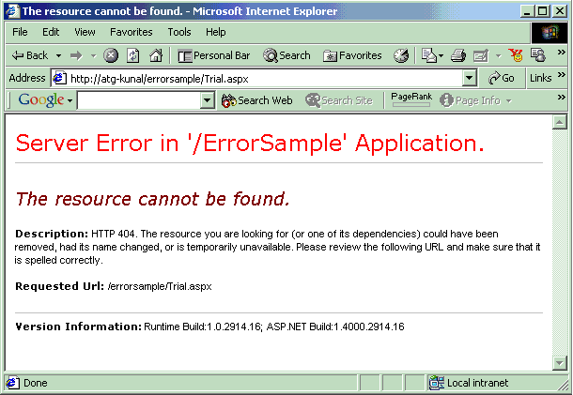
Configuration File
Customization of error page can be implemented by adding a value for an attribute "defaultRedirect" in the <customErrors> tag of the configuration file "web.config". This file determines configuration settings for the underlying application.
Off Mode: In this scenario, set the mode attribute value to "Off" as shown below:
Web.Config File
<?xml version="1.0" encoding="utf-8" ?>
<configuration>
<system.web>
<customErrors mode="Off" />
</system.web>
</configuration>
When the sample ASP.Net web page is viewed in the browser from the remote machine, one gets the below shown default error page.

Slide 7
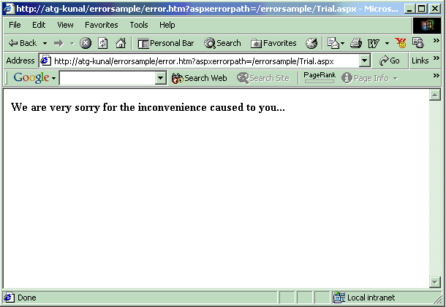
Configuration File
On Mode
In this scenario, set the mode attribute value to "On" as shown below:
Web.Config File
<?xml version="1.0" encoding="utf-8" ?>
<configuration>
<system.web>
<customErrors defaultRedirect="error.htm" mode="On" />
</system.web>
</configuration>
As shown in the configuration file, the "defaultRedirect" attribute has been set to a user-defined page "error.htm". The user-defined error page can be an ASP.Net web page, classic ASP page or a simple HTML page.
For example, the contents of the user-defined error page "error.htm" can be given as follows:

Slide 8
Configuration File
RemoteOnly Mode
In this scenario, set the mode attribute value to "RemoteOnly" as shown below:
Web.Config File
<?xml version="1.0" encoding="utf-8" ?>
<configuration>
<system.web>
<customErrors defaultRedirect="error.htm" mode="RemoteOnly" />
</system.web>
</configuration>
Since the "defaultRedirect" attribute has been set, if the page is requested from a remote machine page is redirected to "error.htm" and if the page is requested from the local machine the default error page is shown.

Slide 9
Thank You

