Slide 1


Working with Form Class

Slide 2
Introduction
Windows Forms is a Graphical User Interface(GUI) class library which is bundled in .Net Framework. Its main purpose is to provide an easier interface to develop the applications for desktop, tablet, PCs. It is also termed as the WinForms. The applications which are developed by using Windows Forms or WinForms are known as the Windows Forms Applications that runs on the desktop computer. WinForms can be used only to develop the Windows Forms Applications not web applications. WinForms applications can contain the different type of controls like labels, list boxes, tooltip etc.

Slide 3
Creating a Windows Forms Application
First, open the Visual Studio then Go to File -> New -> Project to create a new project and then select the language as Visual C# from the left menu. Click on Windows Forms App(.NET Framework) in the middle of current window. After that give the project name and Click OK.
Here the solution is like a container which contains the projects and files that may be required by the program.

Slide 4
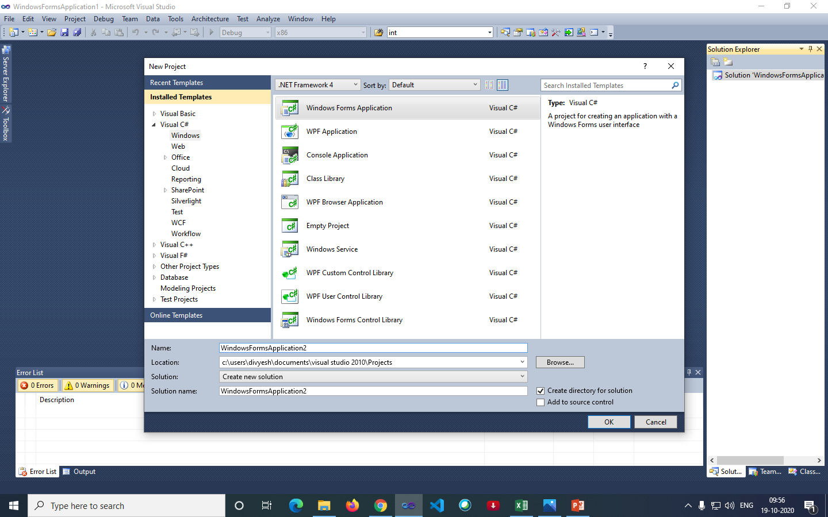
Creating a Windows Forms Application

Slide 5
Creating a Windows Forms Application
After that following window will display which will be divided into three parts as follows:
Editor Window or Main Window: Here, you will work with forms and code editing. You can notice the layout of form which is now blank. You will double click the form then it will open the code for that.
Solution Explorer Window: It is used to navigate between all items in solution. For example, if you will select a file form this window then particular information will be display in the property window.
Properties Window: This window is used to change the different properties of the selected item in the Solution Explorer. Also, you can change the properties of components or controls that you will add to the forms.

Slide 6
Creating a Windows Forms Application
You can also reset the window layout by setting it to default. To set the default layout, go to Window -> Reset Window Layout in Visual Studio Menu.
Now to add the controls to your WinForms application go to Toolbox tab present in the extreme left side of Visual Studio. Here, you can see a list of controls. To access the most commonly used controls go to Common Controls present in Toolbox tab.
Now drag and drop the controls that you needed on created Form. For example, if you can add TextBox, ListBox, Button etc. as shown below. By clicking on the particular dropped control you can see and change its properties present in the right most corner of Visual Studio.

Slide 7
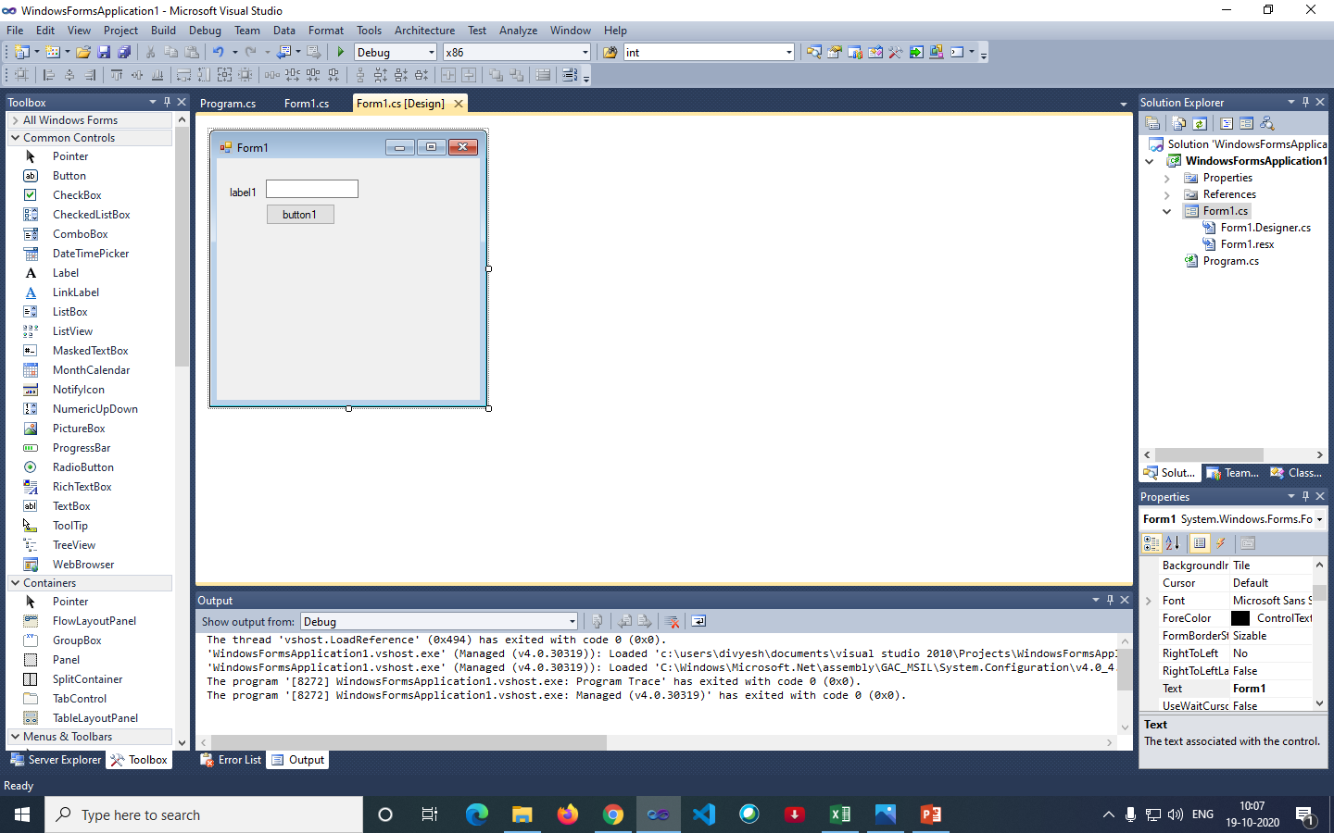
Creating a Windows Forms Application

Slide 8
Creating a Windows Forms Application
To run the program you can use an F5 key or Play button present in the toolbar of Visual Studio. To stop the program you can use pause button present in the ToolBar. You can also run the program by going to Debug->Start Debugging menu in the menubar.

Slide 9
Thank You

