Slide 1


Connected and Disconnected Data Access Architecture

Slide 2
Introduction
The ADO.NET Framework supports two models of Data Access Architecture, Connection Oriented Data Access Architecture and Disconnected Data Access Architecture.
In Connection Oriented Data Access Architecture the application makes a connection to the Data Source and then interact with it through SQL requests using the same connection. In these cases the application stays connected to the database system even when it is not using any Database Operations.

Slide 3
Introduction
ADO.Net solves this problem by introduces a new component called Dataset. The DataSet is the central component in the ADO.NET Disconnected Data Access Architecture. A DataSet is an in-memory data store that can hold multiple tables at the same time. DataSets only hold data and do not interact with a Data Source. One of the key characteristics of the DataSet is that it has no knowledge of the underlying Data Source that might have been used to populate it.

Slide 4
Introduction
In Connection Oriented Data Access, when you read data from a database by using a DataReader object, an open connection must be maintained between your application and the Data Source. Unlike the DataReader, the DataSet is not connected directly to a Data Source through a Connection object when you populate it. It is the DataAdapter that manages connections between Data Source and Dataset by fill the data from Data Source to the Dataset and giving a disconnected behavior to the Dataset. The DataAdapter acts as a bridge between the Connected and Disconnected Objects.
By keeping connections open for only a minimum period of time, ADO .NET conserves system resources and provides maximum security for databases and also has less impact on system performance.

Slide 5
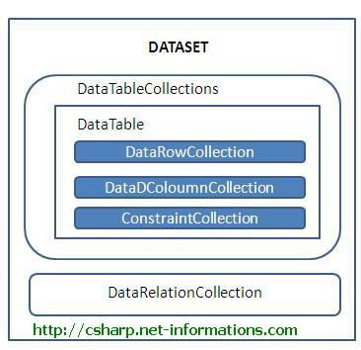
DataSet
DataSet provides a disconnected representation of result sets from the Data Source, and it is completely independent from the Data Source. DataSet provides much greater flexibility when dealing with related Result Sets.

Slide 6
DataSet
DataSet consists of a collection of DataTable objects that you can relate to each other with DataRelation objects. The DataTable contains a collection of DataRow and DataCoulumn Object which contains Data. The DataAdapter Object provides a bridge between the DataSet and the Data Source. From the following section you can see each of the ADO.NET components in details with C# Source Code.

Slide 7
DataTable
The DataTable class in C# ADO.NET is a database table representation and provides a collection of columns and rows to store data in a grid form.
The DataTable class provides methods and properties to remove, copy, and clone data tables. You can also apply filters and sorting on a DataTable. The Constraints property provides access to all the constraints that a data table has. You can also access the child and parent relationship using ChildRelation and ParentRelation objects.

Slide 8
DataTable
A DataTable object represents a database table. A data table is a collection of columns and rows. The DataRow object represents a table row, and the DataColumn object represents a column of the table. The first step to working with these three objects is to create a data table schema, which is defined by the DataColumnCollection object. You use the Add method of the DataColumnCollection to add columns to the collections. The Columns property of the DataTable object represents the DataColumnCollection, which is a collection of DataColumn objects in a DataTable. You use a DataRow object to add data to a data table. TheDataRowCollection object represents a collection of rows of a DataTable object, which can be accessed by its Rows property.

Slide 9
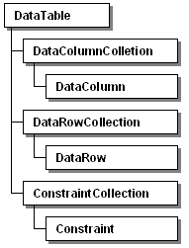
Figure shows the relationship between the DataTable, DataRow, and DataColumn.

Slide 10
DataTable
DataRow: A table has columns. It has rows. Each cell in a row contains a unit of information. Its type is determined by its column.
DataColumn: This class designates columns in DataTables. It specifies the name and type of certain columns in the table. We often use the typeof operator with DataColumn.
DataRelation: The DataRelation is a class of disconnected architecture in the .NET framework. It is found in the System.Data namespace. It represents a relationship between database tables. It correlates tables on the basis of matching column.
A DataView enables you to create different views of the data stored in a DataTable, a capability that is often used in data-binding applications. Using a DataView, you can expose the data in a table with different sort orders, and you can filter the data by row state or based on a filter expression.

Slide 11
Thank You

