Slide 1

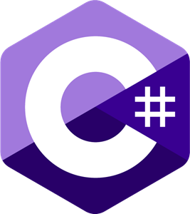
Delegates, Events and Interface

Slide 2
Delegates
A delegate is an object that can refer to a method. Therefore, when you create a delegate, you are creating an object that can hold a reference to a method.
Furthermore, the method can be called through this reference. In other words, a delegate can invoke the method to which it refers. As you will see, this is a very powerful concept.
It is important to understand that the same delegate can be used to call different methods during the runtime of a program by simply changing the method to which the delegate refers. Thus, the method that will be invoked by a delegate is not determined at compile time, but rather at runtime. This is the principal advantage of a delegate.

Slide 3
Delegates
A delegate type is declared using the keyword delegate. The general form of a delegate declaration is shown here:
delegate ret-type name(parameter-list);
Here, ret-type is the type of value returned by the methods that the delegate will be calling. The name of the delegate is specified by name. The parameters required by the methods called through the delegate are specified in the parameter-list.

Slide 4
Delegates - Multicasting
One of the most exciting features of a delegate is its support for multicasting. In simple terms, multicasting is the ability to create an invocation list, or chain, of methods that will be automatically called when a delegate is invoked. Such a chain is very easy to create. Simply instantiate a delegate, and then use the + or += operator to add methods to the chain. To remove a method, use – or – =.
If the delegate returns a value, then the value returned by the last method in the list becomes the return value of the entire delegate invocation. Thus, a delegate that makes use of multicasting will often have a void return type.

Slide 5
Events
An event is, essentially, an automatic notification that some action has occurred. Events work like this: An object that has an interest in an event registers an event handler for that event. When the event occurs, all registered handlers are called. Event handlers are represented by delegates.
Events are members of a class and are declared using the event keyword. Its most commonly used form is shown here:
event event-delegate event-name;
Here, event-delegate is the name of the delegate used to support the event, and event-name is the name of the specific event object being declared.

Slide 6
Interface
Interfaces are syntactically similar to abstract classes. However, in an interface, no method can include a body. That is, an interface provides no implementation whatsoever. It specifies what must be done, but not how. Once an interface is defined, any number of classes can implement it. Also, one class can implement any number of interfaces.
To implement an interface, a class must provide bodies (implementations) for the methods described by the interface. Each class is free to determine the details of its own implementation. Thus, two classes might implement the same interface in different ways, but each class still supports the same set of methods.

Slide 7
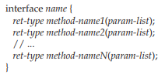
Interface
Therefore, code that has knowledge of the interface can use objects of either class since the interface to those objects is the same. By providing the interface, C# allows you to fully utilize the “one interface, multiple methods” aspect of polymorphism.
Interfaces are declared by using the interface keyword. Here is a simplified form of an interface declaration:
The name of the interface is specified by name. Methods are declared using only their return type and signature. They are, essentially, abstract methods.

Slide 8
Interface
Once an interface has been defined, one or more classes can implement that interface. To implement an interface, the name of the interface is specified after the class name in just the same way that a base class is specified. The general form of a class that implements an interface is shown here:
class class-name : interface-name { // class-body }
The name of the interface being implemented is specified in interface-name. When a class implements an interface, the class must implement the entire interface. It cannot pick and choose which parts to implement.

Slide 9
Thank You

