Slide 1


State Management

Slide 2
Introduction
We all know, browsers are generally stateless.
Now the question arises here, what does stateless actually mean?
Stateless means, whenever we visit a website, our browser communicates with the respective server depending on our requested functionality or the request. The browser communicates with the respective server using the HTTP or HTTPs protocol.
But after that response, what's next or what will happen when we visit that website again after closing our web browser?
In this case HTTP/HTTPs doesn't remember what website or URL we visited, or in other words we can say it doesn't hold the state of a previous website that we visited before closing our browser, that is called stateless.
Now I guess you have at least an idea of what state and stateless actually means.
So our browsers are stateless.

Slide 3
State Management Types
In ASP.NET there are the following 2 State Management methodologies:
Client-Side State Management: Whenever we use Client-Side State Management, the state related information will directly get stored on the client-side. That specific information will travel back and communicate with every request generated by the user then afterwards provides responses after server-side communication
Server-Side State Management: Server-Side State Management is different from Client-Side State Management but the operations and working is somewhat the same in functionality. In Server-Side State Management all the information is stored in the user memory. Due to this functionality there is more secure domains at the server side in comparison to Client-Side State Management.

Slide 4
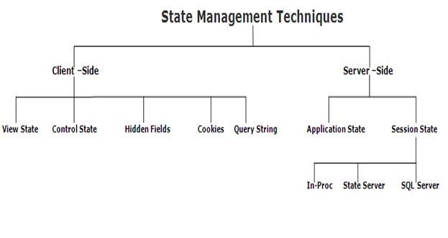
State Management Techniques

Slide 5
Thank You

