Slide 1


Query Strings

Slide 2
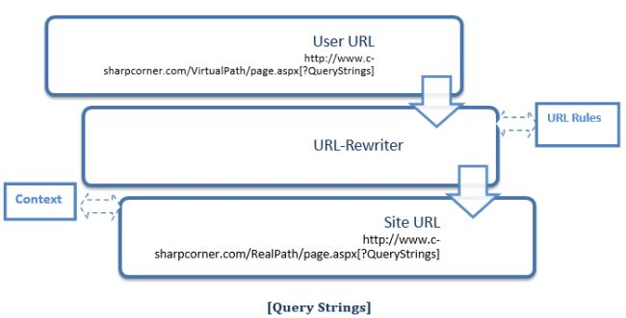
Introduction
Query strings are used for some specific purpose. These in a general case are used for holding some value from a different page and move these values to the different page. The information stored in it can be easily navigated to one page to another or to the same page as well.

Slide 3
Introduction
It is generally used for holding values
Works temporarily
Switches info from one to another page
Increase performance
Uses real and virtual path values for URL routing

Slide 4
Thank You

