Slide 1


Types of Web Technology

Slide 2
Web Technology
Web Technology refers to the various tools and techniques that are utilized in the process of communication between different types of devices over the internet. A web browser is used to access web pages. Web browsers can be defined as programs that display text, data, pictures, animation, and video on the Internet. Hyperlinked resources on the World Wide Web can be accessed using software interfaces provided by Web browsers.

Slide 3
Web Technology can be classified into the following sections
The World Wide Web is based on several different technologies : Web browsers, Hypertext Markup Language (HTML) and Hypertext Transfer Protocol (HTTP).
The web browser is an application software to explore www (World Wide Web). It provides an interface between the server and the client and requests to the server for web documents and services.
Web server is a program which processes the network requests of the users and serves them with files that create web pages. This exchange takes place using Hypertext Transfer Protocol (HTTP).

Slide 4
Web Technology can be classified into the following sections
A webpage is a digital document that is linked to the World Wide Web and viewable by anyone connected to the internet has a web browser.
Web development refers to the building, creating, and maintaining of websites. It includes aspects such as web design, web publishing, web programming, and database management. It is the creation of an application that works over the internet i.e. websites.

Slide 5
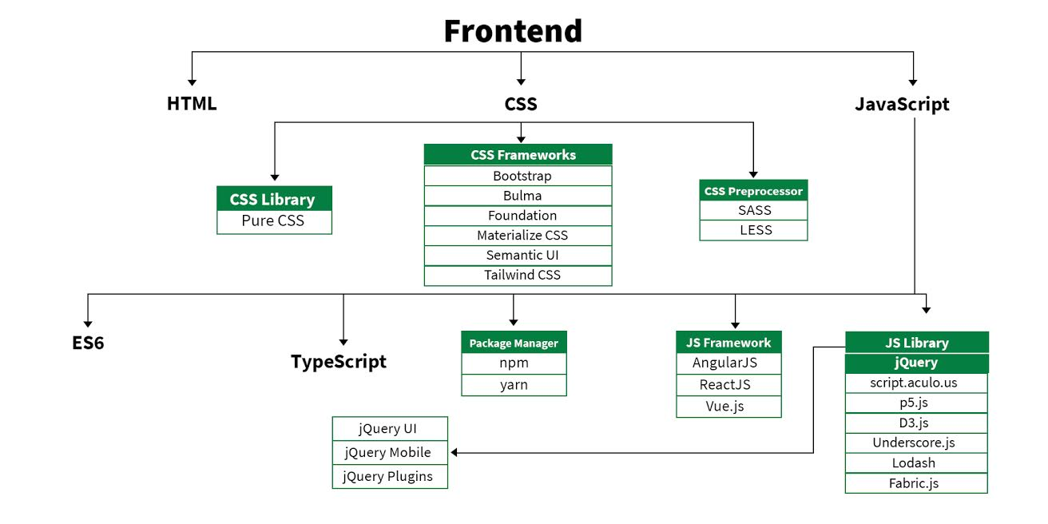
Frontend Languages

Slide 6
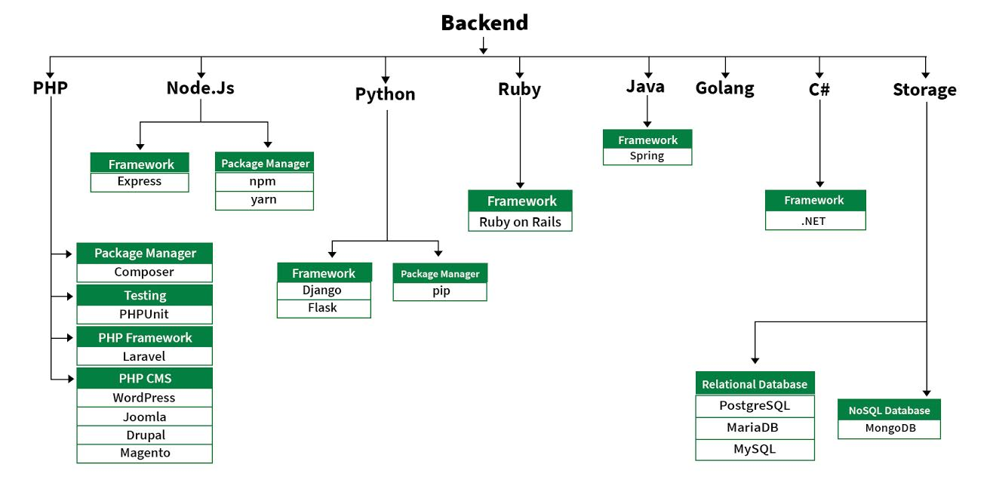
Backend Languages

Slide 7
Thank You

