Slide 1


How ASP.Net works

Slide 2
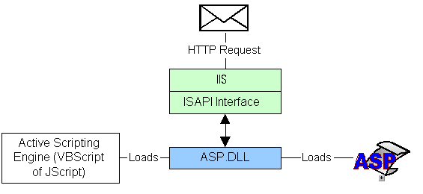
How ASP.Net works
ASP.Net gives us the feasibility of doing multiple tasks using a single framework which makes it better as compared to other web development frameworks.
ASP.NET-Workflow can be explained using the following diagram with a detailed explanation.

Slide 3
How ASP.Net works
Through an URL, a request is sent for an asp.net file by a web browser to the webserver.
As a process, the request is received by the asp.net web server, i.e. IIS, which in return gives the appropriate file from memory.
Now for processing of the asp.net file, it is redirected to the asp.net script engine for the further task by the webserver.
The script engine runs the server-side script it encounters from top to bottom of the file.
After the script engine completes the server-side scripting, it sends an html page to the webserver.
It is explained through the model given below.

Slide 4
Thank You

