Slide 1


Use of Visual Studio 2010

Slide 2
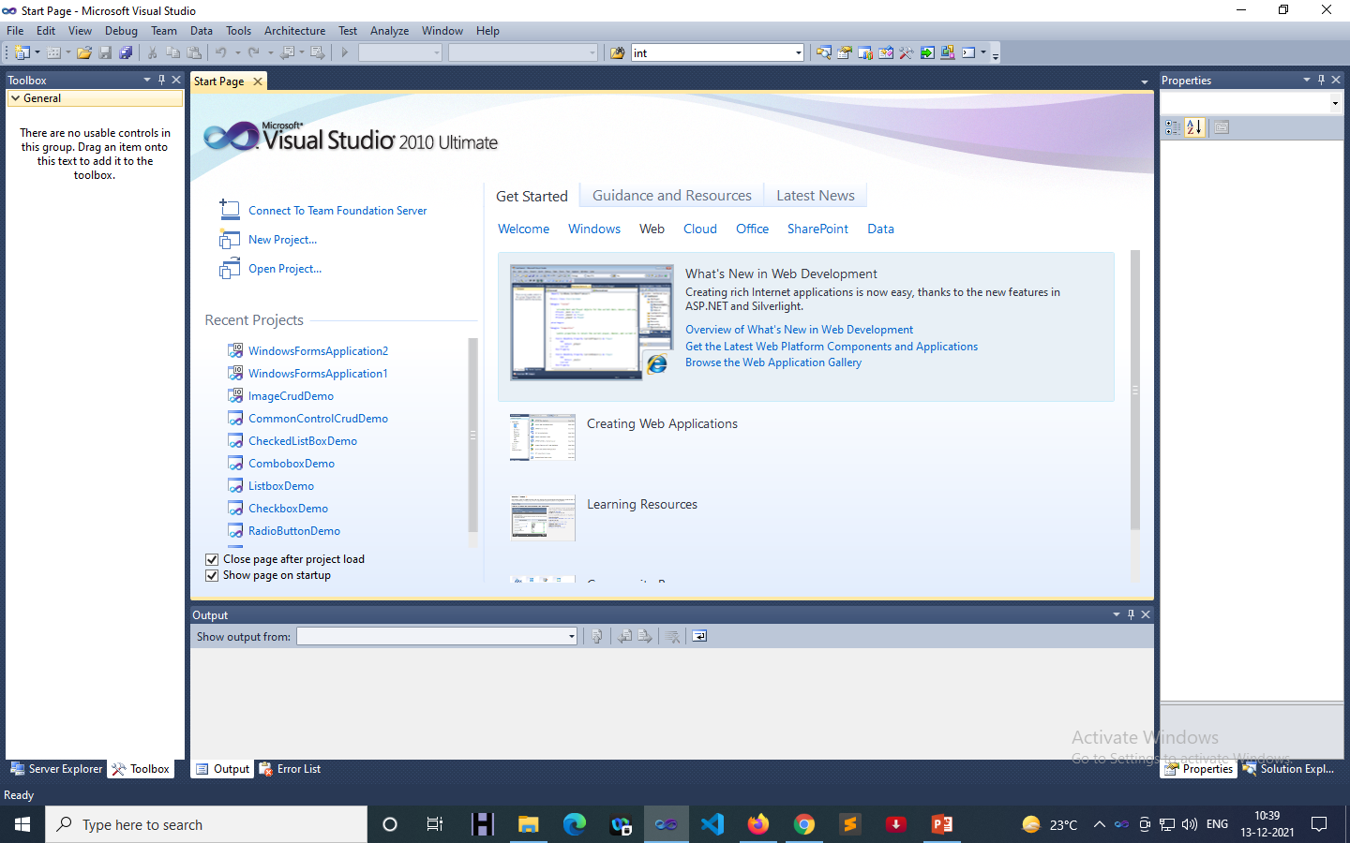
Use of Visual Studio 2010
Start Page
Toolbox
Server Explorer
Properties
Solution Explorer
Output
Error List

Slide 3
Use of Visual Studio 2010
Start Page: The goal of this start page was to provide a location, available when the product first started, for the user to either find out about Visual Studio or to easily get back to what they were working on.
Toolbox: The Toolbox window displays controls that you can add to Visual Studio projects. You can drag and drop different controls onto the surface of the designer you are using, and resize and position the controls.
Server Explorer: Server Explorer allows you to graphically create databases, tables, views, and stored procedures completely from within Visual Studio . NET. You can also edit and delete existing database objects.

Slide 4
Use of Visual Studio 2010
Properties: The Properties window is used to view and change the design-time properties and events of selected objects that are located in editors and designers. You can also use the Properties window to edit and view file, project, and solution properties.
Solution Explorer: The Solution Explorer is used to create, explore & manage your solutions and projects and to view & interact with your code.
Output: The Output window displays status messages for various features in the integrated development environment (IDE).
Error List: The Error List window lets you perform the following tasks: Display the errors, warnings, and messages produced while you write code.

Slide 5
To create Web Application…
File > New > Project > Visual C# + Web + .Net Framework 4 + ASP.NET Web Application + Ok
File > New > Project > Visual C# + Web + .Net Framework 4 + ASP.NET Empty Web Application + Ok
File > New > Website > Visual C# + .Net Framework 4 + ASP.NET Web Site + Ok
File > New > Website > Visual C# + .Net Framework 4 + ASP.NET Empty Web Site + Ok

Slide 6
Thank You

