Slide 1


A First Simple Program Compilation and Execution
It is now time to look at an actual C# program. We will begin by compiling and running the short program.

Slide 2
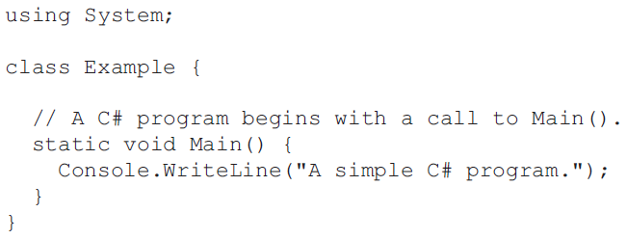
We will use a C# 4.0 and version of Visual Studio 2010 (or later).
There are two general approaches that you can take to creating, compiling, and running a C# program.
First, you can use the Visual Studio IDE. Second, you can use the command-line compiler, csc.exe.

Slide 3
Using csc.exe, the C# Command-Line Compiler
The command-line compiler will be faster and easier than using the IDE.
Visual Studio IDE is probably using for your commercial projects.
We will find the C# command-line compiler more convenient, especially for compiling and running the sample programs.
The reason is that you don’t have to create a project for the program. You can simply create the program and then compile it and run it all from the command line.

Slide 4
Using csc.exe, the C# Command-Line Compiler
To create and run programs using the C# command-line compiler
1. Enter the program using a text editor.
2. Compile the program using csc.exe.
3. Run the program.

Slide 5
Using csc.exe, the C# Command-Line Compiler
Compiling the Program
C:\>csc Example.cs
The csc compiler creates a file called Example.exe that contains the MSIL version of the program.
MSIL is not executable code, it is still contained in an exe file.
The Common Language Runtime automatically invokes the JIT compiler when you attempt to execute Example.exe
If .NET Framework is not installed, the program will not execute because the CLR will be missing.

Slide 6
Using csc.exe, the C# Command-Line Compiler
Running the Program
C:\>Example
When the program is run, the following output is displayed:
A simple C# program.

Slide 7
Using the Visual Studio IDE
Visual Studio is Microsoft’s integrated programming environment (IDE). It is use to edit, compile, run, and debug a C# program,
It is most effective for larger projects, but it can be also use for smaller programs.

Slide 8
1. Create a new, empty C# project by selecting File | New | Project. Then, select Windows in the Installed Templates list. Next, select Empty Project: Then, press OK to create the project.

Slide 9
2. Once the new project is created, the Visual Studio IDE will look like this:

Slide 10
3. At this point, the project is empty and you will need to add a C# source file to it. Do this by right-clicking on the project’s name (which is Project1 in this example) in the Solution Explorer and then selecting Add.

Slide 11
4. Next, select New Item. This causes the Add New Item dialog to be displayed. Select Code in the Installed Templates list. Next, select Code File and then change the name to Example.cs, as shown here:

Slide 12
5. Next, add the file to the project by pressing Add. Your screen will now look like this:

Slide 13
6. Next, type the example program into the Example.cs window. When done, your screen will look like this:

Slide 14
7. Compile the program by selecting Build Solution from the Build menu. 8. Run the program by selecting Start Without Debugging from the Debug menu. When you run the program, you will see the window shown here.

Slide 15
Thank You

