Slide 1


The C# Keywords
Keywords are predefined, reserved identifiers that have special meanings to the compiler. They cannot be used as identifiers in your program unless they include @ as a prefix. For example, @if is a valid identifier, but if is not because if is a keyword.

Slide 2
Introduction
C# defines two types of keywords: reserved and contextual.
The reserved keywords cannot be used as names for variables, classes, or methods. They can be used only as keywords.
There are currently 77 reserved keywords defined by version 4.0 of the C# language.
C# 4.0 defines 18 contextual keywords that have a special meaning in certain contexts.
In those contexts, they act as keywords. Outside those contexts, they can be used as names for other program elements, such as variable names. Thus, they are not technically reserved.

Slide 3
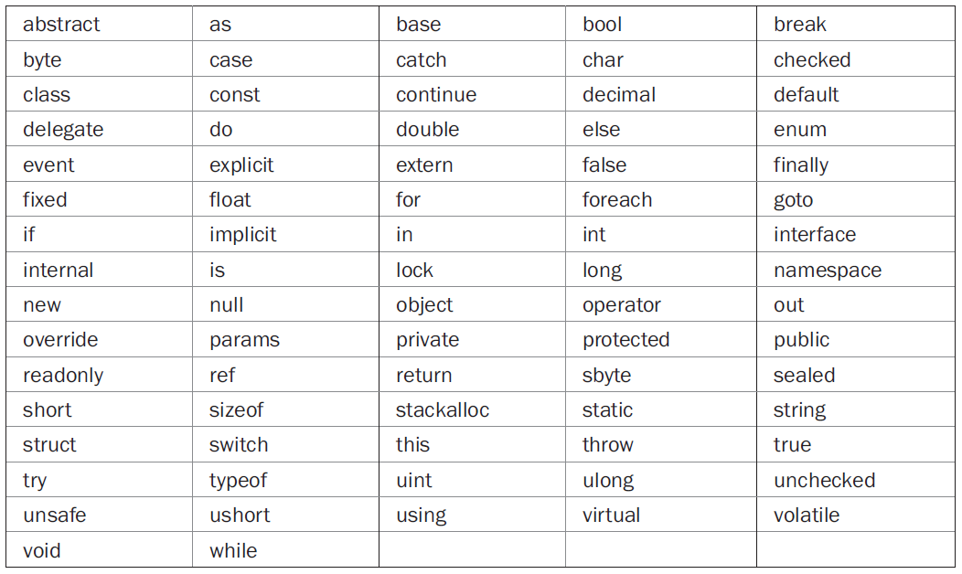
Reserved words

Slide 4
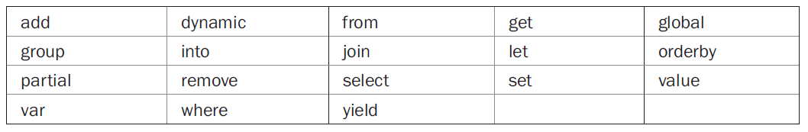
Contextual words

Slide 5
Thank You

