Slide 1


Operators
An operator is a symbol that tells the compiler or interpreter to perform specific mathematical, relational or logical operation and produce final result.

Slide 2
Introduction
C# provides an extensive set of operators that give the programmer detailed control over the construction and evaluation of expressions.
Most of C#’s operators fall into the following categories: arithmetic, bitwise, relational, and logical.

Slide 3
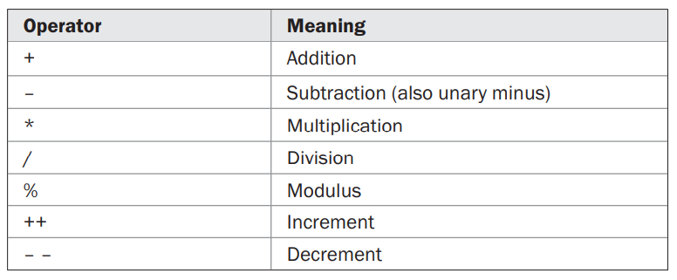
Arithmetic Operators

Slide 4
Arithmetic Operators
Remember that when / is applied to an integer, any remainder will be truncated; for example, 10/3 will equal 3 in integer division.
You can obtain the remainder of this division by using the modulus operator, %.
The remainder of an integer division. For example, 10 % 3 is 1.
In C#, the % can be applied to both integer and floating-point types. Thus, 10.0 % 3.0 is also 1.

Slide 5
Arithmetic Operators
The ++ and the – – are the increment and decrement operators.
Both the increment and decrement operators can either precede (prefix) or follow (postfix) the operand.
++x; // prefix form
x++; // postfix form
x = 10; y = ++x; In this case, y will be set to 11. This is because x is first incremented and then its value is returned.
x = 10; y = x++; then y will be set to 10. In this case, the value of x is first obtained, x is incremented, and then the original value of x is returned.

Slide 6
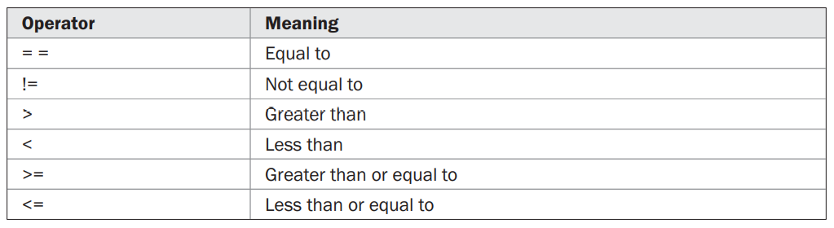
Relational Operators

Slide 7
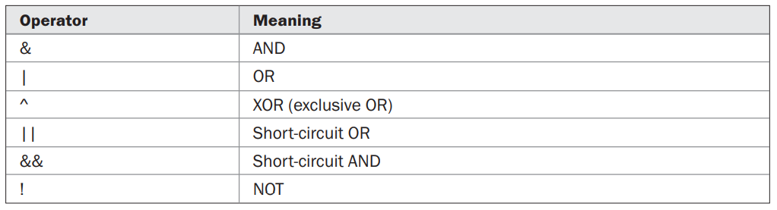
Logical Operators

Slide 8
Relational and Logical Operators
Relational operators refers to the relationships that values can have with one another.
Logical operators refers to the ways in which true and false values can be connected together.
The outcome of the relational and logical operators is a bool value.
In general, objects can be compared for equality or inequality using == and !=. However, the comparison operators, <, >, <=, or >=, can be applied only to those types that support an ordering relationship.
Therefore, all of the relational operators can be applied to all numeric types.

Slide 9
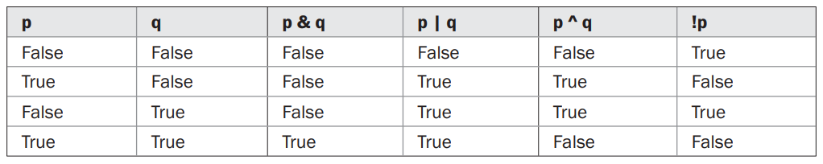
Relational and Logical Operators
For the logical operators, the operands must be of type bool, and the result of a logical operation is of type bool.
The logical operators, &, |, ^, and !, support the basic logical operations AND, OR, XOR, and NOT, according to the following truth table:

Slide 10
Short-Circuit Logical Operators
C# supplies special short-circuit versions of its AND and OR logical operators that can be used to produce more efficient code.
To understand why, consider the following.
In an AND operation, if the first operand is false, then the outcome is false no matter what value the second operand has.
In an OR operation, if the first operand is true, then the outcome of the operation is true no matter what the value of the second operand.
Thus, in these two cases there is no need to evaluate the second operand.
By not evaluating the second operand, time is saved and more efficient code is produced.

Slide 11
Short-Circuit Logical Operators
The short-circuit AND operator is && and the short-circuit OR operator is ||.
The only difference between the normal and short-circuit versions is that the normal operands will always evaluate each operand, but short-circuit versions will evaluate the second operand only when necessary.

Slide 12
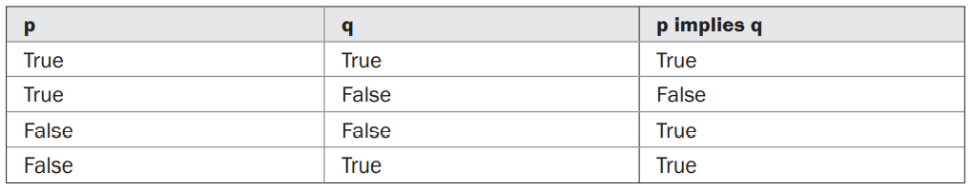
Implication (logical operation)
Implication is a binary operation in which the outcome is false only when the left operand is true and the right operand is false.
(The implication operation reflects the idea that true cannot imply false.)

Slide 13
Assignment Operator
The assignment operator is the single equal sign, =.
The general form of assignment operator is: var-name = expression;
Here, the type of var-name must be compatible with the type of expression.
The assignment operator does have one interesting attribute that allows you to create a chain of assignments. For example,
int x, y, z;
x = y = z = 100; // set x, y, and z to 100
Using a “chain of assignment” is an easy way to set a group of variables to a common value.

Slide 14
Compound Assignments
C# provides special compound assignment operators that simplify the coding of certain assignment statements.
The assignment statement shown here:
x = x + 10;
can be written using a compound assignment as
x += 10;
The general form of the shorthand is
var-name op = expression;

Slide 15
Compound Assignments
The arithmetic and logical assignment operators are
The compound assignment statements are shorter than their noncompound equivalents, the compound assignment operators are also sometimes called the shorthand assignment operators.
The compound assignment operators provide two benefits.
First, they are more compact than their “longhand” equivalents.
Second, they can result in more efficient executable code (because the left-hand operand is evaluated only once).

Slide 16
Bitwise Operators
The bitwise operators act directly upon the bits of their operands.
They are defined only for integer operands.
They cannot be used on bool, float, or double.
They are called the bitwise operators because they are used to test, set, or shift the bits that comprise an integer value.
The bitwise operations are important to a wide variety of systems-level programming tasks, such as analyzing status information from a device.

Slide 17
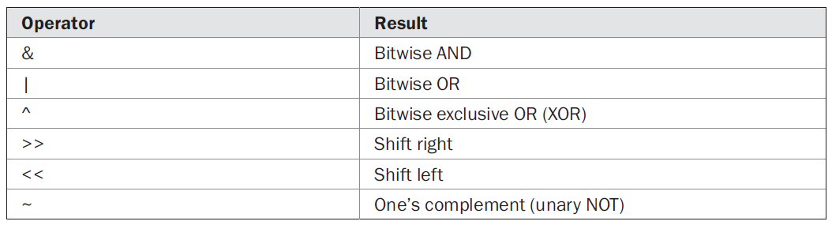
Bitwise Operators

Slide 18
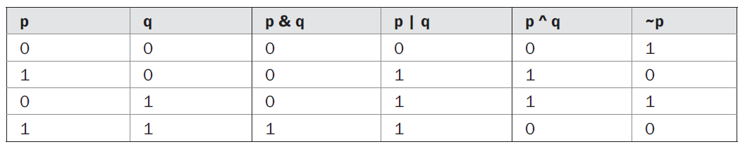
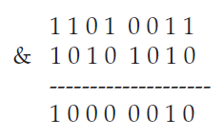
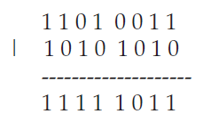
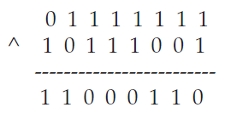
The Bitwise AND, OR, XOR, and NOT Operators
The Bitwise Operators perform the same operations as their Boolean logic equivalents described earlier. The difference is that the bitwise operators work on a bit-by-bit basis. The following table shows the outcome of each operation using 1s and 0s:
For example, bitwise AND

Slide 19
The Bitwise AND, OR, XOR, and NOT Operators
The XOR operator has an interesting property that is useful in a variety of situations. When some value X is XORed with another value Y, and then that result is XORed with Y again, X is produced.
R1 = X ^ Y;
R2 = R1 ^ Y;
R2 is the same value as X. Thus, the outcome of a sequence of two XORs using the same value produces the original value.
This feature of the XOR can be put into action to create a simple cipher in which some integer is the key that is used to both encode and decode a message by XORing the characters in that message.
Remember, this simple XOR cipher is not suitable for any real-world, practical use because it is inherently insecure.

Slide 20
The Shift Operators
In C# it is possible to shift the bits that comprise an integer value to the left or to the right by a specified amount.
The general forms for these operators are shown here:
value << num-bits
value >> num-bits
Here, value is the value being shifted by the number of bit positions specified by num-bits.

Slide 21
The Shift Operators
In the case of a right shift on a signed value, the sign bit is preserved.
If the value being shifted is negative, each right shift brings in a 1 on the left. If the value is positive, each right shift brings in a 0 on the left.
For both left and right shifts, the bits shifted out are lost. Thus, a shift is not a rotate and there is no way to retrieve a bit that has been shifted out.

Slide 22
Bitwise Compound Assignments
All of the binary bitwise operators can be used in compound assignments. For example,
x = x ^ 127;
x ^= 127;

Slide 23
The ? Operator
The ? is called a ternary operator(conditional operator) because it requires three operands. It takes the general form
Exp1 ? Exp2 : Exp3;
where Exp1 is a bool expression, and Exp2 and Exp3 are expressions. The type of Exp2 and Exp3 must be the same.
The value of a ? expression is determined like this: Exp1 is evaluated. If it is true, then Exp2 is evaluated and becomes the value of the entire ? expression. If Exp1 is false, then Exp3 is evaluated, and its value becomes the value of the expression.

Slide 24
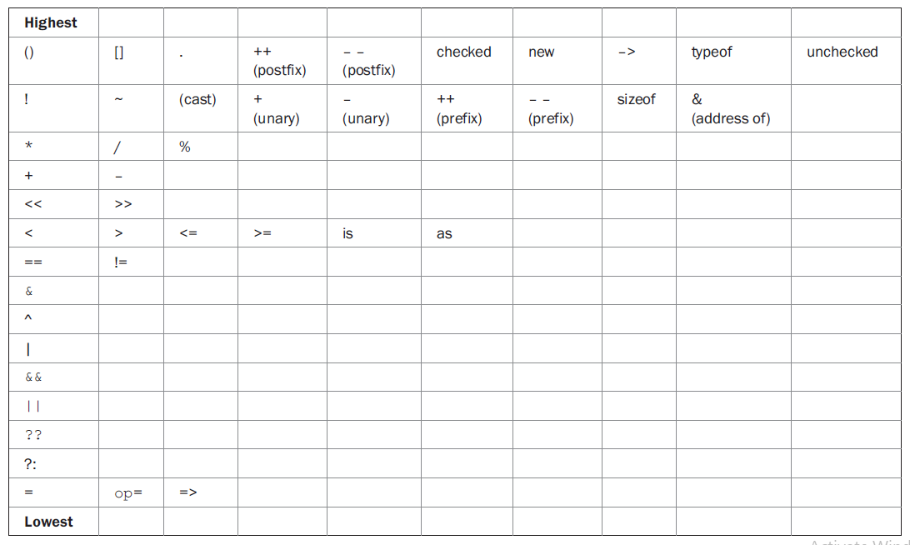
Operator Precedence

Slide 25
Thank You

