Slide 1


C# MessageBox
C# MessageBox in Windows Forms displays a message with the given text and action buttons. You can also use MessageBox control to add additional options such as a caption, an icon, or help buttons. In this article, you'll learn how to display and use a MessageBox in C# WinForms app. You will also learn how to use C# MessageBox class dynamically in code samples.

Slide 2
Introduction
MessageBox class has an overloaded static Show method that displays a message box with a message and action buttons. The action buttons can be OK and Cancel, Yes and No etc. Here are some of the options that can be used in C# message box.

Slide 3
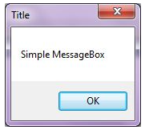
Simple MessageBox & MessageBox with Title
The simplest form of a MessageBox is a dialog with a text and OK button. When you click OK button, the box disappears.
string message = "Simple MessageBox";
string title = "Title";
MessageBox.Show(message, title);

Slide 4
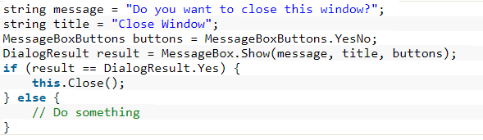
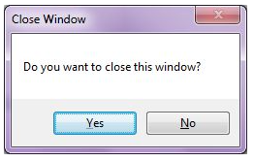
MessageBox with Buttons
A MessageBox can have different button combinations such as YesNo and OKCancel. The MessageBoxButtons enumeration represents the buttons to be displayed on a MessageBox and has following values.
OK
OKCancel
AbortRetryIgnore
YesNoCancel
YesNo
RetryCancel

Slide 5
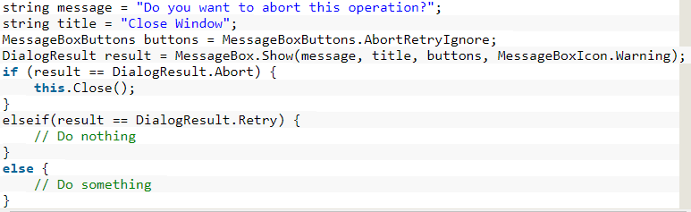
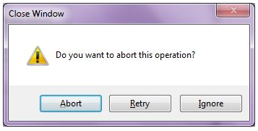
MessageBox with Icon
A MessageBox can display an icon on the dialog. A MessageBoxIcons enumeration represents an icon to be displayed on a MessageBox and has the following values.
None
Hand
Question
Exclamation
Asterisk
Stop
Error
Warning
Information

Slide 6
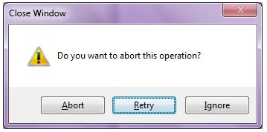
MessageBox with Default Button
We can also set the default button on a MessageBox. By default, the first button is the default button. The MessageBoxDefaultButton enumeration is used for this purpose and it has the following three values.
Button1
Button2
Button3
Set 2nd button as a default button your code 5th argument (MessageBoxDefaultButton.Button2)

Slide 7
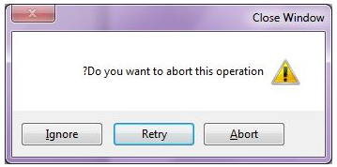
MessageBox with Message Options
MessageBoxOptions enumeration represents various options and has the following values.
ServiceNotification
DefaultDesktopOnly
RightAlign
RtlReading
For message option set 6th argument like (MessageBoxOptions.RightAlign|MessageBoxOptions.RtlReading)

Slide 8
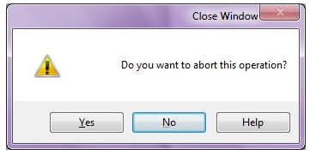
MessageBox with Help Button
A MessageBox can have an extra button called Help button. This is useful when we need to display a help file. The following code snippet creates a MessageBox with a Help button.
For help button set 7th argument like (true) We can also specify a help file when the Help button is clicked. The following code snippet references a help file. ("helpfile.chm")

Slide 9
Thank You

