Slide 1
CAPHE
California Association of Public Health Economists
Member Meeting
February 25, 2026

Slide 2
ICEBREAKER
What’s a policy question you wish
you had better data for?

Slide 3
Today’s Agenda
1. Open Letter Update (Gilda)
2. Upcoming Speakers & Future Invitations
3. Access Explorer Demo
4. Webinar Brainstorm: Fall 2026 Topics
5. Activity: Designing Our Office Hours
6. Youth Data Literacy for Violence Prevention
7. Updates & Next Steps

Slide 4
UPDATE
CDPH Introduction Letter
Letter to California Department of Public Health
Status
New version to be circulated
Gilda to update on:
• Feedback received since January
• Revisions made
• Timeline for sending

Slide 5
SPEAKERS
Upcoming & Future Invitations
MARCH 25 • 11:00 AM
Tim Brown, UC Berkeley
Returns of public health investment on hospital admissions
JUNE 24 • 11:00 AM
Sabety & Rossin-Slater, Stanford
Preschool entry age, developmental diagnoses, and Medicaid
Discussion
• What are we most hoping to learn from each speaker?
• What questions should we be sure to ask?
Looking ahead:
If you could have any health economics expert explain one thing
to this group, who would it be and what would the topic be?

Slide 6
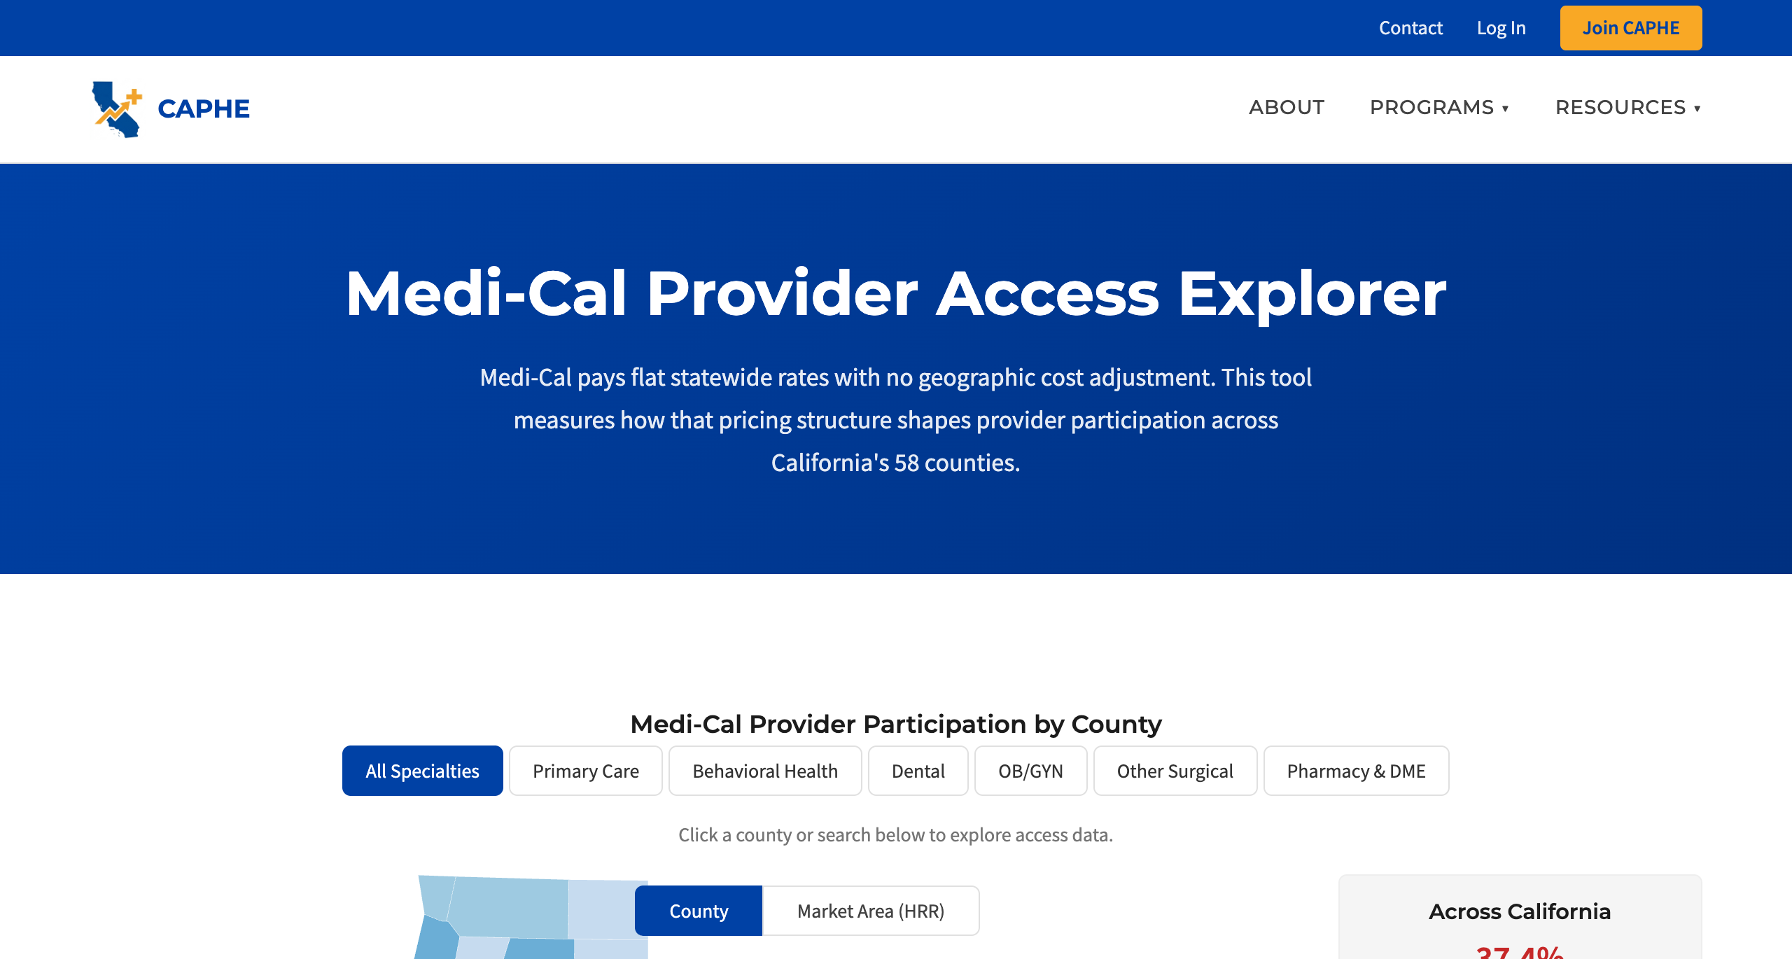
NEW TOOL
Medi-Cal Provider Access Explorer
What it shows
Provider participation rates across all 58 counties by specialty
Why it matters
Medi-Cal pays flat statewide rates — no geographic cost adjustment
Key finding
37.4% of providers statewide bill Medi-Cal
Behavioral Health lowest at 27.3%
caphegroup.org/tools/access-explorer

Slide 7
BRAINSTORM
Fall 2026 Webinar Topics
2026 Webinars (Set)
Feb 12 Introduction to Health Economics ✓
Apr 9 Cost-Effectiveness: The Basics
Jun 11 Return on Investment in Public Health
Oct ???
Nov ???
Discussion
• What are practitioners asking about?
• CA policy changes to build around?
• Go deeper or go broader?
• Audiences we’re not reaching?
• Who wants to present?
Goal: 2–3 candidate topics

Slide 8
ACTIVITY
Designing Our Office Hours
CAPHE economists can offer office hours to practitioners who need methods guidance.
How do we structure these to be most productive? Let’s design this together.
Format
• Open Q&A vs. bring-a-problem?
• Drop-in vs. by appointment?
Scope
• By specialty (CEA, causal inference, data)?
• Or general “ask an economist”?
Logistics
• How often? How long?
• Virtual, in-person, or hybrid?
Audience
• LHJ staff? Program managers?
• Students? Community orgs?
Success looks like...
• What makes someone leave saying
“that was worth my time”?
Pilot plan
• Smallest version we could test?
• Who volunteers for the first round?
Goal: Walk away with a rough format we can pilot

Slide 9
NEW INITIATIVE
Youth Data Literacy for Violence Prevention
The idea
Develop curriculum that helps teens build data literacy skills to advocate for
change in their neighborhoods, with a focus on violence prevention strategies.
Early stage: no funding. CAPHE would develop the curriculum.
What we need from the group
• Know of existing programs doing similar work?
• Experience with youth data education or advocacy training?
• Papers, curricula, or toolkits to review?
• What core data skills matter most for teens?
Goal: Collect leads and gauge interest in a working group

Slide 10
Updates & Reminders
Membership
• Sign up at caphegroup.org/membership
• Once logged in: sign up to present, see upcoming events
CHEAC Training
• CHEAC Training Center has asked us to develop training — more details soon
Tools & Labs
• Have a paper or project? We can adapt it into a tool or methods lab
• We provide the page setup and tracking stats to measure impact
Upcoming
• Mar 25: Tim Brown (UC Berkeley)
• Apr 9: Webinar: Cost-Effectiveness: The Basics
• Jun 11: Webinar: Return on Investment in Public Health
• Jun 24: Sabety & Rossin-Slater (Stanford)

Slide 11
Thank You!
Next Meeting: March 25, 2026
Tim Brown, Returns of Public Health Investment on Hospitalizations
caphegroup.org
info@caphegroup.org

