Slide 1
CAPHE
California Association of Public Health Economists
Introduction to Health Economics
for Public Health
Free Webinar Series
February 12, 2026 · 12:00 PM PT
Notes:
Welcome everyone, and thank you for joining today's webinar: Introduction to Health Economics for Public Health. We're glad you're here.
I'm [presenter name] from CAPHE, the California Association of Public Health Economists. CAPHE is a professional community of health economists and public health professionals working across California's 61 local health jurisdictions. Our mission is to build economic analysis capacity within public health practice.
This webinar is the first in our free 2026 series. We put it together specifically for public health professionals who may not have a formal economics background. If you've never taken an econ course, or if you took one years ago and forgot most of it, you're in exactly the right place.
A quick note on format: I'll present for about 45 minutes, and we'll save 10-15 minutes for questions at the end. Please do drop questions in the chat as we go. I'll address what I can in real time, and we'll catch the rest at the end.
Before we dive in, I'm curious. Can you drop in the chat what county or jurisdiction you're with? It's always nice to see who's in the room.
[Pause for chat responses]
Great, we've got folks from across the state. Let's get started.

Slide 2
Today's Objectives
• Understand what health economics is and why it matters for public health
• Learn key economic concepts: scarcity, trade-offs, opportunity cost
• Explore how economic thinking can strengthen program decisions
• Discover resources for continued learning
This is an introductory session. No prior economics background required.
Notes:
Here are our four learning objectives for today. Let me walk through each one.
First, we're going to define health economics. And I want to be clear up front: health economics is not about money alone. It's really about decision-making under constraints. That's something every one of you does every single day.
Second, we'll cover three foundational concepts: scarcity, trade-offs, and opportunity cost. I promise these are intuitive. You already think this way; we're just going to put names to the thinking you already do.
Third, we'll look at how economic thinking can actually strengthen your program decisions and make them more defensible. This is the practical payoff. How does this help you on a Monday morning?
And fourth, I'll point you to resources so you can continue learning. CAPHE has free tools, and this webinar series continues through the year.
Now, I want to draw your attention to the note at the bottom: this is an introductory session. There is no such thing as a dumb question today. If you're wondering "should I know this already?", no, you shouldn't. That's why we're here.
I'll also say: even if you do have economics training, it can be valuable to revisit fundamentals through a public health lens. The examples and applications today are specific to our field.

Slide 3

Building on What You Know
Epidemiology and economics work together to inform better decisions
Epidemiology asks...
Economics adds...
• Does this intervention reduce disease?
• What is the effect size?
• Is the evidence strong?
• Who benefits most?
• Is this the best use of limited resources?
• What is the cost per outcome?
• What are we giving up to do this?
• How do we maximize impact?
Health economics helps you make the case for why it's worth doing and what to prioritize when you can't do everything.
Notes:
This slide is one of my favorites because it validates what you already bring to the table.
If you work in epidemiology or public health practice, you already think rigorously about evidence. You ask: Does this intervention reduce disease? What's the effect size? Is the study well-designed? Who benefits?
That's powerful. And economics doesn't replace any of it. Economics adds a complementary set of questions.
Let me give you a concrete example. Say your county ran a diabetes prevention program and your epi team found it reduced A1C levels by 0.5 points among participants. Great finding. Solid evidence.
Now a county supervisor asks: "Should we expand this program or use that money for the new opioid response initiative?" Your epi evidence alone can't answer that. You need to know: What did the diabetes program cost per participant? What outcomes would the opioid initiative achieve per dollar? Which investment produces more health per dollar spent?
That's the economics lens. It doesn't diminish the diabetes program's effectiveness. It helps you compare it to alternatives.
Another example: during COVID, many California counties had to rapidly reallocate staff. Epidemiologists were pulled from chronic disease work to do contact tracing. That was an economic decision, whether or not anyone called it that. You were implicitly saying: the marginal value of contact tracing right now exceeds the marginal value of chronic disease surveillance. Economics just makes that reasoning explicit.
The bottom line: health economics helps you make the case for programs you already know are effective. It gives you the language to talk about value, not just outcomes.

Slide 4
Part 1
What is Health Economics?
Notes:
So let's start at the beginning: What exactly is health economics?
I find that many public health professionals have a slightly negative association with the word "economics." They think it means cutting budgets, or putting dollar signs on human life, or letting bean counters make health decisions.
That's not what this is about. Let me show you what it actually means.

Slide 5
KEY CONCEPT
Health Economics
The study of how individuals, institutions, and society make choices about allocating scarce resources to improve health outcomes.
Example:
Should we invest $1 million in a new vaccination program or expand mental health services? Health economics provides frameworks to answer questions like this.
Notes:
Here's our working definition: Health economics is the study of how individuals, institutions, and societies make choices about allocating scarce resources to improve health.
Let me unpack that. The key phrase is "choices about allocating scarce resources." Not maximizing profit. That's business. Not minimizing cost. That's accounting. It's about making the best choices possible given that we can't do everything.
Now look at the example on the slide: Should we invest one million dollars in a new vaccination program or expand mental health services? Both are worthwhile. Both save lives. But if you only have one million dollars, you have to choose. Or at least decide how to split it.
Let me make this more concrete. In 2023, several California counties received one-time ARPA funding. Some invested in community health worker programs. Others expanded telehealth infrastructure. Others funded housing navigation services. Every one of those was a reasonable choice. But each county had to weigh their specific community needs against their specific budget.
Riverside County, for instance, used ARPA funds to expand farmworker health outreach. Was that the "right" choice? Health economics doesn't give you a single right answer. What it gives you is a systematic way to think through the trade-offs so your decision is deliberate and defensible.
Here's what I want you to take away: if you've ever sat in a meeting where someone said "we can't afford to do both," you've already encountered health economics. We're just going to formalize that thinking.

Slide 6
Why Health Economics Matters for Public Health
• Resources are always limited. Every dollar spent is a dollar not available elsewhere
• Public health decisions affect population-level outcomes
• Stakeholders (supervisors, legislators) increasingly demand evidence of value
• Economic analysis helps prioritize interventions with greatest impact
• Strengthens grant applications and program justifications
Notes:
So why should you, as a public health professional, care about health economics? Let me go through these five reasons.
First: resources are always limited. This is true whether budgets are growing or shrinking. Even in a good budget year, you still can't fund everything. In California, local health departments collectively spend about $4 billion annually. That sounds like a lot, but spread across 40 million residents and hundreds of health priorities, every dollar matters.
Second: your decisions affect population-level outcomes. When a hospital makes a bad investment, maybe a few hundred patients are affected. When a county health department misallocates resources, tens of thousands or hundreds of thousands of people may not get services they need. The stakes are high.
Third, and this one is increasingly important: stakeholders want to see evidence of value. Ten years ago, you could justify a program by saying "it's evidence-based." Today, legislators and county supervisors are asking: "What's the return on investment? How does this compare to alternatives? What would happen if we cut this?" You need economic language to answer those questions effectively.
Fourth: economic analysis lets you compare interventions that seem incomparable. How do you weigh a tobacco cessation program against a childhood lead prevention program? They affect different populations, different diseases, different timelines. Economic analysis gives you a common framework.
And fifth: it strengthens grant applications. Federal funders like CDC, HRSA, and SAMHSA increasingly expect cost-effectiveness data or at least a discussion of economic value. If you can say "our program costs $X per case prevented, which is below the commonly cited threshold," your application is significantly stronger.
Quick poll: How many of you have been asked by a supervisor or elected official to justify a program's cost-effectiveness? Drop a yes or no in the chat.
[Pause]
Usually about two-thirds say yes. Economic thinking isn't optional anymore. It's expected.

Slide 7

KEY CONCEPT
Scarcity
The fundamental economic problem: unlimited wants and needs, but limited resources to satisfy them.
Example:
Your county has budget for 2 new positions. Do you hire an epidemiologist, a health educator, or a data analyst? You can't hire all three.
Notes:
Scarcity is the foundational concept in all of economics. Everything else flows from this.
The definition is simple: unlimited wants and needs, but limited resources to meet them. In public health, resources means money, staff time, facilities, political capital. All of it is finite.
Let me bring the example on the slide to life. Your county has budget authority for two new positions. Three divisions each make strong cases:
The communicable disease team wants an epidemiologist to handle the surge in STI cases.
The chronic disease team wants a health educator to run the new diabetes prevention program.
The community health team wants a community health worker to do outreach in underserved neighborhoods.
All three are legitimate needs. All three would improve health. But you can only hire two. Someone is going to be disappointed.
How do you decide? You could go with the loudest advocate. You could rotate who gets priority. You could default to whatever you did last year. Or you could think systematically about which two positions would produce the most health improvement per dollar of salary.
That's health economics. It doesn't make the decision easy. It makes the decision defensible.
Here's a real-world California example: after the 2011 Realignment transferred public health responsibilities to counties, many departments had to make exactly these kinds of choices with reduced state funding. The counties that had the clearest framework for prioritizing, even an informal one, tended to make better decisions than those that just cut across the board.
The point isn't that economics gives you a formula. It's that it gives you a way to be deliberate instead of reactive.

Slide 8
Part 2
Core Economic Concepts
Notes:
Now let's go deeper into three specific concepts that form the foundation of economic thinking. These are tools you can start using immediately, even without any formal analysis.

Slide 9

KEY CONCEPT
Opportunity Cost
The value of the next-best alternative that you give up when making a choice. It extends beyond how much something costs to include the cost of what else you could have done with the resources.
Example:
If your team spends 6 months developing a diabetes prevention program, the opportunity cost includes other programs that couldn't be developed during that time.
Notes:
If you remember one concept from today's entire webinar, make it this one: opportunity cost.
Opportunity cost is the value of the next-best alternative you give up when you make a choice. It's not just the dollar cost. It's what else you could have done with those same resources.
The example on the slide: if your team spends six months developing a diabetes prevention program, the opportunity cost is whatever else that team could have accomplished in those six months. Maybe it was launching the opioid response plan. Maybe it was conducting the community health assessment that was due.
Let me give you a really tangible example. Say your county spends $200,000 per year on a smoking cessation hotline. The direct cost is $200,000. But the opportunity cost includes everything else that $200,000 could have funded: maybe three community health workers, or a childhood asthma intervention, or upgraded data infrastructure.
Does that mean the smoking hotline is a bad investment? Not necessarily. But you can't evaluate it just by asking "does it work?" You also need to ask "compared to what?"
Here's where this gets practical. Next time someone proposes a new initiative, try asking: "What will we not do in order to do this?" That single question is opportunity cost thinking, and it changes the conversation.
I'll share a story. A county health officer I work with told me she started asking her division chiefs this question at every budget meeting: "If I give you this money, what won't get done somewhere else?" She said it completely transformed how her team thought about program proposals. Instead of just arguing for their own programs, they started thinking about the department as a whole.
That's the power of opportunity cost. It's not about saying no to things. It's about making trade-offs visible.

Slide 10

Trade-offs in Public Health
• Breadth vs. Depth: Serve more people with less intensity, or fewer people with more support?
• Prevention vs. Treatment: Invest upstream or address immediate needs?
• Equity vs. Efficiency: Maximize total health gains or prioritize underserved populations?
• Short-term vs. Long-term: Quick wins today or sustainable impact over years?
  No right answer. It depends on values, context, and evidence
Notes:
These four trade-offs come up in almost every public health decision. Let me walk through each with an example.
Breadth versus depth. Imagine you have funding for a home visiting program. You could serve 500 families with monthly visits, or 100 families with weekly intensive visits. The evidence might show weekly visits are more effective per family, but you'd reach five times fewer families. Which is better? It depends on how severe the need is, how much the intensity matters, and what your community looks like.
Prevention versus treatment. This is the classic public health dilemma. During the opioid crisis, counties had to choose: invest in prevention education to keep people from starting opioids, or fund naloxone distribution and treatment beds for people already addicted? The prevention investment pays off over years. The treatment investment saves lives this week. Both are essential, but when budgets are tight, you have to allocate between them.
Equity versus efficiency. This one's important. The most efficient strategy, the one that produces the most total health per dollar, may completely miss the communities that need help most. For example, a countywide social media campaign about flu vaccination might be the cheapest way to increase vaccination rates overall. But it won't reach people without internet access, people who don't speak English, or people who distrust the health system. Reaching those populations costs more per person. An economist would say there's a trade-off between maximizing total benefit and distributing benefit fairly.
Short-term versus long-term. Early childhood programs are a perfect example. Investing in prenatal care and early childhood nutrition may not show measurable returns for 10 or 20 years. But the long-term payoff is enormous: reduced chronic disease, higher educational attainment, lower incarceration. The challenge is that elected officials serve 4-year terms and want to see results now.
Emphasize: there's no universal right answer to any of these. The right balance depends on your community's values, your specific context, and what the evidence shows. Economics doesn't tell you what to value. It helps you be clear about the trade-offs you're making.

Slide 11
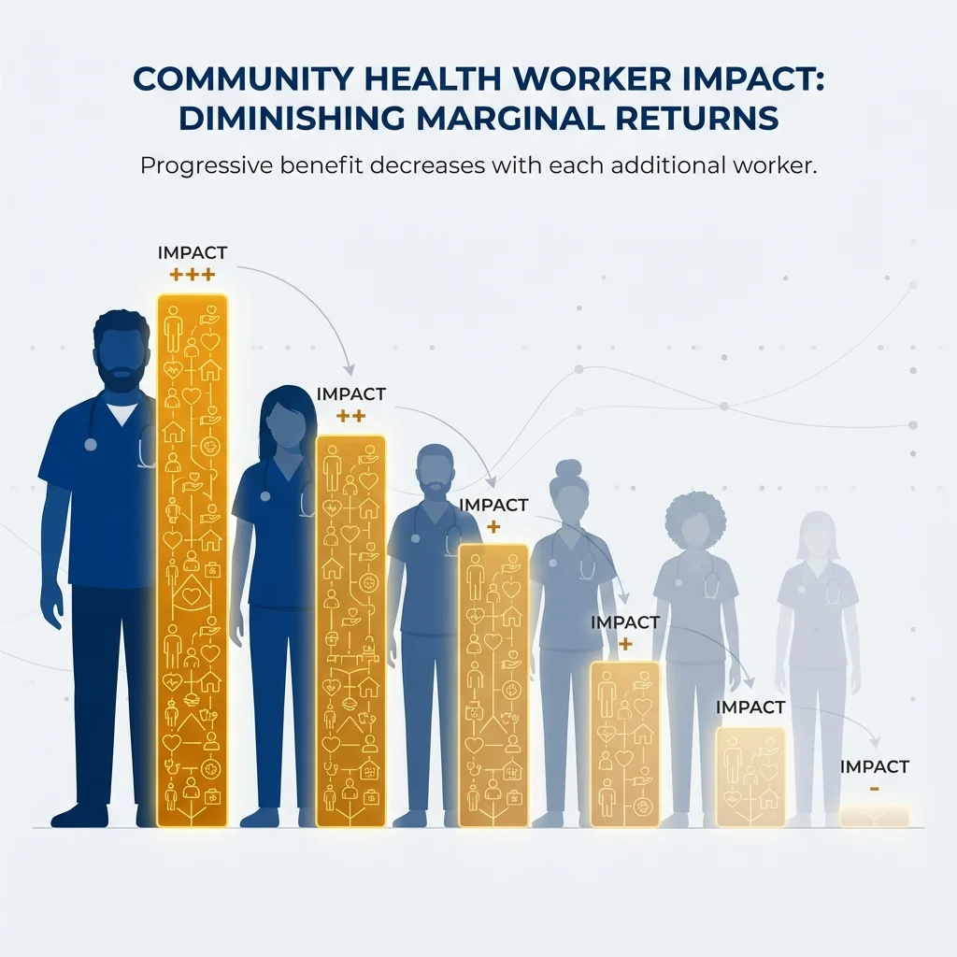
KEY CONCEPT
Marginal Thinking
Focus on the additional (marginal) benefit of one more unit of activity, compared to its additional cost.
Example:
Should we add a 5th community health worker to our team? The answer depends on whether the 5th CHW adds enough benefit to justify the cost.
Notes:
Marginal thinking is one of those concepts that sounds academic but is incredibly practical.
The core idea: instead of asking "is this program good or bad?", ask "would one more unit of this program be worth its cost?"
Let me use the example on the slide. You have four community health workers on your team, and they're doing great work. Someone proposes hiring a fifth. Should you?
Well, the first four CHWs might each carry a caseload of 80 families. Adding a fifth might only add 40 families, because the geographic area is mostly covered, the high-priority families are already enrolled, and the remaining families are harder to reach. That fifth CHW would cost the same salary but produce less impact than the first four.
Does that mean you shouldn't hire them? Not necessarily. Maybe those 40 harder-to-reach families are the ones who need services most. But you should know that the marginal return is different from the average return.
Here's a California-specific example. Many counties expanded contact tracing teams during COVID. The first 20 contact tracers might have been able to reach 80% of cases within 24 hours. Adding another 20 might have only bumped that to 85%. And another 20 on top of that might have gotten you to 87%. Each additional group of tracers cost the same but produced smaller and smaller gains.
This is what economists call diminishing marginal returns. It doesn't mean the program is bad. It means at some point, the next dollar might be better spent on something else.
Practical application: When you're defending your budget, marginal thinking helps you identify where cuts would hurt most and where additional investment would help most. Instead of saying "we need more money," you can say "an additional $100,000 would allow us to serve X more people and prevent Y more cases." That's a much more compelling argument.

Slide 12
Part 3
Types of Economic Analysis
Notes:
Now let's shift from concepts to tools. These are the formal methods health economists use to evaluate programs and interventions.

Slide 13
Economic Analysis in Public Health
Cost Analysis
Value Analysis
• Cost of illness studies
• Budget impact analysis
• Cost minimization
• Focus: What does it cost?
• Cost-effectiveness analysis (CEA)
• Cost-benefit analysis (CBA)
• Return on investment (ROI)
• Focus: Is it worth it?
Notes:
There are two broad families of economic analysis, and I want to make sure you understand the difference.
On the left side: Cost Analysis. This is where most departments start, and it's completely valid. Cost analysis answers the question: "What does it cost?"
Cost-of-illness studies estimate the total economic burden of a disease. For example, diabetes costs California an estimated $39 billion annually in medical expenses and lost productivity. That number is useful for advocacy. It shows the scale of the problem.
Budget impact analysis estimates what a new program would cost your department's budget. If you're proposing a new initiative, your finance team will want to know: how much, for how long, and what's the budget impact?
Cost minimization is used when two programs produce the same outcome, and you just want the cheaper one.
On the right side: Value Analysis. This is where economics really adds power. Instead of just asking what something costs, value analysis asks: "Is it worth it?"
Cost-effectiveness analysis compares costs to health outcomes. Cost-benefit analysis converts everything to dollars. Return on investment expresses value as a ratio.
Here's the practical insight: many of you probably already do informal cost analysis. You know what your programs cost per participant. The next step, connecting those costs to outcomes, is what moves you into value analysis. And that's where the real decision-making power is.
For those just starting out, my advice: get your cost data solid first. You can't do cost-effectiveness analysis if you don't know what things cost. Start there.

Slide 14

Cost-Effectiveness Analysis (CEA)
• Compares costs to health outcomes (not just dollars)
• Results expressed as cost per outcome achieved
  e.g., Cost per life saved, cost per case prevented
• Allows comparison across different health interventions
• Most common type of economic analysis in public health
We'll cover CEA in depth in our April webinar: 'Understanding Cost-Effectiveness: The Basics'
Notes:
Cost-effectiveness analysis, or CEA, deserves special attention because it's the most commonly used economic evaluation method in public health.
Here's what makes CEA different from other methods: you don't have to convert health outcomes into dollars. Instead, you express results as a ratio: cost per outcome.
For example: a childhood vaccination program costs $500 per case of measles prevented. A lead abatement program costs $20,000 per child protected from lead poisoning. A diabetes prevention program costs $3,000 per case of diabetes prevented.
Now, these aren't directly comparable because the outcomes are different. Measles cases, lead exposure, diabetes. But within each disease area, you can compare alternative approaches. Which diabetes prevention strategy gives you the most prevention per dollar?
A particularly powerful measure in CEA is the QALY, or quality-adjusted life year. It combines length of life and quality of life into a single metric. One QALY equals one year of perfect health. This lets you compare across completely different health conditions on a common scale.
In the United States, interventions costing less than $50,000 to $100,000 per QALY gained are generally considered cost-effective. There's no official threshold in the U.S. like there is in the UK, but that range is widely used.
I want to mention: we have an entire webinar dedicated to CEA on April 9. Today I'm just giving you the overview so you understand where it fits. If you want to learn how to actually interpret or conduct a CEA, please join us in April.
Also, our Methods Lab at caphegroup.org/methods-lab has a free interactive tutorial on cost-effectiveness ratios that you can try after today's session.

Slide 15
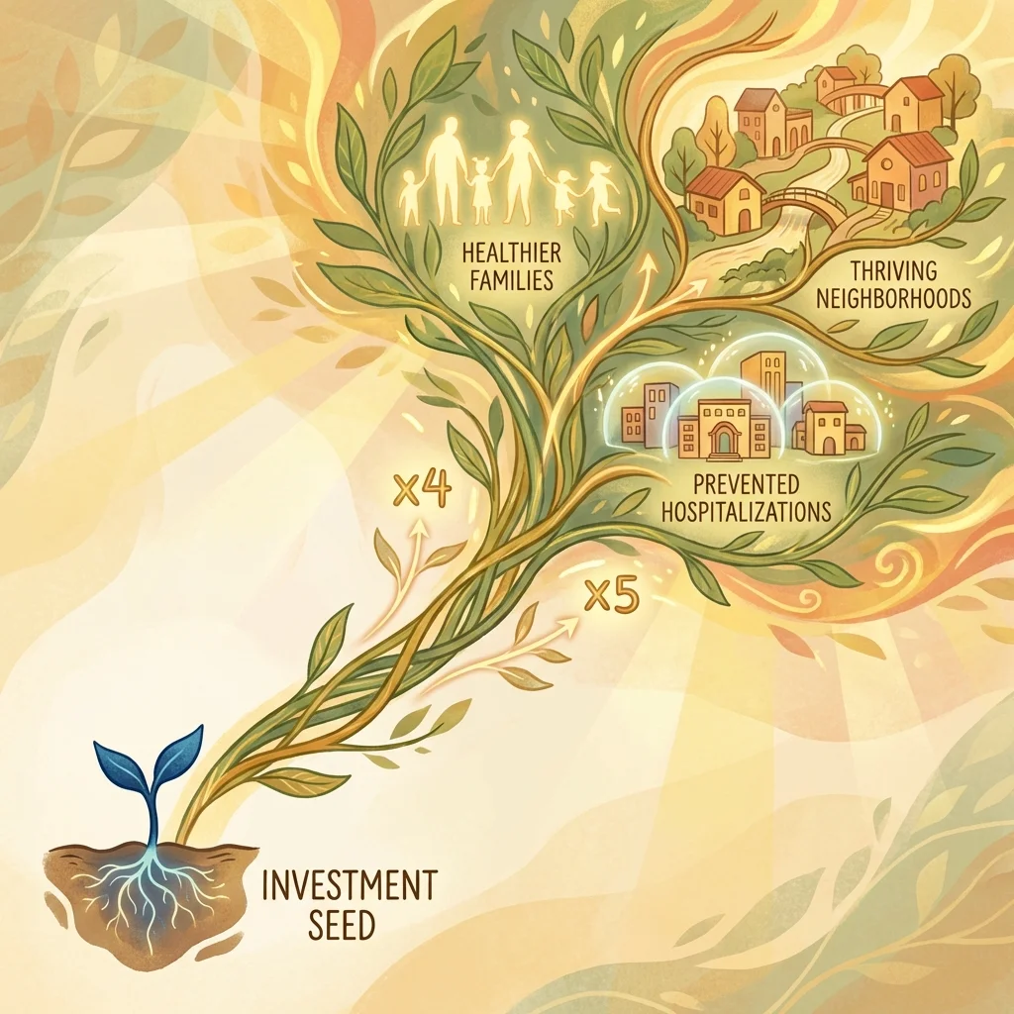
Return on Investment (ROI)
• Compares program benefits to costs, both in dollar terms
• ROI = (Benefits - Costs) / Costs
  An ROI of 5:1 means $5 returned for every $1 invested
• Appealing to policymakers because it speaks their language
• Challenge: How we discuss health outcomes and structural change in terms of dollars is controversial
Research suggests $67-88 return per dollar invested in California public health (Brown, 2014)
Notes:
Return on investment, or ROI, is the metric that gets policymakers to pay attention. Let me explain why, and also where to be careful.
The formula is straightforward: ROI equals benefits minus costs, divided by costs. If you invest $1 million and generate $5 million in benefits, your ROI is 4:1. That's equivalently a 400% return. Every dollar returned four dollars.
An ROI of 5:1 means five dollars returned for every one dollar invested. When you tell a county supervisor or a state legislator that number, they understand it immediately. It speaks the language of business and government budgeting.
Here's where it gets powerful: recent research examining California's local health departments suggests a return of $67 to $88 per dollar invested in public health. Let me say that again: $67 to $88 back for every dollar spent. An extension of that research by Cholette, Patton, and Zarate-Gomez, using updated data through 2023, estimates the return could be as high as $125 per dollar when using current federal valuations.
We actually have an interactive ROI calculator on our website where you can estimate these returns for your own county. I'll share that link later.
But I want to be honest about the challenge: ROI requires expressing health outcomes in dollar terms. And that means answering uncomfortable questions. What is a life saved "worth"? The federal government uses a figure called the Value of a Statistical Life, currently about $13.6 million according to HHS. That's not saying any individual life is worth exactly that much. It's a statistical measure based on how much people are willing to pay for small reductions in mortality risk.
It's a legitimate methodology, but it makes people uncomfortable. And that's okay. Being transparent about these assumptions is important. In our June webinar on ROI, we'll dig into this much more deeply.
The bottom line: ROI is a powerful advocacy tool. Use it. But be transparent about your assumptions and present ranges, not single numbers.

Slide 16
Part 4
Putting It Into Practice
Notes:
Okay, we've covered the conceptual foundation. Now comes the part I think you'll find most immediately useful: how to actually apply these ideas in your work.

Slide 17
When to Use Economic Analysis
• Comparing alternative programs or interventions
• Justifying new program funding to leadership
• Responding to budget cut proposals
• Writing grant applications
• Strategic planning and priority-setting
• Communicating value to external stakeholders
Notes:
Here are six situations where economic analysis adds real, practical value. And I bet many of you are in at least one of these situations right now.
Comparing alternative programs: You have three evidence-based options for addressing youth mental health. Economic analysis helps you pick the one with the best outcome-per-dollar.
Justifying new funding: You want to start a community health worker program. Instead of just saying "CHWs are evidence-based," you can say "based on published cost-effectiveness data, we estimate this program will cost $3,200 per emergency department visit averted, with a projected return of $4.50 per dollar invested over three years." That's a fundamentally different conversation.
Responding to budget cuts: This is where economic thinking becomes defensive. When someone proposes cutting your program, you can show the cost of inaction. Show the downstream costs the county will bear if prevention services disappear. In California, we saw this after Realignment: counties that cut public health services often saw increased emergency department utilization within 2-3 years.
Writing grants: Federal funders like CDC, HRSA, and SAMHSA increasingly want to see cost-effectiveness data or at least a sustainability plan with economic reasoning. Reviewers notice when applicants can articulate the economic value of their proposed work.
Strategic planning: Community Health Improvement Plans and strategic plans are stronger when they include economic criteria for prioritization, not just burden-of-disease rankings.
Communicating with stakeholders: Board of supervisors, community advisory boards, media. All of these audiences respond to economic framing. "This program saves lives" is good. "This program saves lives at a cost of $15,000 per life-year gained, which is well below the cost-effectiveness threshold" is much more persuasive.
Let me ask: which of these six resonates most with your current work? Drop it in the chat.
[Pause for responses]

Slide 18
Common Pitfalls to Avoid
• Ignoring opportunity costs (only counting direct program costs)
• Comparing apples to oranges (programs with different outcomes)
• Overstating benefits or understating costs
• Ignoring uncertainty (presenting point estimates as facts)
• Forgetting equity considerations
  Efficient ≠ Equitable—both matter in public health
Notes:
Now I want to talk about common mistakes, because I've seen well-intentioned economic analyses go wrong in predictable ways. If you can avoid these five pitfalls, you'll be ahead of most people.
Ignoring opportunity costs. This is the most common mistake. A program director says "our program only costs $200,000 a year." Okay, but what else could that $200,000 fund? If you don't mention the alternative, you're only telling half the story. Always frame costs in terms of trade-offs.
Comparing apples to oranges. You can't directly compare a tobacco program that prevents lung cancer deaths to a mental health program that reduces disability days unless you convert both to a common measure like QALYs or dollars. I've seen budget presentations where programs with completely different outcomes were ranked side by side based on cost alone. That's misleading.
Overstating benefits or understating costs. This is tempting, especially in advocacy. But it destroys your credibility. If your analysis says a program returns $50 for every dollar invested, and then the actual results are half that, nobody will trust your next analysis. Better to present a conservative estimate with a range. Say "we estimate a return of $20 to $50 per dollar, with a most likely value around $30." That's honest and still compelling.
Ignoring uncertainty. This is related to the point above. Never present a single number as if it's certain. All economic analyses involve assumptions. Present sensitivity analyses or at least acknowledge what would change your conclusions. For example: "This estimate assumes 80% program retention. If retention drops to 60%, the cost per outcome increases by about 40%."
And finally, forgetting equity. This is the one that matters most in public health. A program can be highly cost-effective overall while completely missing the communities that need it most. A county-wide flu vaccination campaign might prevent the most cases per dollar by targeting middle-income suburbs where uptake is easy. But the people dying of flu are elderly residents in underserved rural areas. The equitable choice is less efficient. Both matter. Report both.
The line at the bottom says it all: efficient does not equal equitable. In public health, we need both.

Slide 19
Getting Started: Practical Tips
• Start with cost documentation. How much do programs actually cost?
• Identify your outcomes and how they're measured
• Look for published CEA studies of similar interventions
• Partner with academic institutions (UC schools, CAPHE members)
• Use existing tools and templates (CDC, WHO resources)
• Don't let 'perfect' be the enemy of 'good enough'
Notes:
I want to close with practical next steps, because I don't want you to leave today thinking "that was interesting but I don't know what to do with it."
Here are six things you can start doing this month:
First, start with cost documentation. This sounds basic, but most programs can't answer the question "what does it cost per participant?" Calculate that number. Include staff time, supplies, overhead. Even a rough estimate is infinitely better than nothing. If you need help, our Methods Lab has a budget impact tutorial that walks through the process.
Second, identify your outcomes and how they're measured. What does your program actually change? Cases prevented? ED visits averted? QALYs gained? If you don't have outcome data, can you use published estimates from similar programs?
Third, look for published CEA studies. Before you do your own analysis, check what's already been published. The Tufts Cost-Effectiveness Analysis Registry has thousands of published ratios. If someone has already studied a program like yours, you can cite their findings.
Fourth, partner with academics. UC Berkeley, UCLA, UCSF, UC Davis. All have health economics faculty who are often looking for practice-based research partnerships. CAPHE can help make introductions. We also have members who consult with county departments on economic analyses.
Fifth, use existing tools and templates. CDC has cost analysis toolkits. WHO has CEA guidelines. And CAPHE has our Methods Lab tutorials and our ROI calculator. Don't reinvent the wheel.
And sixth, this is my favorite: don't let perfect be the enemy of good enough. A back-of-the-envelope cost-per-participant estimate that takes you 30 minutes is far more valuable than a perfect analysis you never have time to do. Start rough. Refine later. The goal is to build the habit of economic thinking, not to publish in a journal.

Slide 20
CAPHE Resources for You
• Methods Lab: Free interactive tutorials on health economics methods
  caphegroup.org/methods-lab
• Monthly Peer Review: Get feedback on your analyses from colleagues
• Professional Membership: Access advanced labs and working groups
• Webinar Series: Continued learning throughout the year
  April 9: Understanding Cost-Effectiveness: The Basics
  June 11: Return on Investment in Public Health
Notes:
Let me tell you about the resources CAPHE offers, because everything I've described today has support available.
Methods Lab: This is our crown jewel. Free, interactive, web-based tutorials that teach health economics concepts through hands-on exercises. Topics include cost-effectiveness ratios, budget impact analysis, study design, confounding, and more. You can access these at caphegroup.org/methods-lab. They're self-paced. Each takes 15 to 30 minutes. And they're designed specifically for public health practitioners.
Monthly Peer Review: Once a month, we hold a virtual session where members can present their analyses, whether it's a rough draft or a polished study, and get constructive feedback from colleagues. This is one of the most valuable things we do because learning happens in the feedback loop.
Professional Membership: For those who want to go deeper, membership gives access to advanced labs, working groups, and networking with health economists across California.
And then there's this webinar series. We have two more sessions:
April 9: Understanding Cost-Effectiveness, the Basics. This is the deep dive into CEA that I mentioned earlier. If you want to learn how to interpret or conduct a cost-effectiveness analysis, that's your session.
June 11: Return on Investment in Public Health. This covers ROI methodology, the research on California public health spending, and how to calculate and communicate ROI for your own programs.
Both are free. Both are recorded. Registration links are on our website at caphegroup.org/programs.
I'd encourage you to register for both now, while you're thinking about it.

Slide 21

Stay Connected
Join a community of California public health economists
Get Updates
Ask Questions
Continue Learning
Sign up for our newsletter to hear about upcoming webinars, new Methods Lab modules, and resources.
caphegroup.org/subscribe
Have a question about applying health economics in your work? Reach out. We're here to help.
info@caphegroup.org
Explore our free Methods Lab tutorials to practice these concepts at your own pace.
caphegroup.org/methods-lab
Upcoming Webinars
April 9: Understanding Cost-Effectiveness: The Basics • June 11: Return on Investment in Public Health
Register at caphegroup.org/programs
Notes:
Here's how to stay connected with CAPHE after today.
Newsletter: We send periodic updates about new webinars, new Methods Lab modules, job postings, and professional development opportunities. Sign up at caphegroup.org/subscribe. We don't spam. Typically one or two emails a month.
Questions: If you have a specific question about applying health economics in your work, maybe you're trying to do a cost analysis and you get stuck, or you need help thinking through a trade-off, email us at info@caphegroup.org. We're a community of practitioners, and helping each other is what we do.
Methods Lab: I mentioned this already, but I want to emphasize. If you do one thing after today's webinar, spend 20 minutes on one Methods Lab tutorial. It will reinforce everything we covered today and give you hands-on practice.
Upcoming webinars: April 9 on CEA basics and June 11 on ROI. Register at caphegroup.org/programs.
Also, if your department is interested in a more tailored training or consultation, CAPHE offers that as well. Reach out to us and we can discuss what would be most useful for your team.

Slide 22
Thank You!
Questions?
caphegroup.org
info@caphegroup.org
Notes:
Thank you all for spending your lunch hour with us. I hope you're leaving with at least a few concepts you can apply right away.
Let's open it up for questions. You can unmute yourself, or type in the chat. Whatever's comfortable.
[Pause for questions. Have these prepared in case of silence:]
If no questions come in immediately, here are some conversation starters:
- "A question I often get is: Where do I find cost data for programs that don't have dedicated budget lines?"
- "Another common question: What if my supervisor doesn't care about cost-effectiveness?"
- "People also ask: How do I get started if I have no economics background at all?"
[After Q&A:]
Closing remarks: I want to leave you with one thought. You don't need to become a health economist to use economic thinking. Start small. Next time you're in a meeting about program funding, ask one question: "What are we giving up to do this?" That's opportunity cost. That's health economics in practice.
Thank you for joining today. Please fill out the evaluation survey. The link will be in the follow-up email. Your feedback directly shapes our future webinars.
We hope to see you April 9 for our deep dive into cost-effectiveness analysis. Have a great afternoon, everyone.

