Slide 1
CAPHE
California Association of Public Health Economists
Introduction to Health Economics
for Public Health
Free Webinar Series
February 12, 2026 · 12:00 PM PT

Slide 2
Today's Objectives
• Understand what health economics is and why it matters for public health
• Learn key economic concepts: scarcity, trade-offs, opportunity cost
• Explore how economic thinking can strengthen program decisions
• Discover resources for continued learning
This is an introductory session. No prior economics background required.

Slide 3

Building on What You Know
Epidemiology and economics work together to inform better decisions
Epidemiology asks...
Economics adds...
• Does this intervention reduce disease?
• What is the effect size?
• Is the evidence strong?
• Who benefits most?
• Is this the best use of limited resources?
• What is the cost per outcome?
• What are we giving up to do this?
• How do we maximize impact?
Health economics helps you make the case for why it's worth doing and what to prioritize when you can't do everything.

Slide 4
Part 1
What is Health Economics?

Slide 5
KEY CONCEPT
Health Economics
The study of how individuals, institutions, and society make choices about allocating scarce resources to improve health outcomes.
Example:
Should we invest $1 million in a new vaccination program or expand mental health services? Health economics provides frameworks to answer questions like this.

Slide 6
Why Health Economics Matters for Public Health
• Resources are always limited. Every dollar spent is a dollar not available elsewhere
• Public health decisions affect population-level outcomes
• Stakeholders (supervisors, legislators) increasingly demand evidence of value
• Economic analysis helps prioritize interventions with greatest impact
• Strengthens grant applications and program justifications

Slide 7

KEY CONCEPT
Scarcity
The fundamental economic problem: unlimited wants and needs, but limited resources to satisfy them.
Example:
Your county has budget for 2 new positions. Do you hire an epidemiologist, a health educator, or a data analyst? You can't hire all three.

Slide 8
Part 2
Core Economic Concepts

Slide 9

KEY CONCEPT
Opportunity Cost
The value of the next-best alternative that you give up when making a choice. It extends beyond how much something costs to include the cost of what else you could have done with the resources.
Example:
If your team spends 6 months developing a diabetes prevention program, the opportunity cost includes other programs that couldn't be developed during that time.

Slide 10

Trade-offs in Public Health
• Breadth vs. Depth: Serve more people with less intensity, or fewer people with more support?
• Prevention vs. Treatment: Invest upstream or address immediate needs?
• Equity vs. Efficiency: Maximize total health gains or prioritize underserved populations?
• Short-term vs. Long-term: Quick wins today or sustainable impact over years?
  No right answer. It depends on values, context, and evidence

Slide 11
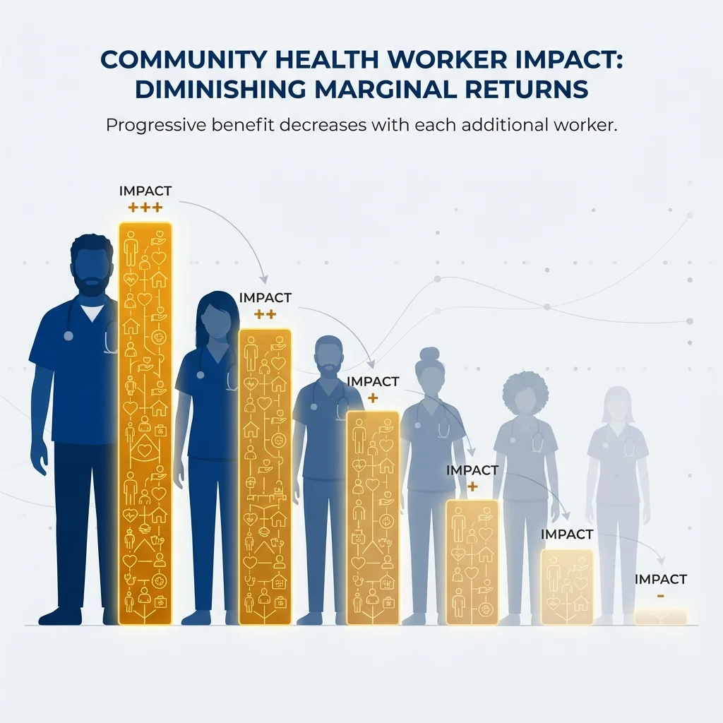
KEY CONCEPT
Marginal Thinking
Focus on the additional (marginal) benefit of one more unit of activity, compared to its additional cost.
Example:
Should we add a 5th community health worker to our team? The answer depends on whether the 5th CHW adds enough benefit to justify the cost.

Slide 12
Part 3
Types of Economic Analysis

Slide 13
Economic Analysis in Public Health
Cost Analysis
Value Analysis
• Cost of illness studies
• Budget impact analysis
• Cost minimization
• Focus: What does it cost?
• Cost-effectiveness analysis (CEA)
• Cost-benefit analysis (CBA)
• Return on investment (ROI)
• Focus: Is it worth it?

Slide 14

Cost-Effectiveness Analysis (CEA)
• Compares costs to health outcomes (not just dollars)
• Results expressed as cost per outcome achieved
  e.g., Cost per life saved, cost per case prevented
• Allows comparison across different health interventions
• Most common type of economic analysis in public health
We'll cover CEA in depth in our April webinar: 'Understanding Cost-Effectiveness: The Basics'

Slide 15

Return on Investment (ROI)
• Compares program benefits to costs, both in dollar terms
• ROI = (Benefits - Costs) / Costs
  An ROI of 5:1 means $5 returned for every $1 invested
• Appealing to policymakers because it speaks their language
• Challenge: How we discuss health outcomes and structural change in terms of dollars is controversial
Research suggests $67-88 return per dollar invested in California public health (Brown, 2014)

Slide 16
Part 4
Putting It Into Practice

Slide 17
When to Use Economic Analysis
• Comparing alternative programs or interventions
• Justifying new program funding to leadership
• Responding to budget cut proposals
• Writing grant applications
• Strategic planning and priority-setting
• Communicating value to external stakeholders

Slide 18
Common Pitfalls to Avoid
• Ignoring opportunity costs (only counting direct program costs)
• Comparing apples to oranges (programs with different outcomes)
• Overstating benefits or understating costs
• Ignoring uncertainty (presenting point estimates as facts)
• Forgetting equity considerations
  Efficient ≠ Equitable—both matter in public health

Slide 19
Getting Started: Practical Tips
• Start with cost documentation. How much do programs actually cost?
• Identify your outcomes and how they're measured
• Look for published CEA studies of similar interventions
• Partner with academic institutions (UC schools, CAPHE members)
• Use existing tools and templates (CDC, WHO resources)
• Don't let 'perfect' be the enemy of 'good enough'

Slide 20
CAPHE Resources for You
• Methods Lab: Free interactive tutorials on health economics methods
  caphegroup.org/methods-lab
• Monthly Peer Review: Get feedback on your analyses from colleagues
• Professional Membership: Access advanced labs and working groups
• Webinar Series: Continued learning throughout the year
  April 9: Understanding Cost-Effectiveness: The Basics
  June 11: Return on Investment in Public Health

Slide 21

Stay Connected
Join a community of California public health economists
Get Updates
Ask Questions
Continue Learning
Sign up for our newsletter to hear about upcoming webinars, new Methods Lab modules, and resources.
caphegroup.org/subscribe
Have a question about applying health economics in your work? Reach out. We're here to help.
info@caphegroup.org
Explore our free Methods Lab tutorials to practice these concepts at your own pace.
caphegroup.org/methods-lab
Upcoming Webinars
April 9: Understanding Cost-Effectiveness: The Basics • June 11: Return on Investment in Public Health
Register at caphegroup.org/programs

Slide 22
Thank You!
Questions?
caphegroup.org
info@caphegroup.org

