Slide 1
CAPHE
California Association of Public Health Economists
Return on Investment in Public Health
Free Webinar Series
June 11, 2026 · 12:00 PM PT

Slide 2

KEY CONCEPT
Public Health Is an Investment
Every dollar spent on public health generates returns. Healthcare savings. Productivity gains. Reduced emergency costs. Stronger communities.
Example:
The question isn't whether to spend on public health. It's how to show stakeholders the value of what we do.

Slide 3
Building on What We've Learned
• February: Economic thinking in public health
Scarcity, opportunity cost, trade-offs
• April: Cost-effectiveness analysis
ICER, QALYs, decision thresholds
• Today: Return on Investment
Making the financial case for public health
Recordings of earlier sessions available at caphegroup.org/programs

Slide 4
Today's Objectives
• Understand what ROI means in a public health context
• Learn to calculate and interpret ROI
• See examples of high-ROI public health investments
• Know when ROI is the right metric (and when it isn't)
• Build skills to communicate value to budget decision-makers

Slide 5
Part 1
What is Return on Investment?

Slide 6
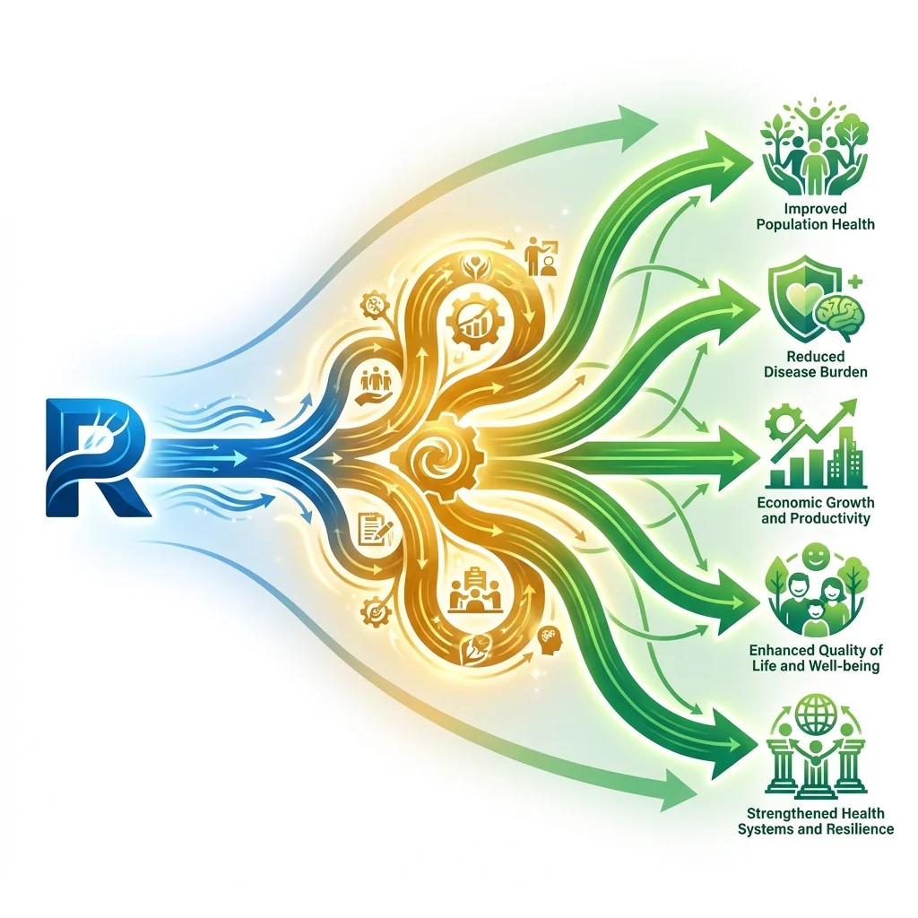
KEY CONCEPT
Return on Investment (ROI)
ROI measures the financial return generated by an investment, expressed as a ratio or percentage. It answers: "For every dollar we spend, how many dollars do we get back?"
Example:
An ROI of 5:1 means every $1 invested generates $5 in returns. That's a 400% return on investment.

Slide 7
The ROI Formula
ROI = (Returns − Investment) ÷ Investment
• Returns: Total value generated (savings, avoided costs, productivity)
• Investment: Total cost of the program or intervention
• Result: Expressed as ratio (5:1) or percentage (400%)
• Positive ROI means the program pays for itself and more
Also expressed as: ROI = Net Benefits ÷ Costs

Slide 8
ROI vs. Cost-Effectiveness: Different Questions
 | ROI | Cost-Effectiveness
Question | "Does this pay for itself?" | "What's the best health value?"
Units | Dollars returned per dollar spent | Cost per health outcome (QALY, life saved)
Best for | Budget justification, elected officials | Comparing health interventions
Limitation | Requires monetizing all benefits | Doesn't show if affordable
Both are valuable. Choose based on your audience and question.

Slide 9

What Counts as "Returns"?
• Healthcare cost savings
Avoided hospitalizations, ER visits, treatments
• Productivity gains
Fewer sick days, longer working lives
• Reduced public program costs
Less Medicaid spending, fewer disability claims
• Avoided emergency response costs
Prevented outbreaks, reduced crisis management
• Economic multiplier effects
Healthier workforce, stronger local economy

Slide 10
Part 2
ROI in Action: California Examples

Slide 11

California Tobacco Control Program
Prop 99-funded comprehensive tobacco prevention (1989-2004)
INVESTMENT
RETURNS
$1.8 billion over 15 years
• $86 billion in healthcare savings
• 1+ million life-years saved
• 33% decline in adult smoking
• Model for national and global programs
ROI: $48 returned for every $1 invested
Source: Lightwood & Glantz, PLOS Medicine 2013

Slide 12
Childhood Immunization Programs
Routine childhood vaccination (national estimates, applicable to CA)
INVESTMENT
RETURNS
~$10 billion annually (US)
• $69 billion in direct medical savings
• $244 billion in total societal savings
• 21 million hospitalizations prevented
• Eliminates or controls 14 diseases
ROI: $7-$24 returned for every $1 invested
Source: Zhou et al., Pediatrics 2014

Slide 13
Diabetes Prevention Programs
CDC-recognized lifestyle change programs
INVESTMENT
RETURNS
~$500 per participant
• 58% reduction in diabetes incidence
• $2,650 savings per participant (3 years)
• Reduced medication costs
• Fewer complications, hospitalizations
ROI: $5 returned for every $1 invested
Source: Diabetes Prevention Program Research Group; CMS Medicare DPP

Slide 14
Lead Poisoning Prevention
Lead hazard control and screening programs
INVESTMENT
RETURNS
$1-2 billion annually (national)
• $50 billion in lifetime earnings preserved
• Reduced special education costs
• Lower criminal justice involvement
• Prevented cognitive impairment
ROI: $17-$221 returned for every $1 invested
Source: Gould, Environmental Health Perspectives 2009

Slide 15
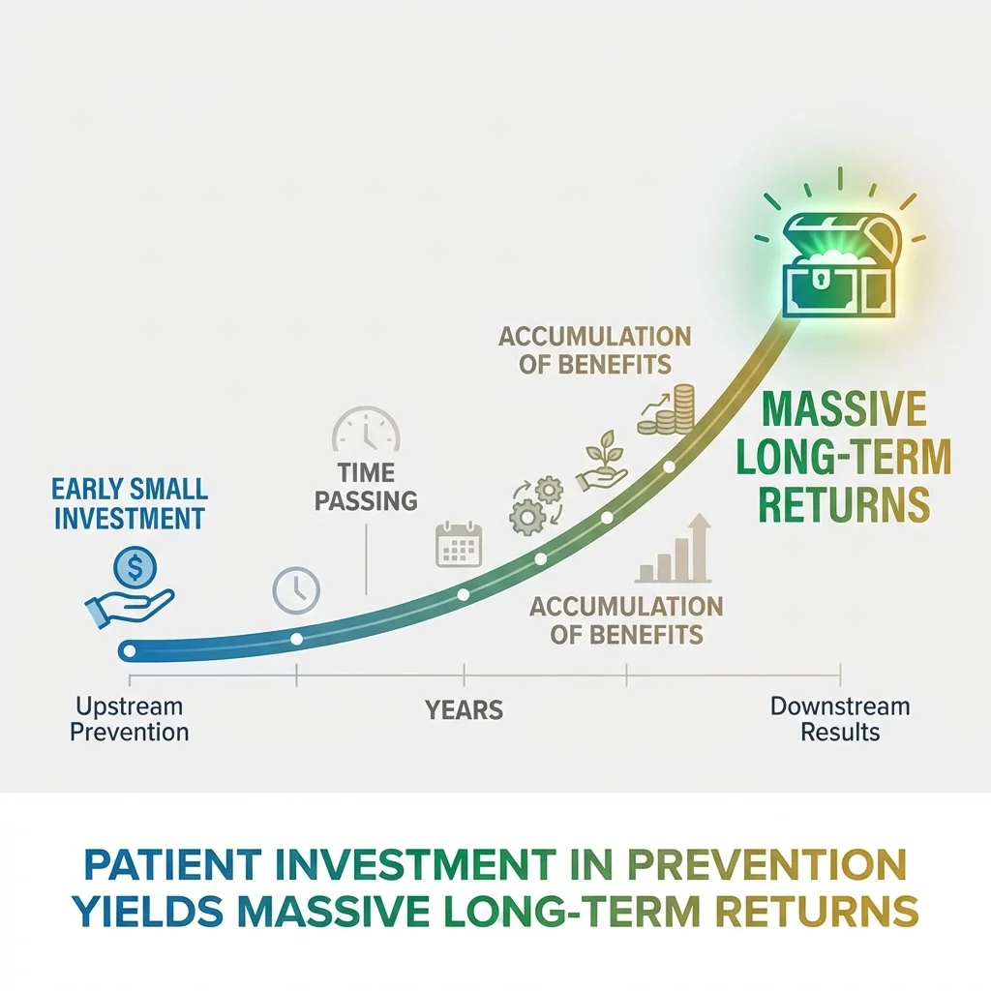
The Pattern: Prevention Pays
• Upstream investments yield downstream savings
• Returns often exceed 5:1 or 10:1
• Benefits extend beyond healthcare to productivity and society
• Long time horizons favor prevention
Tobacco: 15-year analysis showed massive returns
Lead: Lifetime earnings gains from childhood intervention
• Public health generates returns that private markets miss

Slide 16
Part 3
Calculating ROI for Your Programs

Slide 17
Steps to Calculate ROI
• 1. Define your investment clearly
All program costs: staff, materials, overhead
• 2. Identify all relevant returns
Healthcare savings, productivity, avoided costs
• 3. Gather data or use credible estimates
Published studies, local data, reasonable assumptions
• 4. Choose your time horizon
Longer horizons capture more returns but add uncertainty
• 5. Calculate and present with transparency
Show your assumptions, report ranges

Slide 18
Where to Find Return Data
• Published ROI studies on similar programs
County Health Rankings evidence database
Community Guide (thecommunityguide.org)
• Local healthcare cost data
Hospital discharge data, Medicaid claims
• National estimates adapted to local context
CDC, CMS, peer-reviewed literature
• Economic models and calculators
Prevention ROI calculators (various sources)

Slide 19
Common Challenges in ROI Analysis
• Monetizing health outcomes is difficult
What's a life worth? A prevented disease?
• Benefits may accrue to different payers
You invest, insurance company saves
• Time lags between investment and returns
Prevention today, savings in 10 years
• Attribution is imperfect
How much of the improvement came from our program?
• Conservative estimates may understate value
Societal benefits often excluded

Slide 20
When ROI Isn't the Right Metric
• Some programs matter even without positive ROI
Rare disease services, end-of-life care, equity programs
• Not all benefits can be monetized
Dignity, peace of mind, community trust
• ROI favors programs with measurable cost savings
May undervalue prevention of suffering
• Different stakeholders value different things
Use ROI alongside equity and health impact metrics
ROI is a tool, not a decision-maker. It's one input among many.

Slide 21
Part 4
Making the Case to Decision-Makers

Slide 22
Speaking to Your Audience
Health Leaders
Budget Officers & Electeds
• Focus on health outcomes first
• ROI supports the mission
• Use alongside CEA and equity
• "This investment saves lives AND money"
• Lead with financial returns
• Show avoided costs clearly
• Compare to other investments
• "Every $1 invested returns $X"
Same data, different framing. Know your audience.

Slide 23
Building a Compelling Business Case
• Lead with the bottom line
"This program returns $5 for every $1 invested"
• Show where the savings go
Healthcare system, county budget, employers, families
• Use local examples when possible
"In our county, this would mean..."
• Acknowledge uncertainty honestly
"Estimates range from X to Y"
• Connect to priorities they care about
Budget stability, workforce health, crisis prevention

Slide 24
The One-Page ROI Summary
1. The Ask: What you're proposing and the investment needed
2. The Return: Estimated ROI ratio and key benefits
3. The Evidence: Where the numbers come from
4. The Timeline: When returns will be realized
5. The Risk: What happens if we don't invest
6. The Comparison: How this stacks up to alternatives
Template available in CAPHE Methods Lab

Slide 25
Stay Connected
Continue building your health economics skills
Practice in Methods Lab
Get Feedback
Review the Series
Interactive labs on ROI calculation, building the business case, and presenting to stakeholders.
caphegroup.org/methods-lab
Bring your ROI analyses to monthly peer review sessions for expert feedback.
info@caphegroup.org
Missed earlier sessions? Recordings available for Feb (Intro) and April (CEA).
caphegroup.org/programs
2026 Webinar Series Complete!
Feb: Intro to Health Economics • April: Cost-Effectiveness Basics • June: Return on Investment

Slide 26
Public health is an investment,
not just an expense.
Thank You!
caphegroup.org
info@caphegroup.org

