Slide 1
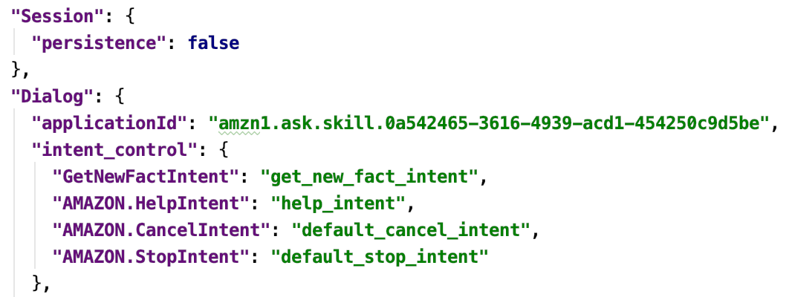
Note: applicationId is required for a production deploy.

