Slide 1




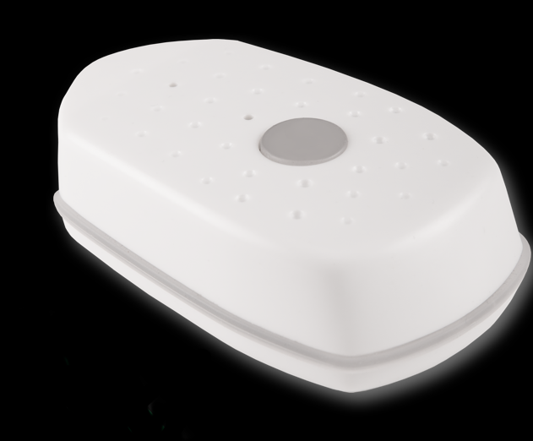





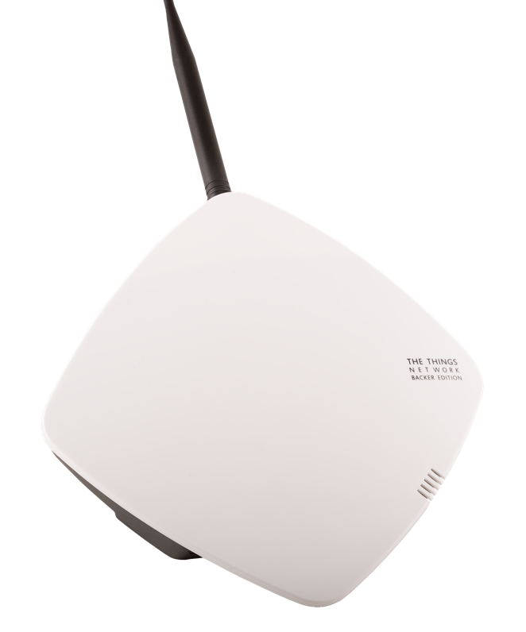
Compost Temps
Temperature
Sensor
EC2
Compost Sever
User
http
TTN Node
mqtt
Temp
Database
MQTT
Client
Compost
Application
Compost
Website
http
Weather
Data
Elastic IP

