Slide 1
Range Identification via Passive Infrared (RIPIR)
Dana Phillips

Slide 2
Presentation Overview
Topic Origin
Overview/Limitations of current state of the art (2015!)
Proposed Solution
RIPIR Innovations & Results
Epipolar Rectification
Levenburg-Marquadt Telemetry Correction
Conclusions

Slide 3
Office of Naval Research (ONR) SBIR Topic -- 2015
From the topic description:
“Terrain sensing and mapping based on stereo imagery, whether from single or multiple cameras, generally relies on having good signal-to-noise characteristics. Military operations necessitate that terrain sensing systems operate primarily at night under low-light conditions where image intensifiers (I2) or infrared (IR) sensors are generally limited to low resolution, low signal-to-noise, or both. This has resulted in the majority of terrain sensing systems now being active (emitting), such as millimeter-wave radar, scanning Laser Detection and Ranging (LADAR), or flash LADAR, all of which pose a signature risk in threat environments. This effort would explore the limits of passive terrain sensing and mapping under low-light conditions using sensors such as I2, fused Electro-optical-infrared (EO-IR) or some alternative, preferably low cost solution. This effort will also stress the limits of machine vision ranging algorithms in low signal-to-noise environments. Terrain and obstacles likely to be encountered by a helicopter Unmanned Aerial Vehicle (UAV) in both rural and urban settings should be emphasized; e.g., hills, trees, water, buildings, towers, wires, etc”.
But what does all this mean?

Slide 4
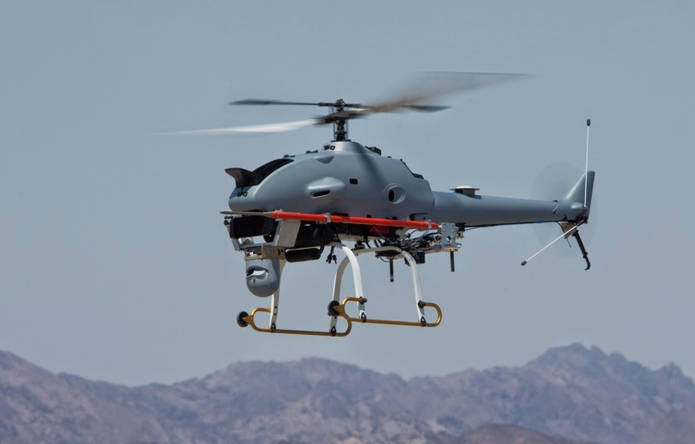
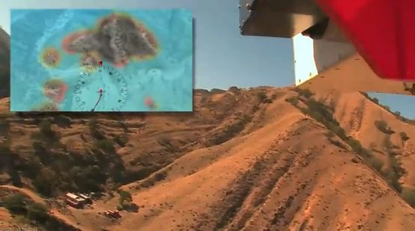
Explanation
UAV operations transitioning to lower altitudes and smaller platforms
Obstacle detection increasingly important
Reliable range measurements required
Active ranging (LIDAR/RADAR) challenge SWAP-C limits, emission risk
ONR wanted a passive approach to terrain sensing for autonomous operations in the dark at ranges exceeding 1000m
ONR performance goal: range measurements accurate to 10% of truth
R-MAX VTOL UAV
AFDD Autonomous Blackhawk Demo

Slide 5
Mapping ONR Requirements to Existing Solution Technologies
ONR Requirement | Technology Area
Passive Ranging | Stereo Vision
Low Light/No Light/DVE operation | Long-wave thermal (LWIR) sensing
Small/Micro UAV platform SWAPC limits | Smartphone-level (or better) computing platform
1000+ meter range with 10% accuracy | Long-baseline Single-camera stereo

Slide 6
Overview of Solution Technologies State of the Art
Computational horsepower for stereo processing available in low SWAP-C package
Resolution of commercial thermal sensors sufficient to support stereo processing
Stereo algorithms already exist
Daylight, fixed-baseline, stereo vision is at consumer-level technology
Video rate thermal stereo has been demonstrated with fixed baseline in automotive applications
Wide-baseline single camera stereo used in robotic navigation
Can basic stereo vision technology meet
ONR requirements?

Slide 7
Limitations of fixed-baseline stereo
Fixed-baseline stereo requires impractically large separation (baseline) to meet ONR metrics:
For comparison, a UH-60 Blackhawk is only 20m nose-to-tail!
Baseline requirement implies that solution needs to use single-camera stereo

Slide 8
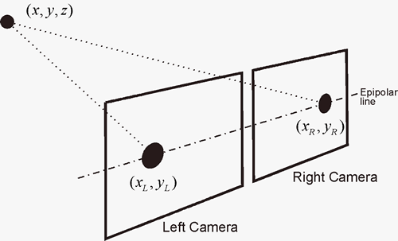
Limitation of single camera stereo
Standard single camera stereo (Fusiello) uses apparent shift of objects due to camera motion (parallax) and knowledge of baseline length to compute object depth via trigonometry
Uses platform motion to generate baseline – easy to make long baselines
Parallax requires camera motion to be perpendicular line of sight
Not useful for ranging in front of UAV!

Slide 9
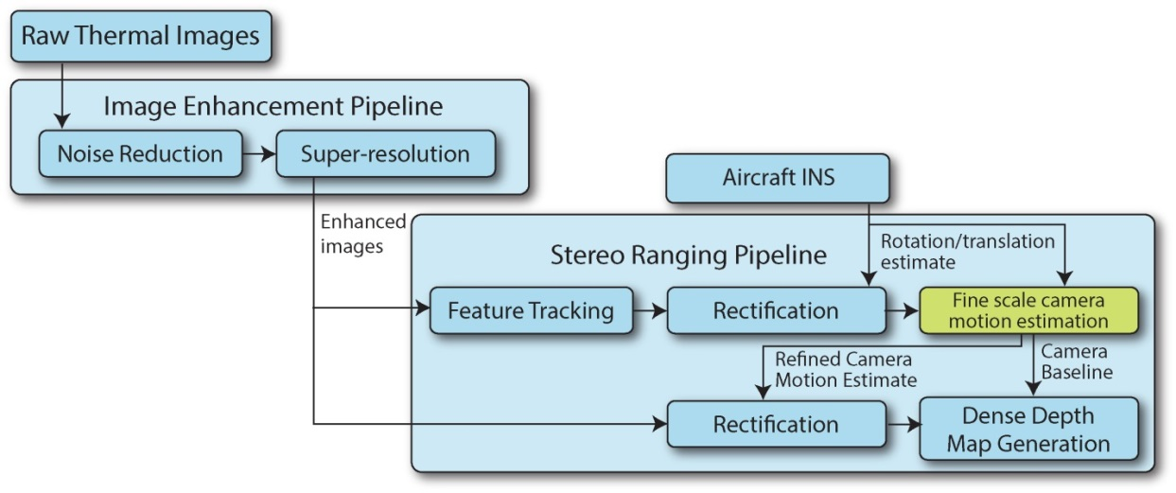
Proposed Solution
RIPIR – Range Identification via Passive Infrared
Low-light/no-light monocular stereo ranging system
Low-cost (Vionics AIR64, ~$1500), high frame rate (60fps), forward-looking LWIR sensor
6 DOF position error minimization technique to improve INS telemetry
Allows use of small, low-resolution, thermal cameras and inexpensive, COTs-level, IMUs
Does not interfere with normal UAV flight operations

Slide 10
RIPIR Innovations
Application of Pollefeys/epipolar warping to airborne stereo
Alternate problem formulation allows for arbitrary platform movements – does not interfere with normal UAV operations
Permits ranging directly ahead of UAV
6 DOF telemetry correction via Levenburg-Marquadt
Allows for use of lower-cost IMUs
Theoretically allows for positioning in GPS-denied/degraded areas

Slide 11
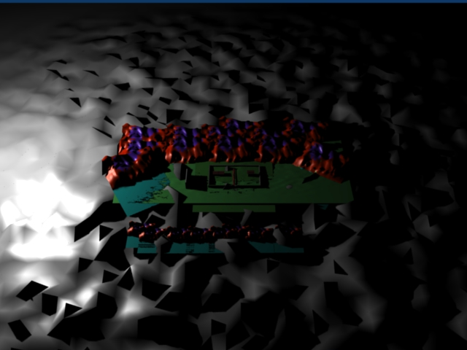
Epipolar/Pollefeys warping
Alternate formulation of imaging geometry
Transforms images from Cartesian (X,Y) to epipolar (R,θ)
X
θ
Y
R

Slide 12
Epipolar/Pollefeys warping continued
In epipolar space, radial displacement from epipole (i.e. camera line of sight) gets mapped to a horizontal displacement
Angular location gets mapped to a vertical displacement
Advantage: Any pair of images with arbitrary 6DOF motion can be warped to a common angular reference through fundamental camera matrix
Cameras now “looking” parallel
Camera motion results in horizontal displacement – restores parallax
Can use COTS tools to generate pixel level disparity maps
X
θ

Slide 13
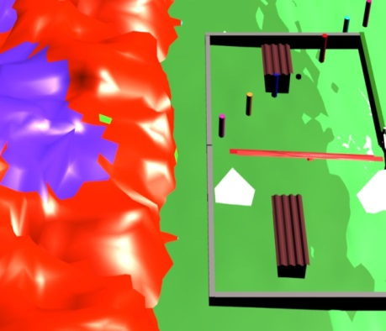
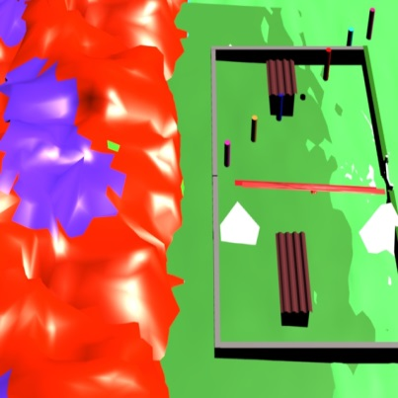
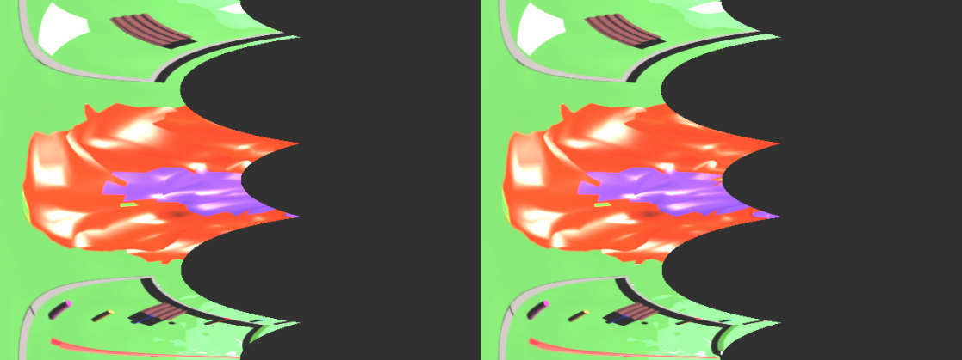
Example: Warping images to common reference

Slide 14
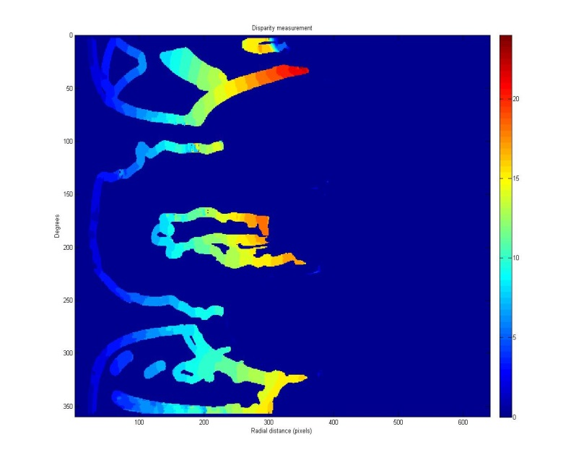
Example: Pixel-level disparity map

Slide 15
Disparity To Depth
Disparity is effectively an angular measurement of pixel displacement between two images
Given baseline length, depth can be found
via basic trigonometry

Slide 16
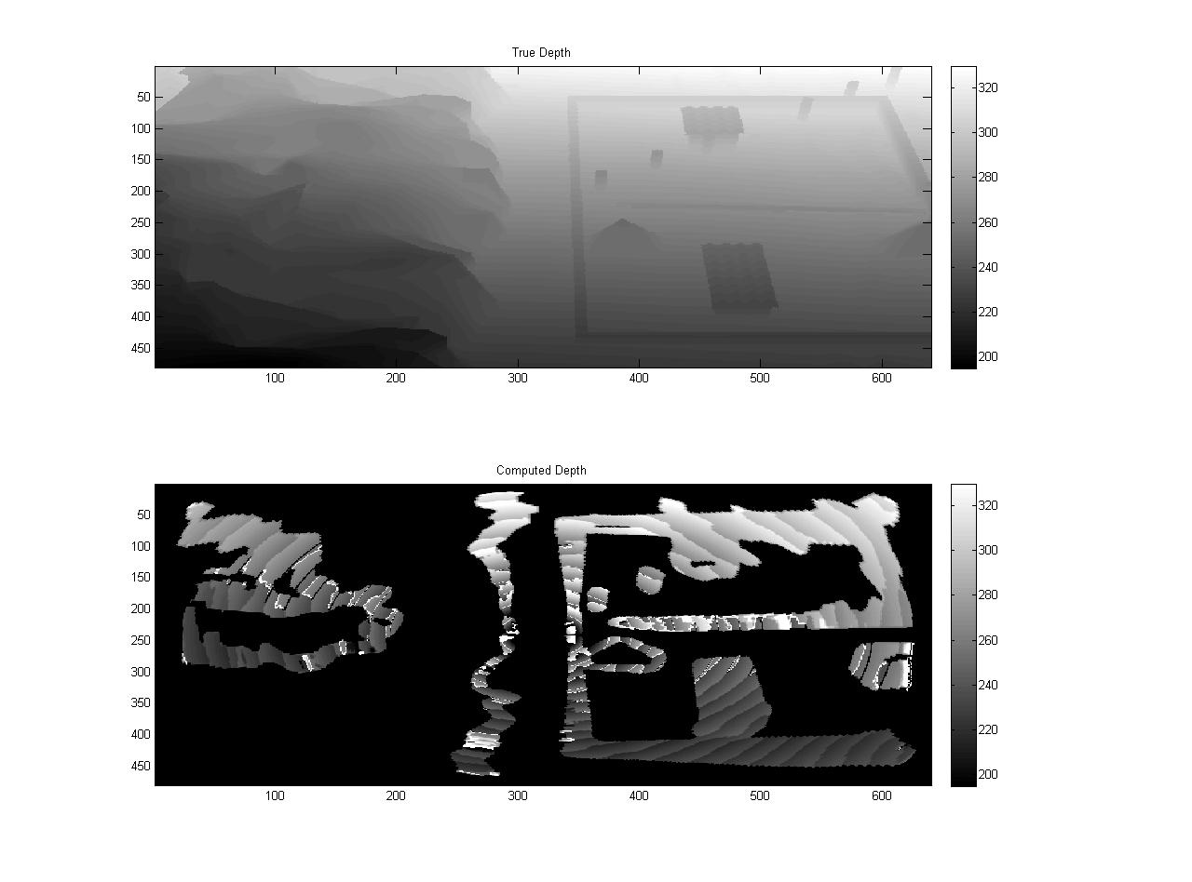
Example Results, “Village”

Slide 17
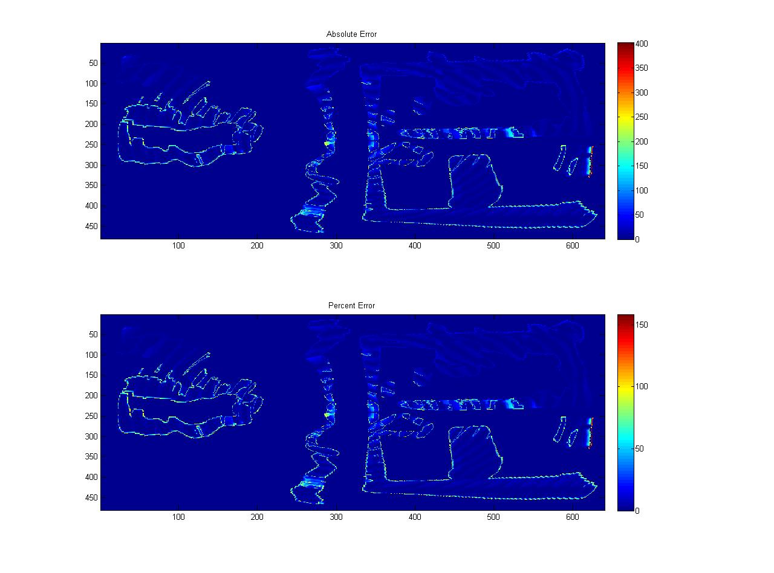
Performance on “Village”

Slide 18
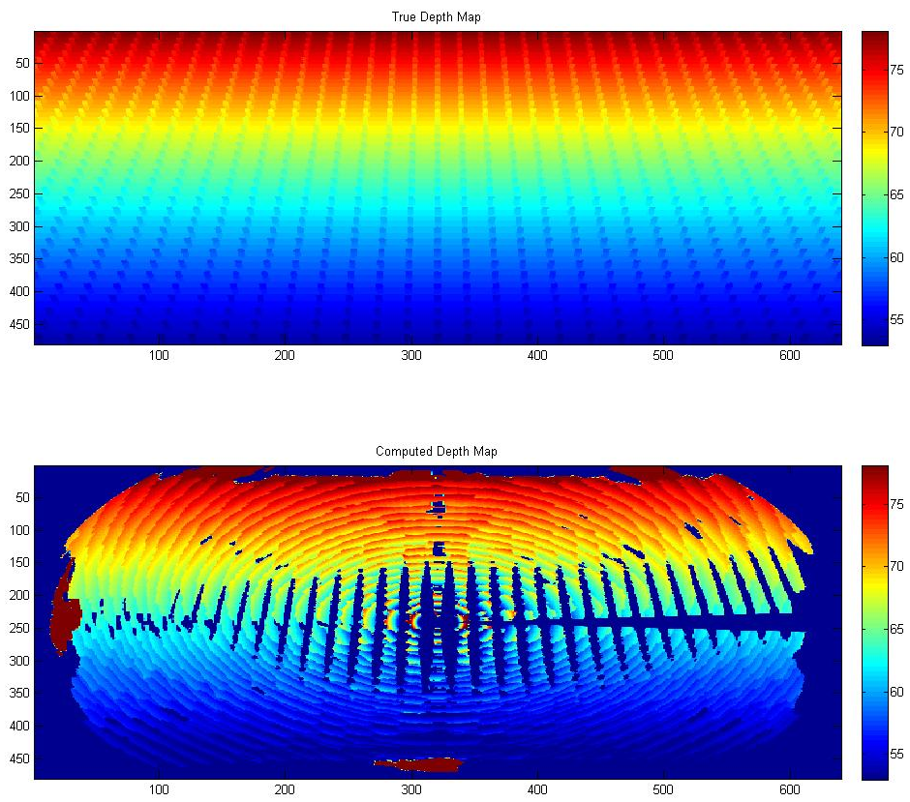
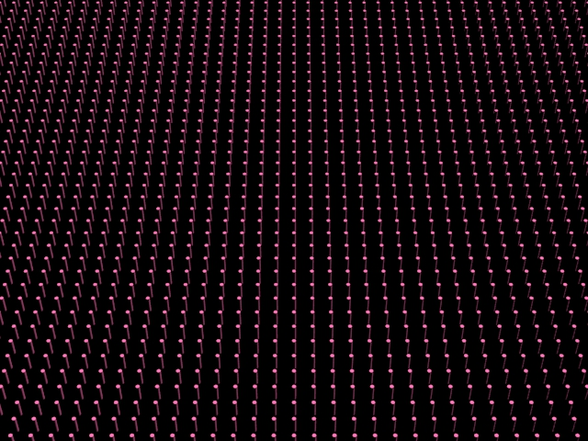
Example Results, “Cylinders”

Slide 19
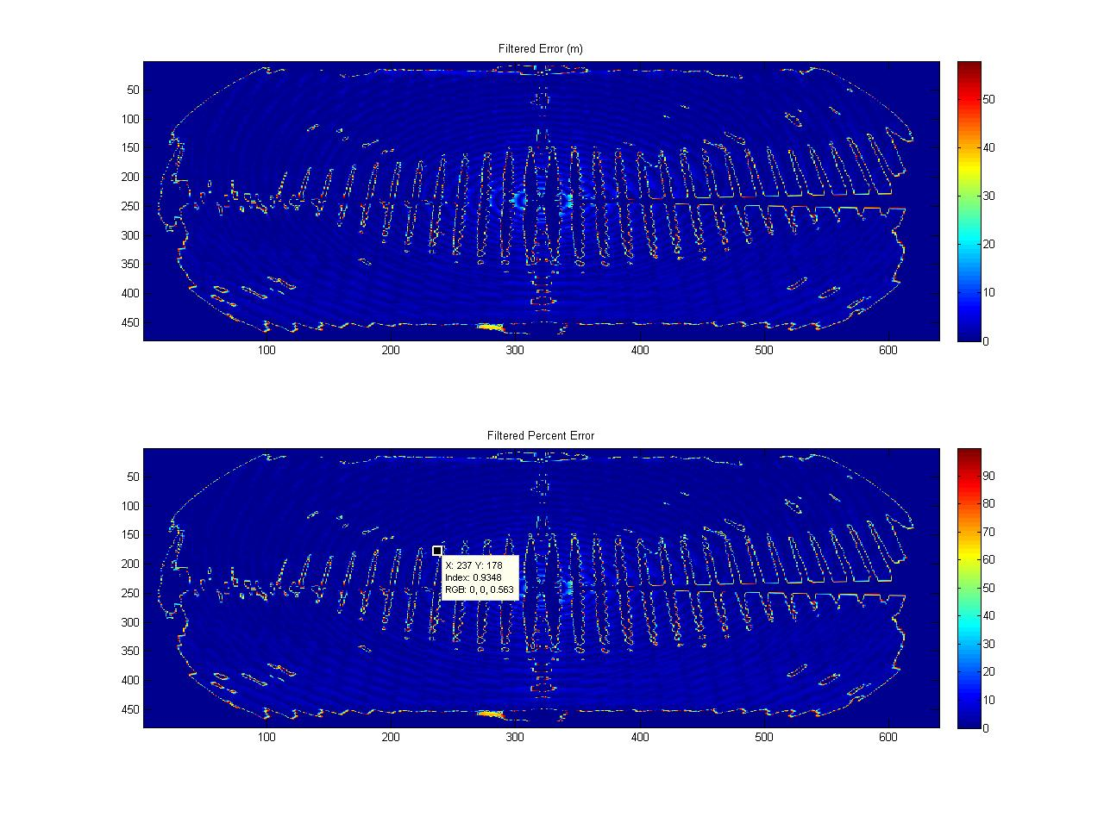
Performance on “Cylinders”

Slide 20
Performance Summary, Simulated Data
Data Set | Average Depth Error (meters) | Average Percent Error | σ Depth error (meters) | ΔZ, meters (near, far) | Operating Range (meters)
Village | 22.8 | 9% | 44.5 | (4.15,8.58) | 160
Cylinders | 2.5 | 10% | 7.5 | (0.25, 0.53) | 50

Slide 21
6 DOF telemetry correction
Depth map computation requires accurate alignment between the image pairs
If telemetry has errors in position, range measurements will be incorrect but at least they’ll be in the right place in the image
If telemetry has errors in rotation, the images won’t align properly and the disparity maps will be thrown off
Rotation errors far more likely – inexpensive GPS is usually fairly accurate, but inexpensive IMU is quite noisy and drifts rapidly

Slide 22
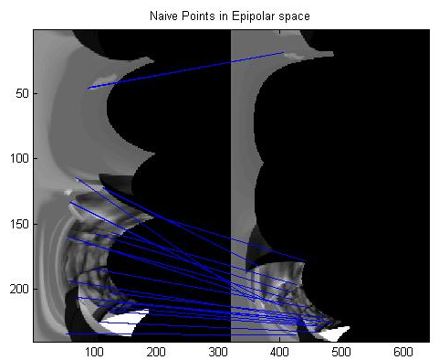
Impact of telemetry rotation errors
Rotation errors manifest as vertical shift in warped image pairs
Can’t compute a depth map from this!

Slide 23
Fine-scale rectification correction
On-board INS has limited accuracy so stereo rectification is always imperfect
In epipolar space, angle is along the Y axis, so unmeasured rotations will cause vertical shift in otherwise correctly rectified images
Given a set of reference points tracked between frames, can compute an angular correction using the Levenberg-Marquardt method

Slide 24
RIPIR Telemetry correction algorithm
Given estimated 6DOF parameters for two images, generate initial fundamental camera matrix F
Compute epipoles by finding the eigevector associated with the smallest eigenvalue for F`F and FF`
Map feature points to epipolar space
Define epipolar error vector ε, which contains the vertical (i.e. angular) errors between each reference data point (in epipolar space) and its location in subsequent epipolar images
Minimize using Levenburg-Marquadt
Compute Jacobian (J) of system with respect to the 6DOF parameters
Use Gauss-Jordan elimination to solve for α
Test error with adjustment vector
If E_{update} >= E_{initial ,}λ= λ*10, repeat step 3
If E_{update} <= E_{initial ,}λ= λ/10
Repeat until E converges
Needed for
Disparity
calculations

Slide 25
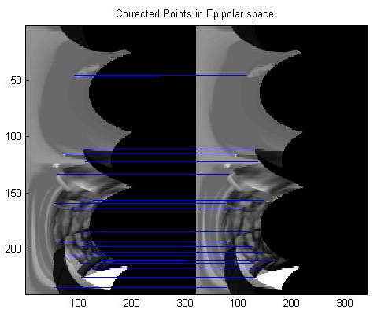
Alignment following LevMar Correction
Much better!

Slide 26
Results with real-world data
Previous slides generated using Blender
Full ground truth
Perfect telemetry/Objective “truth” to correct towards
Real-world data proved much messier
Vionics (thermal camera vendor) provided ground and airborne data collects
~5 hours of ground based thermal video
~15 hours of airborne thermal video
Telemetry generated via homegrown INS system rather than COTS (i.e. Microstrain GX4) solution
.5Hz GPS
Uncompensated Honeywell 3-axis magnetometer
Unfiltered 3-axis accelerometer
No ground truth due to LIDAR flights being very expensive: ~$15K for 3-4 hours!

Slide 27
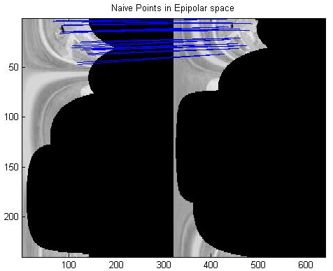
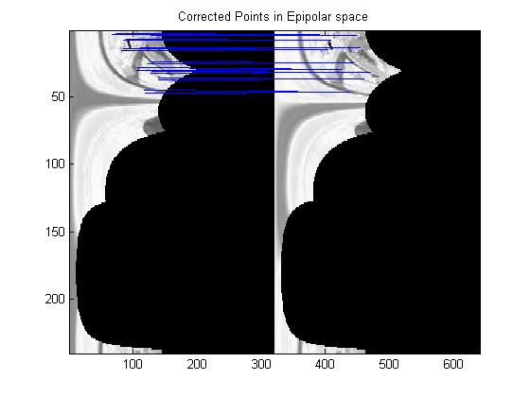
Short-term telemetry correction, real world

Slide 28
Telemetry Correction performance, simulated vs real-world, short-term
Single frame-to-frame correction
Simulated Data had .5 rad added to Roll, pitch, yaw
Real-world data used as is
Conclusion:
LevMar Correction works short term on real-world thermal data
 | Average Absolute Vertical Error, Naive | Average Absolute Vertical Error, Corrected
Simulated Data | 33.85 pixels | .03 pixels
Real-world Data | 4.32 pixels | .58 pixels

Slide 29
Long-term telemetry correction, real-world
To achieve the necessary depth resolution, need to maintain alignment on baselines of 50-100m
100-300 frames of airborne video
Airborne telemetry was stable over 20-30 frames, but beyond was essentially chaotic, with reported roll, pitch, yaw rates >3deg/sec – not realistic for light aircraft!
LevMar helped, but not enough:

Slide 30
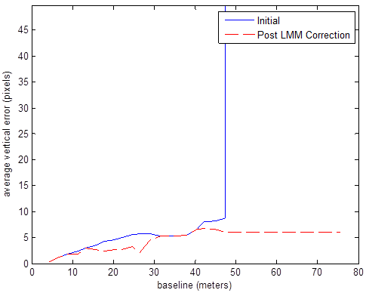
Long-term telemetry correction, continued
To see if LevMar works for longer baselines, identified sequences where GPS indicated aircraft was flying along fixed heading with constant altitude
Replaced roll with median of roll in the sequence, same with pitch
Course over ground from GPS used for heading
Using smoothed data, able to maintain <5 pixel vertical error for 30m baseline and <10 for 50m

Slide 31
Final Results:
False Color Thermal Image
Computed Depth Map (m)

Slide 32
Conclusions
Determined that algorithms are very sensitive to bad telemetry so more work is needed to make this a robust solution
However, core algorithms behind RIPIR work:
Can correct small telemetry errors if the telemetry resembles the imagery behavior
Can track points in thermal imagery well enough to compute a correction
Can generate highly accurate depth maps from a forward looking camera using simulated data
Low-cost thermal cameras provide good enough imagery that depth maps with reasonable accuracy are possible (~30% error based on 1st order trig approximation)

Slide 33
Proposed Next Steps
Repeat data collection efforts with LIDAR for ground truth and better telemetry collection system!
Model uncertainty – how much will obscurants like smoke/haze/fire affect depth measurements?
Determine how to deal with moving objects in the scene – UAVs will have to avoid moving objects like blowing trees
Determine if Levenburg-Marquadt approach supports visual navigation in GPS-denied environments

Slide 34
Questions?

