Slide 1
Parameter-Free ROI Detection
Spectral Anomaly × Spatial Coherence → Stouffer Combination

Slide 2
Overview
Pipeline
1
2
3
4
5
6
Preprocess
Scale Estimation
Spectral Anomaly
Spatial Coherence
Combine
ROI Extraction
Detrend + cast to single
LoG scale-space → cell radius
FFT → background-corrected Z
Neighbor correlation Z-score
Stouffer: (Z₁ + Z₂) / √2
Watershed → ranked basins
No user-defined thresholds or scale parameters — every decision is derived from the data itself

Slide 3
Preprocessing & Scale Estimation
Stage 1/2
1
Preprocessing – Remove linear ramp
2
Cell Scale Estimation
Linear temporal trends (photobleaching, illumination drift) are removed from every pixel's time series independently using detrend. The stack is then cast to single precision, halving memory and arithmetic cost throughout the pipeline.
The temporal variance image is computed — pixels with signal have higher variance. A normalised Laplacian-of-Gaussian scale-space search on a 4× downsampled version finds the dominant blob scale, giving cell radius with no user input.
Derived automatically from cell radius:
neighborRadius ≈ cell radius (coherence kernel spans one cell body) BG_SIGMA = cell radius × 6 (background >> cell scale)

Slide 4
Spectral Anomaly Score
Stage 3
Core Idea
Cell's activity has a characteristic temporal frequency signature — it oscillates or responds at specific frequencies that differ from the surrounding background tissue.
Exploit by computing each pixel's power spectrum and asking: does this pixel's spectral shape look anomalous relative to what we'd expect from a patch of background at the same location in the field of view?
Pixels whose frequency content stands out from their local spatial context are flagged as candidates.
1
FFT
Compute single-sided power spectrum along the time axis for every pixel
2
Normalize
Divide each pixel's spectrum by its total power → brightness-invariant shape
3
Background
Downsample → large Gaussian blur → upsample back to estimate the slowly-varying spatial spectral background
4
Residual Z
Subtract background spectrum; divide by IQR-based robust sigma per bin → z-score per frequency per pixel
5
Wilson-Hilferty
Sum z² across bins (chi-squared); apply cube-root transform to get a single well-scaled N(0,1) score per pixel

Slide 5
Spatial Coherence Score
Stage 4
Core Idea
Block average
A real cell activates as a unit — its pixels move together.
Measure how strongly each pixel co-varies with its immediate spatial neighbors.
Cross-pixel, time-domain measure, fundamentally orthogonal to the single-pixel spectral score.
8 consecutive frames averaged → T/8 temporal samples. Coherence is spatial; full frame-rate resolution is wasted work.
Center exclusion
Neighborhood kernel has center pixel zeroed — prevents self-correlation inflating r toward 1.
Pearson r
Correlation between each pixel's trace and its neighborhood mean trace.
Effective df
Bayley-Hammersley correction for temporal autocorrelation prevents anti-conservative z-scores.
Fisher r-to-z
atanh(r) × √df gives an approximately N(0,1) z-score that never saturates.

Slide 6
Combine & Extract ROI
Stage 5/6
Stage 5 – Stoffer Combination
Stage 6 – ROI Extraction
Z_combined = (Z_spectral + Z_spatial) / √2
Clamp at zero
Negative pixels are below the empirical background median. Clamping collapses them into one background basin rather than thousands of trivial ones.
Watershed
Both maps are rescaled by their empirical median and MAD so background pixels sit at z ≈ 0 on both axes regardless of theoretical null assumptions.
Segments the combined z-score surface into basins. Merge depth = MAD of the surface — shallow noise basins merge up automatically.
Score all basins
Combination done entirely in z-score space — no p-value is ever computed, so there is no numerical saturation for strong signals.
Every basin scored by mean combined z. No basin is discarded.
Stouffer is valid here because spectral (frequency-domain, single-pixel) and spatial (time-domain, cross-pixel) measures are derived from orthogonal signal properties.
Rank
Output is a fully ranked label image. Label 1 = most significant. Inspect the score distribution for a natural elbow.

Slide 7
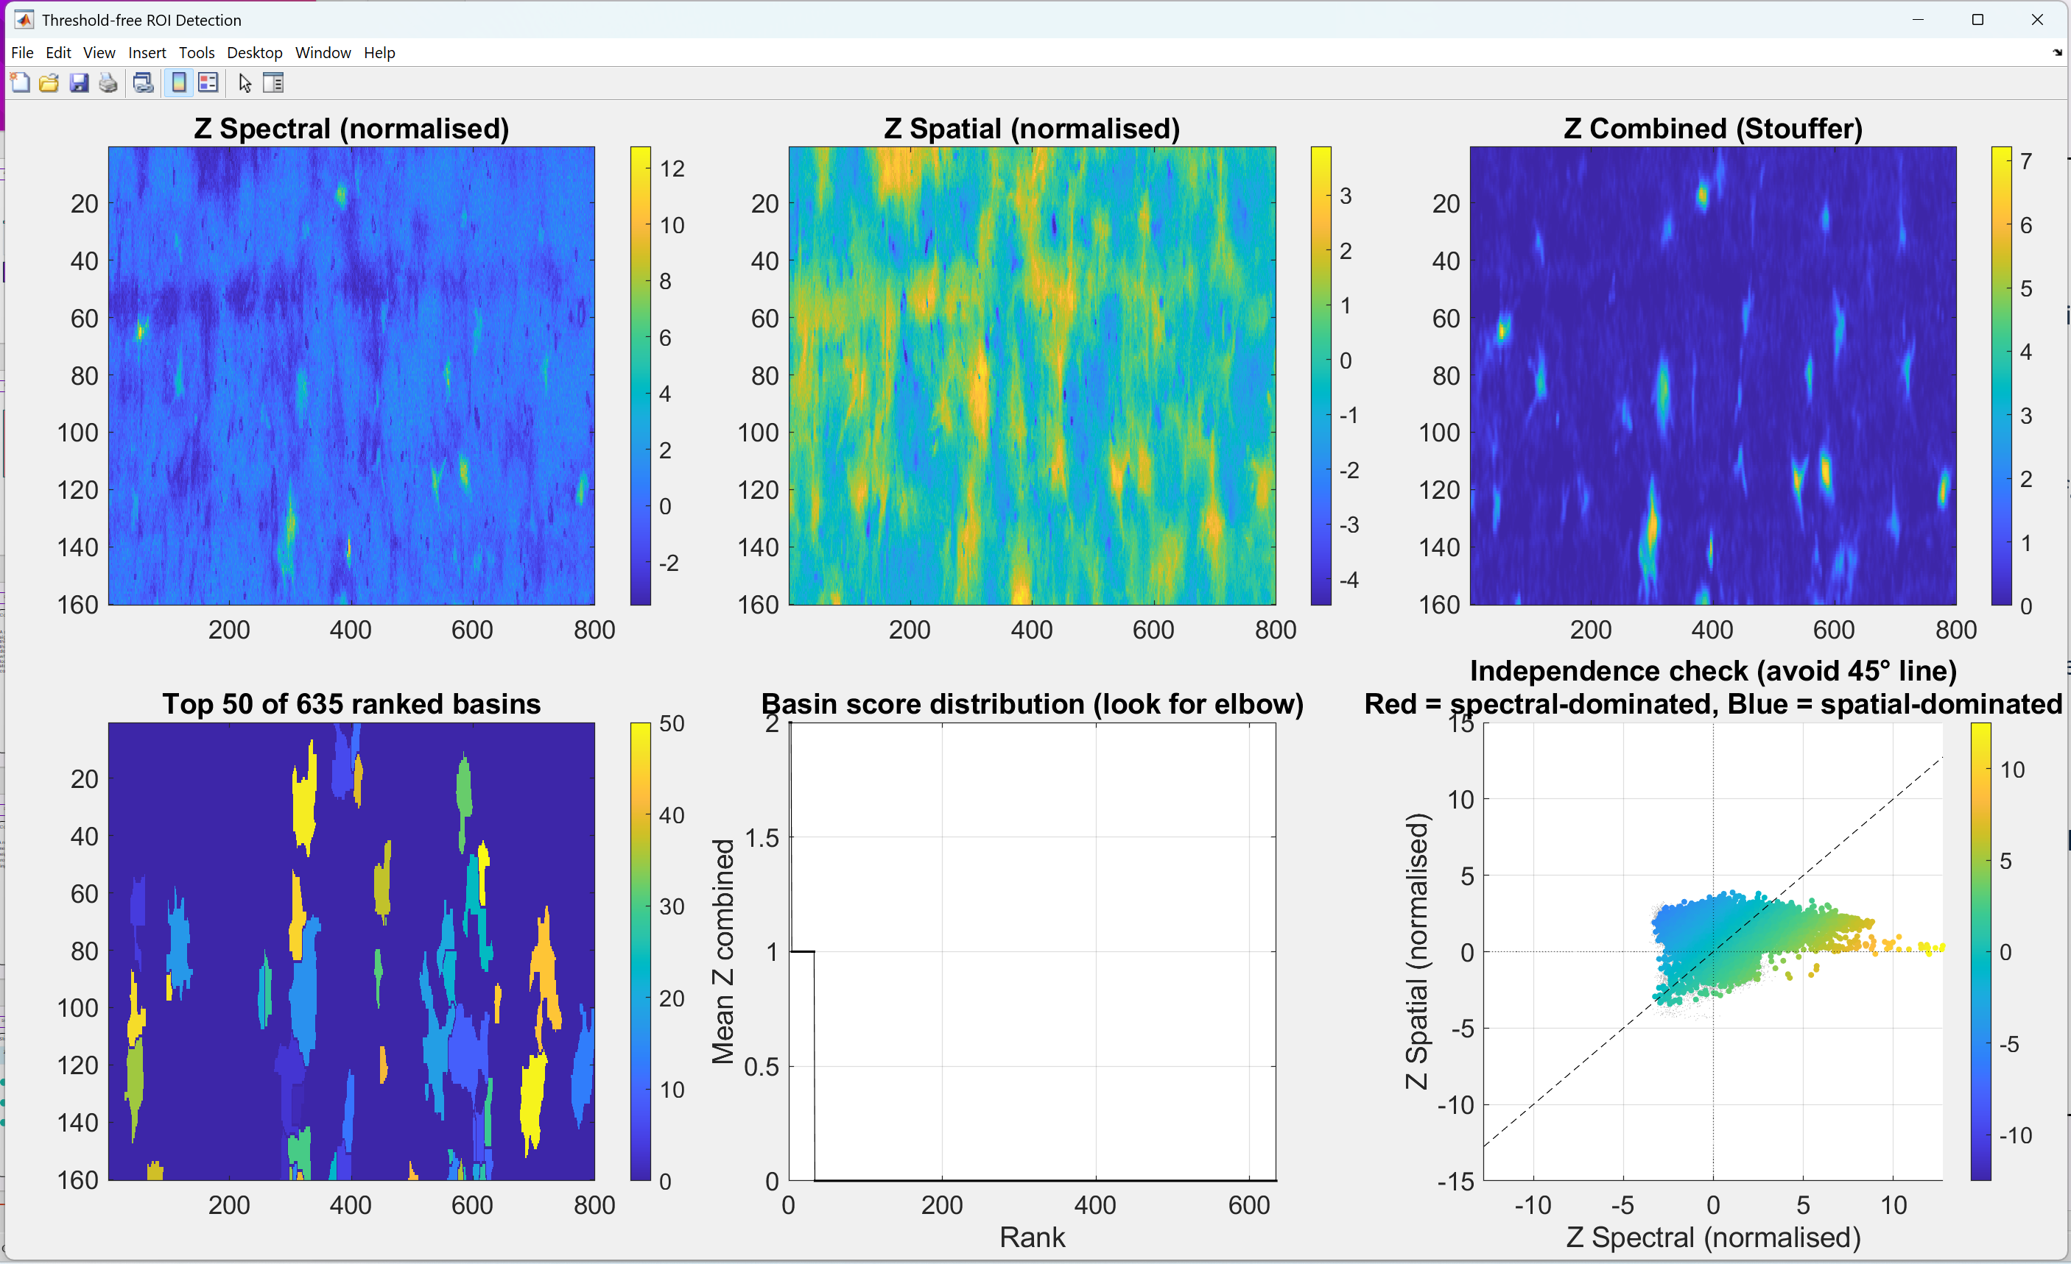
Pipeline output

Slide 8
Key takeaways
No free parameters
Cell scale, neighborhood radius, and background sigma are all derived from the data via LoG scale-space.
No thresholds
All basins are ranked by score. The user inspects the score distribution for a natural elbow — nothing is hard-cut.
Saturation-free
Stouffer combination in z-score space never computes a p-value, avoiding the CDF saturation that breaks Fisher's method on strong signals.
Orthogonal evidence
Spectral (frequency-domain, single-pixel) and spatial (time-domain, cross-pixel) scores measure independent properties of the data.
Background-corrected
Large-Gaussian local background subtraction removes scene-wide illumination gradients from the spectral score before any comparison.

Slide 9
Full citation list:
Scheefhals N et al. "SpecSeg segments neurons and neurites in chronic calcium imaging datasets based on low-frequency cross-spectral power." Cell Reports Methods 2(10), 2022.
Jiang Z et al. "A Preprocessing Toolbox for 2-Photon Subcellular Calcium Imaging." eNeuro 12(5), 2025.
Pachitariu M et al. "Suite2p: beyond 10,000 neurons with standard two-photon microscopy." bioRxiv, 2017.
Stouffer SA et al. The American Soldier: Adjustment during Army Life. Princeton University Press, 1949.
Whitlock MC. "Combining probability from independent tests: the weighted Z-method is superior to Fisher's approach." Journal of Evolutionary Biology 18, 2005.
Winkler AM et al. "Non-parametric combination and related permutation tests for neuroimaging." Human Brain Mapping 37(4), 2016.
Bragantini J et al. "Split and Merge Watershed: a two-step method for cell segmentation in fluorescence microscopy images." Biomedical Signal Processing and Control 2021.

