Slide 1
htb — Connectivity Imaging Toolbox
Digital Twining for optogenetic protocol design

Slide 2
Protocol choice determines success — not hardware
The Problem
Three coupled problems:
Spatial encoding — which cells to stimulate together so individual contributions can be separated
Temporal encoding — what waveform shape and duration to use given indicator kinetics
Robustness — does the protocol work across different preparations, not just one network?
Poor protocol choice → F1 below 0.3 on perfectly good hardware.
htb solves this by simulating the full measurement chain and searching protocol space with Bayesian optimisation.
Each trial evaluated on 5 independent networks — mean F1 is quality, std F1 is robustness.
htb bootstraps protocol tuning
for better experimental results

Slide 3
System Overview
Architecture
Six-layer stack — runners delegate down, results surface up
Runner Scripts
run_sweep · run_balanced_sweep · run_pipeline · run_joint · run_drug_screen · run_variability · run_sensitivity
Analysis Layer
ProtocolOptimizer · BalancedOptimizer · PrepVariability · SensitivityAnalyzer · ConnectivityPipeline · SinglePassOptimizer
Simulation Layer
Simulator — builds E/I network, runs Numba JIT physics, applies neuropil contamination, delegates mask logic
Mask Layer
HadamardMask · SingleCellMask · RandomSubsetMask · MultiScaleHadamardMask · SimplexMask
Protocol &amp; Parameter Layer
BioParams · StimProtocol · HadamardDesign · AnalysisConfig
Numba JIT acceleration: ~50–100× speedup vs NumPy. ~10s warmup on first run, cached thereafter.

Slide 4
Biophysical Simulation Model
Simulation
What the simulator models
Simulation pipeline
E/I network
Random cell positions, synaptic weights, conduction delays
Indicator dynamics
Biexponential rise/decay from BioParams
Neuropil contamination
F_obs[i] = F_soma[i] + r × Gaussian-avg(neighbors) r ≈ 0.7 for 2-photon
Shot + read noise
noise_sigma — calibrate from dark frames
Opsin drive
r_stim = power × opsin_sensitivity — calibrate from patch-clamp power series
1. Build random E/I network
Cell positions, W matrix, synaptic delays
2. Mask: unit assignment + stim_profile
Which cells are illuminated in each pattern
3. Build light drive r_light (JIT)
N_cells × N_t array, waveform-shaped per trial
4. Neural simulation (JIT)
Spikes → Ca → fluorescence → dF/F
5. Extract responses + reconstruct C
Mask matched filter or least-squares
6. Score vs W_unit_weights
weight_corr + E_f1 + I_f1

Slide 5
Spatial Encoding Strategies
Masks
Hadamard (recommended for E/I)
Cells → spatial blocks. Binary S-matrix patterns. Matched filter reconstruction. N patterns for N blocks. Use finest block size from recommended_block_sizes() for best E/I separation.
Single Cell
One pattern per cell — cleanest E/I separation, direct readout. Cost: N_cells patterns per rep. Best for validation and small networks (N ≤ 80).
Mask selection rule:
Balanced sweep → fine-scale HadamardMask
Validation → SingleCellMask
Random Subset
~50% of cells ON per pattern. Least-squares reconstruction. Separates E/I without spatial structure. Requires n_patterns ≥ 4 × N_cells and short ISI.
Simplex (real data)
Blob-based patterns from widefield pre-movie. Simplex vertex design minimises pairwise overlap. Run run_premovie.py first to detect cell positions, then load blobs.npz.

Slide 6
Balanced E/I Recovery
Balanced E/I
The asymmetry problem
The solution: balanced_ei_f1
Objective
Inhibitory cells are ~20% of neurons — their signal is diluted when grouped into spatial blocks.
A threshold tuned to detect the majority E class systematically misses smaller I signals.
Standard composite score weights I_f1 at only 15%, reinforcing the asymmetry.
Independent threshold sweeps per class — E and I each find their own best threshold from quantiles of |C|.
Macro averaging:
balanced_F1 = 0.5 × E_F1 + 0.5 × I_F1
Equal weight regardless of class size.
Fine-scale HadamardMask minimises E/I mixing within blocks — use recommended_block_sizes()[-1].
final_score =
balanced_F1 × (1 − w × t_norm)
t_norm = experiment_time / budget
duration_weight:
0.0 → maximise F1 regardless of time
0.3 → mild efficiency pressure (default)
1.0 → maximise F1 per unit time
Output: Pareto frontier of time vs balanced F1, E vs I scatter, robustness panel.

Slide 7
Pipeline Workflows
Workflows
run_sweep
+ run_variability
Connectivity only
1. Bayesian protocol search (Optuna TPE, 8 parameters)
2. Validate F1 across 50+ simulated preps
3. Sensitivity analysis — rank which BioParams matter
Typical time: 5–15 min
Output: best StimProtocol
run_balanced_sweep
Balanced E & I recovery
1. Fine-scale HadamardMask
2. Cross-network eval on 5 networks per trial
3. Duration-efficiency tradeoff (duration_weight)
4. Pareto frontier output
Typical time: 30–60 min
Output: Pareto plot + best protocol
run_pipeline
/ run_joint
Connectivity + PSP shapes
Stage 1: Hadamard sweep → connectivity matrix C
Stage 2: prior-informed targeted PSP — stimulate only known sources per target (5–10× fewer trials)
Typical time: 10–60 min

Slide 8
Cross-Network Evaluation
Validation
Why cross-network, not cross-validation?
Design properties
5-fold CV on a single simulation splits trials from one fixed network.
It tests data efficiency — how many reps you need — but not generalisation.
Every fold trains and evaluates on the same cells with the same weights.
Cross-network evaluation runs each candidate protocol on 5 independently sampled networks: different cell positions, different synaptic weights, different random seeds.
This directly answers: will this protocol work on a new animal or slice?
Mean F1 across networks = protocol quality
Std F1 across networks = prep-to-prep robustness
A protocol scoring 0.80 ± 0.03 is far more deployable than one scoring 0.85 ± 0.18.
Fixed eval seeds:
Seeds 100–107 are fixed across all Optuna trials so every candidate protocol is scored on exactly the same networks. Prevents lucky network draws inflating scores.
Separate from TPE seeds:
rng_seeds [7, 42, 123...] drive the Optuna sampler, not the evaluation. The sampler never sees the networks it is scored on.
n_eval_seeds:
3 — fast, catches failures
5 — recommended default
8 — final validation runs

Slide 9
Cross-Network Evaluation
Validation
Candidate protocol is evaluated on 5 independently sampled networks
Network seed=100 (new cells, new W)
F1 = X.XX
Network seed=101 (new cells, new W)
F1 = X.XX
Score = mean F1
Robustness = std F1
StimProtocol
candidate
Network seed=102 (new cells, new W)
F1 = X.XX
Network seed=103 (new cells, new W)
F1 = X.XX
Network seed=104 (new cells, new W)
F1 = X.XX
Low std = protocol generalises to new animals. Eval seeds (100–107) are fixed across all Optuna trials — every protocol is scored on the same set of networks.

Slide 10
Scoring Metrics & Roadmap
Metrics, Roadmap
Standard composite score
score = 0.50 × weight_corr + 0.35 × E_f1 + 0.15 × I_f1
Used by run_sweep, run_pipeline, run_joint.
Balanced E/I F1
balanced_f1 = 0.5 × E_f1 + 0.5 × I_f1
Independent threshold sweeps per class. Used by run_balanced_sweep.
Score interpretation:
> 0.8 — Excellent: reliable for drug screens and comparisons
0.6–0.8 — Good: suitable for most connectivity analyses
0.4–0.6 — Marginal: increase reps or recalibrate BioParams
&lt; 0.4 — Poor: check opsin sensitivity, noise, or protocol bounds
Note: F1 values reported are oracle estimates (best threshold over ground truth). They are upper bounds on deployment performance.
Next 1–3 months:
Biological variability model
Sample BioParams from a prior distribution per eval seed so cross-network eval also covers parametric uncertainty.
PSP protocol optimiser
Dedicated run_psp_sweep.py — search stim_dur, ISI, power for Stage 2 given a fixed Stage 1 result.
LASSO reconstruction
AnalysisConfig.use_lasso already stubbed. Sparse reconstruction improves I recovery in low-SNR conditions.

Slide 11
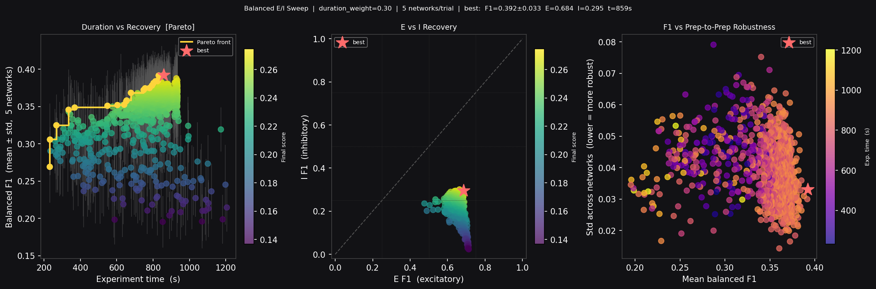
Protocol Design for Maximal E/I Network Recovery – One protocol to rule them all
Results
Best protocol (paste into run_drug_screen.py / run_variability.py):
best_protocol = StimProtocol(
stim_dur=1.8038, stim_min_isi=2.2538,
illumination_power_mw=1.7398,
n_pulses=5, pulse_width_frac=0.3415,
intensity_start=0.6379,
intensity_end=0.0192,
pre_stim_quiet_s=0.2729,
)
BALANCED SWEEP — RESULT
Final score: 0.2746 (duration_weight=0.30)
Balanced F1: 0.392 ± 0.033 (5 networks)
E F1: 0.684 (~301 true E connections)
I F1: 0.295 (~67 true I connections)
Experiment time: 859s (100% of 100s budget)
N patterns: 127 × 3 reps
Protocol: ramp_down n=5 duty=0.34 amp=0.64→0.02 pre=0.27s dur=1.80s isi=2.25s pwr=1.74mW/mm²
════════════════════════════════════════════════════════════════════

Slide 12
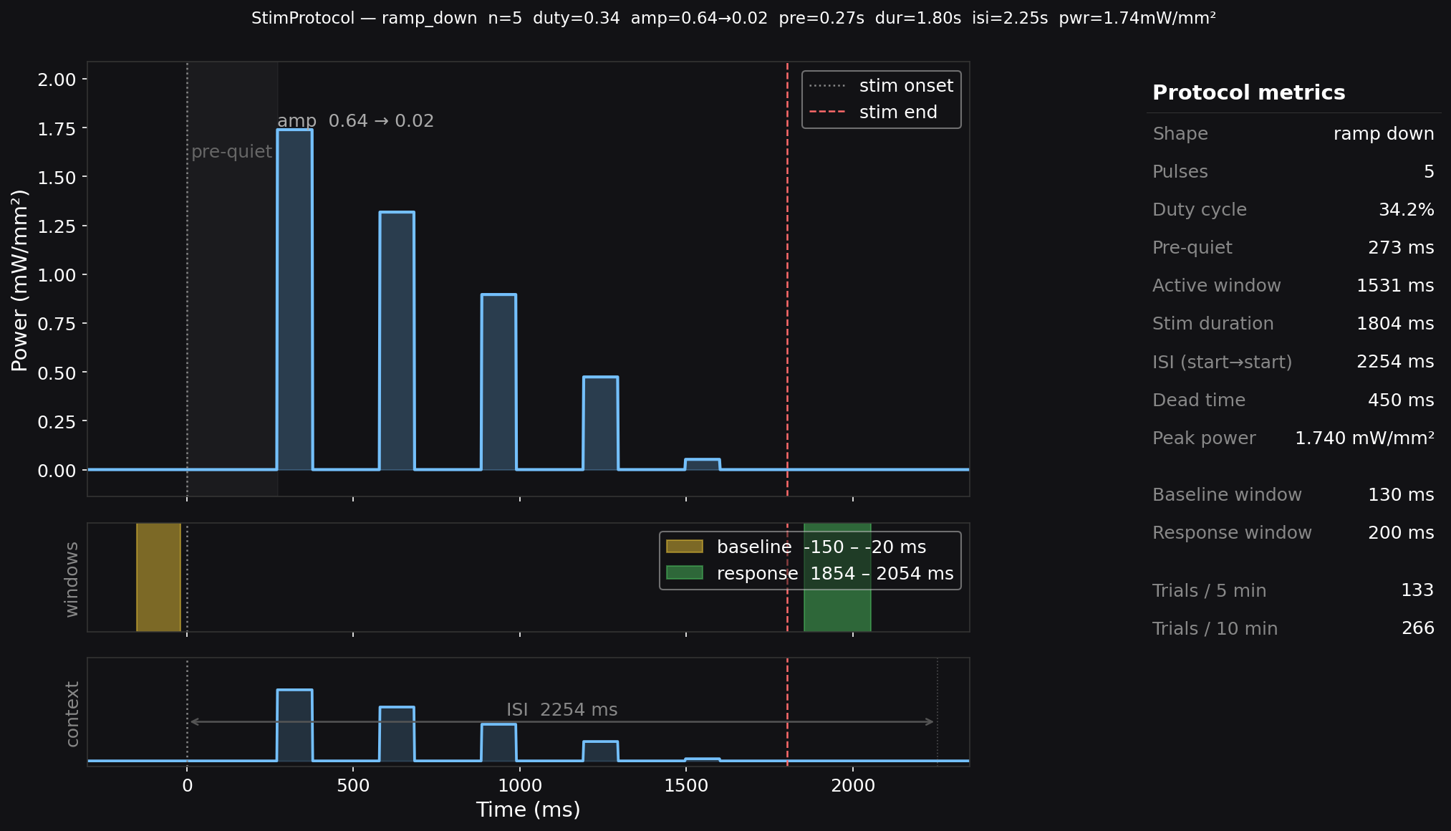
Waveform Design
Goal was to maximize network recovery with some weighting for experiment duration. Other goals may have different shapes

Slide 13
Key Parameters
Results are only as good as the calibration.
tau_ca_rise / tau_ca_decay | Indicator spec sheet or fit to step data
dF_F_max / noise_sigma | Peak dF/F from spec sheet; noise from dark frames
opsin_sensitivity_hz_per_mw | Patch-clamp power series.
conn_prob | Literature or EM reconstruction for brain region
w_excit_mean | Paired patch-clamp recordings if available
r_spont | Spontaneous activity recording
neuropil_r | Estimate from blank-shutter frames
N_cells, N_px_x/y | Acquisition system settings and ROI detection count
Literature or EM reconstruction for brain region
Paired patch-clamp recordings if available
Spontaneous activity recording

Slide 14
Wrap Up
htb enables informed trades between protocol duration and anticipated experimental results

Slide 15
htb — Connectivity Imaging Toolbox
Six capabilities in one framework:
Full biophysical simulation · Bayesian protocol search · Balanced E/I recovery
Cross-network robustness evaluation · PSP fitting · Drug screen simulation
For questions and collaboration

