Slide 1
Beyond The CPU:
Defeating Hardware Based RAM Acquisition
(part I: AMD case)
Joanna Rutkowska
COSEINC Advanced Malware Labs
Black Hat DC 2007
February 28th, 2007, Washington, DC

Slide 2

Focus
In this presentation we focus on x86/x64 architecture, and specifically on AMD64 based systems.

Slide 3
Why do we need RAM acquisition?
Find out whether a given machine is compromised or not
Forensic Analysis
  Find out how malware “works”
  Use as an evidence
Most forensics analysts focus on persistent memory – i.e. hard disk images
This is obviously not enough, because malware can be non-persistent
So, we need a reliable way to get an image of RAM…

Slide 4
Approaches to memory acquisition
Software-based
  Usually uses /dev/mem or \Device\PhysicalMemory
  Requires additional software to be run on a target system
    e.g. dd/dd.exe, EnCase (?), ProDiscover(?)
Hardware-based
  e.g. a PCI or PCMCIA card
  Uses DMA access to read physical memory
  No additional software on the target machine required
  OS-independent

Slide 5
Software-based acquisition
Not reliable!
  Can be cheated by malware which runs at the same privilege level as the imaging software:
    Shadow Walker Rootkit
    \Device\PhysicalMemory memory hooking
    Implementation Specific Attacks against acquisition software
Requires additional software on the target machine!
  This violates the requirement that forensic tools shall not cause data to be written to the target machine

Slide 6
Hardware-based solutions
Reliable!
  Direct Memory Access does not involve CPU
  Acquisition device “talks” directly to the memory controller
  Even if the whole OS is compromised, still we can get a real image of the physical memory
  “The real image” – i.e. the same image as the CPU sees
No additional software on the target – good!
Possible race conditions when reading memory, because systems (i.e. CPU) is still “running”…
  Is it possible for a PCI device to freeze the host’s CPU?

Slide 7
Hardware-based solutions
Tribble by Brian Carrier & Joe Grand
  A dedicated PCI card for RAM acquisition, presented in 2004
  http://www.grandideastudio.com/portfolio/index.php?id=1&prod=14
  Still not available for sale :(
CoPilot by Komoku
  A dedicated PCI card – could be used for online system integrity monitoring and for RAM acquisition
  http://komoku.com/technology.shtml
  “not generally available right now“ :(
RAM Capture Tool by BBN Technologies
  A dedicated (PCI?) card for RAM acquisition
  http://www.tswg.gov/tswg/about/2005_TSWG_ReviewBook-ForWeb.pdf
  Not available?
Using FireWire bus
  http://cansecwest.com/core05/2005-firewire-cansecwest.pdf
  http://www.security-assessment.com/files/presentations/ab_firewire_rux2k6-final.pdf

Slide 8
How does hardware-based RAM acquisition work?

Slide 9
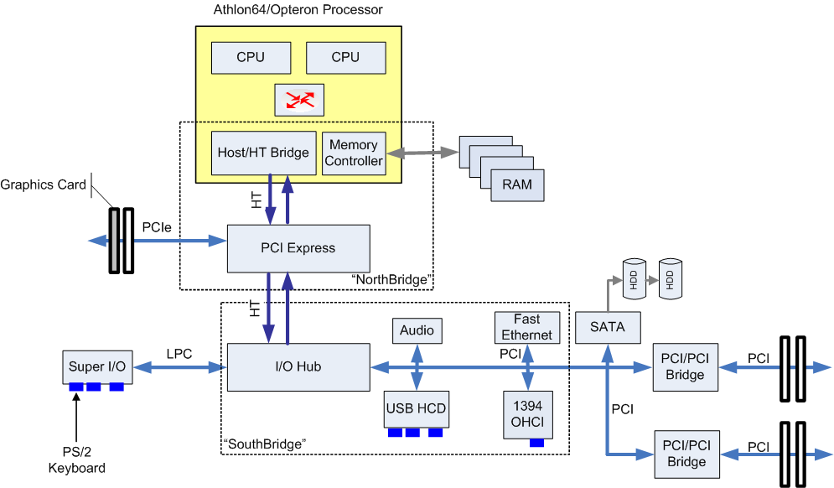
AMD System ex. (Single Processor)

Slide 10
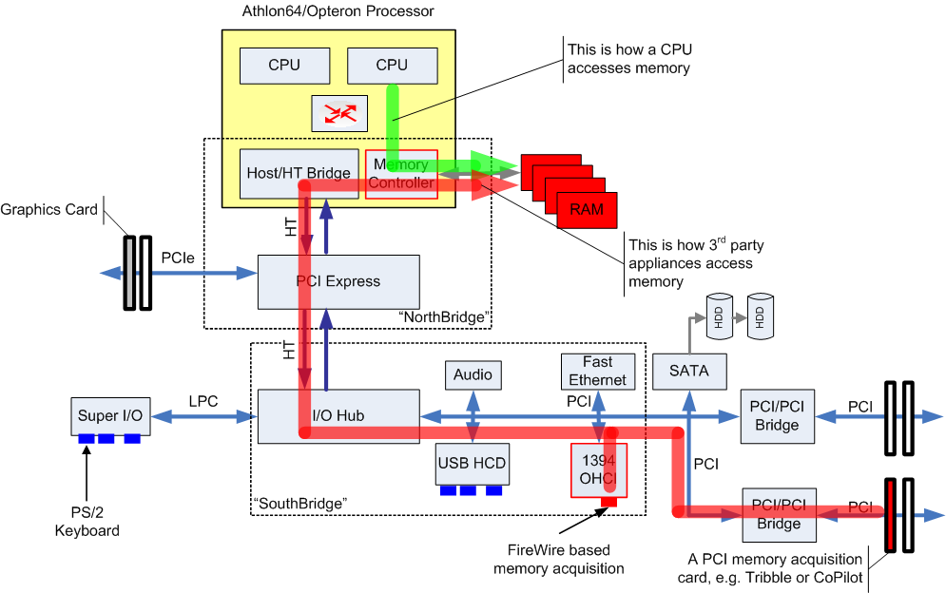
Accessing Physical Memory

Slide 11
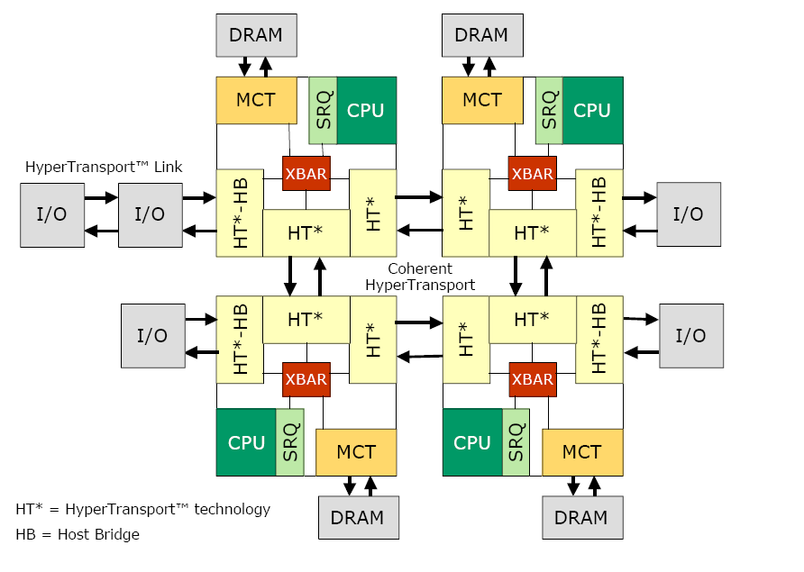

Multi Processor Systems (Opteron)
Source: developer.amd.com

Slide 12
So far, so good!

Slide 13
Attacks!

Slide 14
Attacker’s goals
“DoS Attack”
  Crash/Halt machine when somebody tries to acquire RAM using DMA
  Can cause huge legal consequences for the investigator
“Covering Attack”
  Acquisition tool can not read some part of physical memory – instead it reads some garbage (e.g. 0x00 bytes).
  CPU sees the real content, which e.g. may contain malicious code and data
“Full Replacing Attack”
  Like Covering Attack, but the attacker can also provide custom contents (instead of “garbage”) for the acquisition tool

Slide 15
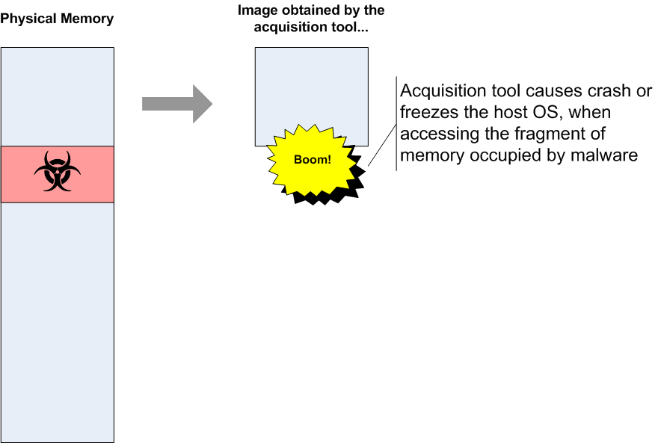
DoS Attack Illustration

Slide 16
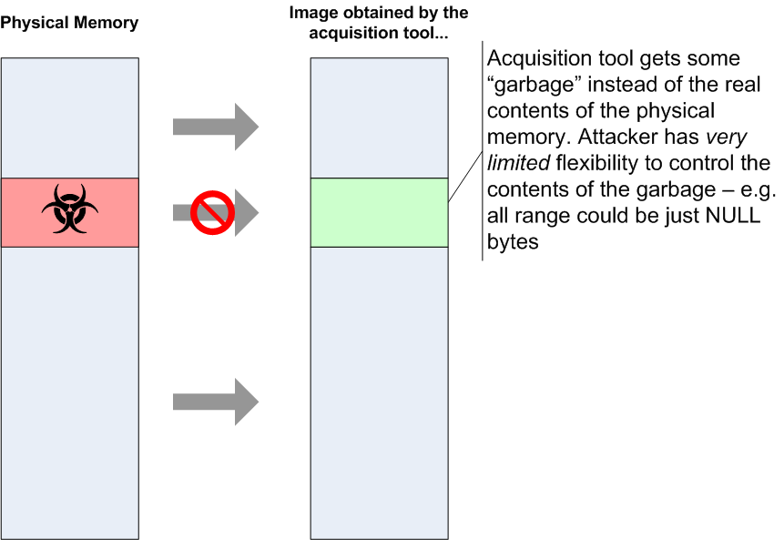
Covering Attack Illustration

Slide 17
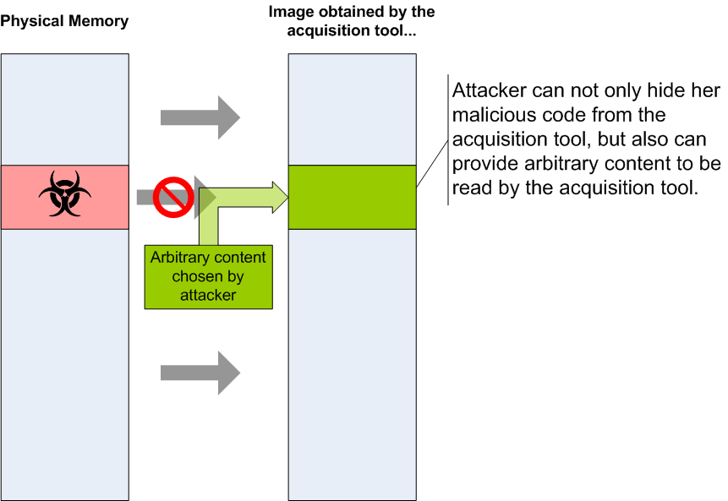
Full Replacing Attack Illustration

Slide 18
So how do we do this?

Slide 19
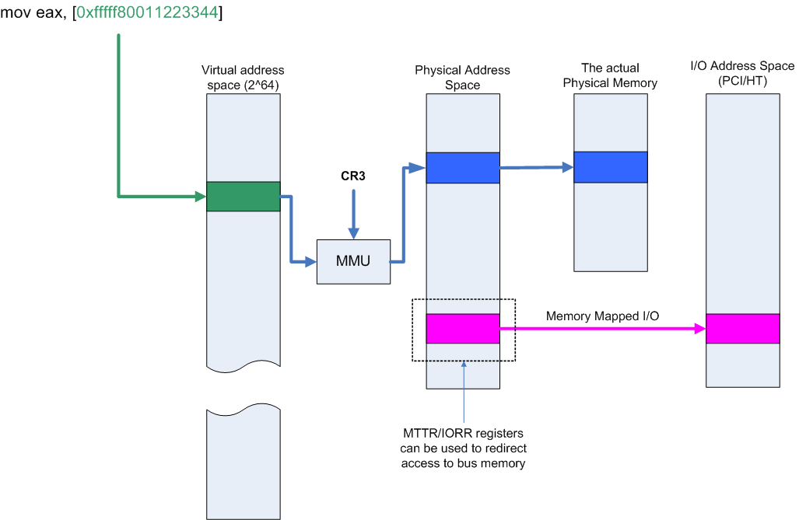
Memory Mapped I/O

Slide 20
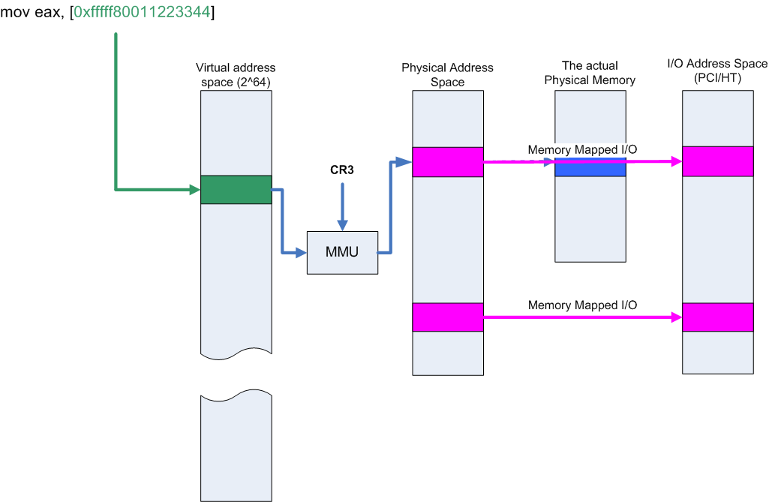
MMIO cont.

Slide 21
MMIO tricks
By using MTTR and IORR registers we can assign arbitrary range of physical pages to be mapped into bus address space
However, this is not what we want, because both processor and bus accesses would be redirected in the same way…
But keep this in mind…

Slide 22
North Bridge’s Memory Map
MTTR/IORR registers instructs the CPU, for a given physical address, whether to access the system memory or the bus address space (I/O space)
They have no effect on DMA accesses originating from I/O devices
DMA accesses are redirected by the Northbridge
So, there must be some kind of address dispatch table in the Northbridge…

Slide 23
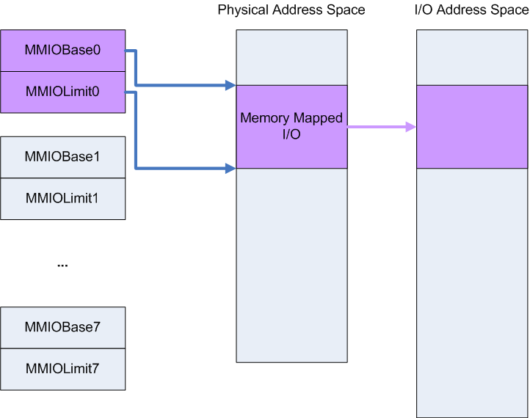
NB’s MMIO Address Map

Slide 24
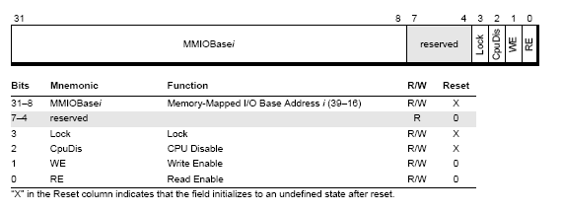
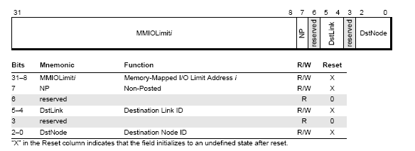
MMIO Map Registers

Slide 25
Where these MMIO accesses go?
Each PCI/HT device can set their address decoders to “listen” on particular range of I/O addresses
So, when Northbridge redirects access to address pa to I/O address space, then (hopefully) there will be a device who will respond to read/write request to address pa

Slide 26
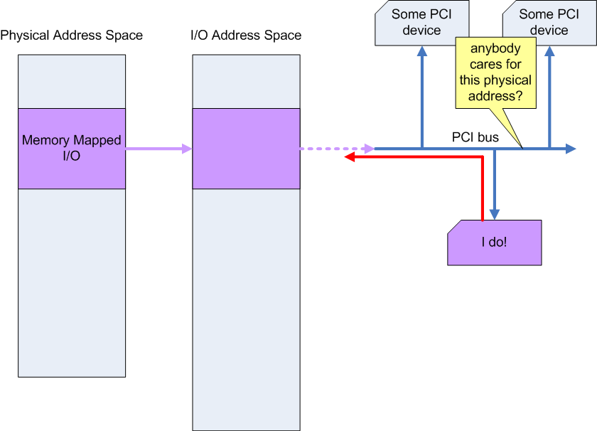
How MMIOs are handled

Slide 27
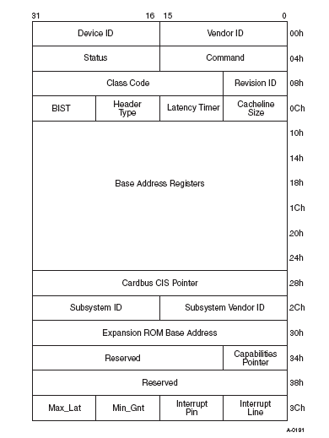
PCI device config space
Base Address
Registers
Expansion ROM Base Addr

Slide 28


Accessing PCI/HT config registers
Two dedicated I/O ports (to be accessed via IN/OUT instructions):
  0xCF8 – selects the address (Bus, Node, Function, Offset)
  0xCFC – data port

Slide 29
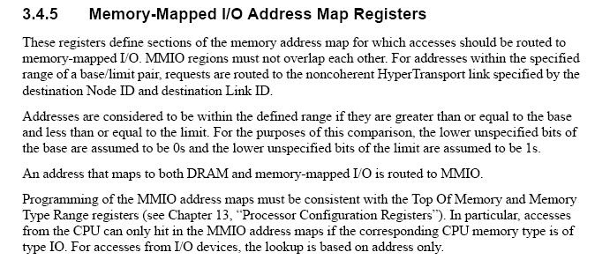
An interesting behavior
BIOS and Kernel Developer's Guide for AMD Athlon 64 and AMD Opteron Processors (Publication #26094), page 73.

Slide 30
Athlon/Opteron Northbridge
Northbridge’s Memory Configuration is accessible via HT configuration registers
HT configuration space is compatible with PCI configuration space
Each processor has its own Northbridge config space:
  But all cores share the same one!
Bus 0, Device 24-31, Functions 0-3
  Device 24 → Node 0’s Northbridge’s Config Space
  Device 31 → Node 7’s NB’s config space

Slide 31
AMD processors config space
Bus Address: Bus 0, Device 24-31,
Function 0: HyperTransport™ Technology Configuration
Function 1: Address Map ← Yes!
Function 2: DRAM Controller
Function 3: Miscellaneous Control
So, we’re interested in playing with
  Bus 0, Dev 24 (-31), Function 1
  Within this device, we want to play with Config Registers MMIOBase and MMIOLimit

Slide 32
Setting up the attack
We need to add additional entry to processor’s NB’s memory map
Let’s assume that we would like to cover physical memory starting from address pa1 until pa2
So, we need to redirect all access from I/O devices to that physical range (pa1–pa2) back to I/O…
First, we need to find i (from 0 to 7), so that MMIOBase[i] is NULL. This indicates an unused entry in the table…

Slide 33
Setting up the attack – cont.
Now we just need to set:
  MMIOBase[i].Base = pa1
  MMIOBase[i].RE = 1
  MMIOLimit[i].limit = pa2
And, of course, we do make sure that neither of MTTR/IORR registers marks this very range as MMIO from the CPU point of view
Now, all accesses to <pa1, pa2) from I/O will be redirected back to I/O. While access from CPU will get to the real memory!

Slide 34
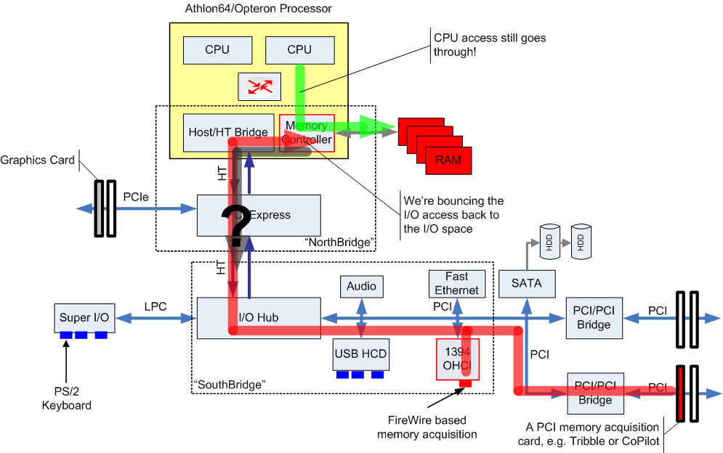
I/O Access Bouncing!

Slide 35
Deadlock!
So, what memory is actually read by the I/O device after we bounce the access back to the H/T bus?
After all, there is nobody on the HT link or PCI bus to answer the request to read that physical addresses…
Experiments showed that systems will hang after the acquisition tool will try to read bytes from such a redirected memory!
This is attack #1: DoS attack!

Slide 36
Getting around the deadlock
We need to find a device (on HT link or on PCI bus) that would respond to the read request for our physical address,
Usually there are many PCI Bridges in modern systems,
Usually most of them are unused – i.e. no secondary bus is attached,
We can use such a PCI bridge to be our “responder”.

Slide 37
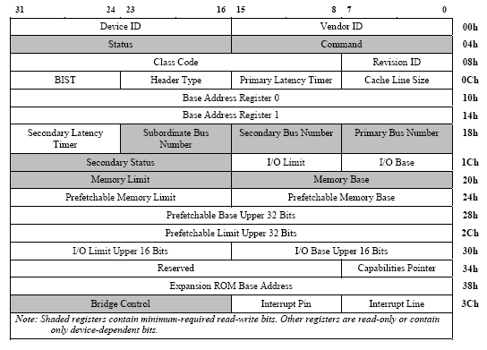
HT Bridge Config Registers

Slide 38
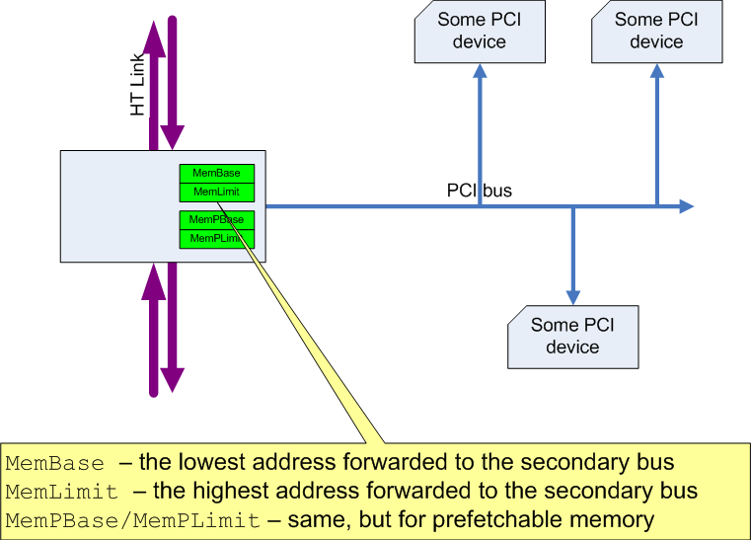
HT/PCI bridges

Slide 39
Using a bridge to solve the deadlock
We need to find unused bridge
  Usually this is not a problem,
  Also we might use both Non-Prefetachble and Prefetchable “part” of the bridge – just one of them should be unused.
Now we do:
  Bridge.Mem(P)Base = pa1
  Bridge.Mem(P)Limit = pa2
That’s all! :)
Now the bridge will respond to read access request on an HT link, effectively eliminating the deadlock :)
Experiments showed that the reading device will get bytes of value 0xff, for each redirected byte…
This is attack #2: The Covering Attack!

Slide 40
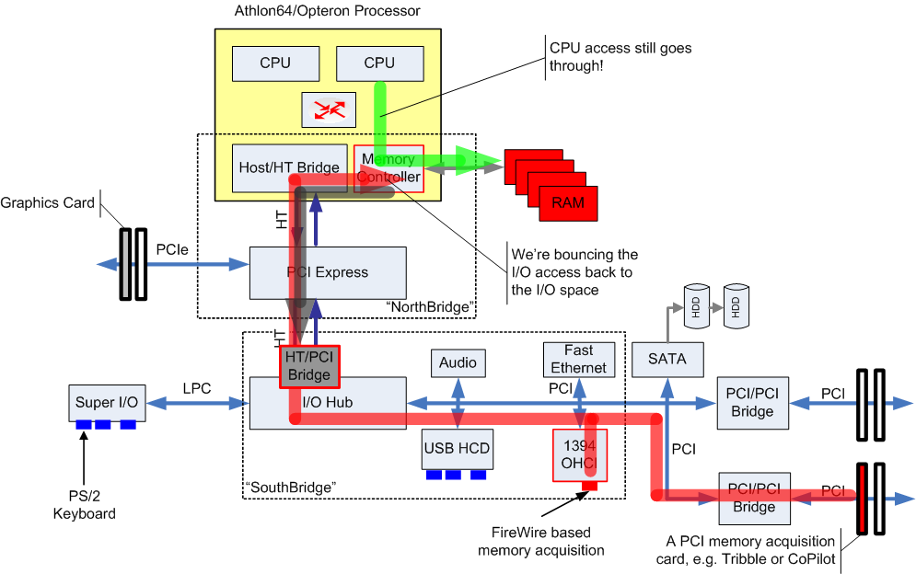
Bouncing Attack with PCI Bridge

Slide 41
Demo!

Slide 42
Full Replacing Attack Discussion
Using unused device’s RAM
Using device’s ROM memory
Using HT remapping capability

Slide 43
FRA: Using devices RAM (?)
We can remap one of the Base Address Registers of some device, so that device thinks that its memory has been mapped starting from pa1 address…
Then we need to fill the device’s memory with our arbitrary content…
Now, all access to pa1 from I/O devices will be redirected back to I/O and will be answered by the device whose memory we’ve stolen.
Problem – if the memory is really used for something, we will break the device’s functionality
  E.g. if we used graphics card memory and the card is really used to display some hi-res or 3D graphics…

Slide 44
FRA: Using device’s ROM (?)
Expansion ROM is not used after system initialization,
If the ROM is programmatically re-flashable (EEPROM) we can replace it with our content…
We then set ROM Base Address to pa1
Then the device will answer to all requests to read pa1+
Problems
  This is type I infection (and we don’t like type I infections!)
  Most likely will be easily detected when OS uses TPM to verify its booting process…
  Possible workaround: re-flash back, before rebooting the system… But, not elegant :(

Slide 45
Some Considerations
Because of the layout of MMIOBase and MMIOLimit registers both pa1 and pa2 should be 64kB aligned,
That also determines the minimal size of the region to be 64kB at least,
That means, in order to implement Full Replacing Attack, we need to find a PCI or HT device
  having at least 64kB of RAM memory
  having at least 64kB of reflashable ROM
That should not be a big problem – think about all those graphics cards we have today and that they are often used in servers which run in 80x25 text mode…

Slide 46
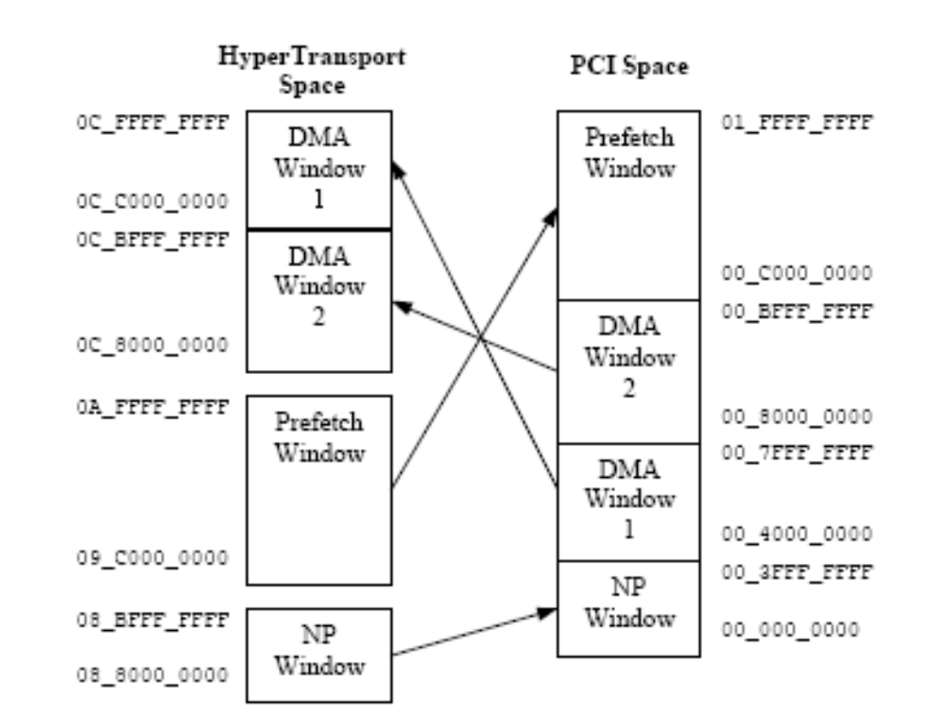
FRA: Using HT Remapping capabilities
Some HT bridges may implement Address Remapping Capability, which supports so called “DMA Window Remapping”:

Slide 47
FRA: Using HT Remapping capabilities
Problem: there must be at least one such HT bridge in the system which supports this functionality,
On all authors AMD systems that was not the case,
However that seems like a very flexible and powerful technique,
Further research is needed.

Slide 48
Defense?

Slide 49
Defense?
Maybe a smart PCI device could remove the malicious entry from the Northbridge’s map table?
It’s not clear whether PCI device can access Northbridge’s config space (i.e. Bus 0, Dev 24-31)?
  I don’t know the answer
Even if they could…
…they should not be able to remove the offending entry!
The “lock bit” is to assure that!

Slide 50
The “Lock” Bit

Slide 51
Locking the MMIO entry
If we set the lock bit in MMIO entry, this entry will become read-only!
  This means, nobody will be able to modify it without rebooting the system!
PCI/HT device can not remove our malicious MMIO entry!
  even if the device is smart enough to find it!
It seems then, that:
There is no way to defeat this hack, using a hardware only solution!

Slide 52
Demo

Slide 53
Repercussions
DoS Attack: investigator who causes system crash/hang might face legal actions for disturbing the work of mission critical servers.
Covering Attack:
  Makes it impossible to analyze malware (even though we might find its “hooks” in case of type I and II malware),
  We can’t learn how it works and in consequence can’t find the “bad guys” behind it :(
Full Replacing Attack
  Full stealth even for type I and type II malware
  Falsify digital evidences → legal consequences

Slide 54
The Near Future: IOMMU
Arbitrary translations between address space seen by the PCI/HT devices and the physical memory
Using IOMMU to cheat hardware based acquisition will be trivial
AMD and Intel are expected to release processors/northbridges fully supporting IOMMU in 2008
  IOMMU will be part of the hardware virtualization extensions
say goodbye to hardware based memory acquisition :(

Slide 55
Final notes
Hardware based memory acquisition was considered as the most reliable way to gather evidence or check system compromises…
Now, when it has been demonstrated that it is not that reliable as we believed, the question remains:
What is the proper method to obtain image of volatile memory?
  We live in the 21st century, but apparently can’t reliably read memory of our computers!
Maybe we should rethink the design of our computer systems, so that they were somehow verifiable…

Slide 56
Thank you!
joanna@research.coseinc.com

