Slide 1

CloudFormation 101
Dave Pigliavento

Slide 2
What is CloudFormation?
CloudFormation is a zero cost AWS service for provisioning resources in a predictable, repeatable and automated way.
** While CloudFormation does not cost anything the resources CloudFormation provisions do

Slide 3
Why Use CloudFormation?
No more clicking
How do you know what changed and when?
Infrastructure as code
version controlled, know exactly what changed and when
Easy to integrate in deployment pipeline
Easy to replication infrastructure
Build a common set of templates used across your organization

Slide 4
Rules of the Road:
Do not start with CloudFormation!
Learn first in the console
Understand available options for a given service before jumping into CloudFormation
Don’t reinvent the wheel
Find a template online to start with
CloudFormation designer is a GUI tool for authoring templates
Do not manually change resources CloudFormation deployed
Future updates could potentially fail as a result

Slide 5
CloudFormation Concepts
Template
AWS infrastructure blueprint
JSON or YAML formatted document
Stack
A collection of resources that are managed as a single unit
Group resources that live the same lifecycle in a single stack
Change Set
dry-run for updating an existing stack
provides the list of actions that will be taken

Slide 6

Update behavior of stack resources
Updates with no Interruption
Updates with Some Interruption
Replacement
Unintended Resource Deletion
Be careful with certain resources, if a change is not allowed for a given parameter CloudFormation will destroy the existing and create a new resource (.i.e DynamoDB local index)

Slide 7
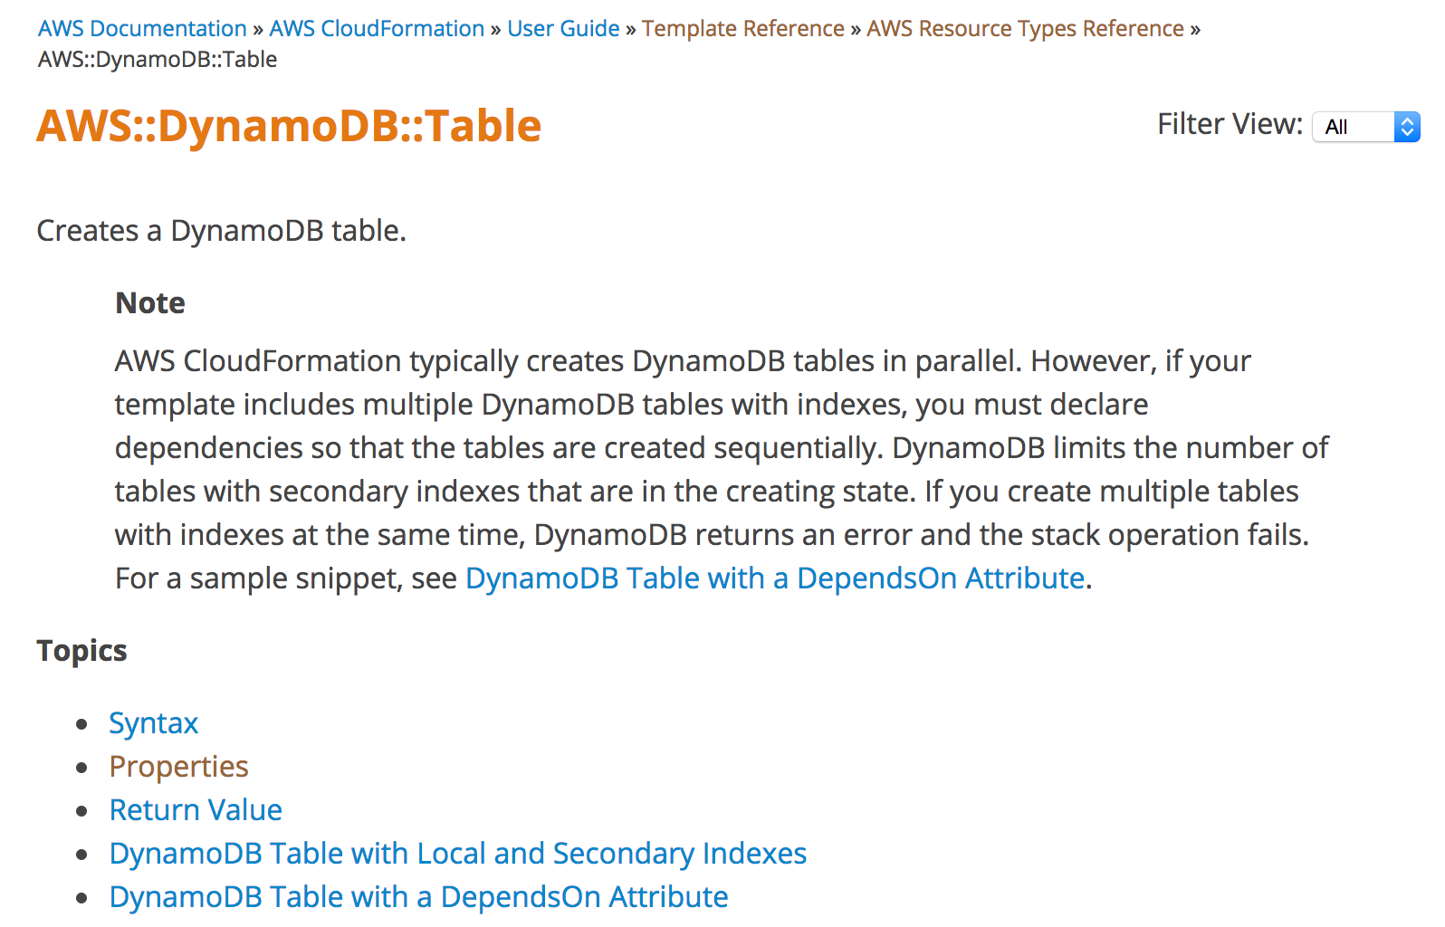
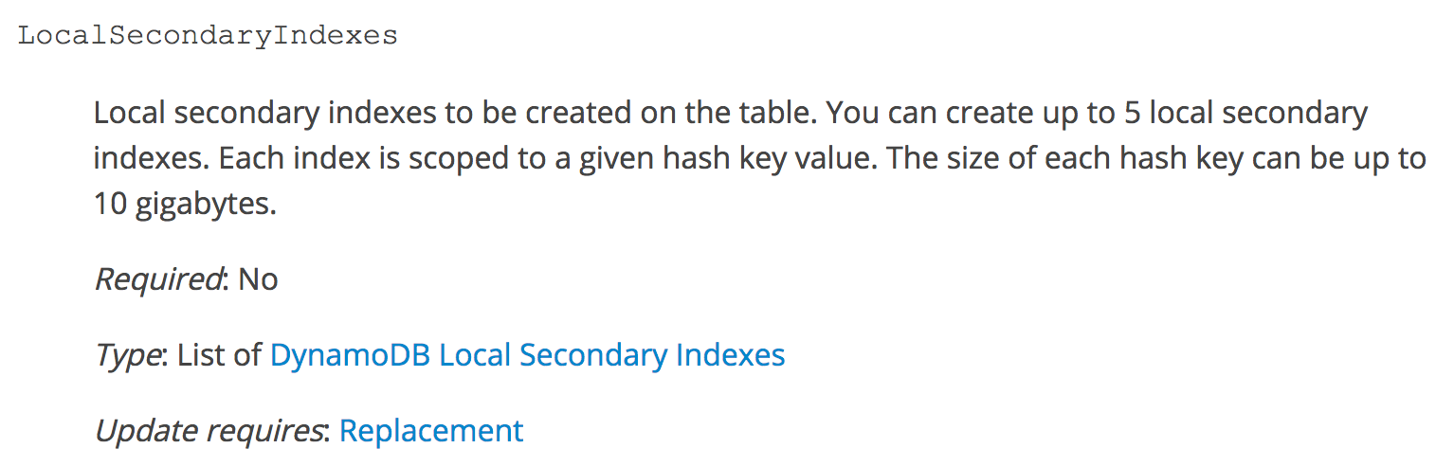

Slide 8
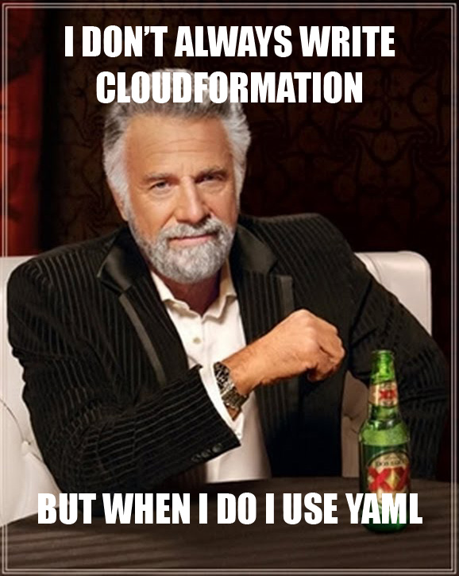
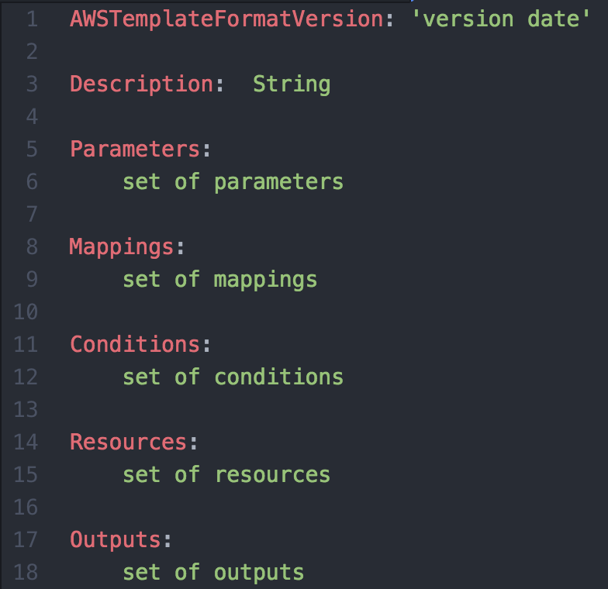
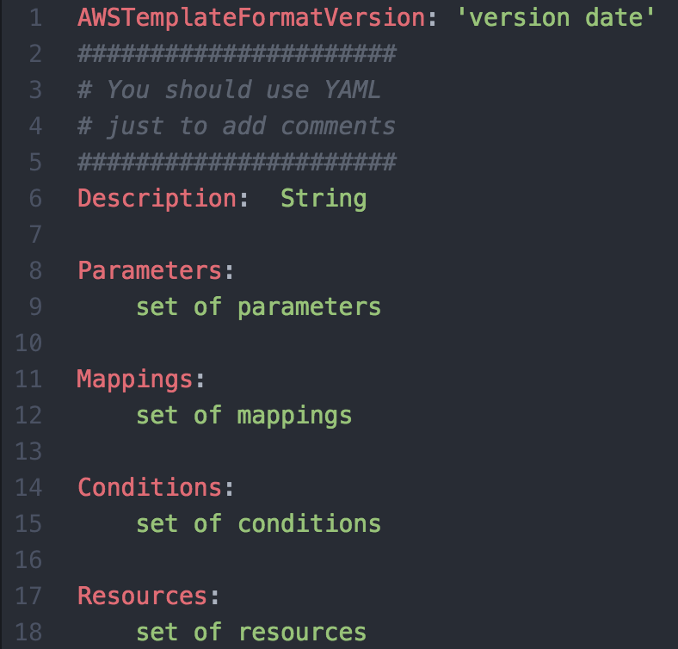
CloudFormation Template Anatomy (YAML)
Notes:
All examples will be shown in yaml

Slide 9
CloudFormation Template Anatomy
Required: No
2010-09-09 is currently the only available options. This setting identifies the capabilities of the template.
Play it safe and include this in all your templates. When AWS does decide to add a new version you don’t need to update existing templates.

Slide 10
CloudFormation Template Anatomy
Required: Yes
The meat of a CloudFormation template
All the AWS resources and their respective properties

Slide 11
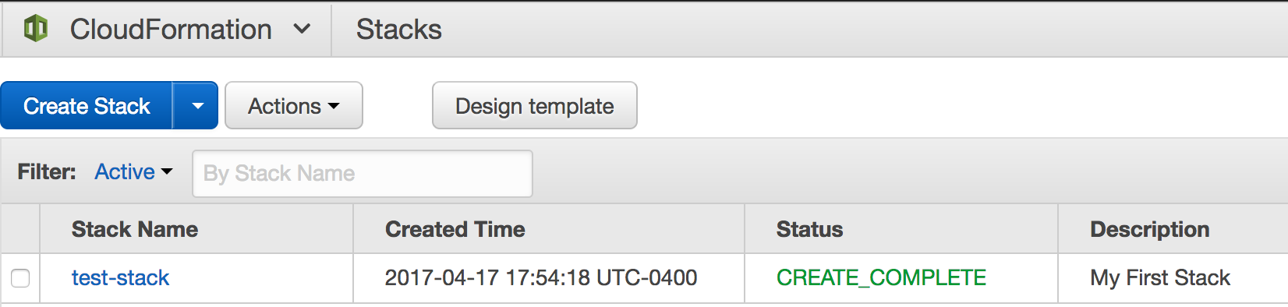
CloudFormation Template Anatomy
Required: No
Description of the template and the created stack

Slide 12
CloudFormation Template Anatomy
Required: No
Input parameters for customizing deployed resources
Allows you to generalize CloudFormation templates for reuse

Slide 13
CloudFormation Template Anatomy
Required: No
Provides a hash map of values that can be referenced within your template
Common use case is regional or environment specific values

Slide 14
CloudFormation Template Anatomy
Required: No
Allows you to define conditionals controlling when a resource is created or a property is defined

Slide 15
CloudFormation Template Anatomy
Required: No
Values you stack can output for information purposes or to provide cross stack references

Slide 16
S3 Example Template

Slide 17
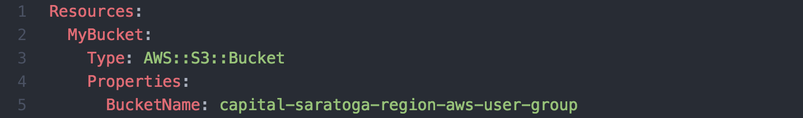
S3 Example Template

Slide 18
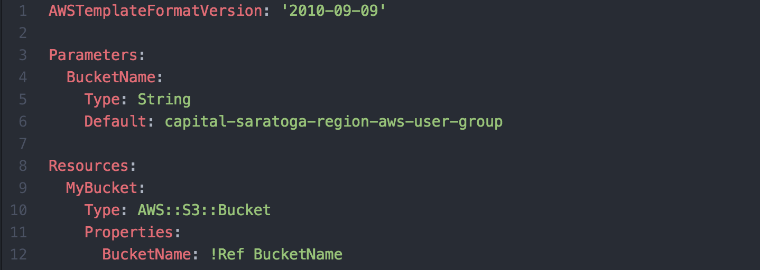
S3 Example - Template

Slide 19
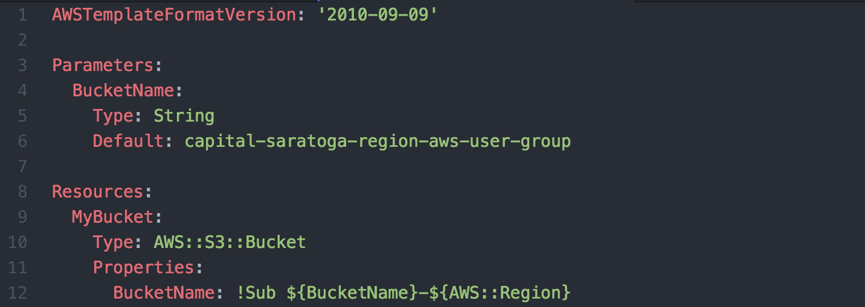
S3 Example - Template

Slide 20
Intrinsic Functions
Use intrinsic functions in your templates to assign values to properties that are not available until runtime
Fn::Base64
Condition Functions
Fn::And
Fn::Equals
Fn::If
Fn::Not
Fn::Or
Fn::FindInMap
Fn::GetAtt
Fn::GetAZs
Fn::ImportValue
Fn::Join
Fn::Select
Fn::Split
Fn::Sub
Ref
YAML Syntactic Sugar
!ImportValue
!Sub
!Ref

Slide 21
Pseudo Parameters
Predefined parameters available in your CloudFormation templates
AWS::AccountId
AWS::NotificationARNs
AWS::NoValue
AWS::Region
AWS::StackId
AWS::StackName

Slide 22
S3 Example - Template

Slide 23
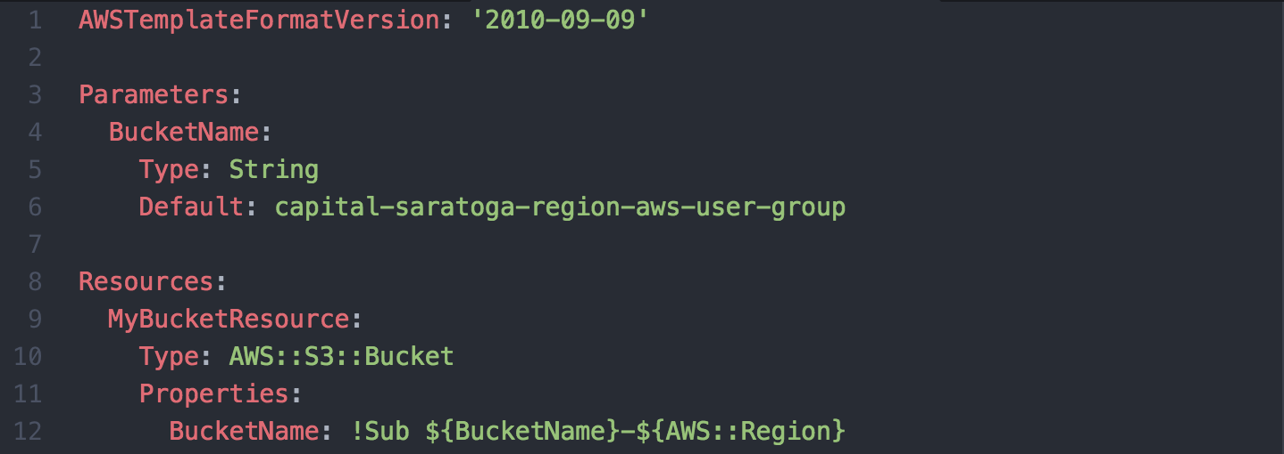
S3 Example - Template
Resource Logical Id should not be changed once created.

Slide 24
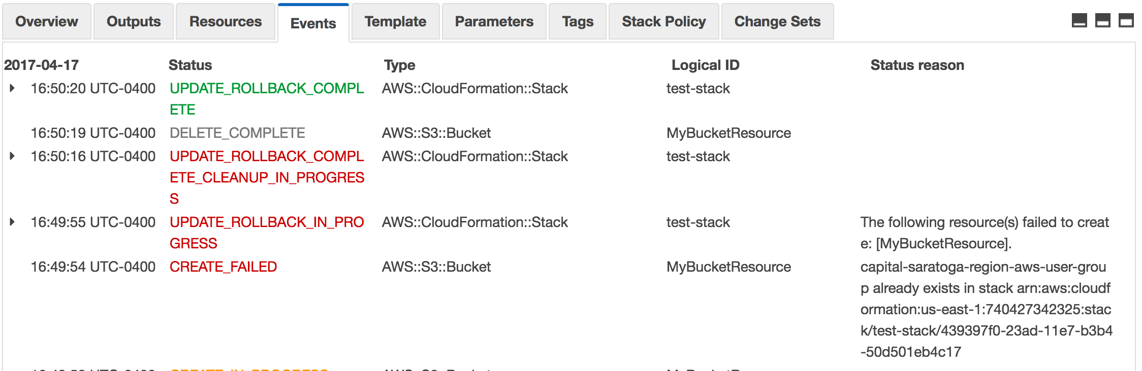
S3 Example – Changed Existing Logical ID

Slide 25
Do not change logical id once created.
Logical Ids are relevant only to the stack they are deployed. You can reference within a single stack but not outside from other stacks.
Logical Ids must be unique within a given stack.

Slide 26
Extend S3 Template
Cross-Region Replication

Slide 27
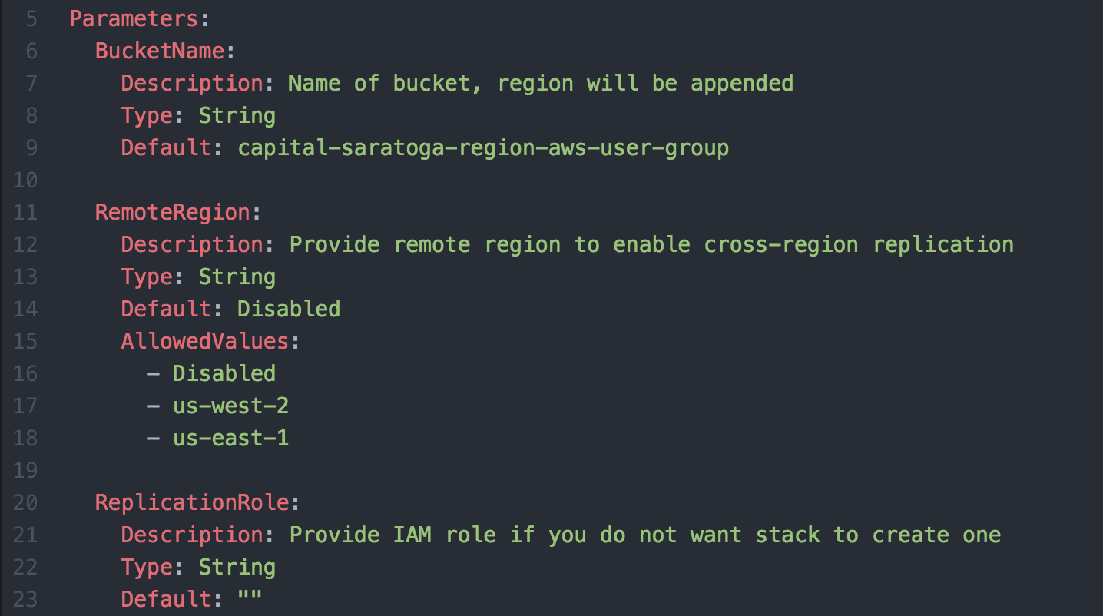
S3 Example - Template
Input validation
AllowedValues
AllowdPatterns via regex
MinValue/MaxValue for Integer
MinLength/MaxLength for strings

Slide 28
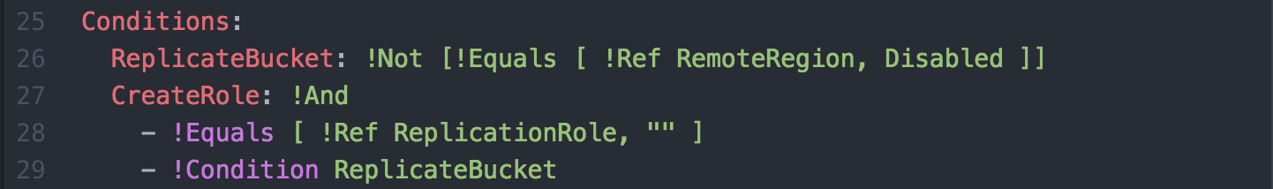
S3 Example - Template
ReplicateBucket is True if RemoteRegion parameter is NOT equal to Disabled

Slide 29
S3 Example - Template
CreateRole is True if ReplicationRole parameter is and empty string and the condition ReplicateBucket is True

Slide 30
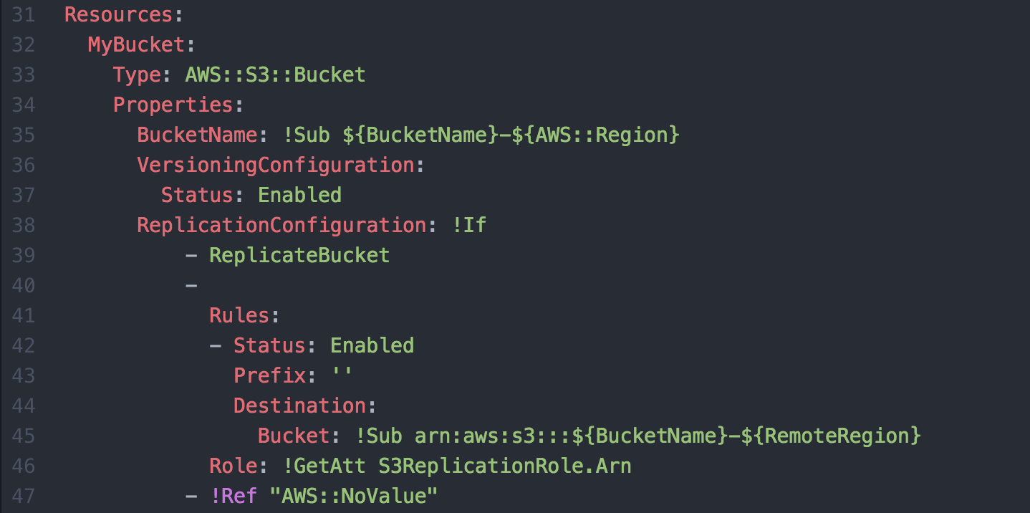
S3 Example - Template
S3 cross-region replication requires that versioning be enabled on the bucket

Slide 31
S3 Example - Template
Conditional parameter block, AWS::NoValue will remove the parameter when set.

Slide 32
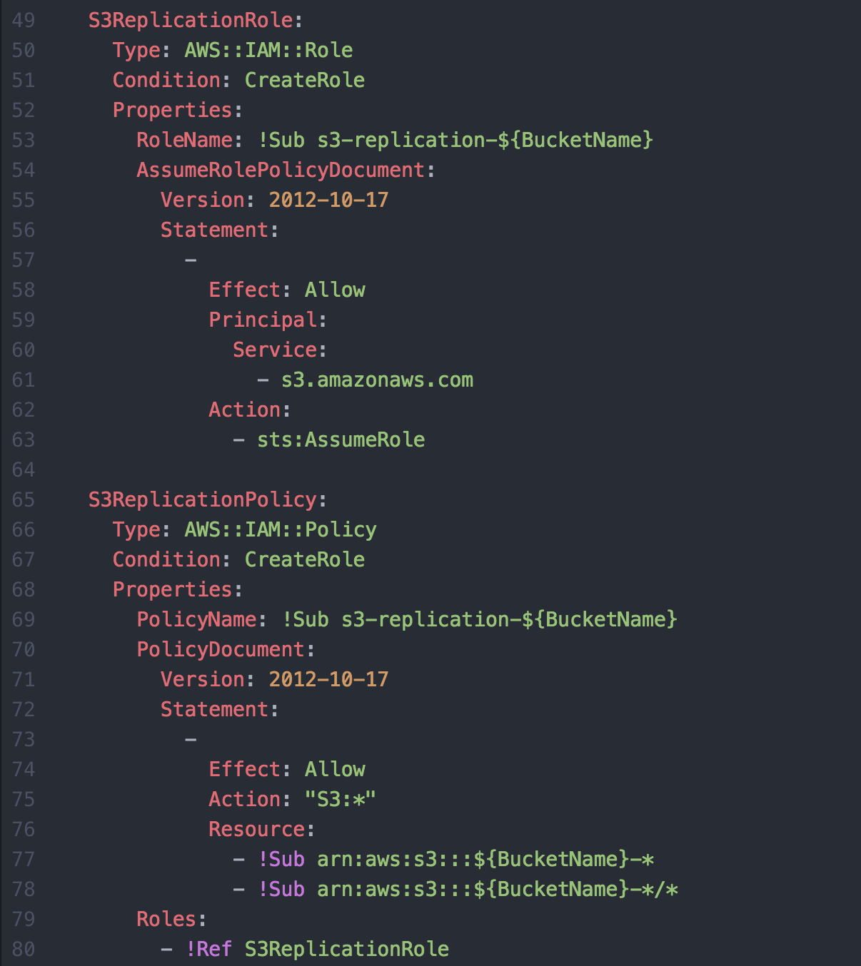
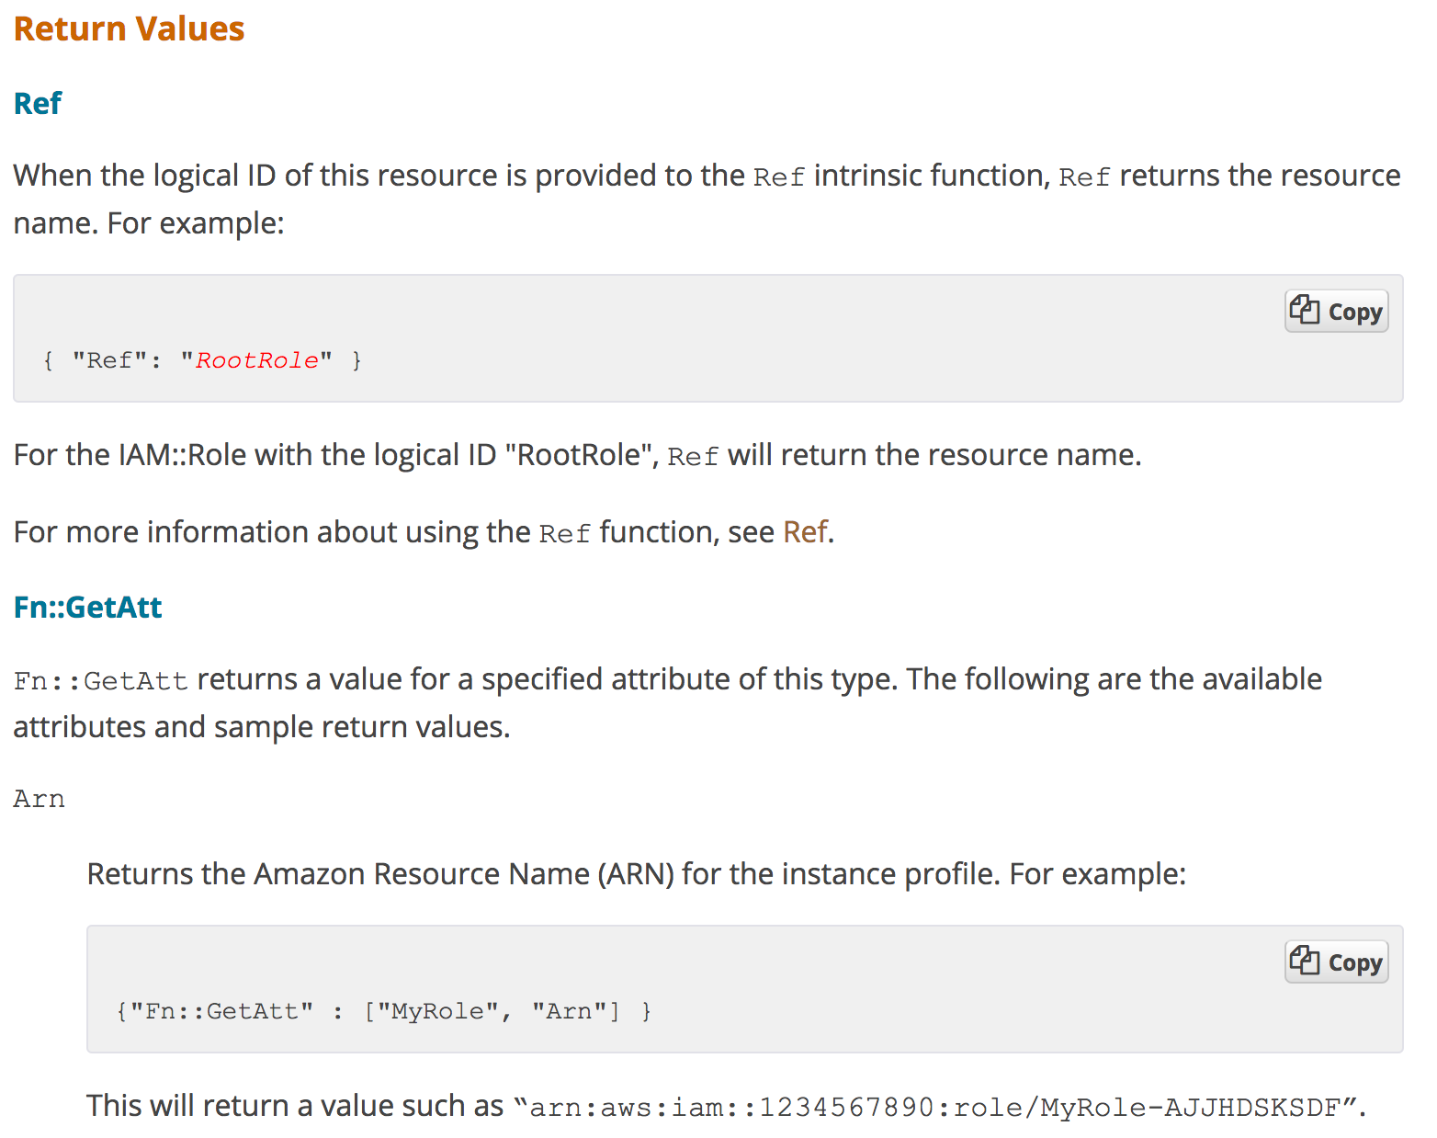
S3 Example - Template

Slide 33
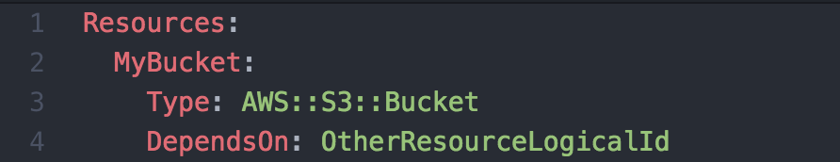
Dependencies
Cloudformation resources have implicit dependences based on the Ref and GetAtt functions but you can explicitly define them as well.

Slide 34
Deploying Stacks Using AWSCLI

Slide 35
Deploying Stack (awscli) - Success
$
$ aws cloudformation deploy --stack-name test-stack --template-file stack.yaml –region us-west-2
Waiting for changeset to be created..
Waiting for stack create/update to complete
Successfully created/updated stack - test-stack

Slide 36
Deploying Stack (awscli) - Failure
$
$ aws cloudformation deploy --stack-name test-stack --template-file stack.yaml
Waiting for changeset to be created..
Waiting for stack create/update to complete
Failed to create/update the stack. Run the following command
to fetch the list of events leading up to the failure
aws cloudformation describe-stack-events --stack-name test-stack

Slide 37
Debug Stack (awscli)
$
$ aws cloudformation describe-stack-events --stack-name test-stack
{
"StackEvents": [
{
"StackId": "arn:aws:cloudformation:us-east-1:740427342325:stack/test-stack/50d535e0-23c1-11e7-9f58-50faeaee44fd",
"EventId": "6a0ad860-23c3-11e7-8311-500c286e44d1",
"ResourceStatus": "UPDATE_ROLLBACK_COMPLETE",
"ResourceType": "AWS::CloudFormation::Stack",
"Timestamp": "2017-04-17T23:13:06.110Z",
"StackName": "test-stack",
"PhysicalResourceId": "arn:aws:cloudformation:us-east-1:740427342325:stack/test-stack/50d535e0-23c1-11e7-9f58-50faeaee44fd",
"LogicalResourceId": "test-stack"
},
...

Slide 38
Debug Stack (awscli)
$
$ aws cloudformation describe-stack-events --stack-name test-stack | jq ‘.StackEvents[] | {Timestamp,ResourceStatus,ResourceType,ResourceStatusReason}’
"Timestamp": "2017-04-17T23:12:51.059Z",
"ResourceStatus": "CREATE_FAILED",
"ResourceType": "AWS::S3::Bucket",
"ResourceStatusReason": "capital-saratoga-region-aws-user-group already exists in stack arn:aws:cloudformation:us-east-1:740427342325:stack/test-stack/50d535e0-23c1-11e7-9f58-50faeaee44fd"

Slide 39
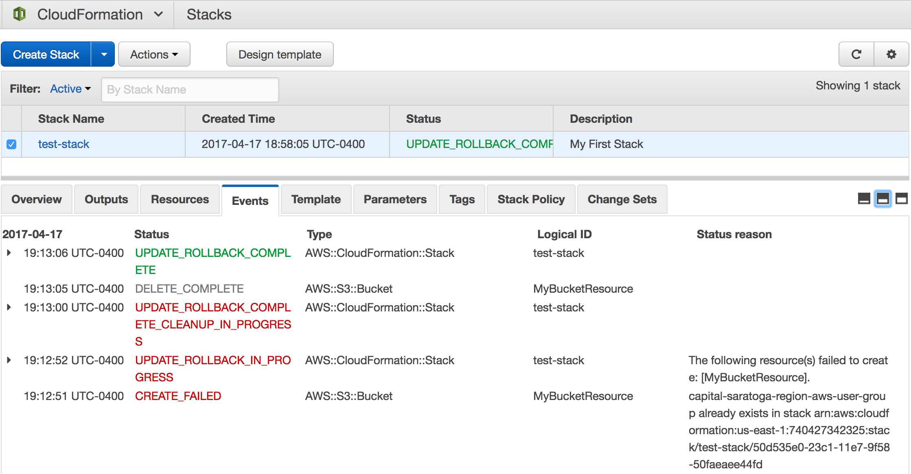
Debug Stack (Console)

Slide 40
EC2
+
CloudFormation

Slide 41
EC2 Example Template

Slide 42
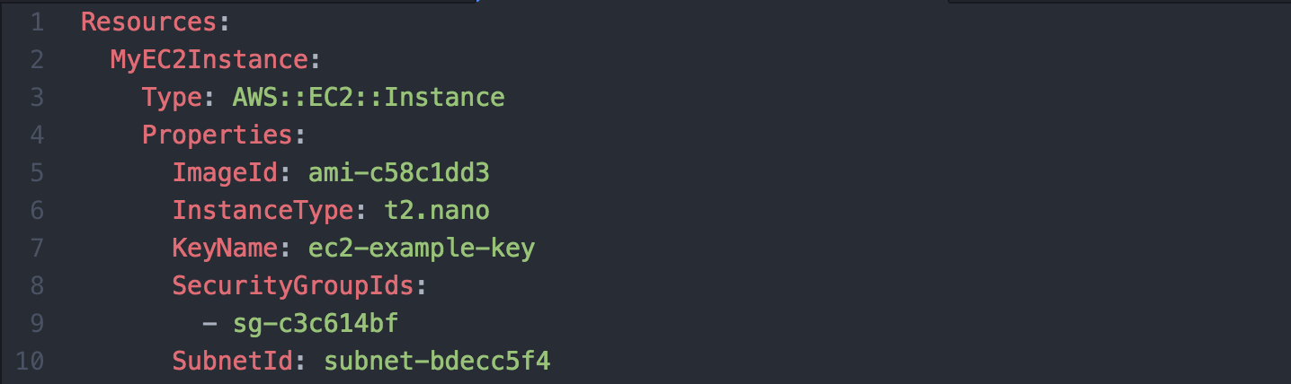
EC2 Example Template

Slide 43
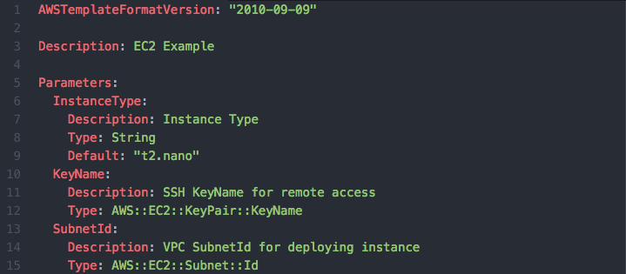
EC2 Example Template

Slide 44
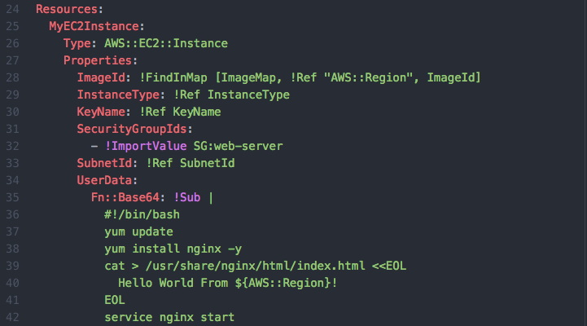
EC2 Example Template

Slide 45
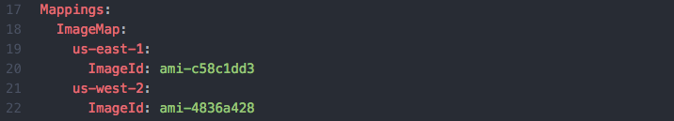
EC2 Example Template
Notes:
Hash map that can provide appropriate AMI Id based on region

Slide 46
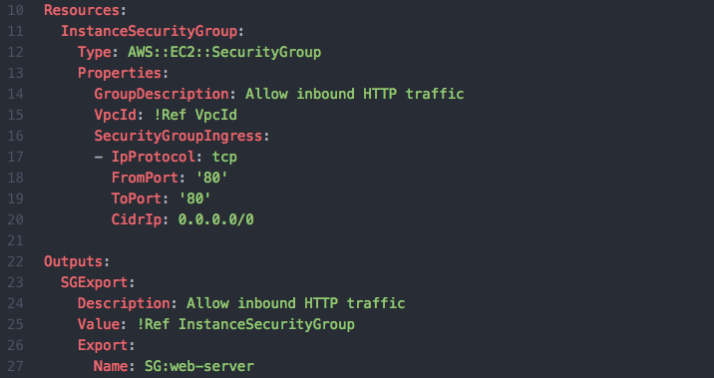

Export Example Template

Slide 47
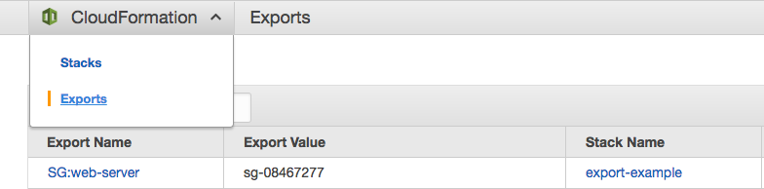
Exports

Slide 48
EC2 Example Template – Userdata Script
Notes:
Userdata script is execute the first time EC2 instances boots and never again

Slide 49
How does CloudFormation know when my EC2 instance is ready?

Slide 50
Cloudformation Signaling
Allows for external conditions be required before CloudFormation considers a resource complete
Ensures that your EC2 configuration is complete before CloudFormation continues
Can be a Create and/or Update policy for EC2 and ASG

Slide 51
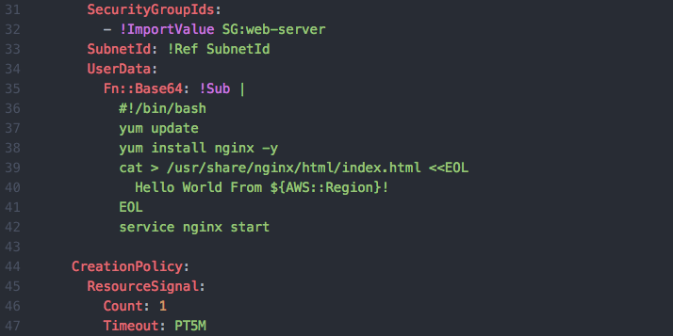
EC2 Example Template – CreatePolicy

Slide 52
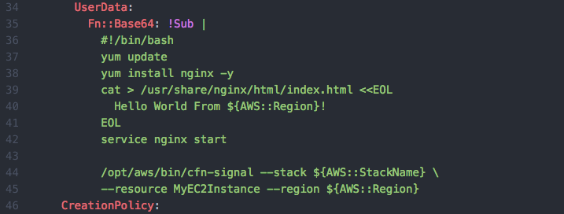
EC2 Example Template – cfn-signal

Slide 53
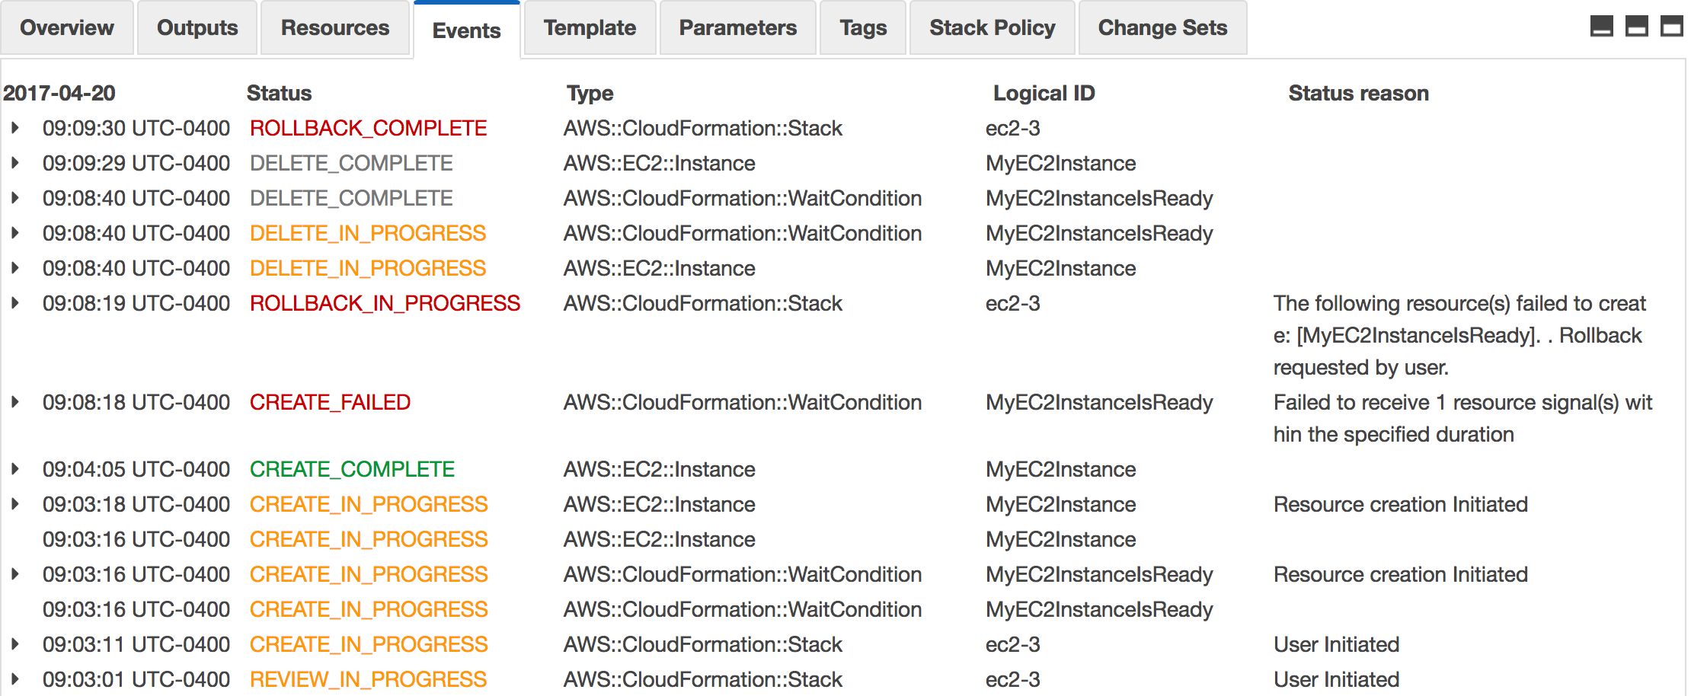

Slide 54
Cloudformation Helper Scripts
A set of tools to assist with the configuration of EC2 that are preinstalled on Amazon provided images
cfn-signal: Notifies CloudFormation of a state change
cfn-init: Uses resource metadata for instance bootstrap
cfn-get-metadata: Get resource metadata
cfn-hub: A daemon to check for updates to metadata and execute custom hooks when changes are detected

Slide 55
cfn-init Helper Script
Tool that completes initial bootstrap based on metadata provided in CloudFormation template
Commands
Files
Users
Groups
Packages
Services
Sources
Preinstalled on Amazon provided images
State based approach to instance configuration
Can be executed multiple times to bring instance to desired state

Slide 56
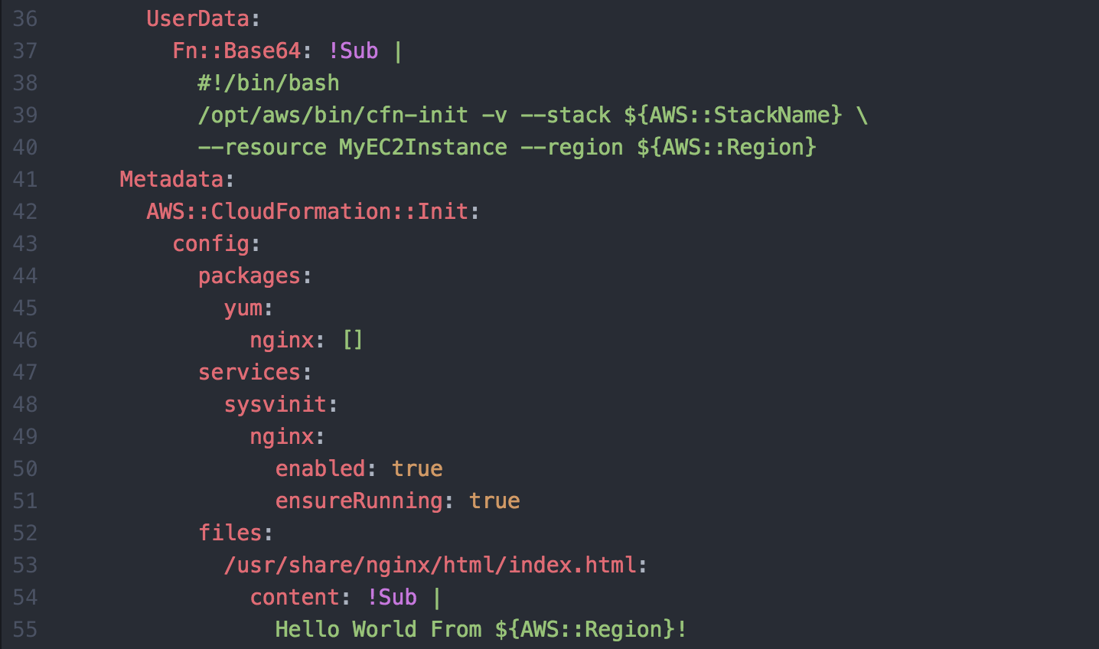
EC2 Example Template – cfn-init

Slide 57
cfn-init vs userdata
userdata is procedural and will only run once
cfn-init is state based
Can be run multiple times to bring instance to desired state
Validation and logging built in

Slide 58
CloudFormation 101
Dave Pigliavento

