Slide 1

Ansible Automation
Dusan Pilipovic 2019

Slide 2
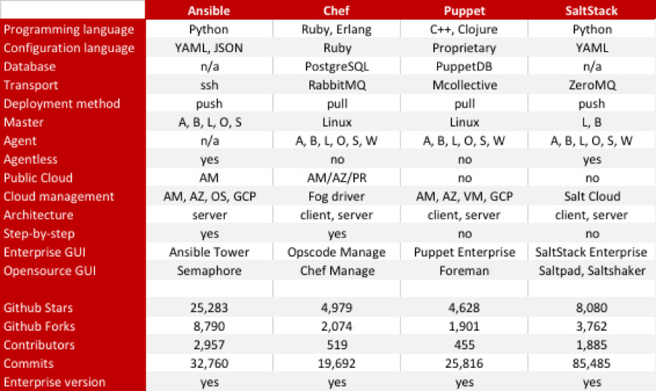

Slide 3
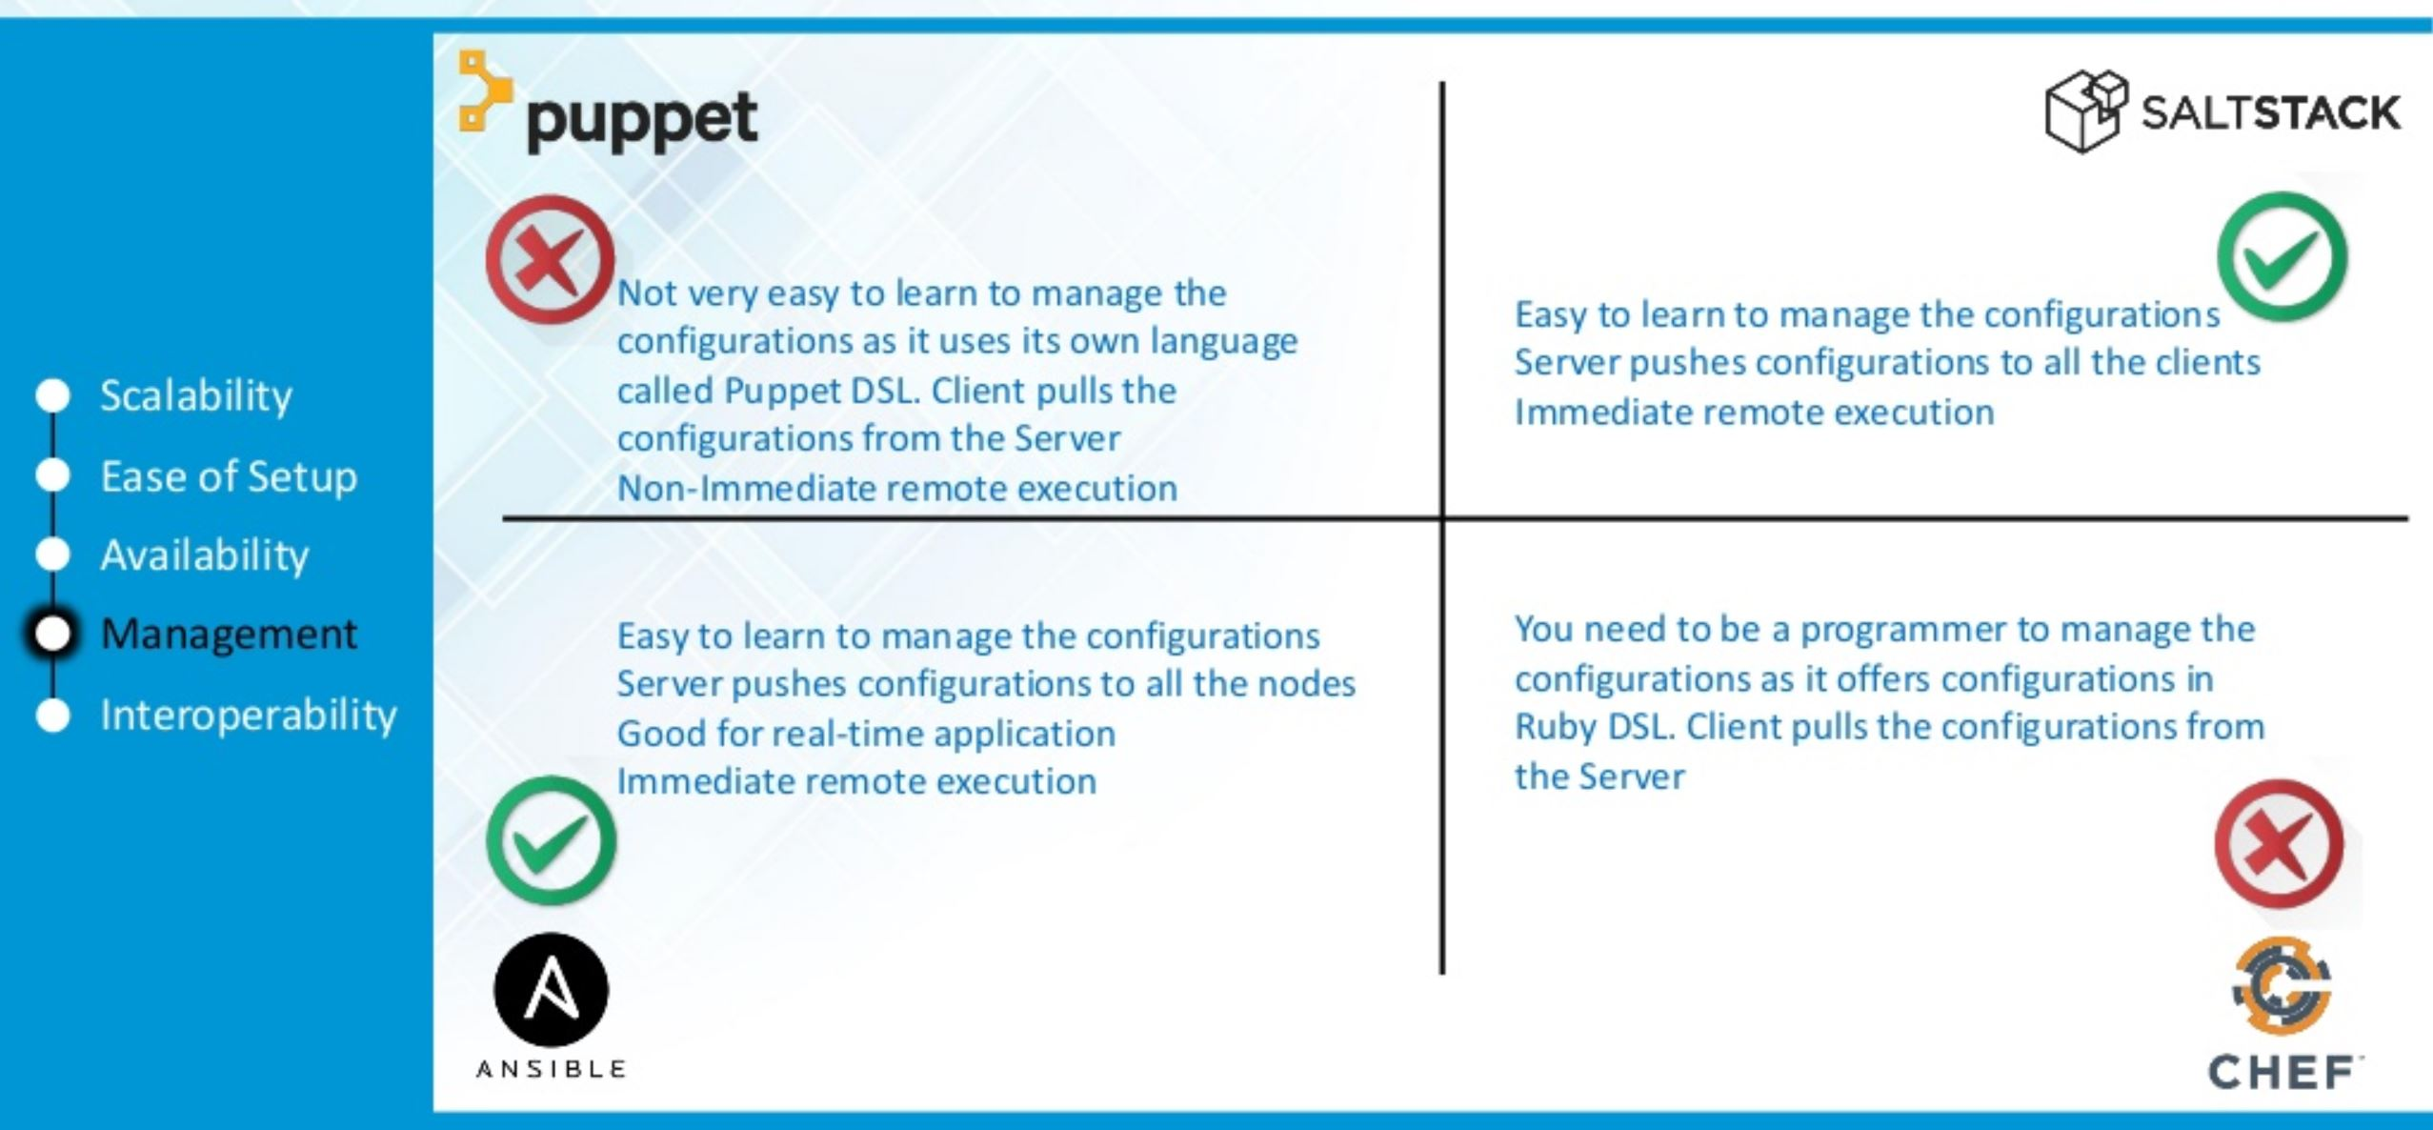

Slide 4
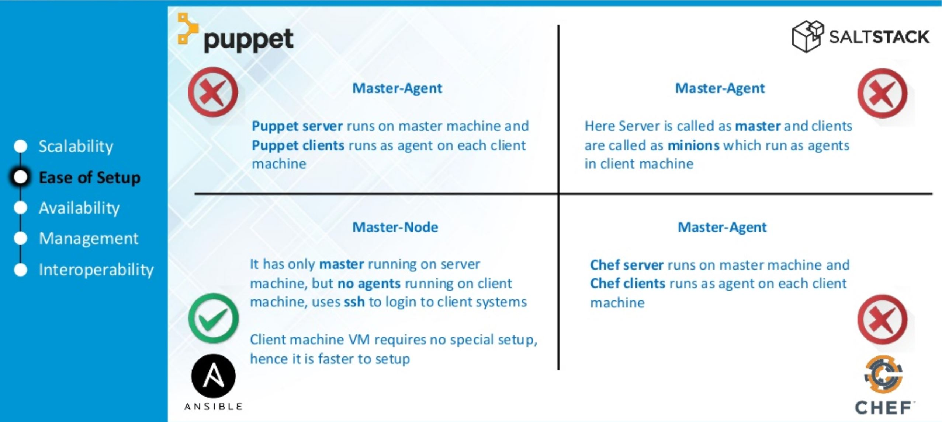

Slide 5
