Slide 1
Basic Introduction to JavaScript
David Pinezich

Slide 2
Organization

Slide 3

About me
Education
Informatiker Applikationsentwicklung EFZ (BMS / Passerelle)
Bachelor of Informatics at UZH
Master of Informatics at UZH
Lehrdiplom für Maturitätsschulen (LfM)
Work Experience
Paul Scherrer Institut (PSI)
Architonic
ti&m
Helsana (Lead Webengineering)
Programming Experience
david.pinezich@gmail.com / david.pinezich@uzh.ch

Slide 4
Organization
Please Ask
Breaks
Certificate

Slide 5
Course Overview
Learning Objectives
Apply basics of JavaScript syntax
Students can describe the function and the main elements of DOM and are able to select and manipulate element with the DOM.
Learning activities
JavaScript fundamentals: Syntax, Data types, variables, functions, conditionals, loops, arrays and objects
Objects basics
DOM manipulation
UI events

Slide 6
Vanilla JavaScript
In the age of many JavaScript frameworks such
as jQuery, Angular, React - vanilla JavaScript refers to the
actual, pure JavaScript.

Slide 7

Short History
JavaScript was invented by Brendan Eich in 1995 and became an ECMA standard in 1997.
ECMAScript is the official name of the language.
ECMAScript versions have been abbreviated to ES1, ES2, ES3, ES5, and ES6.
Since 2016 new versions are named by year (ECMAScript 2016 / 2017 / 2018).
ECMAScript 1 - 6 is fully supported in all modern browsers.

Slide 8
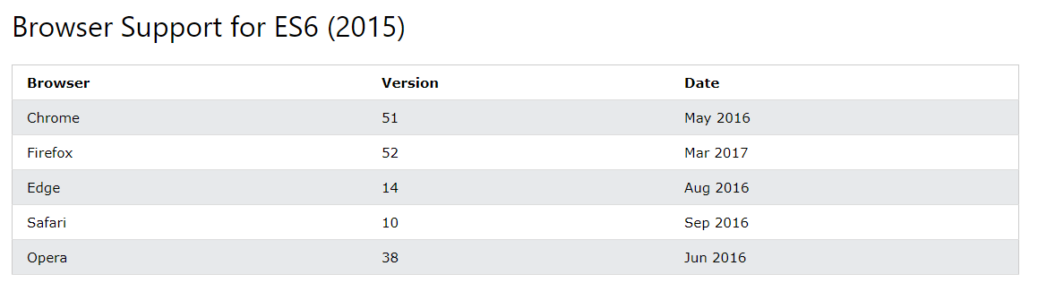
Short History (2)

Slide 9
This course…
…is based on ES5 (JavaScript 2009)
But I will talk briefly about the ES6 (ECMAScript 2015) features:
Added let and const
Added default parameter values
Added Array.find()
Added Array.findIndex()
I will not talk about ECMAScript 2016+ since it is not fully supported by all major browser (yet)
BUT: It will be easy for you to understand the newer version with your base knowledge after this course
See: JavaScript Versions (w3schools.com)

Slide 10

Learn by DOING
Source: https://patti13strick.files.wordpress.com/2015/12/learn-by-doing.jpg?w=540

Slide 11


Material
Most of the material is linked to web examples
For the Hands-on-Examples an IDE (Integrated Development Environment) is recommended like Visual Studio Code or Webstorm
The Material will be shared via Teams or via Email ☺

Slide 12
Agenda
What are we going to look at:
Intro
Output
Syntax
Where to
Variables
Functions
Objects
Loops
HTML DOM

Slide 13
Intro

Slide 14
JavaScript can
… change HTML content
… change HTML attribute values
… change HTML styles (CSS)
… hide HTML elements
… and much more ☺

Slide 15
… change HTML content
One of many JavaScript HTML methods is getElementById().
The example below tries to "find" an HTML element (with id="demo")
document.getElementById("demo").innerHTML="Hello JavaScript";
TRY IT >>

Slide 16
… change HTML attribute values
In this example JavaScript changes the value of the src (source) attribute of an <img> tag:
<button onclick="document.getElementById('myImage').src='pic_bulbon.gif'"> Turn on the light </button> <img id="myImage" src="pic_bulboff.gif" style="width:100px"> <button onclick="document.getElementById('myImage').src='pic_bulboff.gif'"> Turn off the light </button>
TRY IT >>

Slide 17
… change HTML styles (CSS)
Changing the style of an HTML element, is a variant of changing an HTML attribute:
document.getElementById("demo").style.fontSize = "35px";
TRY IT >>

Slide 18
… hide and show HTML elements
Hiding / showing HTML elements can be done by changing the display style:
document.getElementById("demo").style.display="none";
document.getElementById("demo").style.display="block";
Hint: The Online-Editor is also mutable, try to add the "show" button ☺
➔ no harm, and no persistence is going to happen
TRY IT >>

Slide 19
Output

Slide 20
JavaScript display possibilities
JavaScript can "display" data in various ways:
Writing into an HTML element, using innerHTML
Writing into the HTML output using document.write()
Writing into an alert box, using window.alert()
Writing into the browser console, using console.log()

Slide 21
Using innerHTML
To access an HTML element, JavaScript can use the document.getElementById(id) function.
The id attribute defines the HTML element
The innerHTML property defines the HTML content
<h1>My First Web Page</h1> <p>My First Paragraph</p> <p id="demo"></p> <script> document.getElementById("demo").innerHTMLinnerHTML = 5 + 6; </script>
TRY IT >>

Slide 22
Using document.write()
For testing purposes, it is convenient to use document.write():
<h1>My First Web Page</h1> <p>My First Paragraph.</p> <script> document.write(5 + 6); </script>
TRY IT >>

Slide 23
Using window.alert()
You can also use an alert box to display data
careful! It can be very annoying!
<!DOCTYPE html> <html> <body> <h2>My First Web Page</h2> <p>My First Paragraph.</p> <script> window.alert(5 + 6); </script> </body> </html>
TRY IT >>

Slide 24
Syntax

Slide 25
Syntax
JavaScript syntax is the set of rules, how JavaScript programs are constructed:
var x, y, z; // Declare Variables, we will talk about let/const later x = 5; y = 6; // Assign Values z = x + y; // Compute Values

Slide 26
Values
The JavaScript syntax defines two types of values:
Fixed values: called Literals
Variable values: called Variables

Slide 27
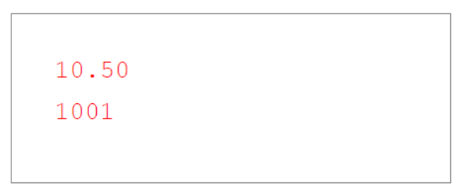
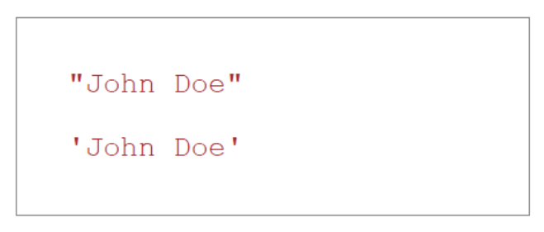
Literals
The two most important syntax rules for fixed values are:
Numbers are written with or without decimals:
Strings are text, written withing double or single quotes:

Slide 28
Variables
In most programming languages, variables are used to store data values.
JavaScript uses the var keyword to declare variables
An equal sign is used to assign values to variables
In this example x is defined as a variable. After, the integer 6 is assigned to the variable
var x;
x = 6;

Slide 29
Variables - Let
With ES6 it is also possible to declare variables with let. The difference between let and var is:
var can be reassigned and redeclared (multiple times)
let can not be redeclared
let x = "John Doe"; let x = 0; // SyntaxError: 'x' has already been declared
x = "John Petterson"; // This works

Slide 30
Variables - Const
With ES6 it is also possible to declare variables with let. The difference between const and var is:
var can be reassigned and redeclared (multiple times)
const can not be reassigned and redeclared
const PI = 3.141592653589793; PI = 3.14; // This will give an error PI = PI + 10; // This will also give an error

Slide 31
Operators
JavaScript uses arithmetic operators (+ - * / ) to compute values:
JavaScript uses an assignment operator ( = ) to assign values to variables:
(5 + 6) * 10
var x, y;
x = 5; y = 6;

Slide 32
Expressions
An expression is a combination of values, variables and operators, which computes to a value.
The computation is called an evaluation
Example: 5 * 3 evaluates to 15:
5 * 3

Slide 33
Expressions (cont.)
Expressions are also able to contain variable values:
The values can be of various types, such as numbers and strings.
Example, "John" + " " + "Doe", evaluates to "John Doe":
x * 3
"John" + " " + "Doe"

Slide 34
Keywords
JavaScript keywords are used to identify "actions" to be performed
The var keyword tells the browser to create one or more variables:
var x, y;
x = 5 + 6; y = x * 6;

Slide 35
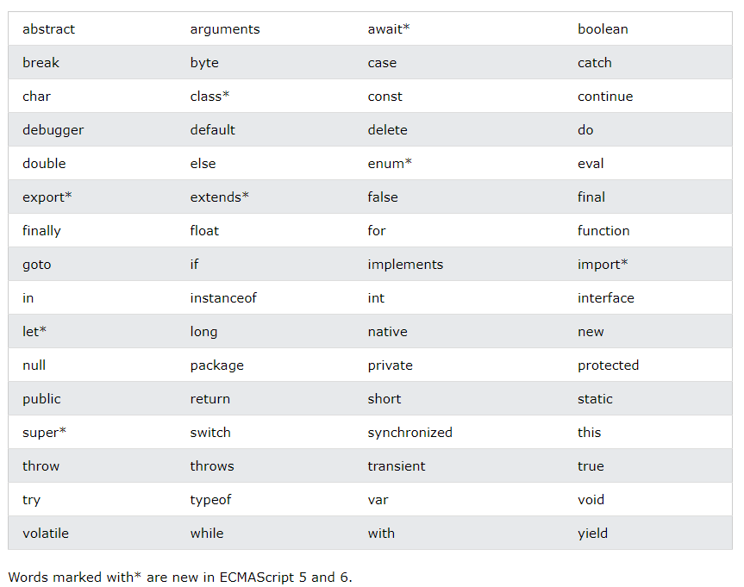
Keywords (cont.)

Slide 36
Comments
Not all JavaScript statements are "executed".
Code after double slashes // or between /* and */ is treated as a comment.
Comments are ignored, and will never be executed or evaluated.
var x = 5; // I will not be executed
// z = x + y; I will not be executed

Slide 37
Case sensitive
All JavaScript identifiers are case sensitive.
The variables lastname and lastName, are two different variables:
JavaScript does not interpret VAR or Var as the keyword var.
var lastname, lastName; lastname = "Doe"; lastName = "Peterson";

Slide 38
JavaScript and CamelCase
Historically, programmers have many ways of joining multiple words into variable names:
Hyphens: first-name, last-name, master-card, inter-city
Underscore: first_name, last_name, master_card, inter_city
Upper CamelCase: FirstName, LastName, MasterCard, InterCity
Lower camelCase: firstName, lastName, masterCard, interCity
JavaScript programmers tend to use Lower camelCase.
But the most important rule is to be consistent in your choice.

Slide 39
Where to

Slide 40

The HTML DOM
DOM = Document Object Model

Slide 41
The <script> Tag
In HTML, JavaScript code is inserted between <script> and </script> tags.
<script> document.getElementById("demo").innerHTML = "My first JavaScript"; </script>
TRY IT >>

Slide 42
In <head>, <body> and <footer>
You can place any number of scripts in an HTML document.
Scripts can be placed in the <body>, the <head> or the <footer> section of an HTML page. Or in all of them.
If your script needs to be loaded before the HTML page, place it in the <head> section.
If your script can be loaded with the HTML page, place it in the <body> section.
If it is ok that the script is loaded after the HTML page, place it in the <footer> section (best choice for performance).
TRY IT >>

Slide 43
External JavaScript
External scripts are practical when the same code is used in many different web pages.
JavaScript files have the file extension .js. The script will behave as if it was located exactly where the <script> tag is located.
To use an external script, put the name of the script in the src (source) attribute of a <script> tag:
<script src="myScript.js"></script> <script src="myScript2.js"></script>

Slide 44
Variables

Slide 45
Variables
JavaScript variables are containers for storing data values.
In this example, x, y, and z are variables declared with the var keyword:
var x = 5; var y = 6; var z = x + y;

Slide 46
Algebra?
In this example, price1, price2, and total are variables:
In programming, just like in algebra, we use variables (like price1) to hold values.
In programming, just like in algebra, we use variables in expressions (total = price1 + price2).
From the example above, you can calculate the total to be 11.
var price1 = 5; var price2 = 6; var z = price1 + price2;

Slide 47
Identifiers
All JavaScript variables must be identified with unique names.
These unique names are called identifiers.
Identifiers can be short names (like x and y) or more descriptive names (age, sum, totalVolume).
The general rule for constructing names for variables (unique identifiers) are:
Names can contain letters, digits, underscores and dollar signs
Names must begin with a letter
Names can also begin with $ and _ (rarely used)
Names are case sensitive (y and Y are different variables)
Reserved words (keywords) cannot be used as names
In programming, just like in algebra, we use variables (like price1) to hold values.
In programming, just like in algebra, we use variables in expressions (total = price1 + price2).
From the example above, you can calculate the total to be 11.

Slide 48
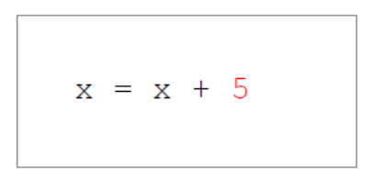
Assignment operator
In JavaScript, the equal sign (=) is an assignment operator, not an "equal to" operator. This is different from algebra!
The following does not make sense in algebra:
In JavaScript, however, it makes perfect sense:
It assigns the value of x + 5 to x.
It calculates the value of x + 5 and "puts" the result into x. The value of x is incremented by 5.
Hint: Equal to is == in JavaScript

Slide 49
Data types
JavaScript variables can hold numbers like 100 and text values like "John Doe".
In programming, text values are called text strings.
JavaScript can handle many types of data, but for now just think of numbers and strings.
Strings are written inside double or single quotes.
Numbers are written without quotes.
If you put a number in quotes, it will be treated as a text string.
var pi = 3.14; var person = "John Doe"; var person = 'John Doe';

Slide 50
Creating JavaScript Variables
Creating a variable in JavaScript is called "declaring" a variable.
You declare a JavaScript variable with the var keyword:
After the declaration, the variable has no value (technically it has the value of undefined).
var carName;
carName = "Volvo";
var carName = "Volvo";

Slide 51
Arithmetic
As with algebra, you can do arithmetic with JavaScript variables using operators like = and +;
You can also use strings, but they will be concatenated:
var x = 5 + 2 + 3;
var x = "John" + " " + "John";

Slide 52
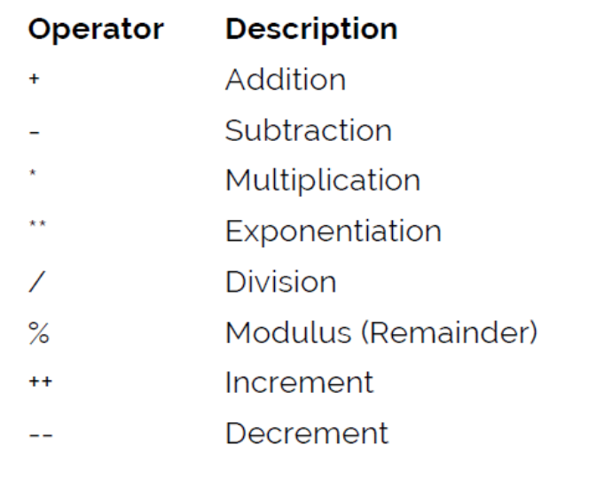
Arithmetic Operators
Arithmetic operators perform arithmetic on numbers (literals or variables).

Slide 53
Exercise 1
Create a variable called carName, assign the value Volvo to it.
Create a variable called x, assign the value 50 to it.
Display the sum of 5 + 10 in a paragraph called "demo", using two variables x and y.
Create a variable called z, assign x + y to it, and display the result in an alert box.
On one single line, declare three variables with the following names and values:
firstName = "John" / lastName = "Doe" / age = 35

