Slide 1
Basic Introduction to JavaScript
David Pinezich

Slide 2
Organization

Slide 3

About me
Education
Informatiker Applikationsentwicklung EFZ (BMS / Passerelle)
BSc & MSc of Informatics at UZH
Lehrdiplom für Maturitätsschulen (LfM)
Work Experience
Past
Paul Scherrer Institut (PSI), Architonic
ti&m
Helsana (Lead Webengineering)
apigenio GmbH – Consulting, Teaching, Architecture-Audits
Kantonsschule Baden
Programming Experience
david.pinezich@apigenio.ch / david.pinezich@uzh.ch

Slide 4
Organization
Please Ask
Breaks
Certificate

Slide 5
Course Overview
Learning Objectives
Apply basics of JavaScript syntax
Students can describe the function and the main elements of DOM and are able to select and manipulate element with the DOM.
Learning activities
JavaScript fundamentals: Syntax, Data types, variables, functions, conditionals, loops, arrays and objects
Objects basics
DOM manipulation
UI events

Slide 6
Vanilla JavaScript
In the age of many JavaScript frameworks such
as jQuery, Angular, React - vanilla JavaScript refers to the
actual, pure JavaScript.

Slide 7

Short History
JavaScript was invented by Brendan Eich in 1995 and became an ECMA standard in 1997.
ECMAScript is the official name of the language.
ECMAScript versions have been abbreviated to ES1, ES2, ES3, ES5, and ES6.
Since 2016 new versions are named by year (ECMAScript 2016 / 2017 / 2018 .. 2022).
ECMAScript 1 - 6 is fully supported in all modern browsers.

Slide 8
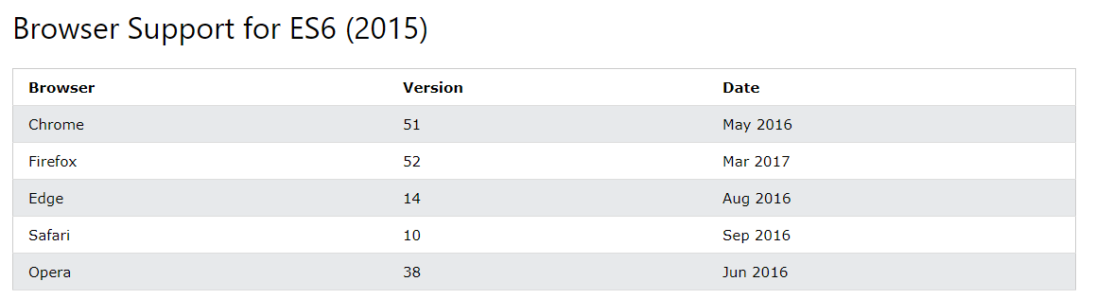
Short History (2)

Slide 9
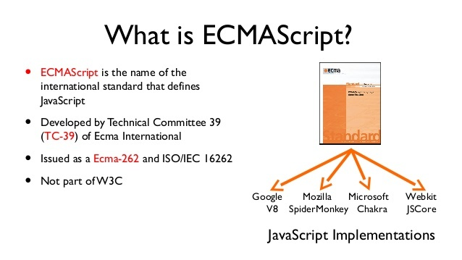
Short History (3)

Slide 10
This course…
…is based on ES5/ES6 (JavaScript 2009/2015)
But I will talk also about newer features (ECMAScript 2015+) :
Added let and const
Added default parameter values
Added Array.find()
Added Array.findIndex()
And more
BUT: It will be easy for you to understand the newer version with your base knowledge after this course
See: JavaScript Versions (w3schools.com)
Can I Use: https://caniuse.com/sr_es13 (es 2022)

Slide 11

Learn by DOING
Source: https://patti13strick.files.wordpress.com/2015/12/learn-by-doing.jpg?w=540

Slide 12


Material
Most of the material is linked to web examples
For the Hands-on-Examples an IDE (Integrated Development Environment) is recommended like Visual Studio Code or Webstorm
The Material will be shared via Teams or via Email ☺
https://github.com/dpinezich/ajs_23/archive/refs/heads/main.zip

Slide 13
Agenda
What are we going to look at:
Intro
Output
Syntax
Where to
Variables
Functions
Objects
Conditional Statements
Arrays
Loops
HTML DOM

Slide 14
Intro

Slide 15
JavaScript can
… change HTML content
… change HTML attribute values
… change HTML styles (CSS)
… hide HTML elements
… and much more ☺

Slide 16
… change HTML content
One of many JavaScript HTML methods is getElementById().
The example below tries to "find" an HTML element (with id="demo")
document.getElementById("demo").innerHTML="Hello JavaScript";
TRY IT >>

Slide 17
… change HTML attribute values
In this example JavaScript changes the value of the src (source) attribute of an <img> tag:
<button onclick="document.getElementById('myImage').src='pic_bulbon.gif'"> Turn on the light </button> <img id="myImage" src="pic_bulboff.gif" style="width:100px"> <button onclick="document.getElementById('myImage').src='pic_bulboff.gif'"> Turn off the light </button>
TRY IT >>

Slide 18
… change HTML styles (CSS)
Changing the style of an HTML element, is a variant of changing an HTML attribute:
document.getElementById("demo").style.fontSize = "35px";
TRY IT >>

Slide 19
… hide and show HTML elements
Hiding / showing HTML elements can be done by changing the display style:
document.getElementById("demo").style.display="none";
document.getElementById("demo").style.display="block";
Hint: The Online-Editor is also mutable, try to add the "show" button ☺
➔ no harm, and no persistence is going to happen
TRY IT >>

Slide 20
Output

Slide 21
JavaScript display possibilities
JavaScript can "display" data in various ways:
Writing into an HTML element, using innerHTML
Writing into the HTML output using document.write()
Writing into an alert box, using window.alert()
Writing into the browser console, using console.log()

Slide 22
Using innerHTML
To access an HTML element, JavaScript can use the document.getElementById(id) function.
The id attribute defines the HTML element
The innerHTML property defines the HTML content
<h1>My First Web Page</h1> <p>My First Paragraph</p> <p id="demo"></p> <script> document.getElementById("demo").innerHTML = 5 + 6; </script>
TRY IT >>

Slide 23
Using document.write()
For testing purposes, it is convenient to use document.write():
<h1>My First Web Page</h1> <p>My First Paragraph.</p> <script> document.write(5 + 6); </script>
TRY IT >>

Slide 24
Using window.alert()
You can also use an alert box to display data
careful! It can be very annoying!
<!DOCTYPE html> <html> <body> <h2>My First Web Page</h2> <p>My First Paragraph.</p> <script> window.alert(5 + 6); </script> </body> </html>
TRY IT >>

Slide 25
Using console.log()
For debugging purposes, you can call the console.log() method in the browser to display data.
<!DOCTYPE html> <html><body> <h2>Activate Debugging</h2> <p>F12 on your keyboard will activate debugging.</p> <p>Then select "Console" in the debugger menu.</p> <p>Then click Run again.</p> <script> console.log(5 + 6); </script> </body></html>
TRY IT >>

Slide 26
Syntax

Slide 27
Syntax
JavaScript syntax is the set of rules, how JavaScript programs are constructed:
var x, y, z; // Declare Variables, we will talk about let/const later x = 5; y = 6; // Assign Values z = x + y; // Compute Values

Slide 28
Values
The JavaScript syntax defines two types of values:
Fixed values: called Literals
Variable values: called Variables

Slide 29
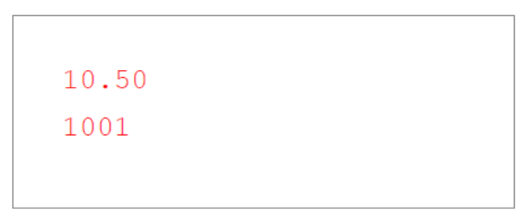
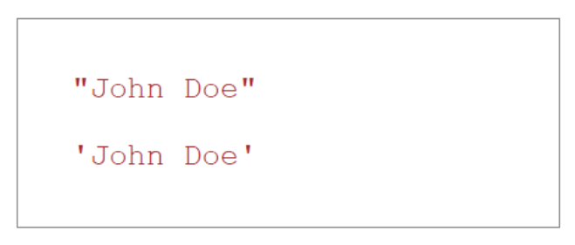
Literals
The two most important syntax rules for fixed values are:
Numbers are written with or without decimals:
Strings are text, written withing double or single quotes:

Slide 30
Variables
In most programming languages, variables are used to store data values.
JavaScript uses the var keyword to declare variables
An equal sign is used to assign values to variables
In this example x is defined as a variable. After, the integer 6 is assigned to the variable
var x;
x = 6;

Slide 31
Variables - Let
With ES6 it is also possible to declare variables with let. The difference between let and var is:
var can be reassigned and redeclared (multiple times)
let can be reassigned but not be redeclared
The good point: You cannot “accidentally” redeclare a variable
let x = "John Doe"; let x = 0; // SyntaxError: 'x' has already been declared
x = "John Petterson"; // This works

Slide 32
Variables - Const
With ES6 it is also possible to declare variables with let. The difference between const and var is:
var can be reassigned and redeclared (multiple times)
const can not be reassigned and not be redeclared
You cannot accidentally reassign or redeclare a variable
const PI = 3.141592653589793; PI = 3.14; // This will give an error PI = PI + 10; // This will also give an error

Slide 33


Variables Overview
var
Assignement: var x = "John Doe"; Redeclaration: var x = 0;
Reassignement : x = 0;
let
Assignenment: let x = "John Doe"; Redeclaration: let x = 0;
Reassignement : x = 0;
const
Assignement: const x = "John Doe"; Redeclaration: const x = 0;
Reassignement : x = 0;
It is possible to mix and match all three but recommended to use let & const.
The only exception is if you must support older browsers

Slide 34
Operators
JavaScript uses arithmetic operators (+ - * / ) to compute values:
JavaScript uses an assignment operator ( = ) to assign values to variables:
(5 + 6) * 10
var x, y;
x = 5; y = 6;

Slide 35
Expressions
An expression is a combination of values, variables and operators, which computes to a value.
The computation is called an evaluation
Example: 5 * 3 evaluates to 15:
5 * 3

Slide 36
Expressions (cont.)
Expressions are also able to contain variable values:
The values can be of various types, such as numbers and strings.
Example, "John" + " " + "Doe", evaluates to "John Doe":
x * 3
"John" + " " + "Doe"

Slide 37
Keywords
JavaScript keywords are used to identify "actions" to be performed
The var keyword tells the browser to create one or more variables:
var x, y;
x = 5 + 6; y = x * 6;

Slide 38
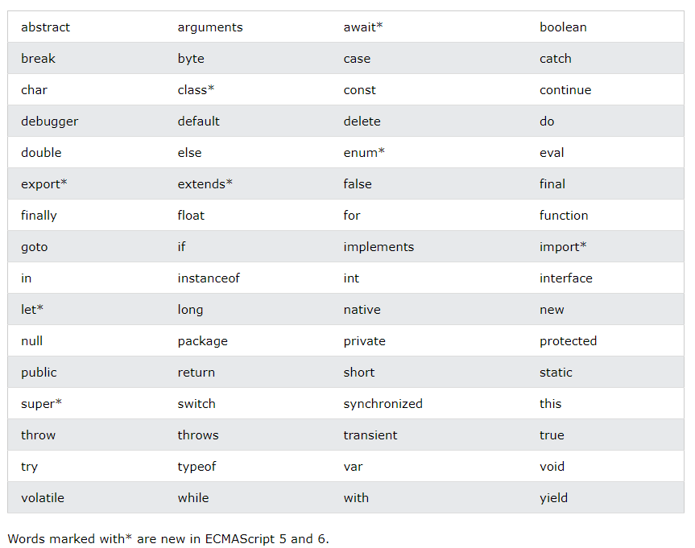
Keywords (cont.)

Slide 39
Comments
Not all JavaScript statements are "executed".
Code after double slashes // or between /* and */ is treated as a comment.
Comments are ignored, and will never be executed or evaluated.
var x = 5; // I will not be executed
// z = x + y; I will not be executed

Slide 40
Case sensitive
All JavaScript identifiers are case sensitive.
The variables lastname and lastName, are two different variables:
JavaScript does not interpret VAR or Var as the keyword var.
var lastname, lastName; lastname = "Doe"; lastName = "Peterson";

Slide 41
JavaScript and CamelCase
Historically, programmers have many ways of joining multiple words into variable names:
Hyphens: first-name, last-name, master-card, inter-city
Underscore: first_name, last_name, master_card, inter_city
Upper CamelCase: FirstName, LastName, MasterCard, InterCity
Lower camelCase: firstName, lastName, masterCard, interCity
JavaScript programmers tend to use Lower camelCase.
But the most important rule is to be consistent in your choice.

Slide 42
Where to

Slide 43

The HTML DOM
DOM = Document Object Model

Slide 44
The <script> Tag
In HTML, JavaScript code is inserted between <script> and </script> tags.
<script> document.getElementById("demo").innerHTML = "My first JavaScript"; </script>
TRY IT >>

Slide 45
In <head>, <body> and <footer>
You can place any number of scripts in an HTML document.
Scripts can be placed in the <body>, the <head> or the <footer> section of an HTML page. Or in all of them.
If your script needs to be loaded before the HTML page, place it in the <head> section.
If your script can be loaded with the HTML page, place it in the <body> section.
If it is ok that the script is loaded after the HTML page, place it in the <footer> section (best choice for performance).
TRY IT >>

Slide 46
External JavaScript
External scripts are practical when the same code is used in many different web pages.
JavaScript files have the file extension .js. The script will behave as if it was located exactly where the <script> tag is located.
To use an external script, put the name of the script in the src (source) attribute of a <script> tag:
<script src="myScript.js"></script> <script src="myScript2.js"></script>

Slide 47
Variables

Slide 48
Variables
JavaScript variables are containers for storing data values.
In this example, x, y, and z are variables declared with the var keyword:
var x = 5; var y = 6; var z = x + y;

Slide 49
Algebra?
In this example, price1, price2, and total are variables:
In programming, just like in algebra, we use variables (like price1) to hold values.
In programming, just like in algebra, we use variables in expressions (total = price1 + price2).
From the example above, you can calculate the total to be 11.
var price1 = 5; var price2 = 6; var total = price1 + price2;

Slide 50
Identifiers
All JavaScript variables must be identified with unique names.
These unique names are called identifiers.
Identifiers can be short names (like x and y) or more descriptive names (age, sum, totalVolume).
The general rule for constructing names for variables (unique identifiers) are:
Names can contain letters, digits, underscores and dollar signs
Names must begin with a letter
Names can also begin with $ and _ (rarely used)
Names are case sensitive (y and Y are different variables)
Reserved words (keywords) cannot be used as names
In programming, just like in algebra, we use variables (like price1) to hold values.
In programming, just like in algebra, we use variables in expressions (total = price1 + price2).
From the example above, you can calculate the total to be 11.

Slide 51
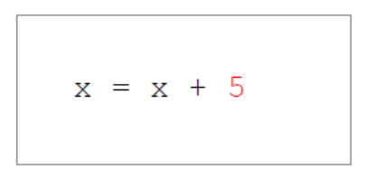
Assignment operator
In JavaScript, the equal sign (=) is an assignment operator, not an "equal to" operator. This is different from algebra!
The following does not make sense in algebra:
In JavaScript, however, it makes perfect sense:
It assigns the value of x + 5 to x.
It calculates the value of x + 5 and "puts" the result into x. The value of x is incremented by 5.
Hint: Equal to is == in JavaScript

Slide 52
Data types
JavaScript variables can hold numbers like 100 and text values like "John Doe".
In programming, text values are called text strings.
JavaScript can handle many types of data, but for now just think of numbers and strings.
Strings are written inside double or single quotes.
Numbers are written without quotes.
If you put a number in quotes, it will be treated as a text string.
var pi = 3.14; var person = "John Doe"; var person = 'John Doe';

Slide 53
Declaring (creating) JavaScript Variables
Creating a variable in JavaScript is called "declaring" a variable.
You declare a JavaScript variable with the var keyword:
After the declaration, the variable has no value (technically it has the value of undefined).
But, you can also assign a value to the variable when you declare it:
var carName;
carName = "Volvo";
var carName = "Volvo";

Slide 54
Arithmetic
As with algebra, you can do arithmetic with JavaScript variables using operators like = and +;
You can also use strings, but they will be concatenated:
var x = 5 + 2 + 3;
var x = "John" + " " + "Doe";

Slide 55
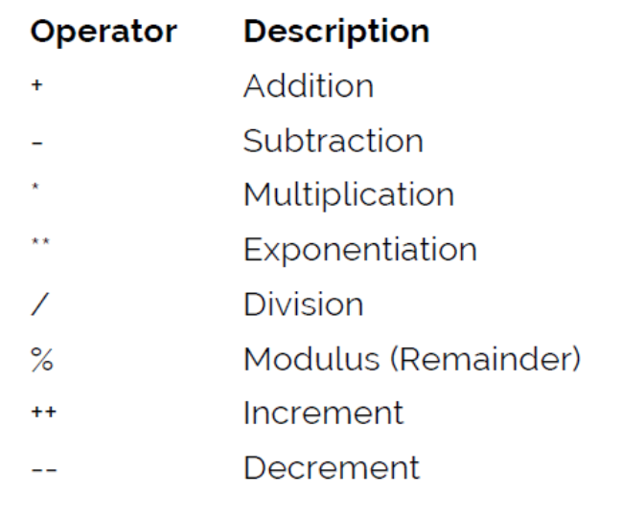
Arithmetic Operators
Arithmetic operators perform arithmetic on numbers (literals or variables).

Slide 56
Exercise 1
Create a variable called carName, assign the value Volvo to it.
Create a variable called x, assign the value 50 to it.
Display the sum of 5 + 10 in a paragraph called "demo", using two variables x and y.
Create a variable called z, assign x + y to it, and display the result in an alert box.
On one single line, declare three variables with the following names and values:
firstName = "John" / lastName = "Doe" / age = 35

Slide 57
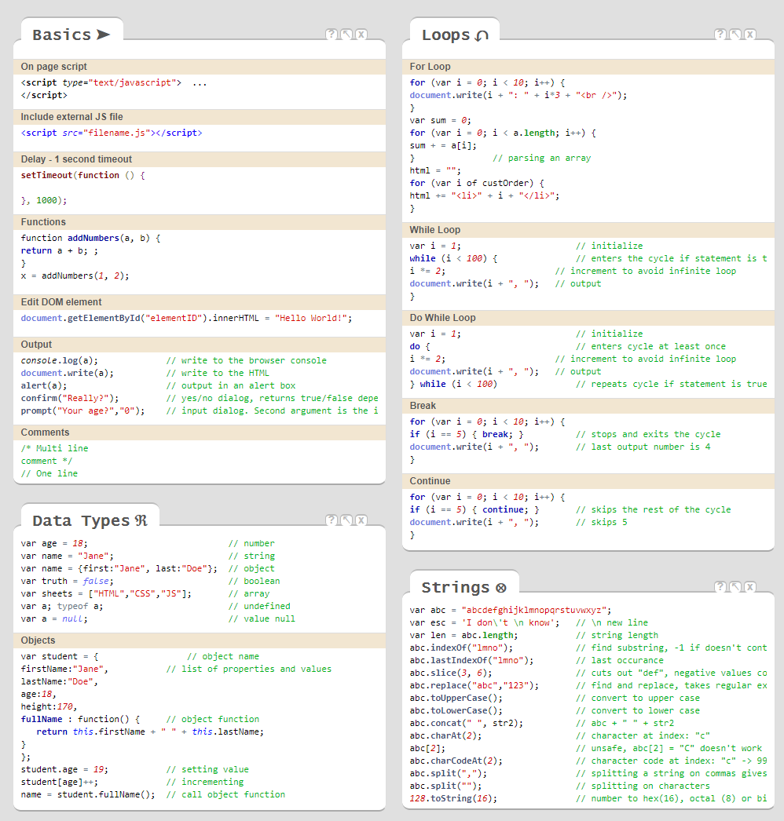
JS CheatSheet
https://htmlcheatsheet.com/js/
And HTML:
https://htmlcheatsheet.com/

Slide 58
Functions

Slide 59
Functions
A JavaScript function is a block of code designed to perform a particular task.
A JavaScript function is executed when "something" invokes (calls) it.
function myFunction(p1, p2) { return p1 * p2; // The function returns the product of p1 and p2 }
myFunction(5, 6);
TRY IT >>

Slide 60
Function Syntax
A JavaScript function is defined with the function keyword, followed by a name, followed by parentheses ().
Function names can contain letters, digits, underscores, and dollar signs (same as with variables)
The parentheses may include parameter names separated by commas: (parameter1, parameter2, …)
The code to be executed, by the function, is placed inside curly brackets: {}
function name(parameter1, parameter2, parameter3) { // Code to be executed }

Slide 61
Function Syntax (cont.)
Function parameters are listed inside the parentheses () in the function definition.
Function arguments are the values received by the function when it is invoked.
Inside the function, the arguments behave as local variables.
A function is much the same as a procedure or a subroutine in other programming languages.
Parameter(s)
function name(parameter1, parameter2, parameter3) { window.alert(parameter1); }
argument

Slide 62
Function Invocation
The code inside the function will execute when "something" invokes (calls) the function:
When an event occurs (when a user clicks a button)
When it is invoked (called) from JavaScript code
Automatically (self invoked)

Slide 63
Function Return
When JavaScript reaches a return statement, the function will stop executing (processing).
If the function was invoked from a statement, JavaScript will "return" to execute the code after the invoking statement.
Functions often compute a return value. The return value is "returned" back to the "caller" (jump back).
<script> let x = myFunction(4, 3); // Function is called, return value will end up in x console.log(x) function myFunction(a, b) { return a * b; } </script>
TRY IT >>

Slide 64
Why Functions?
You can reuse code: Define the code once, and use it many times.
You can use the same code many times with different (input) arguments, to produce different results.

Slide 65
Exercise 2
Convert Fahrenheit to Celsius:
C = (5/9) * (F – 32)
Create a function called "toCelcius" with the Fahrenheit values as parameter
Try it in an Editor (Visual Studio Code / Webstorm) or Online

Slide 66
Exercise Solution
Convert Fahrenheit to Celsius:
<script> function toCelsius(fahrenheit) { return (5/9) * (fahrenheit - 32); } document.getElementById("demo").innerHTML = toCelsius(88); </script>

Slide 67
The () operator invokes the function
Using the former example, toCelsius refers to the function object, and toCelsius() refers to the function result.
Spot the small difference of the parentheses ()
Accessing a function without () will return the function object instead of the function result
<script> function toCelsius(fahrenheit) { return (5/9) * (fahrenheit - 32); } document.getElementById("demo").innerHTML = toCelsius; </script>
TRY IT >>

Slide 68
Function used as variable values
Functions can be used the same way as you use variables, in all types of formulas, assignments and calculations.

Slide 69
Function used as variable values (cont.)
Functions can be used the same way as you use variables, in all types of formulas, assignments and calculations.
Instead of using a variable to store the return value of a function:
<script> function toCelsius(fahrenheit) { return (5/9) * (fahrenheit - 32); } let x = toCelsius(88); let text = "The temperature is " + x + " Celsius"; </script>

Slide 70
Function used as variable values (cont.)
Or even direct while calling:
<script> function toCelsius(fahrenheit) { return (5/9) * (fahrenheit - 32); } let text = "The temperature is " + toCelsius(88) + " Celsius"; </script>

Slide 71
Exercise 3
Create and execute a function with an alert box that says "Hello World!"
Modify that function so it return that message (as opposed to the alert box).
Use that function to change an inner HTML's value of an element with the ID "demo"
Try it in an Editor (Visual Studio Code / Webstorm) or Online

Slide 72
Objects

Slide 73
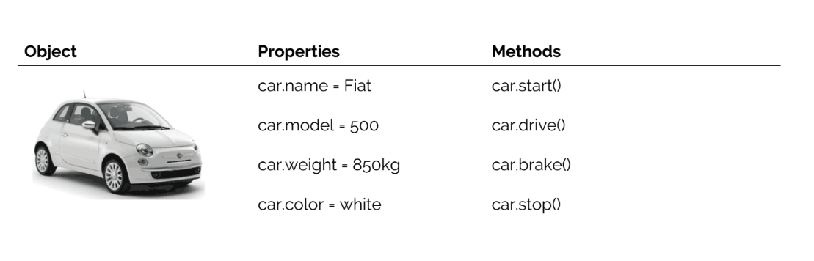
Real life objects, properties and methods
All cars have the same properties, but the property values differ from car to car.
All cars have the same methods, but the methods are performed at different times.

Slide 74
Objects
You have already learned that JavaScript variables are containers for data values.
This code assigns a simple value (Fiat) to a variable named car:
<script> let car = "Fiat"; </script>

Slide 75
Objects (cont.)
Objects are variables too.
But objects can contain many values.
The values are written as name:value pairs (name and value separated by a colon).
This code assigns many values (Fiat, 500, green) to a variable named car:
<script> let car = {type: "Fiat", model: "500", color: "green"}; </script>

Slide 76
Object definition
You define (and create) a JavaScript object with an object literal:
Spaces and line breaks are not important.
An object definition can span over multiple lines.
<script> let person = {firstName: "John", lastName: "Doe", age: 50, eyeColor: "blue" }; </script>

Slide 77
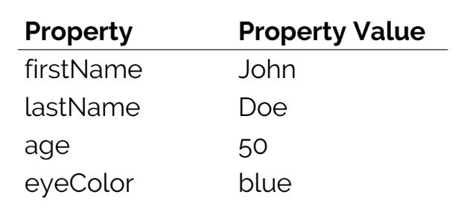
Object Properties
The name:values pairs in JavaScript objects are called properties:

Slide 78
Accessing Object Properties
You can access object properties in two ways:
Or:
objectName.propertyName
objectName["propertyName"]

Slide 79
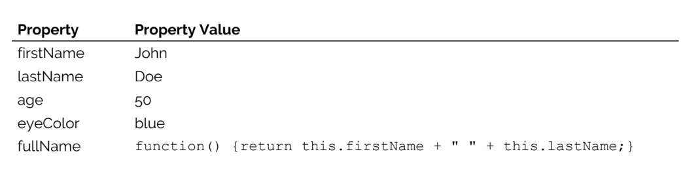
Object Methods
Objects can also have methods (similar to functions).
Methods are actions that can be performed on objects.
Methods are stored in properties as function definitions.

Slide 80
Object Methods
A method is a function stored as a property.
let person = { firstName: "John", lastName: "Doe", id: 5566, fullName: function () { return this.firstName + " " + this.lastName; } };

Slide 81
The "this" Keyword
In a function definition, this refers to the "owner" of the function.
In the example before, this is the person object that "owns" the fullName method.
In other words, this.firstName means the firstName property of this object.

Slide 82
Accessing Object Methods
You can access object methods in two ways:
Or:
objectName.methodName()
name = this.fullName()

Slide 83
Exercise 4
Create a "person" object with first name "John", last name "Doe"
Alert "John" by extracting information from the person object.
Add the property "country" with the value "Norway" to the person object.
Add the property "age" with the value 50 to the person object.
Finally, alert ("John is 50 and lives in Norway").
Try it in an Editor (Visual Studio Code / Webstorm) or Online

Slide 84
Exercise Solution
let person = { firstName: "John", lastName: "Doe", country: "Norway",
age: 50, }; alert(person.firstName + " is " + person.age + " and lives in " + person.country);

Slide 85
Conditional Statements

Slide 86
Conditional statements
Very often when you write code, you want to perform different actions for different decisions.
You can use conditional statements in your code to do this.
In JavaScript we have the following conditional statements:
Use if to specify a block of code to be executed, if a specified condition is true
Use else to specify a block of code to be executed, if the same condition is false
Use else if to specify a new condition to test, if the first condition is false
Use switch to specify many alternative blocks of code to be executed

Slide 87
The if statement
Use if to specify a block of code to be executed, if a specified condition is true
if (condition) { // block of code to execute if the condition is true }

Slide 88
The if statement (cont.)
Make a "Good day!" greeting if the hour is less than 18:00:
if (hour < 18) { greeting = "Good day!" }

Slide 89
Conditional statements
Use else to specify a block of code to be executed, if the same condition is false
if (condition) { // block of code to execute if the condition is true } else {
// block of code to execute if the condition is false
}

Slide 90
The if statement (cont.)
If the hour is less than 18:00, create a "Good day!" greeting, otherwise "Good evening":
if (hour < 18) { greeting = "Good day!" } else { greeting = "Good evening!" }

Slide 91
Conditional statements
Use else if to specify a new condition to test, if the first condition is false
if (condition1) { // block of code to execute if the condition1 is true } else if (condition2) {
// block of code to execute if the condition1 is false and condition2 is true
} else {
// block of code to execute if the condition1 and condition2 is false
}

Slide 92
The if statement (cont.)
If time is less than 10:00, create a "Good morning!" greeting, if not, but time is less than 20:00, create a "Good day!" greeting, in all other cases, a "Good evening" greeting:
It is important to note, that JavaScript works "Top-Down" here!
if (hour < 10) { greeting = "Good morning!" } else if (hour < 20) { greeting = "Good day!" } else { greeting = "Good evening!" }

Slide 93
Conditional statements
Use switch to specify many alternative blocks of code to be executed
switch (hour) { case "10": alert("It is 10 o'clock"); case "11": alert("It is 11 o'clock"); case "12": alert("It is 12 o'clock"); case "13": alert("It is 1 o'clock"); }

Slide 94
Exercise 4
Create an if statement that uses the variable numberOfTheMonth to alert the user. Conditions:
When numberOfTheMonth is less than 3 → Winter
When numberOfTheMonth is less than 6 → Spring
When numberOfTheMonth is less than 9 → Summer
When numberOfTheMonth is less than 12 → Fall
Try it in an Editor (Visual Studio Code / Webstorm) or Online

Slide 95
Exercise Solution
if (numberOfTheMonth < 3) { alert("Winter"); } else if (numberOfTheMonth < 6) { alert("Spring"); } else if (numberOfTheMonth < 9) { alert("Summer"); } else { alert("Fall"); }

Slide 96
Arrays

Slide 97
What is an array?
An array is a special variable, which can hold more than one value at a time.
If you have a list of items (a list of car names, for example), storing the cars in a single variable could look like this:
let car1 = "Fiat"; let car2 = "Tesla"; let car3 = "Subaru";

Slide 98
What is an array? (cont.)
However, what if you want to loop through the cars and find a specific one? And what if you had not 3 cars, but 3000?
The solution is an array!
An array can hold many values under a single name, and you can access the values by referring an index number.

Slide 99
Creating an array
Using an array literal is the easiest way to create a JavaScript Array
Syntax:
let array_name = [item1, item2, item3, ...];

Slide 100
Creating an array (cont.)
Example:
Spaces and line breaks are not important.
A declaration can span multiple lines:
let cars = ["Fiat", "Tesla", "Subaru"];
let cars = [
"Fiat",
"Tesla",
"Subaru"
];

Slide 101
Using the keyword new
The following example also creates an Array, and assigns values to it:
let cars = new Array("Fiat", "Tesla", "Subaru");

Slide 102
Access the elements of an array
You can access an array element by referring to the index number.
This statement accesses the value of the first element in cars:
Example:
let specialName = [0];
let cars = ["Fiat", "Tesla", "Subaru"]; document.getElementById("demo").innerHTML = cars[0];

Slide 103
Changing an array element
This statement changes the value of the first element in cars:
let cars = ["Fiat", "Tesla", "Subaru"]; cars[0] = "Opel"; document.getElementById("demo").innerHTML = cars[0];

Slide 104
Access the full array
With JavaScript, the full array can be accessed by referring to the array name:
let cars = ["Fiat", "Tesla", "Subaru"]; document.getElementById("demo").innerHTML = cars;

Slide 105
Loops

Slide 106
Loops
Loops are handy, if you want to run the same code repeatedly, each time with a different value.
Often this is the case when working with arrays:

Slide 107
Loops
Instead of writing:
You can write:
text += cars[0] + "<br />"; text += cars[1] + "<br />"; text += cars[2] + "<br />"; text += cars[3] + "<br />"; text += cars[4] + "<br />"; text += cars[5] + "<br />";
let i; for (i = 0; i < cars.length; i++) { text += cars[i] + "<br />"; }
TRY IT >>

Slide 108
Loops
JavaScript supports different kinds of loops:.
for – loops through a block of code several times
for/in – loops through the properties of an object
for/of – loops through the values of an iterable object
while – loops through a block of code while a specified condition is true
do/while – also loops through a block of code while a specified condition is true

Slide 109
The for loop
The for loop has the following syntax:
Statement 1: Is executed (one time) before the execution of the code block.
Statement 2: defines the condition for executing the code block.
Statement 3: Is executed (every time) after the code block has been executed.
for (statement 1; statement 2; statement 3) { // code block to be executed }

Slide 110
The for loop (cont.)
Example
From the example above, you can read:
Statement 1: sets a variable before the loop starts (let i = 0).
Statement 2: defines the for the loop to run (i needs to be less than 5, i < 5).
Statement 3: Increases a value (i++) each time the code block in the loop has been executed.
for (let i = 0; i < 5; i++) { text += "The number is " + i + "<br />"; }
TRY IT >>

Slide 111
Statement 1
Normally you will use statement 1 to initialize the variable used in the loop (let i = 0).
This is not always the case; JavaScript does not care. Statement 1 is optional.
You can initiate many values in statement 1 (separated by comma)
for (let i = 0, len = cars.length, text = i; i < 5; i++) { text += "The number is " + i + "<br />"; }

Slide 112
Statement 1
And you can omit statement 1 completely, if the values are set beforehand.
let i = 0, len = cars.length, text = i; for (; i < 5; i++) { text += "The number is " + i + "<br />"; }
TRY IT >>

Slide 113
Statement 2
Often statement 2 is used to evaluate the condition of the initial variable.
This is not always the case; JavaScript does not care. Statement 2 is optional as well.
If statement 2 returns true, the loop will start over again, if it returns false, the loop will end.

Slide 114
Statement 3
Often statement 2 increments the value of the initial variable.
This is not always the case; JavaScript does not care. Statement 3 is optional as well.
Statement 3 can do anything like negative increment (i--), positive increment (i = i + 15), or anything else.
Statement 3 can also be omitted (like when you increment your values inside the loop):
let i = 0, len = cars.length; for (; i < 5;) { text += "The number is " + i + "<br />"; i++; }
TRY IT >>

Slide 115
Exercise 5
Create a loop that runs from 0 to 9. It starts with the value 0 and adds 1 after each loop. Display the numbers by using document.write() and with a line break in between each other.
Try it in an Editor (Visual Studio Code / Webstorm) or Online

Slide 116
Exercise Solution
for (let i = 0; i < 10; i++) { document.write(i + "<br />") }

Slide 117
The for in loop
The JavaScript for in statement loops through the properties of an object:
for (key in object) { // code block to be executed }

Slide 118
The for in loop (cont.)
How would that look like for our "John Doe" Object?
Explanation:
The for in loop iterates over a person object
Each iteration returns a key (x)
The key is used to access the value of the key
The value of the key is person[x]
const person = {firstName:"John", lastName:"Doe", age:25}; let text = ""; for (let x in person) { text += person[x]; }
TRY IT >>

Slide 119
The for of loop (ES6 feature)
The JavaScript for of statement loops through the values of an iterable object.
variable - For every iteration the value of the next property is assigned to the variable. Variable can be declared with const, let, or var.
iterable - An object that has iterable properties.
for (variable of iterable) { // code block to be executed }

Slide 120
The for of loop (cont.)
Back to our car example:
const cars = ["Fiat", "Tesla", "Subaru"]; let text = ""; for (let x of cars) { text += x; }
TRY IT >>

Slide 121
While Loop
The while loop loops through a block of code as long as a specified condition is true.
Example:
while (condition) { // code block to be executed }
while (i < 10) { text += "The number is " + i; i++; }
Important: If you forget to increase the variable used in the condition, the loop will never end. This will crash your browser.
TRY IT >>

Slide 122
Do While Loop
The do while loop is a variant of the while loop. This loop will execute the code block once, before checking if the condition is true, then it will repeat the loop as long as the condition is true.
Example:
do { // code block to be executed } while (condition);
do { text += "The number is " + i; i++; } while (i < 10);
TRY IT >>

Slide 123
HTML DOM

Slide 124
Topics
Intro
Methods
Document
Elements
HTML
CSS

Slide 125
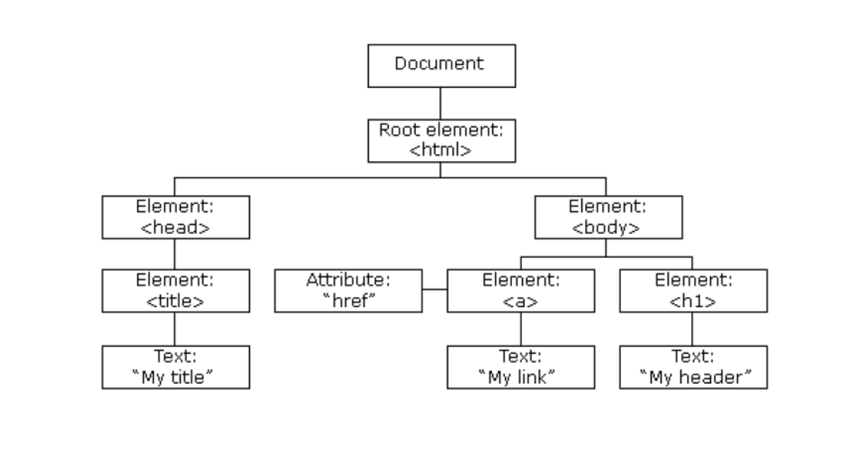
The HTML DOM
When a web page is loaded, the browser creates a Document Object Model of the page.
The HTML DOM model is constructed as a tree of Objects:

Slide 126
The HTML DOM
With the object model, JavaScript gets all the power it needs to create dynamic HTML:
JS can change all the HTML elements in the page
JS can change all the HTML attributes in the page
JS can change all the CSS styles in the page
JS can remove existing HTML elements and attributes
JS can add new HTML elements and attributes
JS can react to all existing HTML events in the page
JS can create new HTML events in the page

Slide 127
What is the HTML DOM
The HTML DOM is a standard object model and programming interface for HTML. It defines:
The HTML elements as objects
The properties of all HTML elements
The methods to access all HTML elements
The events for all HTML elements
In other words: The HTML DOM is a standard for how to get, change, add, or delete HTML elements.

Slide 128
HTML DOM Methods
HTML DOM methods are actions you can perform (on HTML elements).
HTML DOM properties are values (of HTML elements) that you can set or change.

Slide 129
HTML DOM Methods
The following example changes the content (the innerHTML) of the <p> element with id="demo":
In this example, getElementById is a method, while innerHTML is a property.
<html lang="en"> <body> <p id="demo"></p> <script> document.getElementById("demo").innerHTML = "Hello World!"; </script> </body> </html>

Slide 130
The getElementById Method
The most common way to access an HTML element is to use the id of the element.
This makes sense, because an id needs to be unique on a page
In the example before, the getElementById method used id="demo" to find the element.

Slide 131
The innerHTML Property
The easiest way to get the content of an element is by using the innerHTML property.
The innerHTML property is useful for getting or replacing the content of HTML elements.

Slide 132
The HTML DOM Document Object
The document object represents your web page.
If you want to access any element in an HTML page, you always start with accessing the document object.
On the next slides are some examples of how you can use the document object to access and manipulate HTML.

Slide 133
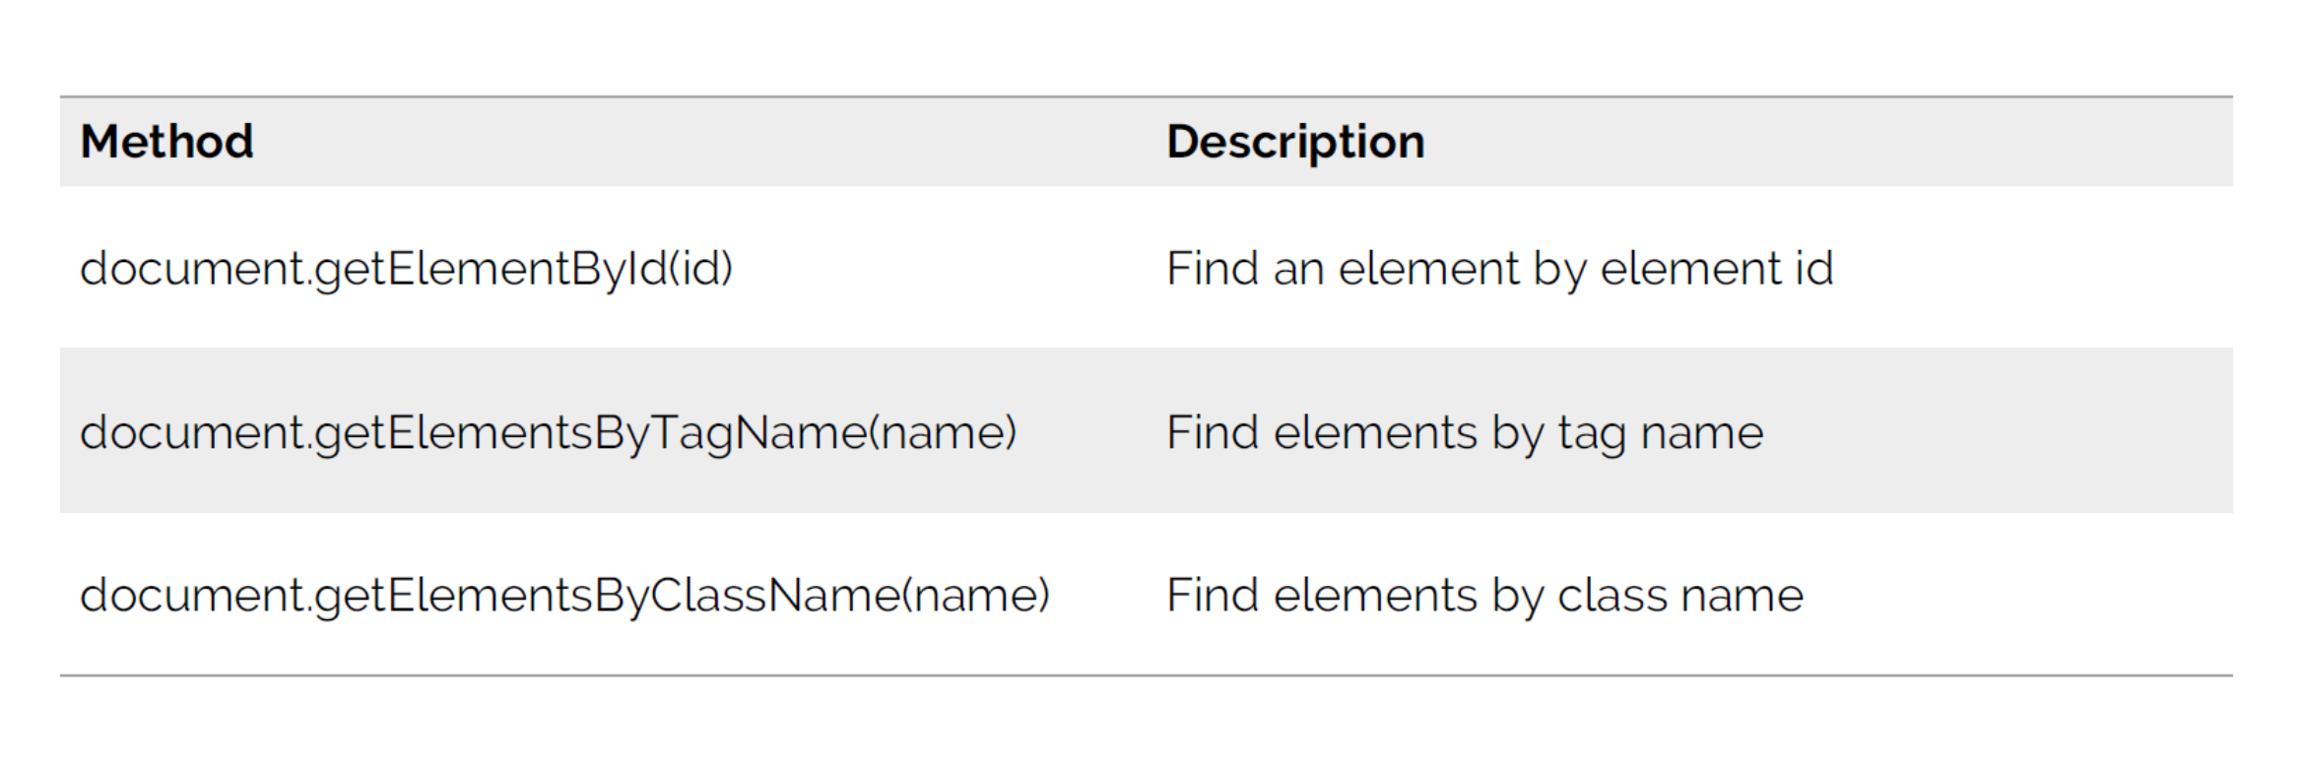
Finding HTML Elements

Slide 134
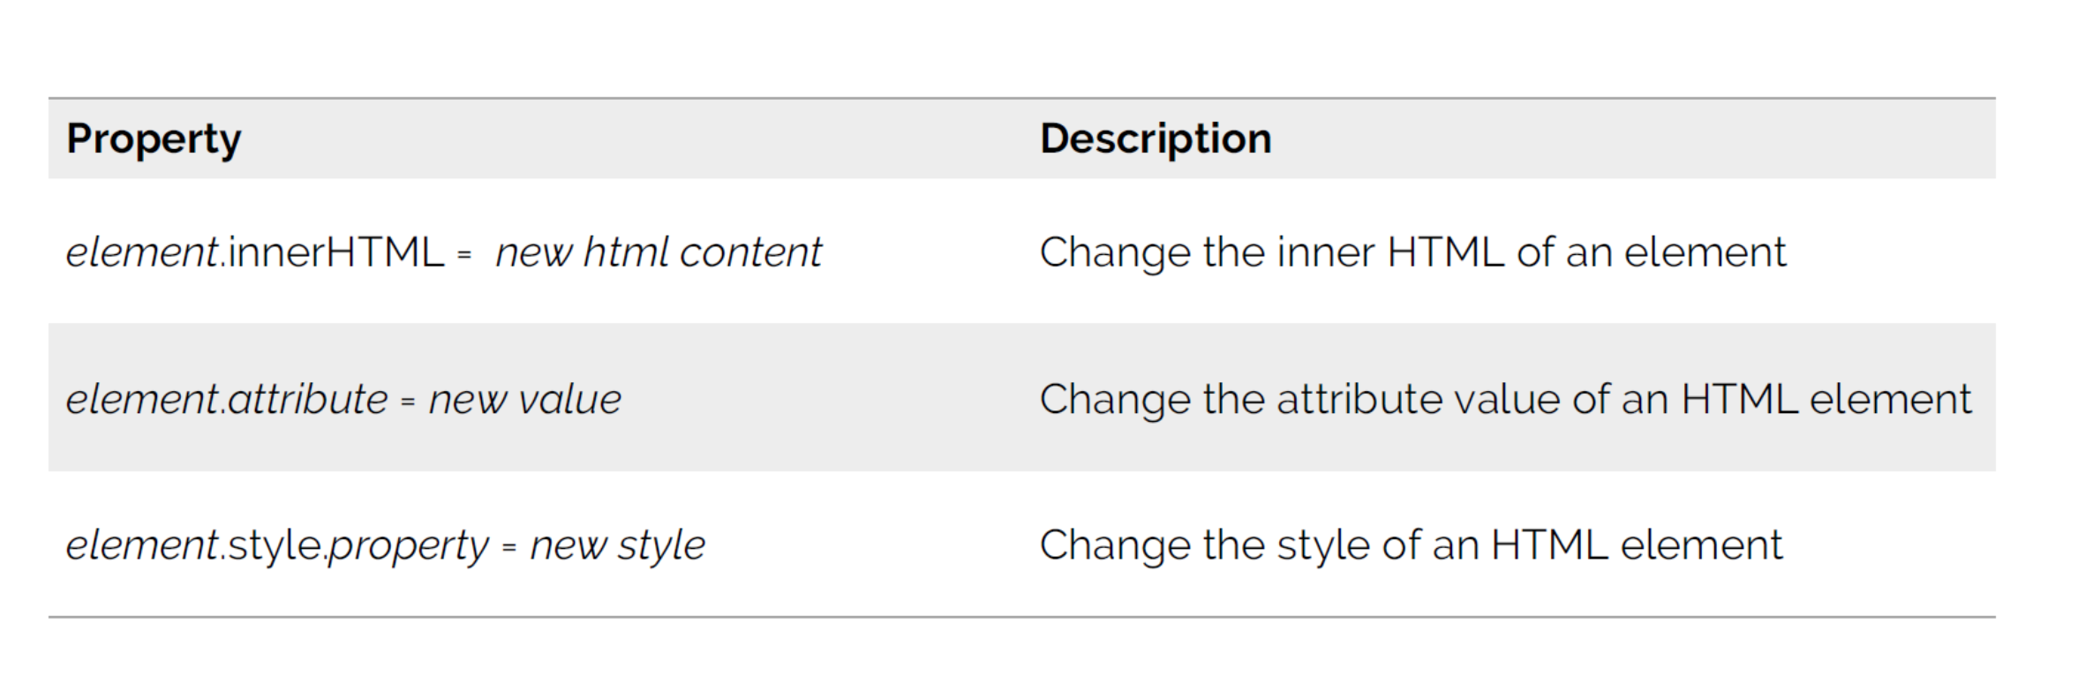
Changing HTML Elements

Slide 135
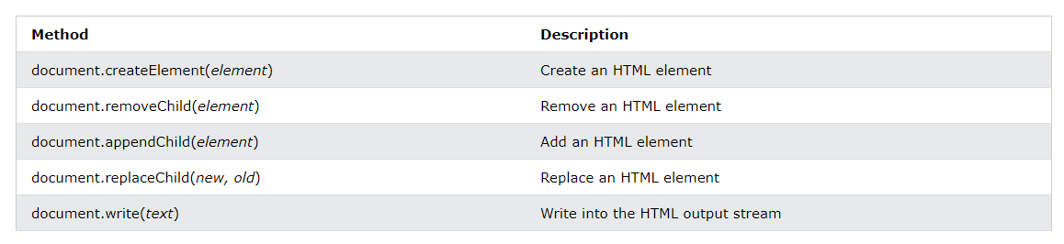
Adding or Deleting Elements

Slide 136
Further details
You can find many more details on:
JavaScript DOM Document (w3schools.com)

Slide 137
Changing HTML Content
The easiest way to modify the content of an HTML element is by using the innerHTML property.
To change the content of an HTML element, use this syntax:
document.getElementById(id).innerHTML = "new HTML"

Slide 138
Changing HTML Content (cont.)
Let's see this in action on www.digitec.ch with (with your F12 console):
Hint: No harm has been done with this experiment, since it is only viewable for you. But if it was in the source-code of digitec.ch, exactly the same would happen ☺
document.getElementById("pageContent").innerHTML = "<h1>Hello JavaScript course</h1>"

Slide 139
Changing HTML Content (cont.)
Here is a more generic example:
The HTML document contains an <img> element with id="myImage"
We use the HTML DOM to get the element with id="myImage"
A JavaScript changes the src attribute of that element from "smiley.gif" to "landscape.jpg"
<img id="myImage" src="smiley.gif"> <script> document.getElementById("myImage").src = "landscape.jpg" </script>
TRY IT >>

Slide 140
Changing CSS
To change the style of an HTML element, use this syntax:
document.getElementById(id).style.property = "new style"

Slide 141
Changing CSS (cont.)
The following example changes the style of a <p> element:
<p id="p1">Hello World!</p> <p id="p2">Hello World!</p> <script> document.getElementById("p2").style.color = "blue"; document.getElementById("p2").style.fontFamily = "Arial"; document.getElementById("p2").style.fontSize = "larger"; </script>
TRY IT >>

Slide 142
Using Events
The HTML DOM allows you to execute code when an event occurs.
Events are generated by the browser when "things happen" to HTML elements.

Slide 143
Using Events (cont.)
What are events?
When a user clicks the mouse
When a web page has loaded
When an image has been loaded
When the mouse moves over an element
When an input field is changed
When an HTML form is submitted
When a user strokes a key
… and many more
Find out more about events:
https://www.w3schools.com/js/js_htmldom_events.asp

Slide 144
Further information and reference
This course is based on the content of:
JavaScript Tutorial (w3schools.com)
And
https://wiki.selfhtml.org/wiki/JavaScript/Tutorials
And former JavaScript Courses at UZH by Alain A. Asik

Slide 145
JS Quiz

Slide 146
Quiz
Finally, a little quiz ☺
W3Schools Quiz v3.0
One hint: Mathematics are done with the "Math" object, and can be looked up here: JavaScript Math Object (w3schools.com)

Slide 147
End

