Slide 1
Aneuvis figures

Slide 2
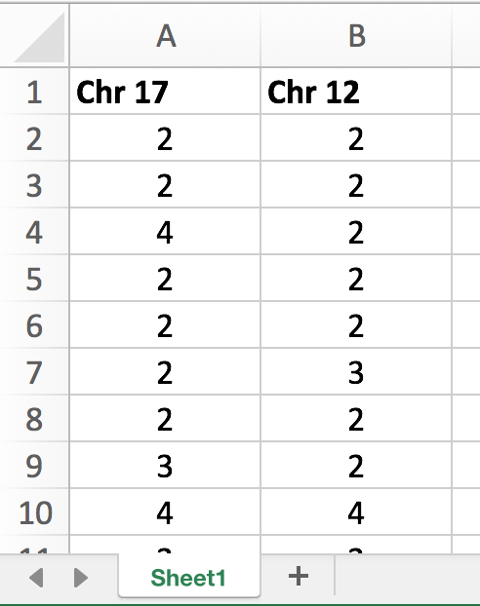
Each column is a chromosome (up to 4 columns)
First row is the name of each chromosome
Each row represents the number of chromosomes in an individual cell
Any name
.xls or .xlsx file

Slide 3
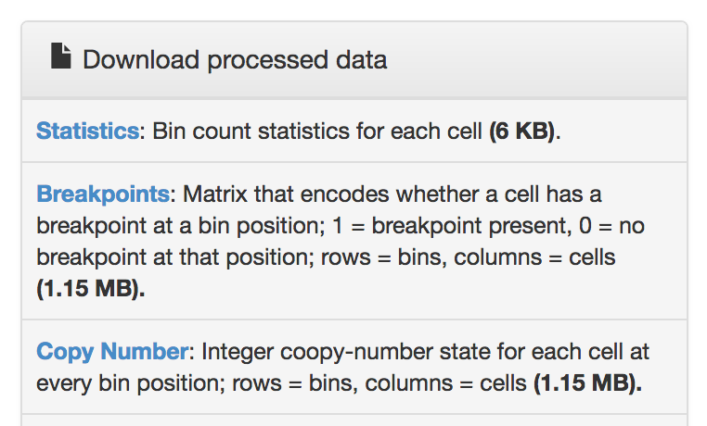
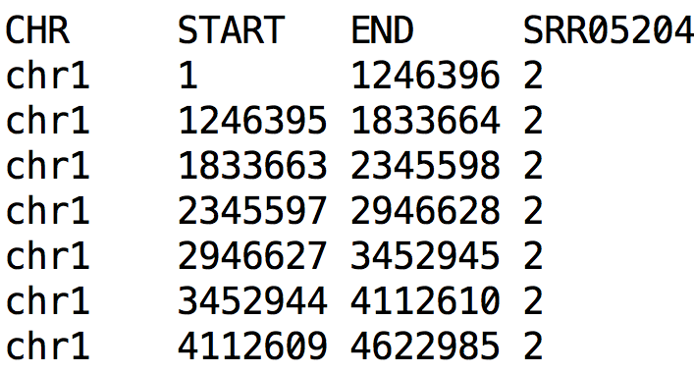
Screenshot from ginkgo website
These 3 columns are coordinates: the chromosome (CHR) plus the START and END position of each coordinate
1st row is the column names
http://qb.cshl.edu/ginkgo/?q=results/_t10breast_navin
Tab-separated file (.txt, .tsv)

Slide 4
These 3 columns are coordinates: the chromosome (CHR) plus the START and END position of each coordinate
Each subsequent column is an individual cell.
1st row contains column names. SRR05204 is the ID of 1 single cell
Each row is a chromosomal bin
Tab-separated file (.txt, .tsv)
Number of copies at 1 bin in 1 cell

Slide 5
Input
Copy number matrices
.bed
Display
File type
Cells
Summary
Heatmaps
Table
Inference
- Cross-platform
- Cross-label
.xls, .xlsx
Aneuvis
Chromosomes
Cells
Chromosomes
FISH
SKY, SC-WGS
Description
Visualization
Table summary
Inference
Comparison
- Cross-platform
-
Aneufinder
Ginkgo
Fluorescent labeling and counting
Treatment labels
.bam files
Visualization
Table summary
Experiment
Control vs Treatment A

Slide 6
Input
a
Copy number matrices
.bed
Display
Cells
Summary
Copy number heatmaps
Measures of chromosome number variation (Table)
Statistical Inference
- Between experimental platforms
- Between treatments
.xls, .xlsx
Aneuvis
Chromosomes
Cells
Chromosomes
FISH
SKY, SC-WGS
Aneufinder
Ginkgo
Fluorescent labeling and counting
Treatment labels
.bam files
Experiment
Control vs Treatment A
b

Slide 7
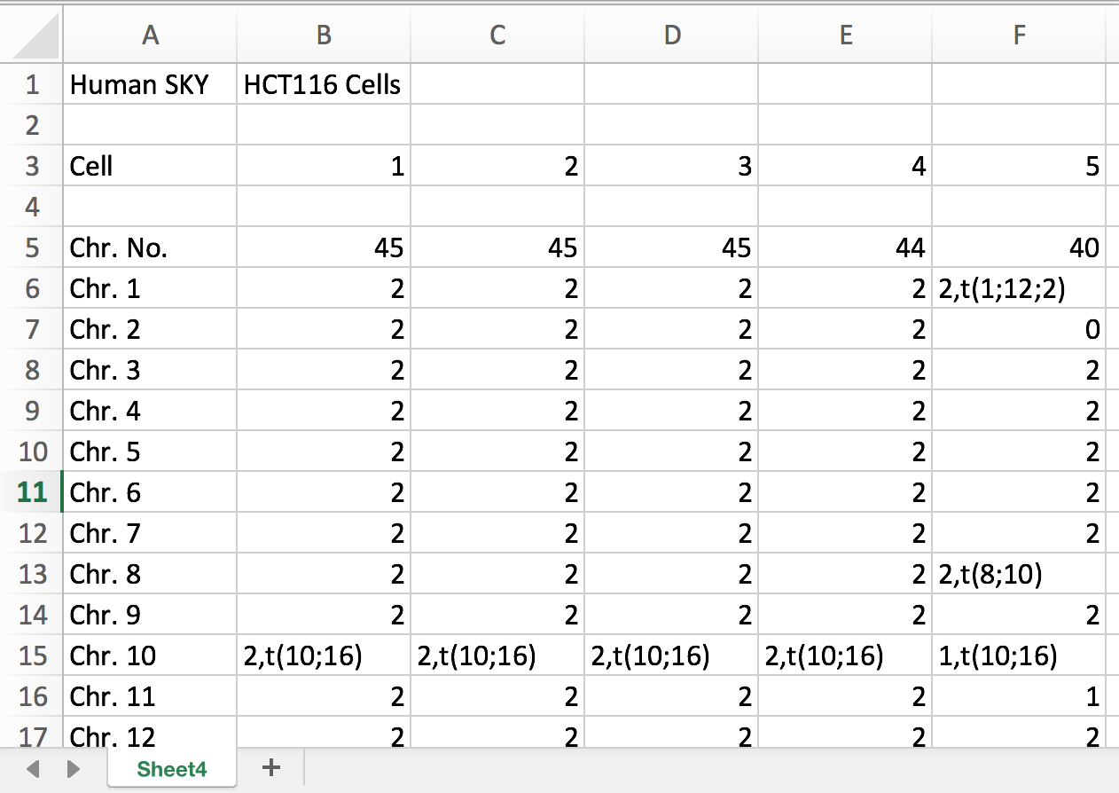
First column is the chromosome name
Each column is a cell
First row is the name of each chromosome
Optional header
Each row is a chromosome
Any name
.xls or .xlsx file
https://cgap.nci.nih.gov/Chromosomes/ISCNSymbols

Slide 8
Polyploidization rate

