Slide 1
Aneuvis figures

Slide 2
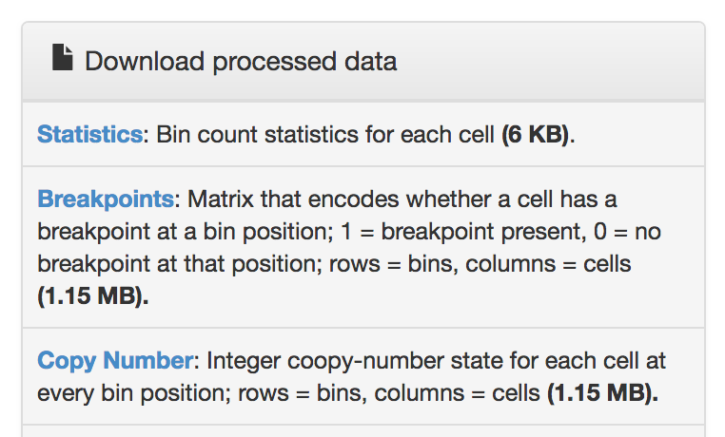
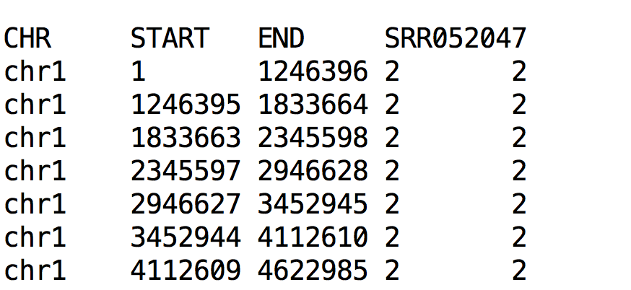
Screenshot from ginkgo website
These 3 columns are coordinates: the chromosome (CHR) plus the START and END position of each coordinate
1st row is the column names
http://qb.cshl.edu/ginkgo/?q=results/_t10breast_navin
Tab-separated file (.txt, .tsv)

Slide 3
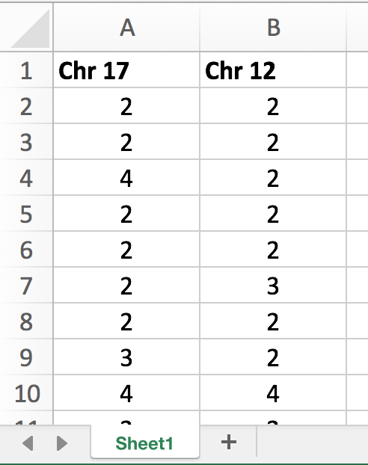
Each column is a chromosome (up to 4 columns)
First row is the name of each chromosome
Each row represents the number of chromosomes in an individual cell
Any name
.xls or .xlsx file

Slide 4
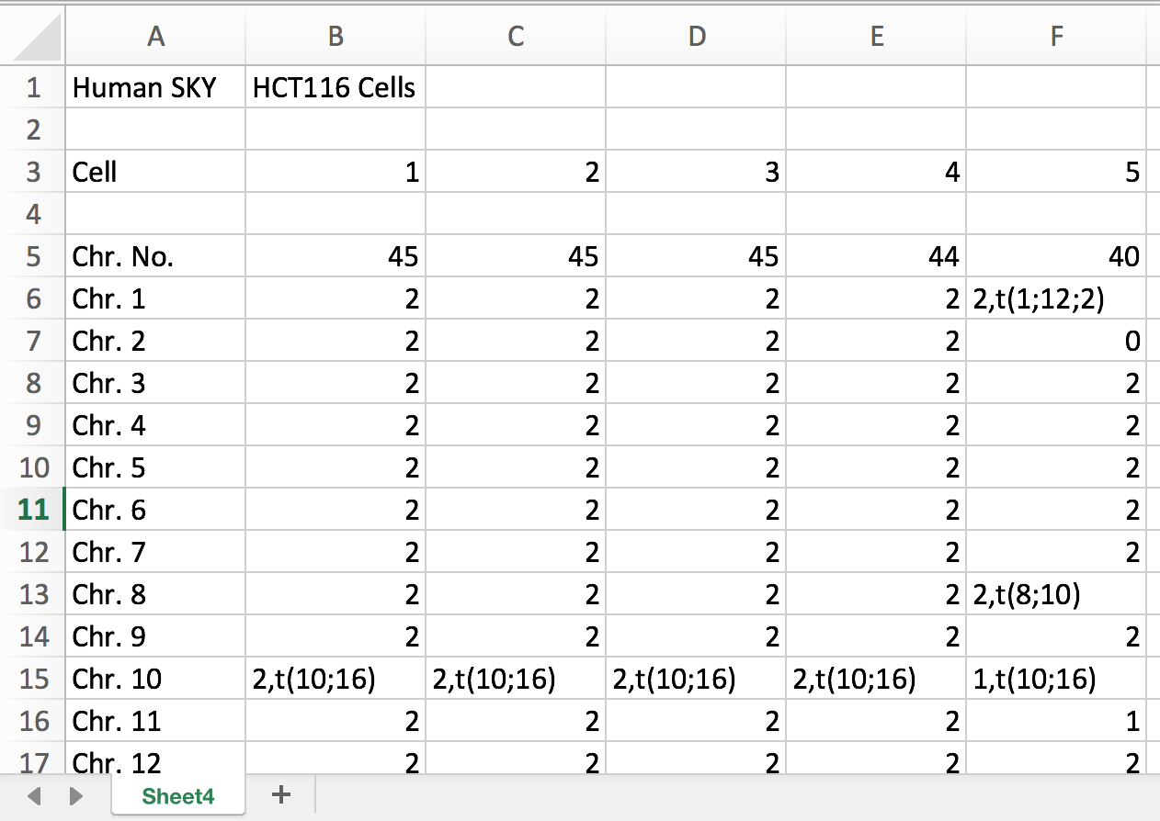
First column is the chromosome name
Each column is a cell
First row is the name of each chromosome
Optional header
Each row is a chromosome
Any name
.xls or .xlsx file
https://cgap.nci.nih.gov/Chromosomes/ISCNSymbols

Slide 5
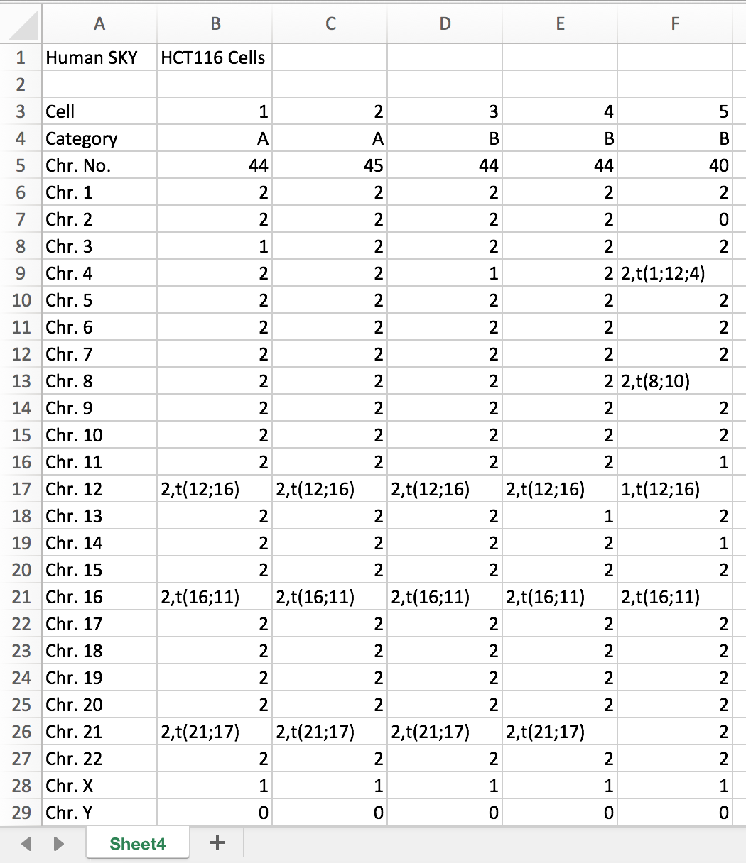
First column is the chromosome name.*
*All labels in the first column should match what is shown here
Each column is a cell
Optional header
Cell number (1, 2, …, n)
Category – indicates different patients
# of chromosomes (optional)
Integer indicating # of chromosomes
Each row is a chromosome
ISCN symbols are accepted
Any name
.xls or .xlsx file
https://cgap.nci.nih.gov/Chromosomes/ISCNSymbols

Slide 6
These 3 columns are coordinates: the chromosome (CHR) plus the START and END position of each coordinate
Each subsequent column is an individual cell.
1st row contains column names. SRR052047 is the ID of 1 single cell
Each row is a chromosomal bin
Tab-separated file (.txt, .tsv)
Number of copies at 1 bin in 1 cell

Slide 7
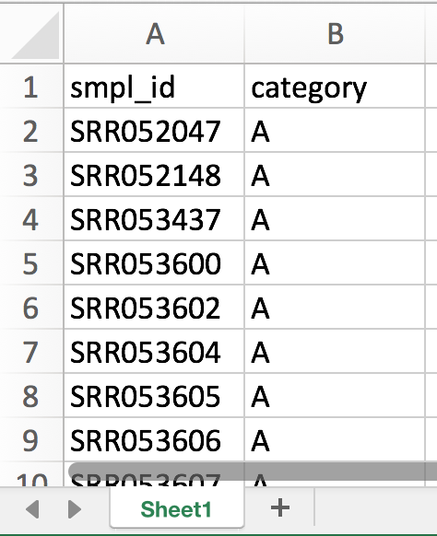
*Sample identifier
*Should match column names in copy number file
category
Column headers (should be named as shown here)
Each row corresponds to 1 sample

Slide 8
Input
Copy number matrices
.bed
Display
File type
Cells
Summary
Heatmaps
Table
Inference
- Cross-platform
- Cross-label
.xls, .xlsx
Aneuvis
Chromosomes
Cells
Chromosomes
FISH
SKY, SC-WGS
Description
Visualization
Table summary
Inference
Comparison
- Cross-platform
-
Aneufinder
Ginkgo
Fluorescent labeling and counting
Treatment labels
.bam files
Visualization
Table summary
Experiment
Control vs Treatment A

Slide 9
Input
a
Copy number matrices
.bed
Display
Cells
Summary
Copy number heatmaps
Measures of chromosome number variation (Table)
Statistical Inference
- Between experimental platforms
- Between treatments
.xls, .xlsx
Aneuvis
Chromosomes
Cells
Chromosomes
FISH
SKY, SC-WGS
Aneufinder
Ginkgo
Fluorescent labeling and counting
Treatment labels
.bam files
Experiment
Control vs Treatment A
b

Slide 10
Control vs Treatment A vs Treatment B
Patient A vs Patient B
Patient A vs Patient B
Between-group summary
Input
a
Copy number matrices
.bed
Display
Cells
Treatment-level summary
Copy number heatmaps
Measures of chromosome number variation (Table)
Statistical Inference
- Between experimental platforms
- Between treatments
.xls, .xlsx
Aneuvis
Chromosomes
Cells
Chromosomes
FISH
SKY, SC-WGS
Existing software
Treatment labels
Treatment B
Treatment A
Experiment
b
Control
Question: Do treatments A and B induce aneuploidy/CIN?

Slide 11

Question: Do treatments A and B induce aneuploidy/CIN?
a
Treatment B
.xls, .xlsx
.bed
Display
Chromosomes
Cells
Treatment A
Control
Experiment
Cells
Chromosomes
FISH
SKY, SC-WGS
FISH, SKY, SC-WGS
Experimental groups
Copy number matrices
Aneuvis
a
Input
User-friendly, interactive, open-source web application
Output
FISH
SKY
SC-WGS
Upload data and provide experimental labels
Gridplot
Treatment labels
Can we see any patterns?
Ternary plot
Chr. x Cell
Heatmap
Are there statistically significant differences between groups?
Summary tables
Treatment-level summary
Copy number heatmaps
Measures of chromosome number variation (Table)
Statistical Inference
- Between experimental platforms
- Between treatments
Permutation tests
Is there statistical significance?
Visualize
Summarize
Between treatments and experimental platforms

Slide 12


Question: Do treatments A and B induce aneuploidy/CIN?
a
b
Treatment B
.xls, .xlsx
.bed
Chromosomes
Cells
Treatment A
Experiment
Control
Cells
Chromosomes
FISH, SKY, SC-WGS
Experimental groups
Copy number matrices
c
Aneuvis summarizes numerical chromosomal changes between experimental groups.
FISH bivariate %-age heatmap
Copy number heatmap
Summary statistics
chromosomes
Cell state
Loss
User uploads copy number matrices and experimental groups.
Aneuvis automatically constructs summary statistics and visualizations
Gain
Upload
# chromosomes
chromosome
Score scatterplot
Ternary plot
Group (& Chromosome)
% diploid
Analysis
Aneuploidy
% aneu-ploid
% poly-ploid
Heterogeneity
Permutation
Notes:
is an interactive, open-source web application for summarizing
A single place for interactive analysis of chromosomal changes between groups

Slide 13
Question: Do treatments A and B induce aneuploidy/CIN?
a
b
Treatment B
.xls, .xlsx
.bed
Chromosomes
Cells
Treatment A
Experiment
Control
Cells
Chromosomes
FISH, SKY, SC-WGS
Experimental groups
Copy number matrices
c
Aneuvis summarizes numerical chromosomal changes between experimental groups.
FISH bivariate %-age heatmap
Copy number heatmap
User uploads copy number matrices and experimental groups
Summary statistics
chromosomes
Cell state
Loss
Gain
Upload
# chromosomes
chromosome
Automatic calculation of summary statistics and visualizations
Score scatterplot
Ternary plot
Group (& Chromosome)
% diploid
Analysis
Aneuploidy
Permutation tests check for significant differences between groups
% aneu-ploid
% poly-ploid
Heterogeneity
Permutation
Notes:
is an interactive, open-source web application for summarizing
A single place for interactive analysis of chromosomal changes between groups

Slide 14
Polyploidization rate

