Slide 1
Aneuvis - reported errors

Slide 2
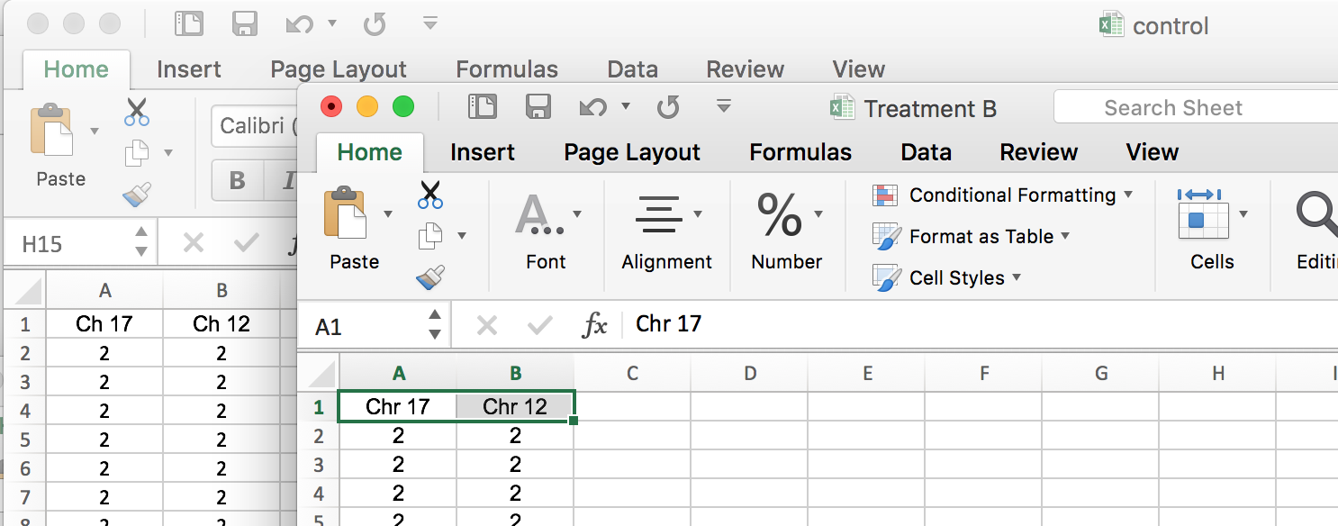
“Chr 17” vs “Ch 17”

Slide 4
If there’s an issue with encoding…
Try resaving the file without changing it (as the same name). Then try reuploading the file again

