Slide 1
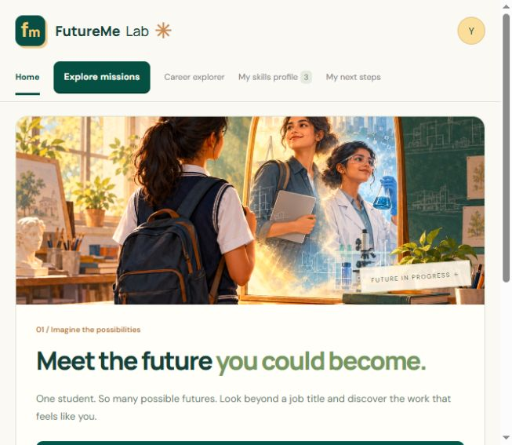
STUDENT AND PARENT GUIDE
FutureMe Lab
A visual guide
to using the app
Actual app screenshots
Numbered instructions
All main views and mission flows
Screenshots use a separate demo session with sample responses.
FutureMe Lab user manual
01
Notes:
Screenshots show the current SPA build captured on 24 October 2026. All answers, ages, grade choices and mission results are demonstration data. The local capture uses the same app source as the deployed version. Source: https://github.com/dpjegankumar/futurelab

Slide 2
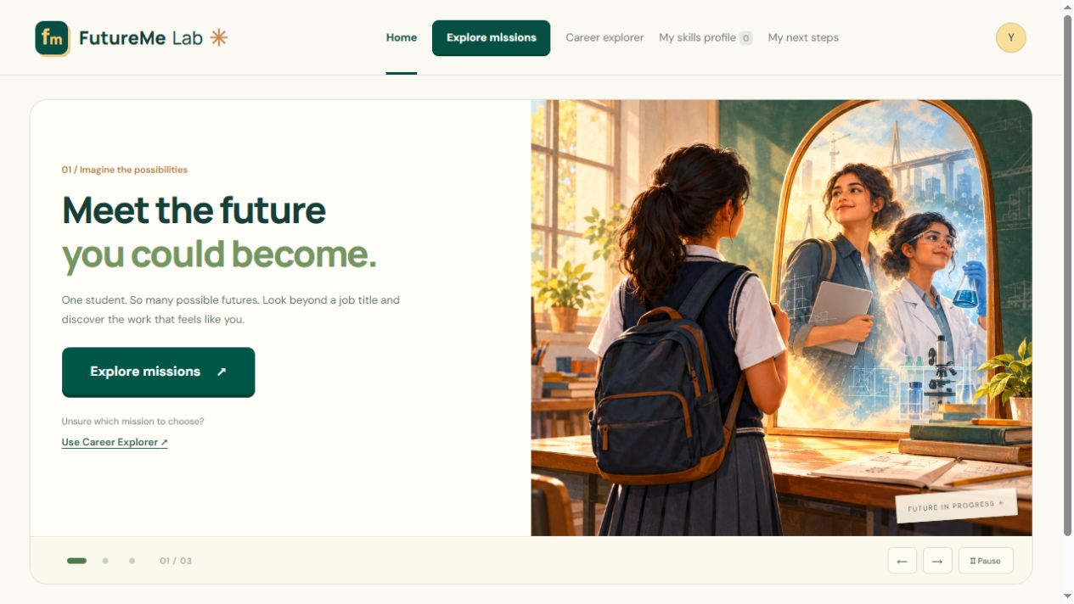
HOME
Start with Explore missions
1. Open FutureMe Lab.
2. Select the large Explore missions button to browse the career lab.
3. If you are unsure where to start, select Use Career Explorer.
Home contains the carousel. Other sections open only when you select them.
FutureMe Lab user manual
02
Notes:
Home: Start with Explore missions
1. Open FutureMe Lab.
2. Select the large Explore missions button to browse the career lab.
3. If you are unsure where to start, select Use Career Explorer.
Home contains the carousel. Other sections open only when you select them.
Screenshot: 01-home.jpg. Current app build, demonstration data. Source: https://github.com/dpjegankumar/futurelab

Slide 3
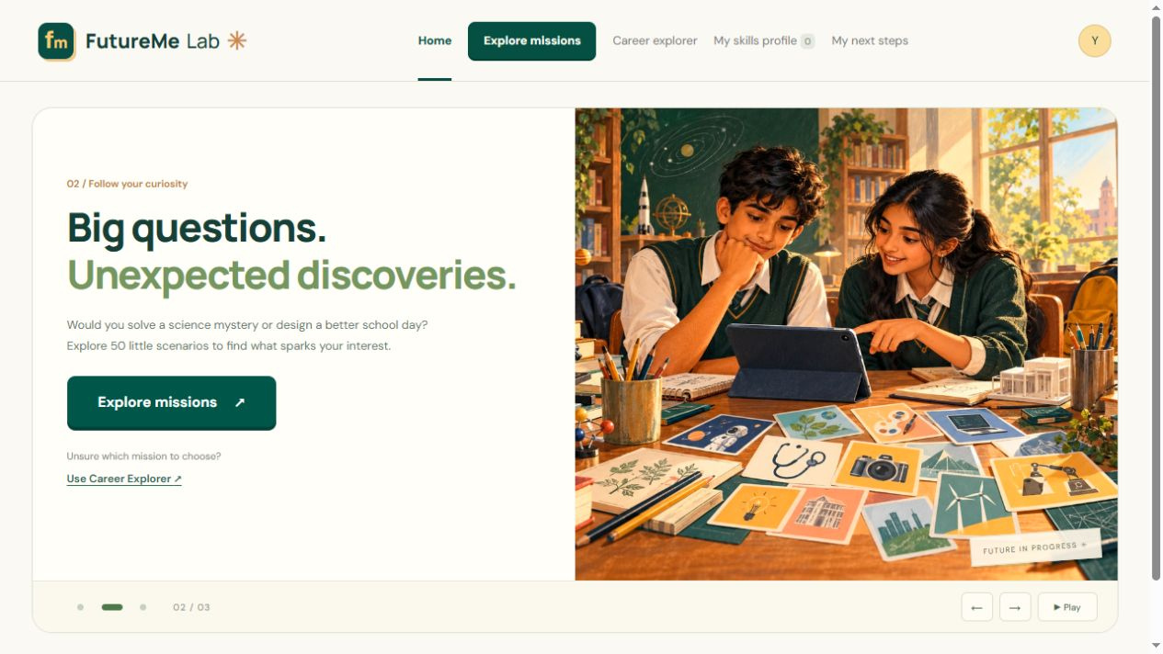
HOME
Move between carousel scenes
1. Select a dot or an arrow below the image.
2. Use Pause to stop automatic rotation. Use Play to resume it.
3. Explore missions remains the main action on every scene.
Keyboard users can use the left and right arrows inside the carousel.
FutureMe Lab user manual
03
Notes:
Home: Move between carousel scenes
1. Select a dot or an arrow below the image.
2. Use Pause to stop automatic rotation. Use Play to resume it.
3. Explore missions remains the main action on every scene.
Keyboard users can use the left and right arrows inside the carousel.
Screenshot: 02-home-questions.jpg. Current app build, demonstration data. Source: https://github.com/dpjegankumar/futurelab

Slide 4
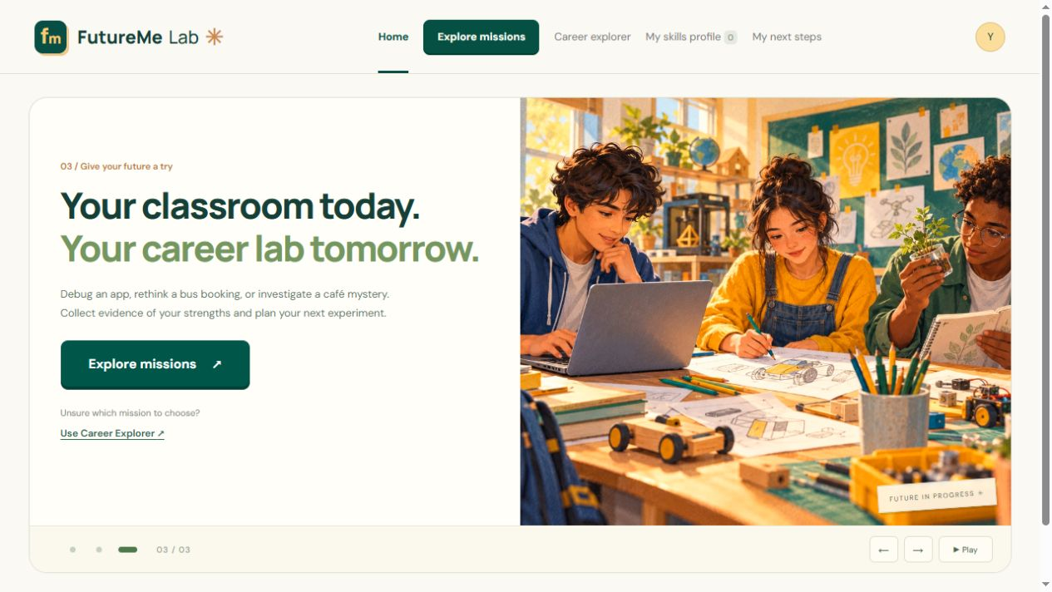
HOME
Return to the home screen
1. Select Home in the top navigation.
2. You can also select the FutureMe Lab logo.
3. Use the browser Back and Forward buttons to revisit app views.
The carousel stays on Home. It does not appear inside the mission or profile views.
FutureMe Lab user manual
04
Notes:
Home: Return to the home screen
1. Select Home in the top navigation.
2. You can also select the FutureMe Lab logo.
3. Use the browser Back and Forward buttons to revisit app views.
The carousel stays on Home. It does not appear inside the mission or profile views.
Screenshot: 03-home-missions.jpg. Current app build, demonstration data. Source: https://github.com/dpjegankumar/futurelab

Slide 5
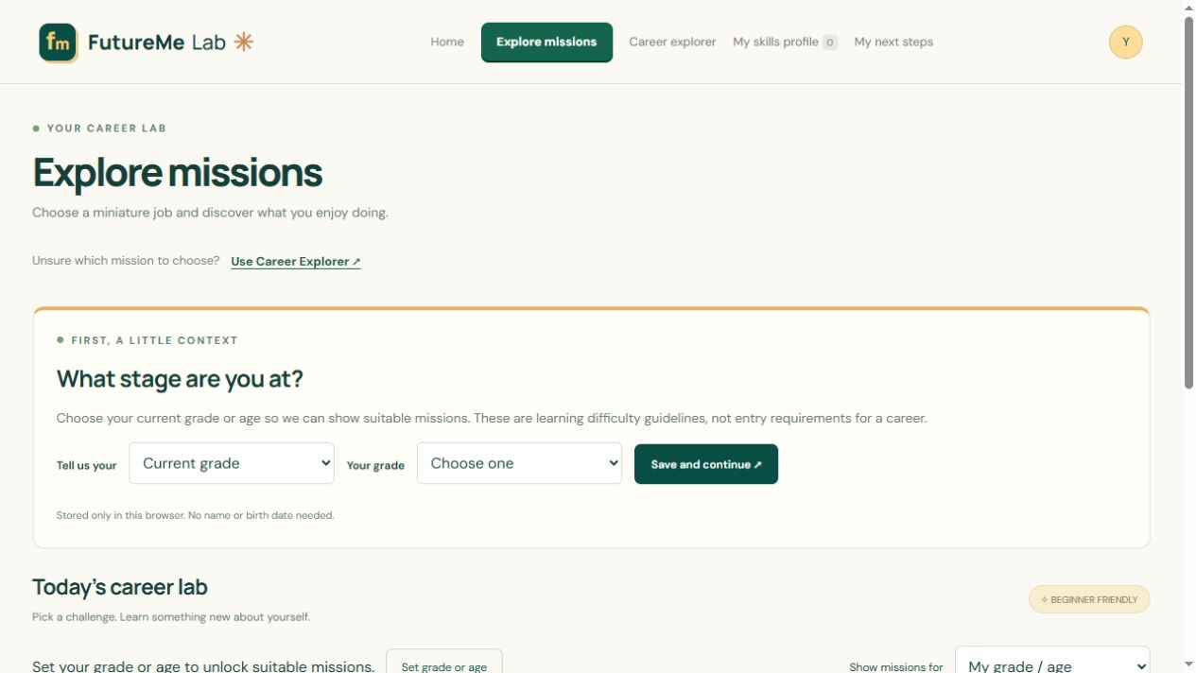
SETUP
Choose your current grade
1. Open Explore missions.
2. Under Tell us your, choose Current grade and select your grade.
3. Select Save and continue.
Your grade sets the mission learning level. It does not determine your future career.
FutureMe Lab user manual
05
Notes:
Setup: Choose your current grade
1. Open Explore missions.
2. Under Tell us your, choose Current grade and select your grade.
3. Select Save and continue.
Your grade sets the mission learning level. It does not determine your future career.
Screenshot: 04-grade-setup.jpg. Current app build, demonstration data. Source: https://github.com/dpjegankumar/futurelab

Slide 6
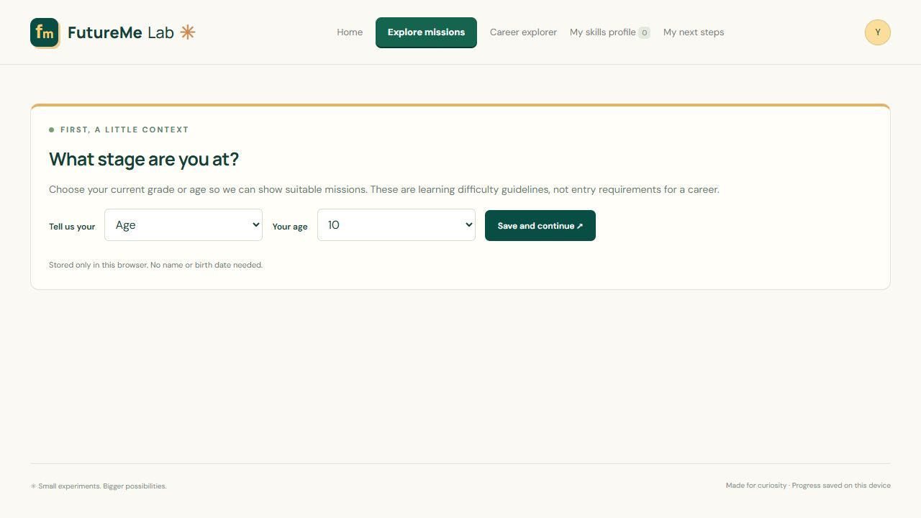
SETUP
Use age instead of grade
1. Select Change grade / age.
2. Choose Age, then select your current age.
3. Select Save and continue to update your eligible missions.
Use either grade or age. The app does not ask for a date of birth.
FutureMe Lab user manual
06
Notes:
Setup: Use age instead of grade
1. Select Change grade / age.
2. Choose Age, then select your current age.
3. Select Save and continue to update your eligible missions.
Use either grade or age. The app does not ask for a date of birth.
Screenshot: 09-age-setup.jpg. Current app build, demonstration data. Source: https://github.com/dpjegankumar/futurelab

Slide 7
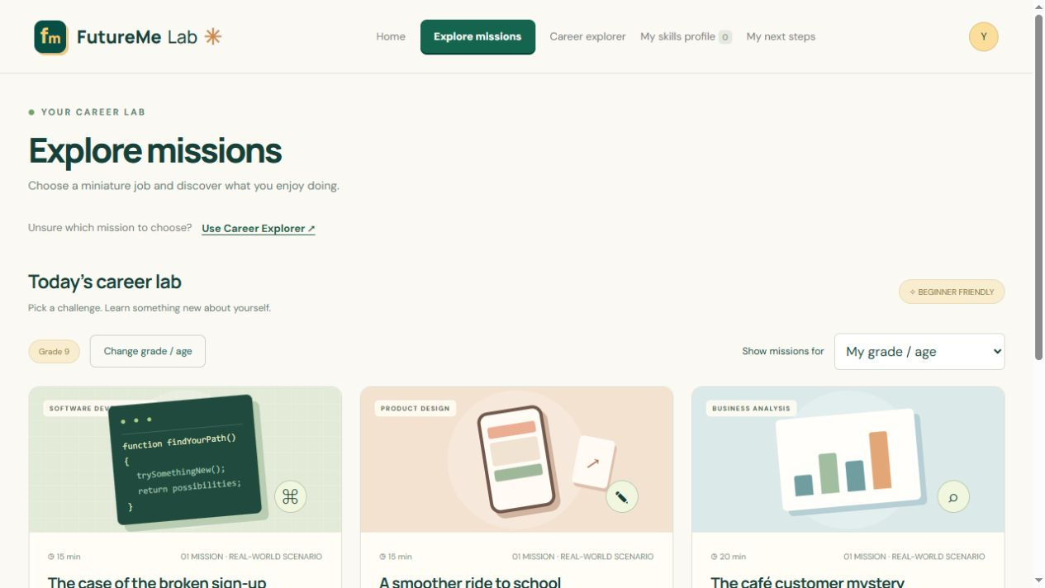
MISSIONS
Browse your career lab
1. Read the mission titles and descriptions.
2. Check the learning level and expected time.
3. Scroll down to find the start button on each card.
The default My grade / age filter uses your saved details.
FutureMe Lab user manual
07
Notes:
Missions: Browse your career lab
1. Read the mission titles and descriptions.
2. Check the learning level and expected time.
3. Scroll down to find the start button on each card.
The default My grade / age filter uses your saved details.
Screenshot: 05-missions.jpg. Current app build, demonstration data. Source: https://github.com/dpjegankumar/futurelab

Slide 8
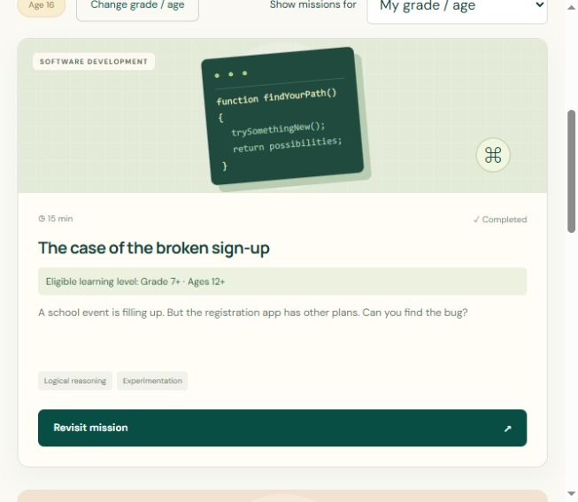
MISSIONS
Open a mission card
1. Look for the eligible grade and age label.
2. Select Try this career to begin.
3. Later, Continue mission resumes a draft and Revisit mission opens it again.
Submitting a repeated mission replaces its earlier result in your profile.
FutureMe Lab user manual
08
Notes:
Missions: Open a mission card
1. Look for the eligible grade and age label.
2. Select Try this career to begin.
3. Later, Continue mission resumes a draft and Revisit mission opens it again.
Submitting a repeated mission replaces its earlier result in your profile.
Screenshot: 37-mission-card-details.jpg. Current app build, demonstration data. Source: https://github.com/dpjegankumar/futurelab

Slide 9
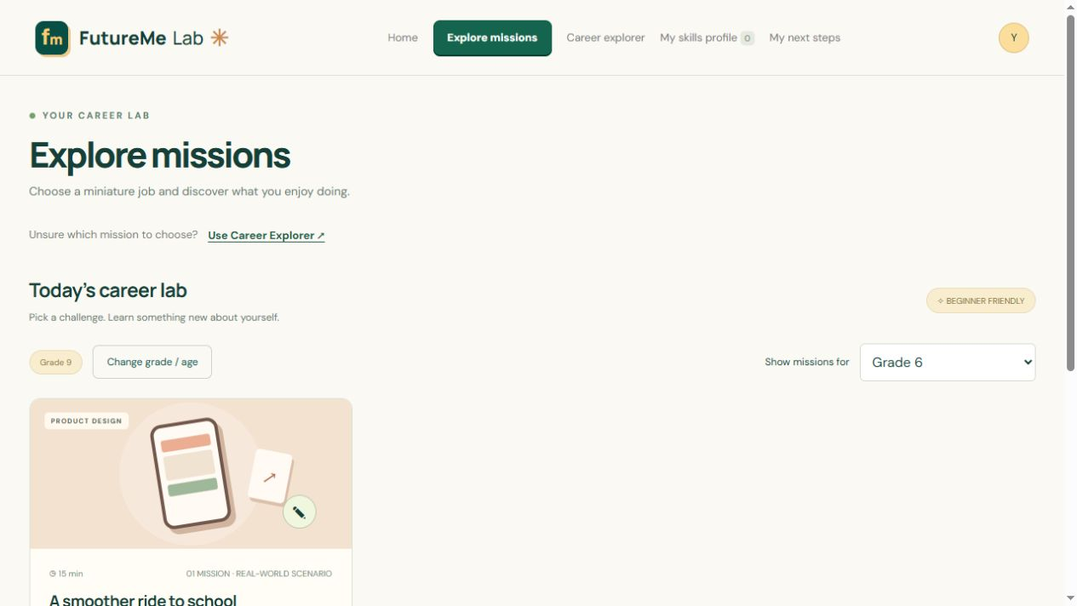
MISSIONS
Filter missions by grade
1. Open Show missions for.
2. Choose a grade to browse its learning level.
3. Choose My grade / age to return to your own recommendations.
Browsing another grade does not change your saved details or unlock an ineligible mission.
FutureMe Lab user manual
09
Notes:
Missions: Filter missions by grade
1. Open Show missions for.
2. Choose a grade to browse its learning level.
3. Choose My grade / age to return to your own recommendations.
Browsing another grade does not change your saved details or unlock an ineligible mission.
Screenshot: 06-grade-filter.jpg. Current app build, demonstration data. Source: https://github.com/dpjegankumar/futurelab

Slide 10
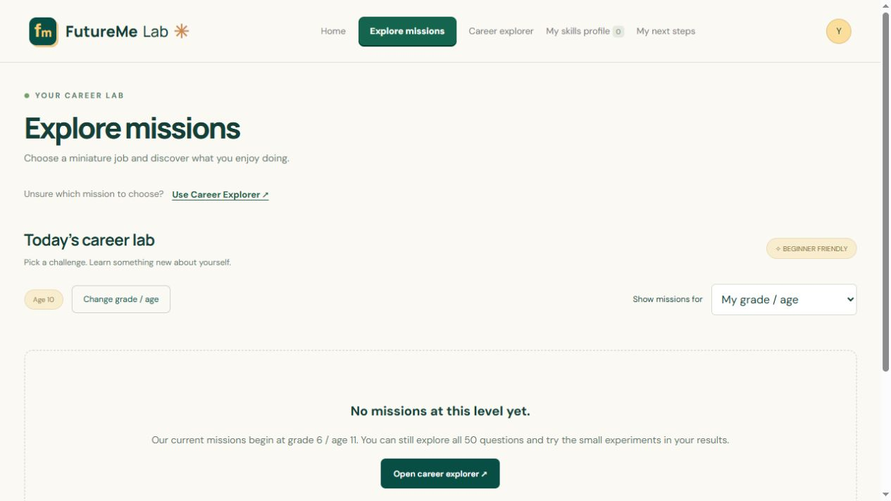
MISSIONS
Understand an empty mission list
1. Check that your grade or age is correct.
2. Current missions begin at grade 6 or age 11.
3. You can still open Career Explorer and try its suggested small experiments.
The age-10 example shown here uses demonstration data.
FutureMe Lab user manual
10
Notes:
Missions: Understand an empty mission list
1. Check that your grade or age is correct.
2. Current missions begin at grade 6 or age 11.
3. You can still open Career Explorer and try its suggested small experiments.
The age-10 example shown here uses demonstration data.
Screenshot: 10-no-missions.jpg. Current app build, demonstration data. Source: https://github.com/dpjegankumar/futurelab

Slide 11
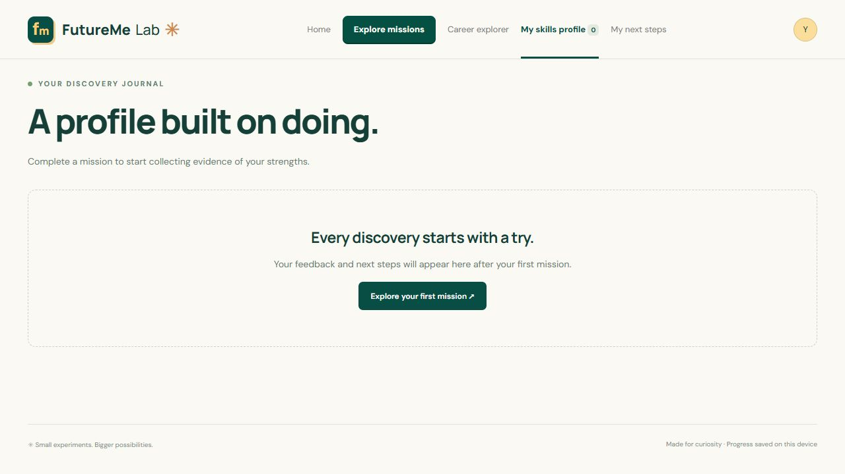
FIRST USE
An empty skills profile is normal
1. Open My skills profile.
2. If you have not submitted a mission, the profile is empty.
3. Select Explore your first mission to start collecting evidence.
Questionnaire answers alone do not create demonstrated mission skills.
FutureMe Lab user manual
11
Notes:
First use: An empty skills profile is normal
1. Open My skills profile.
2. If you have not submitted a mission, the profile is empty.
3. Select Explore your first mission to start collecting evidence.
Questionnaire answers alone do not create demonstrated mission skills.
Screenshot: 07-empty-profile.jpg. Current app build, demonstration data. Source: https://github.com/dpjegankumar/futurelab

Slide 12
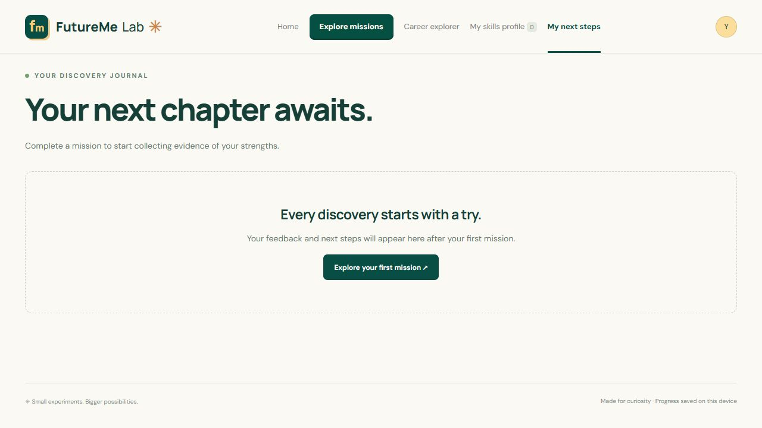
FIRST USE
Next steps appear after a mission
1. Open My next steps.
2. Complete and submit a mission if no plan appears yet.
3. Return here for practical follow-up experiments.
The mission-based plan uses completed missions and enjoyment ratings.
FutureMe Lab user manual
12
Notes:
First use: Next steps appear after a mission
1. Open My next steps.
2. Complete and submit a mission if no plan appears yet.
3. Return here for practical follow-up experiments.
The mission-based plan uses completed missions and enjoyment ratings.
Screenshot: 08-empty-plan.jpg. Current app build, demonstration data. Source: https://github.com/dpjegankumar/futurelab

Slide 13
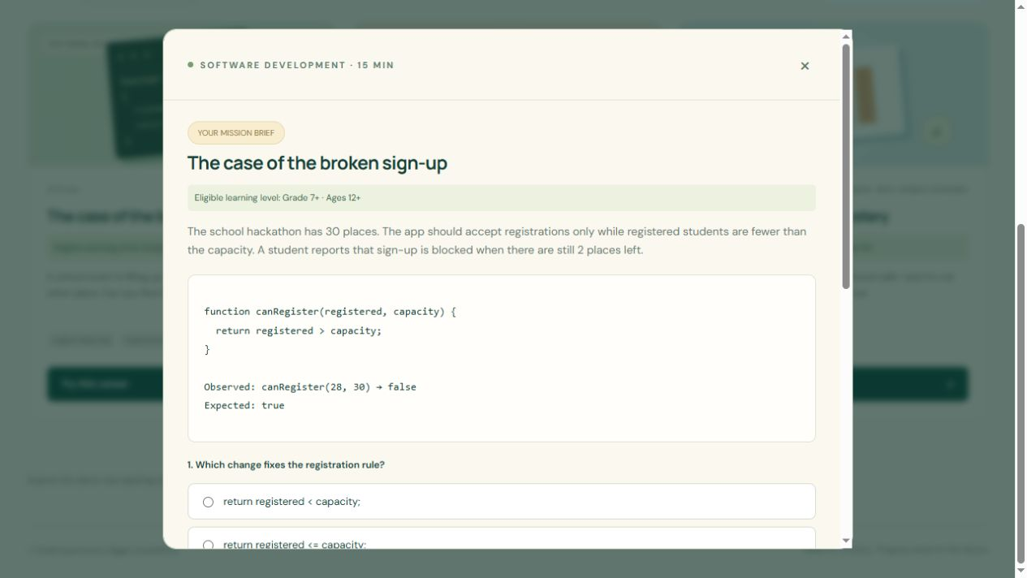
SOFTWARE MISSION
Read the brief and the evidence
1. Read the registration problem carefully.
2. Compare the observed and expected results.
3. Choose the rule you think solves the problem.
Use the close button to leave the mission. Draft answers save when storage is available.
FutureMe Lab user manual
13
Notes:
Software mission: Read the brief and the evidence
1. Read the registration problem carefully.
2. Compare the observed and expected results.
3. Choose the rule you think solves the problem.
Use the close button to leave the mission. Draft answers save when storage is available.
Screenshot: 11-software-brief.jpg. Current app build, demonstration data. Source: https://github.com/dpjegankumar/futurelab

Slide 14
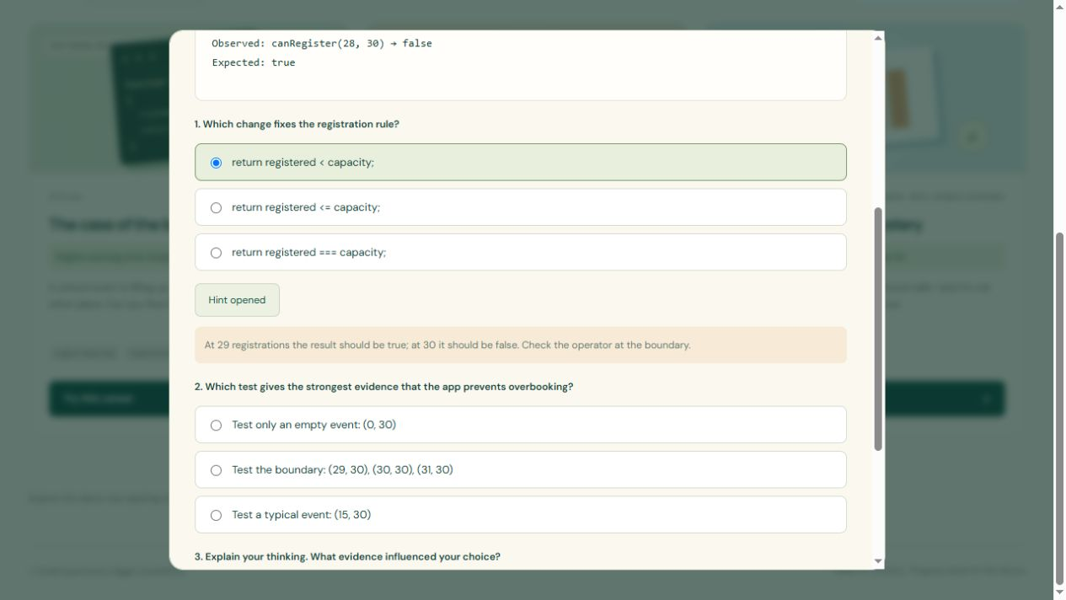
SOFTWARE MISSION
Ask for a hint when needed
1. Select Need a hint? if you want support.
2. Read the hint before deciding.
3. Choose a test that would check your solution.
Hint use appears in feedback. The app treats it as support, not automatic failure.
FutureMe Lab user manual
14
Notes:
Software mission: Ask for a hint when needed
1. Select Need a hint? if you want support.
2. Read the hint before deciding.
3. Choose a test that would check your solution.
Hint use appears in feedback. The app treats it as support, not automatic failure.
Screenshot: 12-software-hint.jpg. Current app build, demonstration data. Source: https://github.com/dpjegankumar/futurelab

Slide 15
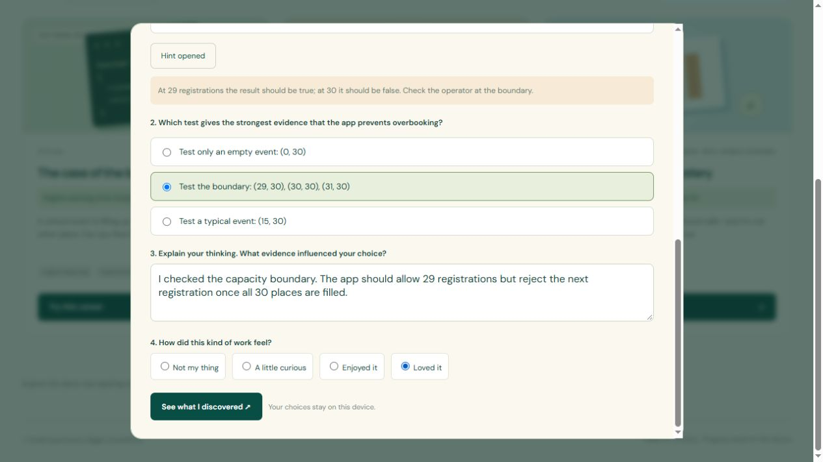
SOFTWARE MISSION
Explain your thinking
1. Complete both multiple-choice questions.
2. Write at least 20 characters explaining your reasoning.
3. Rate your enjoyment and select See what I discovered.
The response in this screenshot is an example. Write your own reasoning.
FutureMe Lab user manual
15
Notes:
Software mission: Explain your thinking
1. Complete both multiple-choice questions.
2. Write at least 20 characters explaining your reasoning.
3. Rate your enjoyment and select See what I discovered.
The response in this screenshot is an example. Write your own reasoning.
Screenshot: 13-software-reflection.jpg. Current app build, demonstration data. Source: https://github.com/dpjegankumar/futurelab

Slide 16
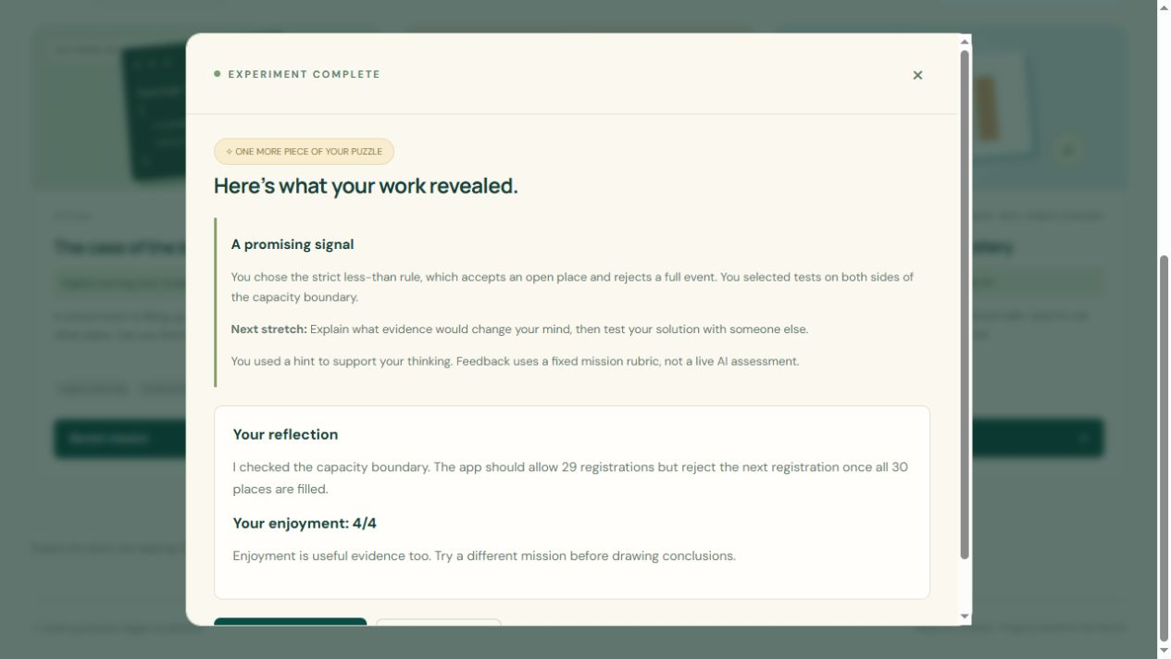
SOFTWARE MISSION
Read your mission feedback
1. Read the evidence linked to your choices.
2. Find the Next stretch suggestion.
3. Open your skills profile or try another career.
Current feedback follows authored rubrics. It is not a live AI assessment.
FutureMe Lab user manual
16
Notes:
Software mission: Read your mission feedback
1. Read the evidence linked to your choices.
2. Find the Next stretch suggestion.
3. Open your skills profile or try another career.
Current feedback follows authored rubrics. It is not a live AI assessment.
Screenshot: 14-software-feedback.jpg. Current app build, demonstration data. Source: https://github.com/dpjegankumar/futurelab

Slide 17
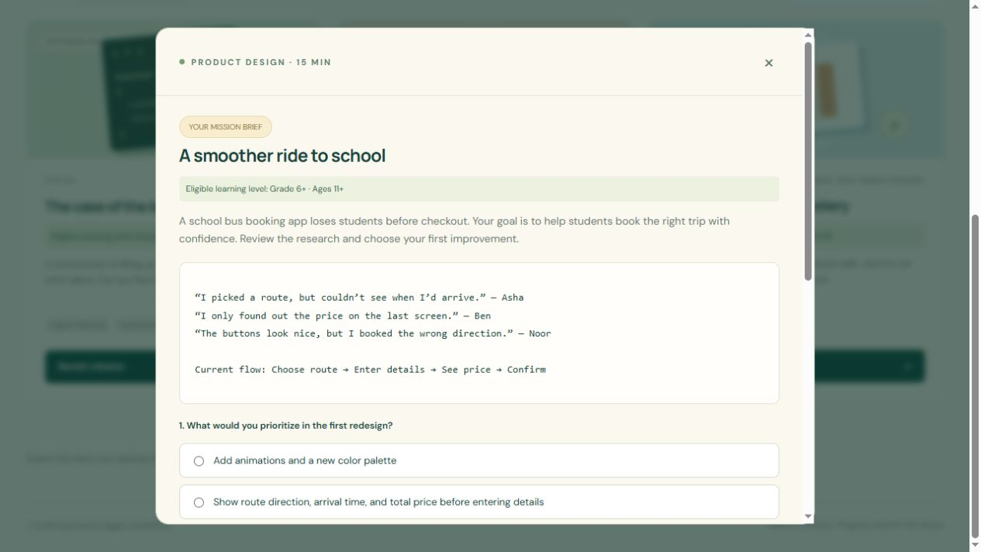
DESIGN MISSION
Investigate a confusing experience
1. Read the student quotes about bus booking.
2. Decide what the first redesign should prioritize.
3. Choose how you would check whether it helps.
This mission explores user-centered thinking.
FutureMe Lab user manual
17
Notes:
Design mission: Investigate a confusing experience
1. Read the student quotes about bus booking.
2. Decide what the first redesign should prioritize.
3. Choose how you would check whether it helps.
This mission explores user-centered thinking.
Screenshot: 15-design-brief.jpg. Current app build, demonstration data. Source: https://github.com/dpjegankumar/futurelab

Slide 18
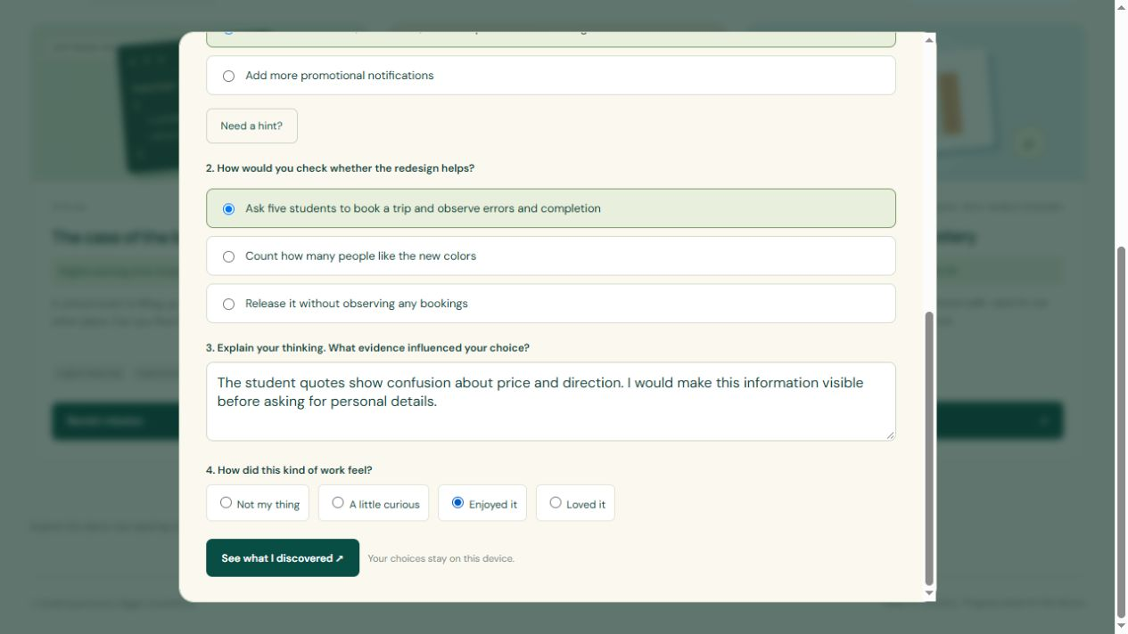
DESIGN MISSION
Reflect on the design task
1. Connect your choice to the student research.
2. Explain why your proposed check would be useful.
3. Record enjoyment and submit the mission.
Enjoyment and performance are separate signals.
FutureMe Lab user manual
18
Notes:
Design mission: Reflect on the design task
1. Connect your choice to the student research.
2. Explain why your proposed check would be useful.
3. Record enjoyment and submit the mission.
Enjoyment and performance are separate signals.
Screenshot: 16-design-reflection.jpg. Current app build, demonstration data. Source: https://github.com/dpjegankumar/futurelab

Slide 19
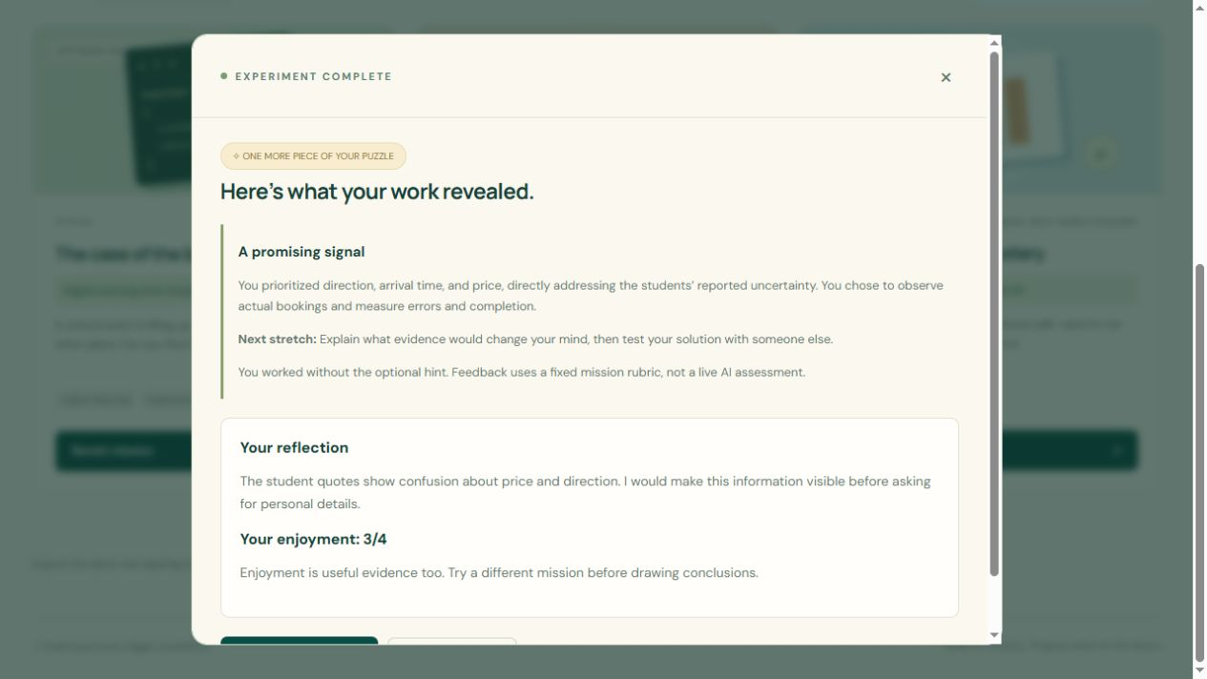
DESIGN MISSION
Use design feedback
1. Read which student needs your choices addressed.
2. Review the suggested next stretch.
3. Compare this work with the software mission.
A different enjoyment rating may suggest a different next experiment.
FutureMe Lab user manual
19
Notes:
Design mission: Use design feedback
1. Read which student needs your choices addressed.
2. Review the suggested next stretch.
3. Compare this work with the software mission.
A different enjoyment rating may suggest a different next experiment.
Screenshot: 17-design-feedback.jpg. Current app build, demonstration data. Source: https://github.com/dpjegankumar/futurelab

Slide 20
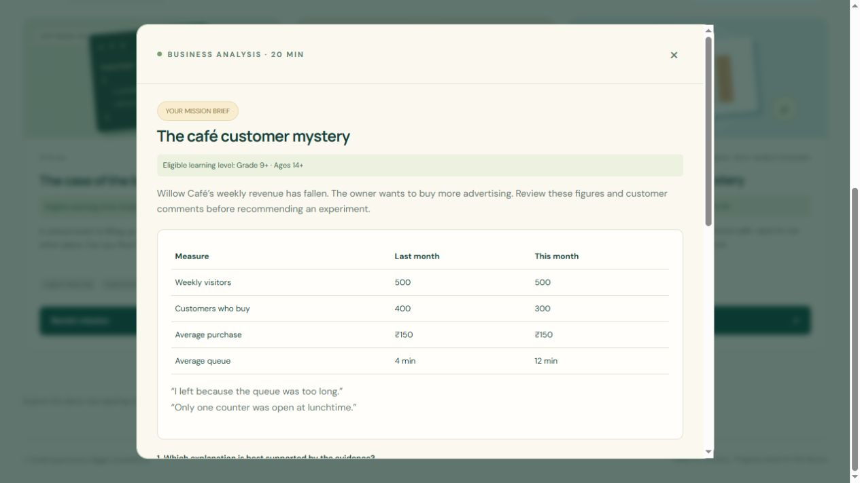
BUSINESS MISSION
Follow the café evidence
1. Compare visitors, purchases, spending, and queue time.
2. Choose the explanation supported by those figures.
3. Select a small experiment before making a big change.
This mission explores evidence-based decisions.
FutureMe Lab user manual
20
Notes:
Business mission: Follow the café evidence
1. Compare visitors, purchases, spending, and queue time.
2. Choose the explanation supported by those figures.
3. Select a small experiment before making a big change.
This mission explores evidence-based decisions.
Screenshot: 18-business-brief.jpg. Current app build, demonstration data. Source: https://github.com/dpjegankumar/futurelab

Slide 21

BUSINESS MISSION
Review your analysis
1. Check which evidence your choices used.
2. Read the improvement or next-stretch suggestion.
3. Continue to your skills profile to compare missions.
Strong feedback on one task does not predict career success.
FutureMe Lab user manual
21
Notes:
Business mission: Review your analysis
1. Check which evidence your choices used.
2. Read the improvement or next-stretch suggestion.
3. Continue to your skills profile to compare missions.
Strong feedback on one task does not predict career success.
Screenshot: 19-business-feedback.jpg. Current app build, demonstration data. Source: https://github.com/dpjegankumar/futurelab

Slide 22
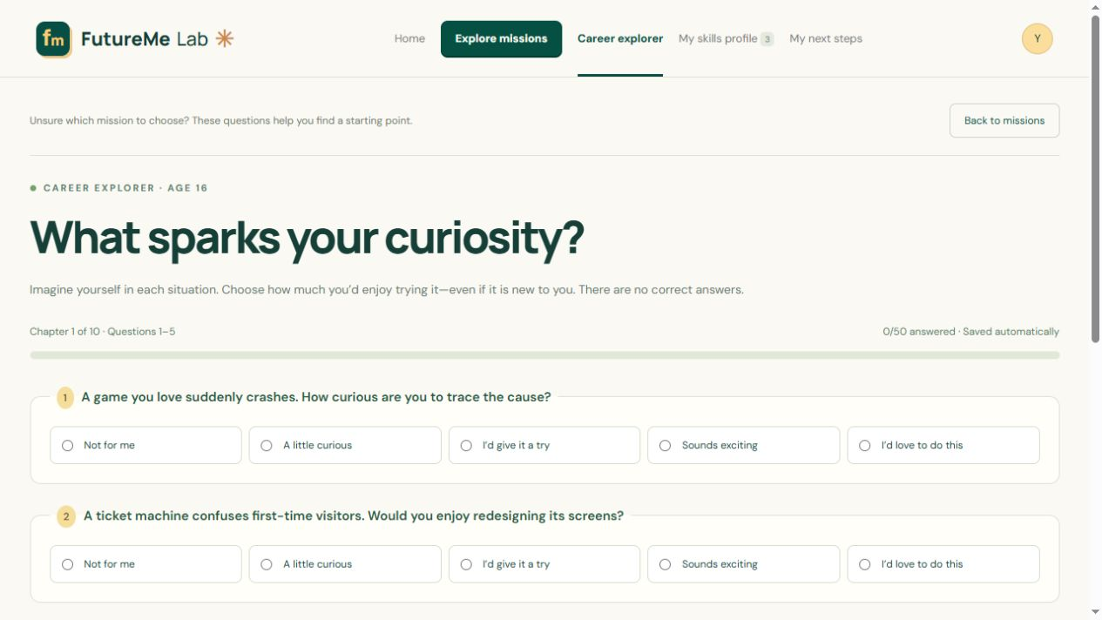
CAREER EXPLORER
Use questions when you feel unsure
1. Open Use Career Explorer from Home or Missions.
2. Imagine trying each activity, even if it is new to you.
3. Choose an honest interest rating. There are no correct answers.
The explorer contains 50 questions across six career interest areas.
FutureMe Lab user manual
22
Notes:
Career Explorer: Use questions when you feel unsure
1. Open Use Career Explorer from Home or Missions.
2. Imagine trying each activity, even if it is new to you.
3. Choose an honest interest rating. There are no correct answers.
The explorer contains 50 questions across six career interest areas.
Screenshot: 24-explorer-start.jpg. Current app build, demonstration data. Source: https://github.com/dpjegankumar/futurelab

Slide 23
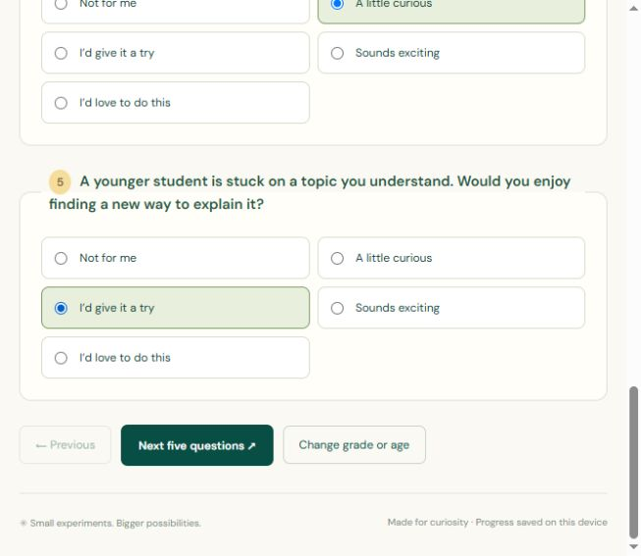
CAREER EXPLORER
Move through the questions
1. Answer all five questions on the page.
2. Select Next five questions to continue.
3. Use Previous to revisit an earlier page.
The last page replaces Next with Discover my career directions.
FutureMe Lab user manual
23
Notes:
Career Explorer: Move through the questions
1. Answer all five questions on the page.
2. Select Next five questions to continue.
3. Use Previous to revisit an earlier page.
The last page replaces Next with Discover my career directions.
Screenshot: 25-quiz-controls.jpg. Current app build, demonstration data. Source: https://github.com/dpjegankumar/futurelab

Slide 24
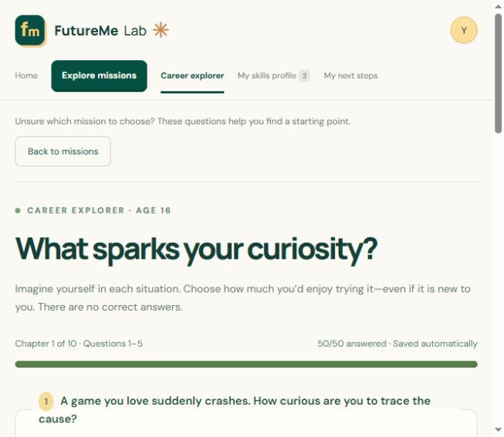
CAREER EXPLORER
Pause, resume, or review answers
1. Your choices save automatically when browser storage is available.
2. Return using the same browser, device, and app address.
3. After results, select Review my answers to revise them.
After reviewing, continue through the pages to generate updated results.
FutureMe Lab user manual
24
Notes:
Career Explorer: Pause, resume, or review answers
1. Your choices save automatically when browser storage is available.
2. Return using the same browser, device, and app address.
3. After results, select Review my answers to revise them.
After reviewing, continue through the pages to generate updated results.
Screenshot: 36-review-saved-answers.jpg. Current app build, demonstration data. Source: https://github.com/dpjegankumar/futurelab

Slide 25
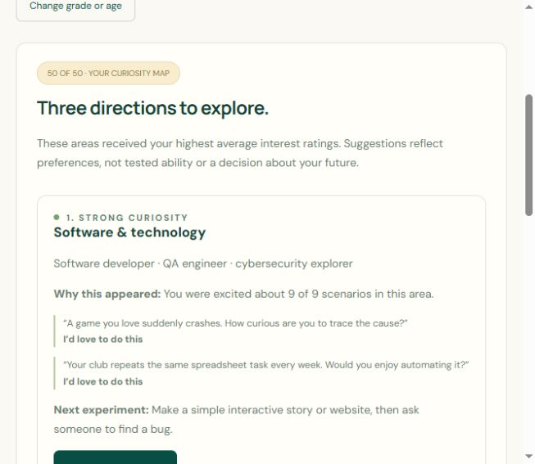
CAREER EXPLORER
Read your suggested directions
1. Compare the three suggested interest areas.
2. Read Why this appeared and the supporting answers.
3. Choose a suggested small experiment or an eligible mission.
These suggestions describe preferences, not proven ability.
FutureMe Lab user manual
25
Notes:
Career Explorer: Read your suggested directions
1. Compare the three suggested interest areas.
2. Read Why this appeared and the supporting answers.
3. Choose a suggested small experiment or an eligible mission.
These suggestions describe preferences, not proven ability.
Screenshot: 34-results-evidence.jpg. Current app build, demonstration data. Source: https://github.com/dpjegankumar/futurelab

Slide 26
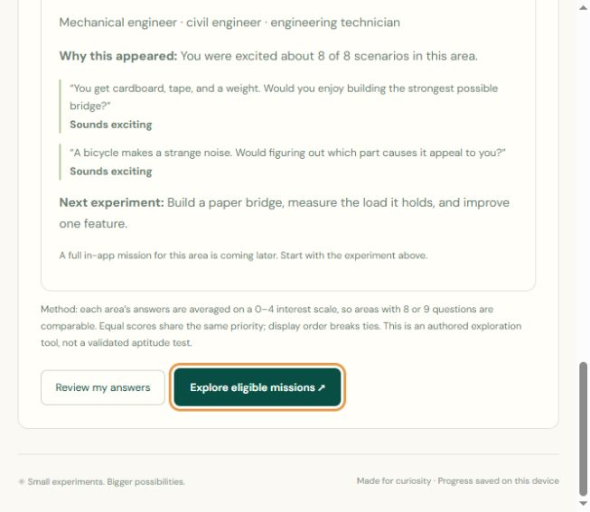
CAREER EXPLORER
Choose your next action
1. Select Test it in a mission when available.
2. Use Review my answers to change responses.
3. Select Explore eligible missions to return to the career lab.
Some interest areas currently offer small experiments rather than full in-app missions.
FutureMe Lab user manual
26
Notes:
Career Explorer: Choose your next action
1. Select Test it in a mission when available.
2. Use Review my answers to change responses.
3. Select Explore eligible missions to return to the career lab.
Some interest areas currently offer small experiments rather than full in-app missions.
Screenshot: 35-results-review.jpg. Current app build, demonstration data. Source: https://github.com/dpjegankumar/futurelab

Slide 27
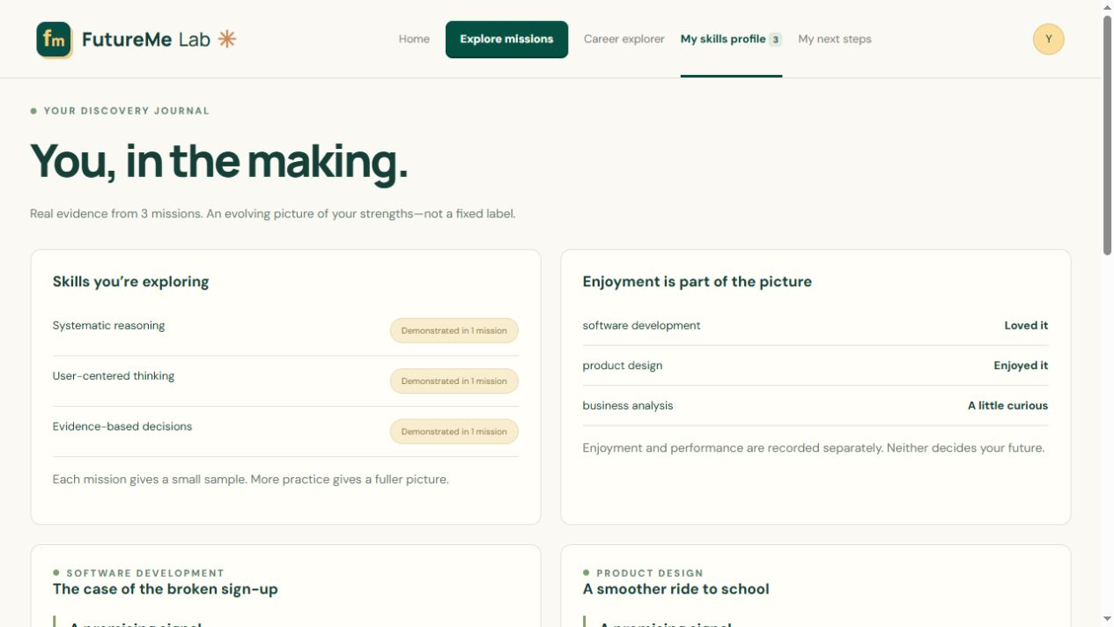
SKILLS PROFILE
Review the skills overview
1. Select My skills profile in the top menu.
2. Read the early-evidence or demonstrated-skill labels.
3. Scroll down to see the mission details behind each signal.
The number in the navigation counts completed missions.
FutureMe Lab user manual
27
Notes:
Skills profile: Review the skills overview
1. Select My skills profile in the top menu.
2. Read the early-evidence or demonstrated-skill labels.
3. Scroll down to see the mission details behind each signal.
The number in the navigation counts completed missions.
Screenshot: 20-profile-overview.jpg. Current app build, demonstration data. Source: https://github.com/dpjegankumar/futurelab

Slide 28
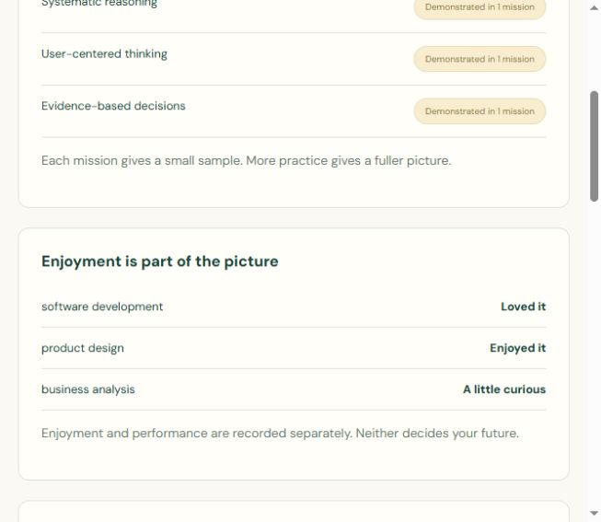
SKILLS PROFILE
Compare enjoyment with performance
1. Find Enjoyment is part of the picture.
2. Compare your enjoyment ratings across the missions.
3. Notice work you would choose to do again.
You can enjoy something while still learning it, or perform well at work you do not enjoy.
FutureMe Lab user manual
28
Notes:
Skills profile: Compare enjoyment with performance
1. Find Enjoyment is part of the picture.
2. Compare your enjoyment ratings across the missions.
3. Notice work you would choose to do again.
You can enjoy something while still learning it, or perform well at work you do not enjoy.
Screenshot: 38-profile-enjoyment.jpg. Current app build, demonstration data. Source: https://github.com/dpjegankumar/futurelab

Slide 29
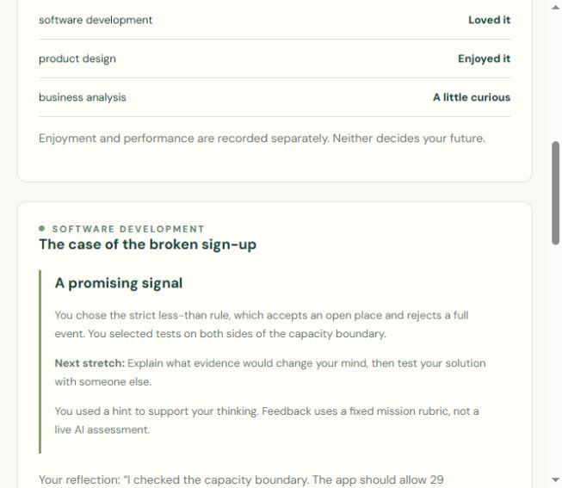
SKILLS PROFILE
Revisit the supporting evidence
1. Read the mission choices and reflection.
2. Review your next-stretch suggestion.
3. Use Try again to repeat the experience.
A new submission replaces that mission’s earlier saved result.
FutureMe Lab user manual
29
Notes:
Skills profile: Revisit the supporting evidence
1. Read the mission choices and reflection.
2. Review your next-stretch suggestion.
3. Use Try again to repeat the experience.
A new submission replaces that mission’s earlier saved result.
Screenshot: 39-profile-evidence.jpg. Current app build, demonstration data. Source: https://github.com/dpjegankumar/futurelab

Slide 30
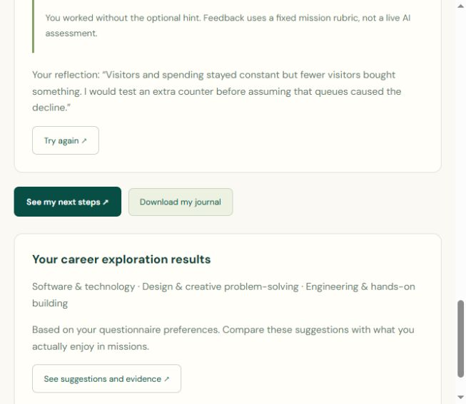
SKILLS PROFILE
Download your discovery journal
1. Scroll to Download my journal.
2. Select it and check your browser’s Downloads folder.
3. Keep the text report for reflection or a career conversation.
The journal is a readable report. It does not restore app progress or export questionnaire answers.
FutureMe Lab user manual
30
Notes:
Skills profile: Download your discovery journal
1. Scroll to Download my journal.
2. Select it and check your browser’s Downloads folder.
3. Keep the text report for reflection or a career conversation.
The journal is a readable report. It does not restore app progress or export questionnaire answers.
Screenshot: 29-download-journal.jpg. Current app build, demonstration data. Source: https://github.com/dpjegankumar/futurelab

Slide 31
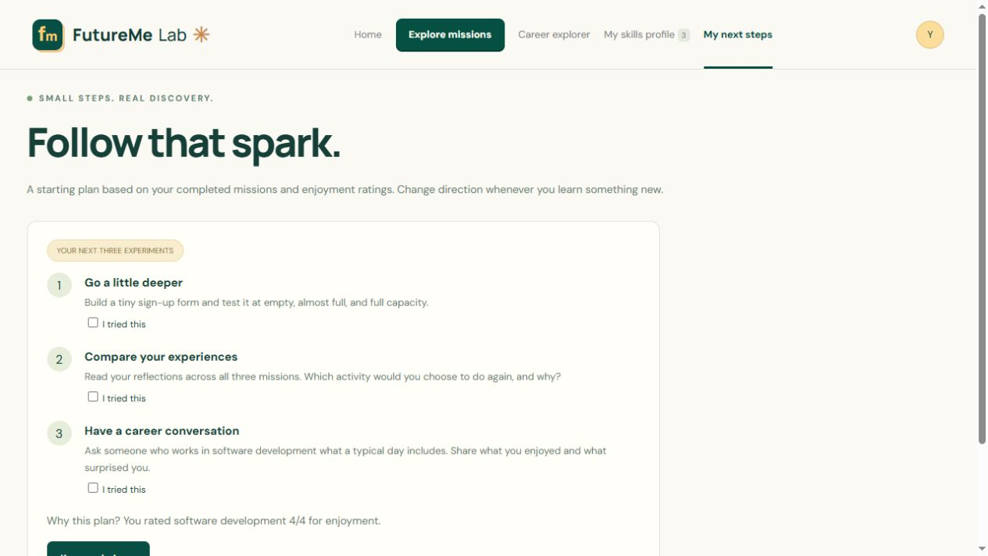
NEXT STEPS
Follow your personal plan
1. Open My next steps.
2. Read the three suggested experiments.
3. Start with one small action outside the app.
The plan explains which mission and enjoyment rating influenced it.
FutureMe Lab user manual
31
Notes:
Next steps: Follow your personal plan
1. Open My next steps.
2. Read the three suggested experiments.
3. Start with one small action outside the app.
The plan explains which mission and enjoyment rating influenced it.
Screenshot: 22-plan.jpg. Current app build, demonstration data. Source: https://github.com/dpjegankumar/futurelab

Slide 32
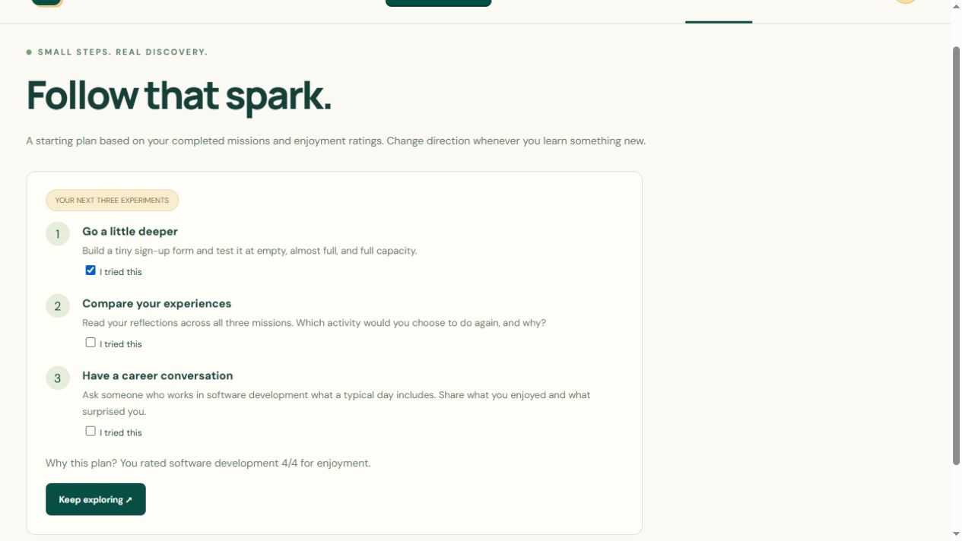
NEXT STEPS
Track what you tried
1. Tick I tried this after an experiment.
2. Return later to track your progress.
3. Choose Keep exploring to try more work.
Checklist progress stays in this browser when storage is available.
FutureMe Lab user manual
32
Notes:
Next steps: Track what you tried
1. Tick I tried this after an experiment.
2. Return later to track your progress.
3. Choose Keep exploring to try more work.
Checklist progress stays in this browser when storage is available.
Screenshot: 23-plan-checked.jpg. Current app build, demonstration data. Source: https://github.com/dpjegankumar/futurelab

Slide 33
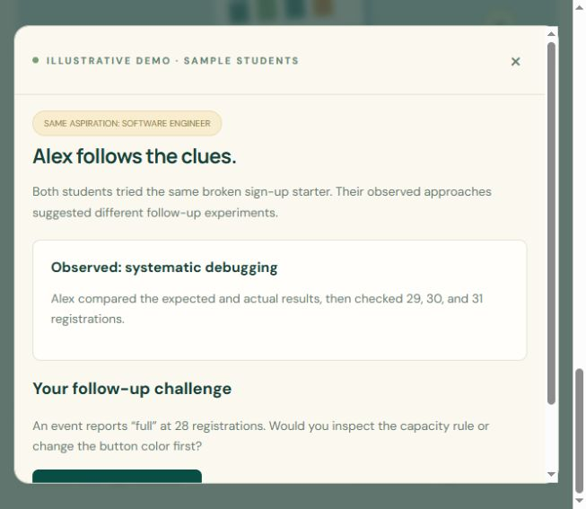
SAMPLE DEMOS
Meet Alex, the debugger
1. Open Explore missions and scroll to the demo links.
2. Select Meet Alex.
3. Read the sample evidence and choose the follow-up action.
Alex is an illustrative student, not a real assessment result.
FutureMe Lab user manual
33
Notes:
Sample demos: Meet Alex, the debugger
1. Open Explore missions and scroll to the demo links.
2. Select Meet Alex.
3. Read the sample evidence and choose the follow-up action.
Alex is an illustrative student, not a real assessment result.
Screenshot: 30-alex-demo.jpg. Current app build, demonstration data. Source: https://github.com/dpjegankumar/futurelab

Slide 34
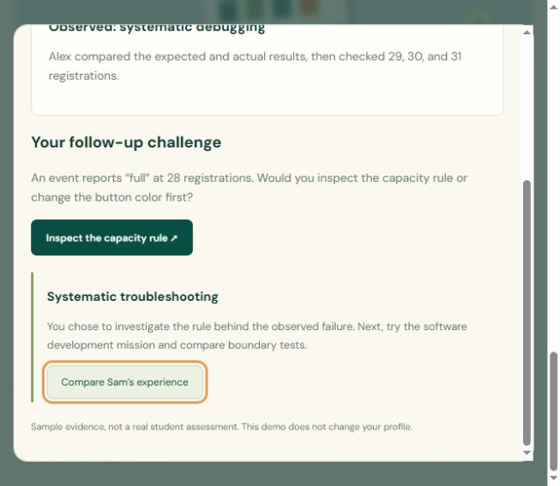
SAMPLE DEMOS
Compare the demo feedback
1. Read the observed approach and follow-up feedback.
2. Select Compare Sam’s experience.
3. Notice how the suggested next experiment changes.
The sample demos do not change your own skills profile.
FutureMe Lab user manual
34
Notes:
Sample demos: Compare the demo feedback
1. Read the observed approach and follow-up feedback.
2. Select Compare Sam’s experience.
3. Notice how the suggested next experiment changes.
The sample demos do not change your own skills profile.
Screenshot: 31-alex-response.jpg. Current app build, demonstration data. Source: https://github.com/dpjegankumar/futurelab

Slide 35
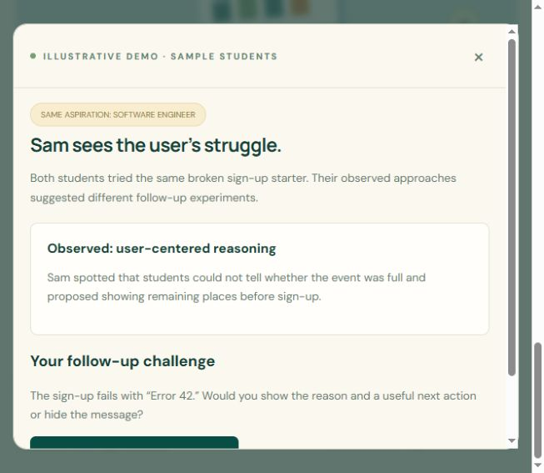
SAMPLE DEMOS
Meet Sam, the designer
1. Read Sam’s approach to the same starter problem.
2. Choose the clearer recovery message.
3. Compare this approach with Alex’s debugging process.
The same career ambition can lead to different useful experiments.
FutureMe Lab user manual
35
Notes:
Sample demos: Meet Sam, the designer
1. Read Sam’s approach to the same starter problem.
2. Choose the clearer recovery message.
3. Compare this approach with Alex’s debugging process.
The same career ambition can lead to different useful experiments.
Screenshot: 32-sam-demo.jpg. Current app build, demonstration data. Source: https://github.com/dpjegankumar/futurelab

Slide 36
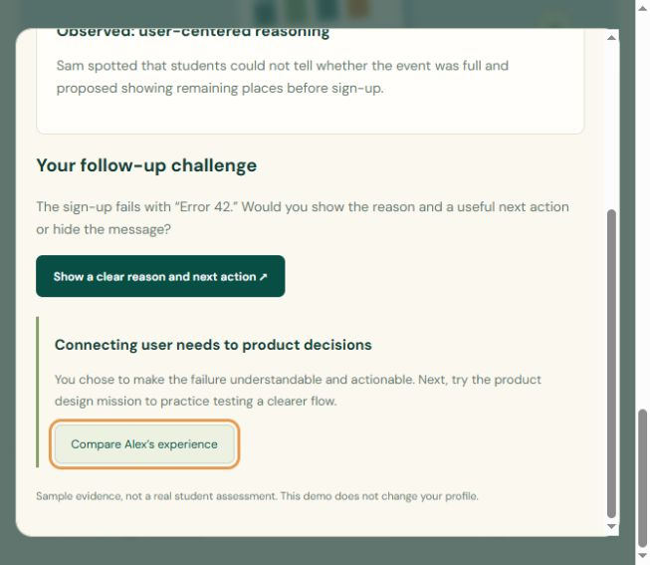
SAMPLE DEMOS
Return to your own exploration
1. Review Sam’s suggested next experiment.
2. Close the demo using the close button.
3. Return to your own mission, profile, or plan.
Use sample stories to understand the experience, then collect your own evidence.
FutureMe Lab user manual
36
Notes:
Sample demos: Return to your own exploration
1. Review Sam’s suggested next experiment.
2. Close the demo using the close button.
3. Return to your own mission, profile, or plan.
Use sample stories to understand the experience, then collect your own evidence.
Screenshot: 33-sam-response.jpg. Current app build, demonstration data. Source: https://github.com/dpjegankumar/futurelab

Slide 37
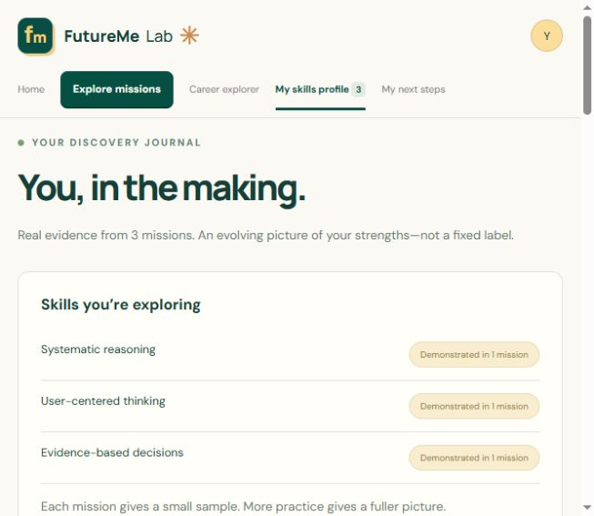
PROGRESS AND PRIVACY
Keep your progress accessible
1. Return using the same device, browser profile, and app address.
2. Avoid private browsing if you want progress to persist.
3. Use separate browser profiles for different students.
Clearing site data removes saved answers and results. There is no cloud sync in this MVP.
FutureMe Lab user manual
37
Notes:
Progress and privacy: Keep your progress accessible
1. Return using the same device, browser profile, and app address.
2. Avoid private browsing if you want progress to persist.
3. Use separate browser profiles for different students.
Clearing site data removes saved answers and results. There is no cloud sync in this MVP.
Screenshot: 28-profile-with-explorer.jpg. Current app build, demonstration data. Source: https://github.com/dpjegankumar/futurelab

Slide 38
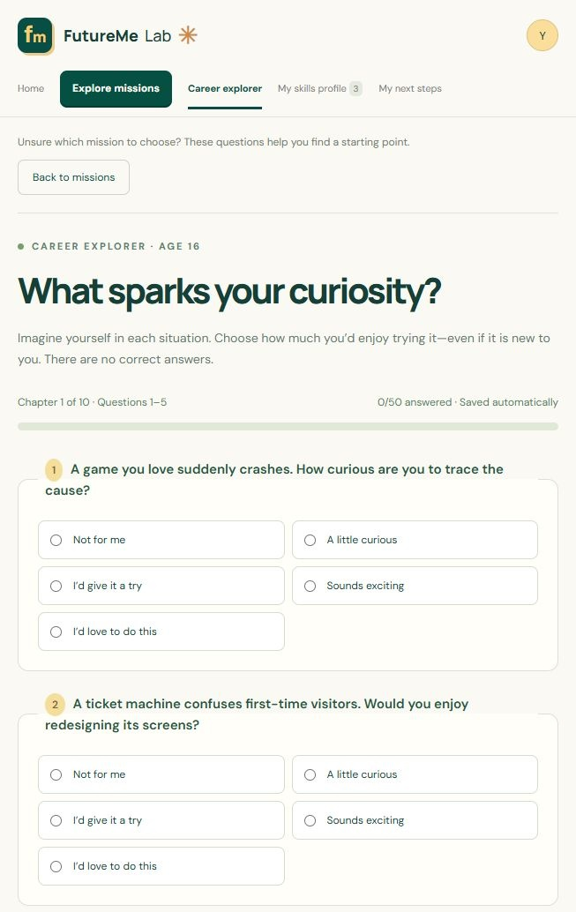
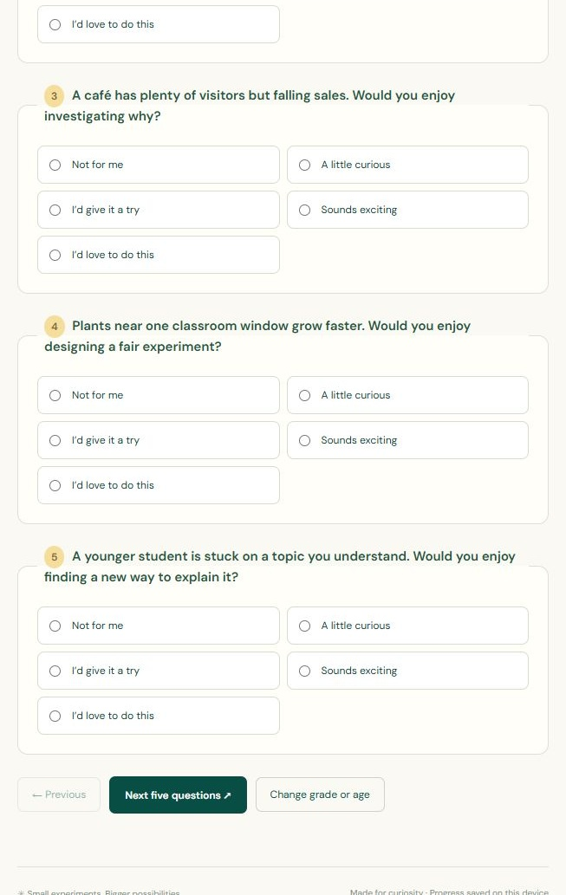
QUESTIONNAIRE SCREEN REFERENCE
Page 1 of 10: questions 1–5
TOP OF PAGE
CONTINUE SCROLLING
FutureMe Lab user manual
38
Notes:
Full captured questionnaire page 1, showing questions 1 through 5. The two excerpts overlap slightly at the split. Use the original full-page JPG in the screenshot archive for detail. This is a reference appendix, not an answer key. Source: https://github.com/dpjegankumar/futurelab

Slide 39
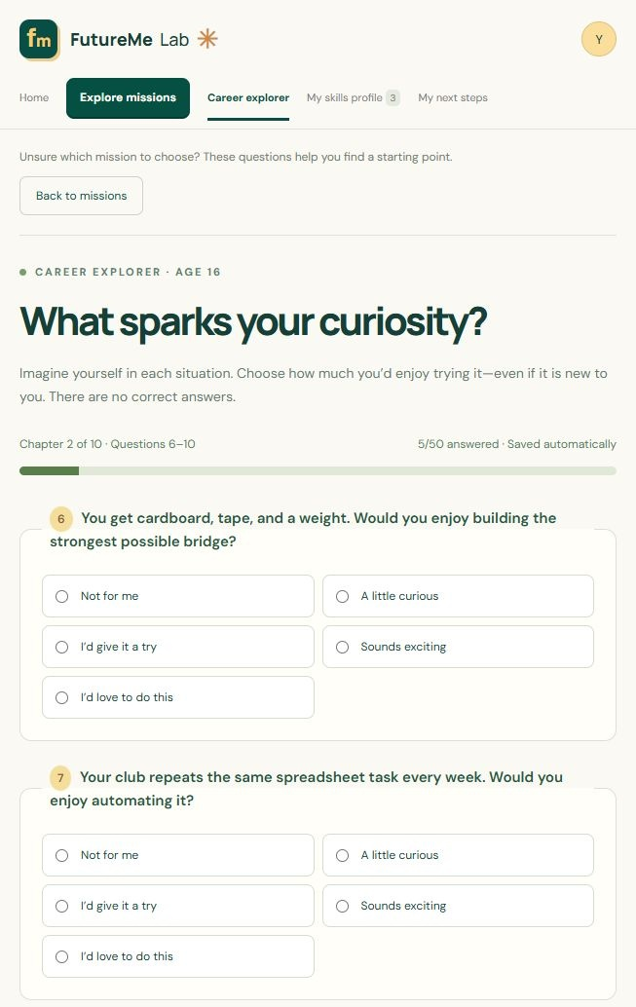
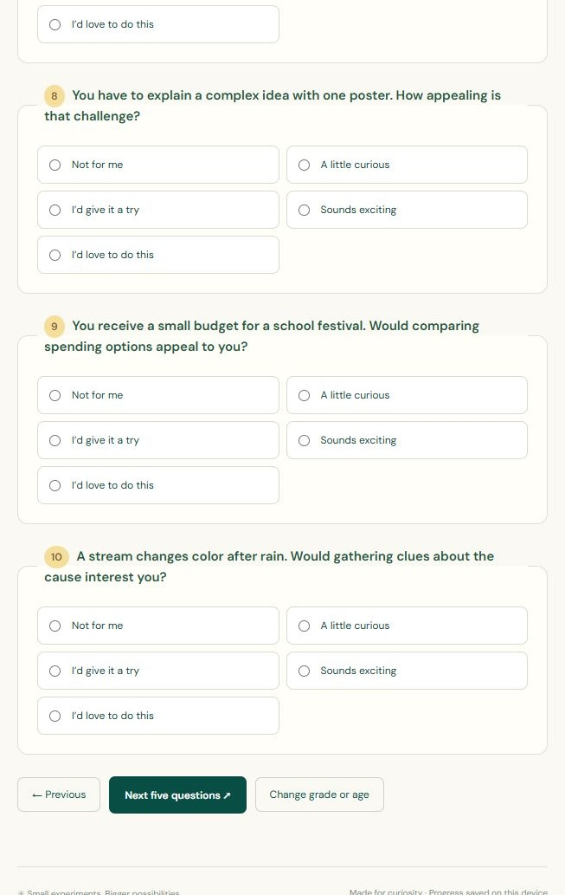
QUESTIONNAIRE SCREEN REFERENCE
Page 2 of 10: questions 6–10
TOP OF PAGE
CONTINUE SCROLLING
FutureMe Lab user manual
39
Notes:
Full captured questionnaire page 2, showing questions 6 through 10. The two excerpts overlap slightly at the split. Use the original full-page JPG in the screenshot archive for detail. This is a reference appendix, not an answer key. Source: https://github.com/dpjegankumar/futurelab

Slide 40
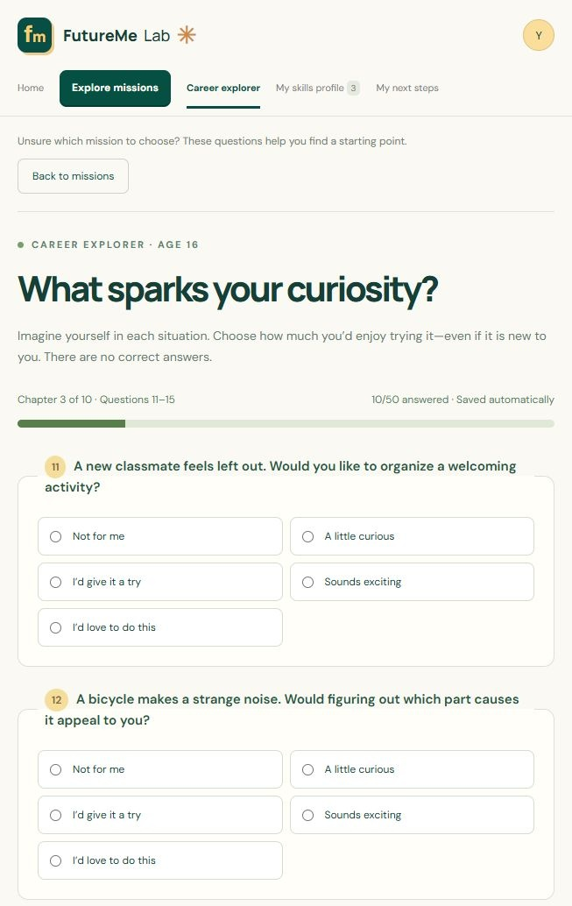

QUESTIONNAIRE SCREEN REFERENCE
Page 3 of 10: questions 11–15
TOP OF PAGE
CONTINUE SCROLLING
FutureMe Lab user manual
40
Notes:
Full captured questionnaire page 3, showing questions 11 through 15. The two excerpts overlap slightly at the split. Use the original full-page JPG in the screenshot archive for detail. This is a reference appendix, not an answer key. Source: https://github.com/dpjegankumar/futurelab

Slide 41
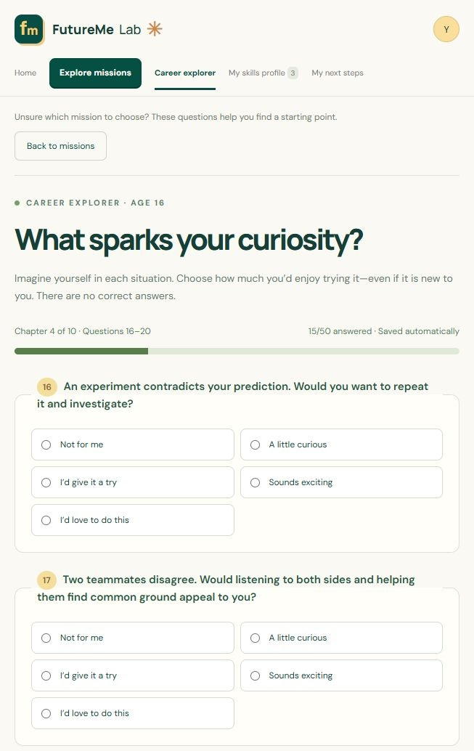

QUESTIONNAIRE SCREEN REFERENCE
Page 4 of 10: questions 16–20
TOP OF PAGE
CONTINUE SCROLLING
FutureMe Lab user manual
41
Notes:
Full captured questionnaire page 4, showing questions 16 through 20. The two excerpts overlap slightly at the split. Use the original full-page JPG in the screenshot archive for detail. This is a reference appendix, not an answer key. Source: https://github.com/dpjegankumar/futurelab

Slide 42
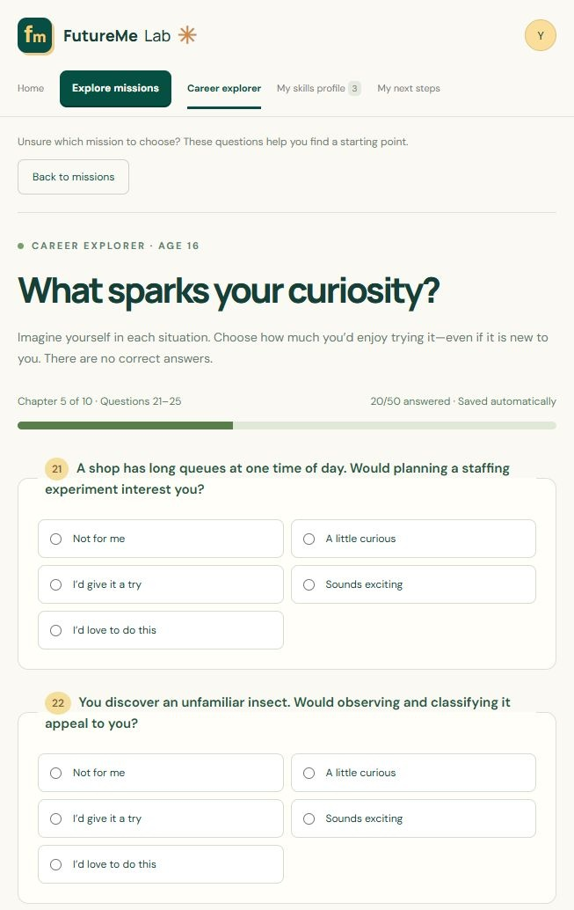

QUESTIONNAIRE SCREEN REFERENCE
Page 5 of 10: questions 21–25
TOP OF PAGE
CONTINUE SCROLLING
FutureMe Lab user manual
42
Notes:
Full captured questionnaire page 5, showing questions 21 through 25. The two excerpts overlap slightly at the split. Use the original full-page JPG in the screenshot archive for detail. This is a reference appendix, not an answer key. Source: https://github.com/dpjegankumar/futurelab

Slide 43
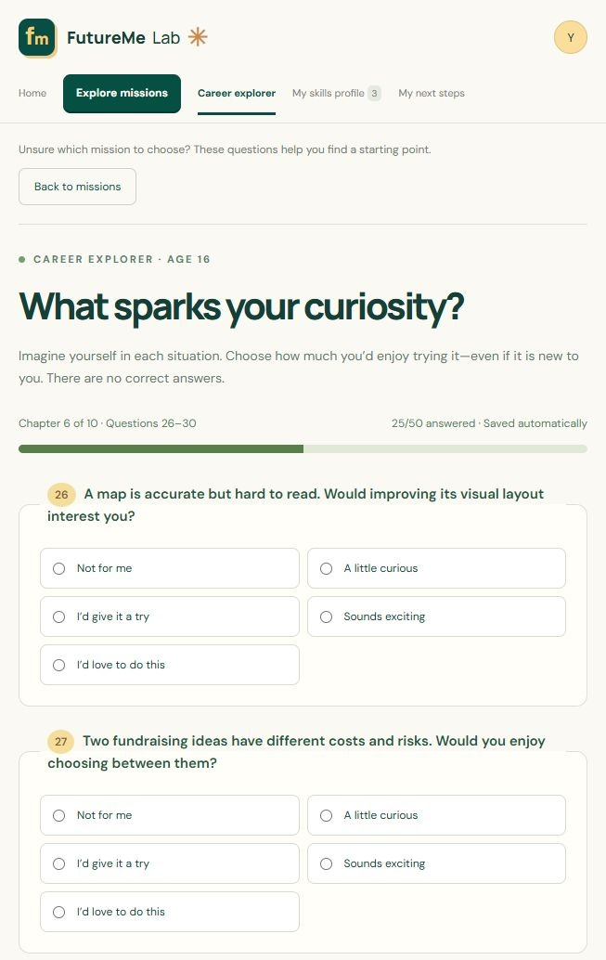

QUESTIONNAIRE SCREEN REFERENCE
Page 6 of 10: questions 26–30
TOP OF PAGE
CONTINUE SCROLLING
FutureMe Lab user manual
43
Notes:
Full captured questionnaire page 6, showing questions 26 through 30. The two excerpts overlap slightly at the split. Use the original full-page JPG in the screenshot archive for detail. This is a reference appendix, not an answer key. Source: https://github.com/dpjegankumar/futurelab

Slide 44
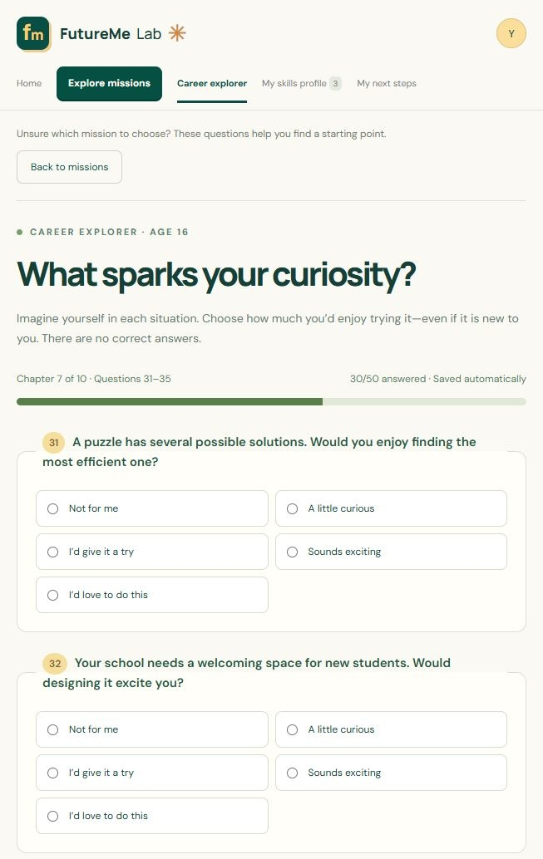
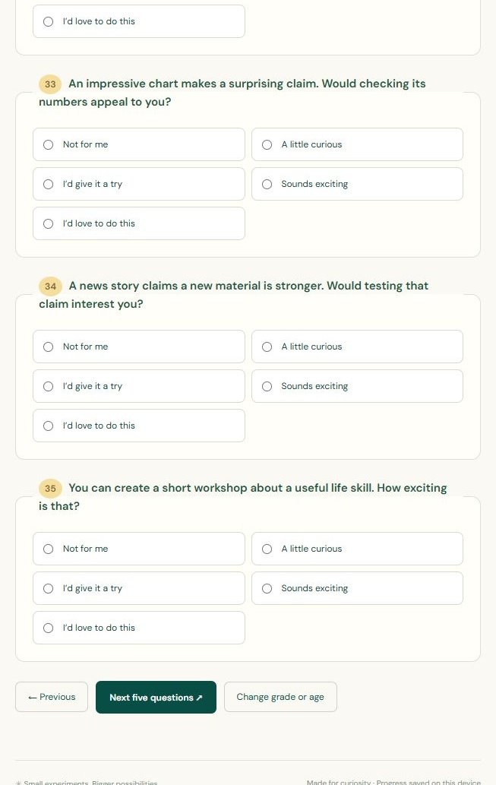
QUESTIONNAIRE SCREEN REFERENCE
Page 7 of 10: questions 31–35
TOP OF PAGE
CONTINUE SCROLLING
FutureMe Lab user manual
44
Notes:
Full captured questionnaire page 7, showing questions 31 through 35. The two excerpts overlap slightly at the split. Use the original full-page JPG in the screenshot archive for detail. This is a reference appendix, not an answer key. Source: https://github.com/dpjegankumar/futurelab

Slide 45
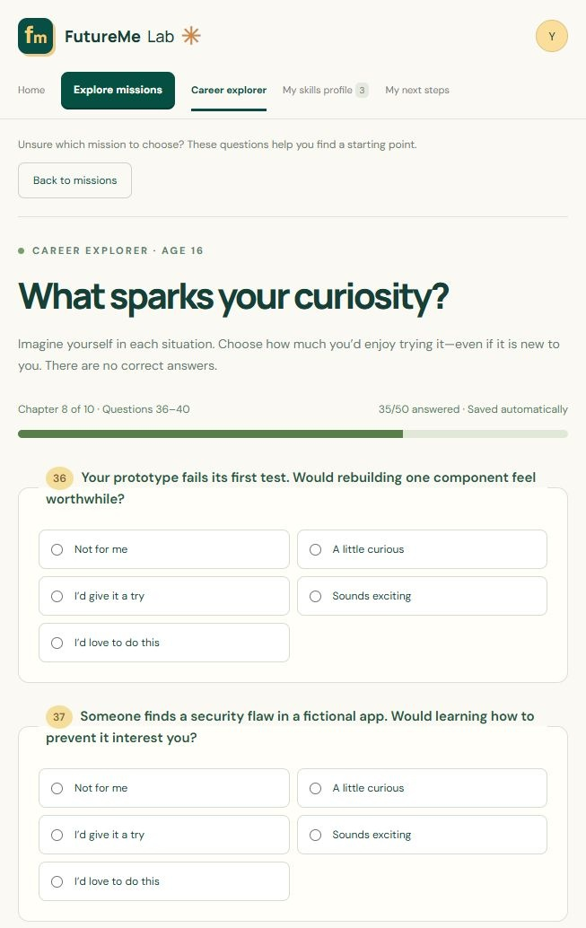
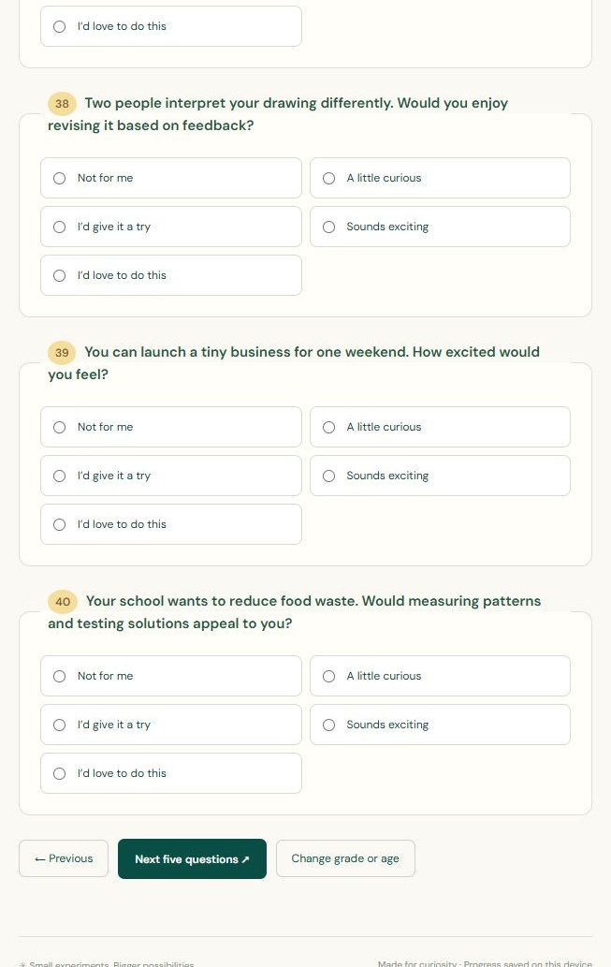
QUESTIONNAIRE SCREEN REFERENCE
Page 8 of 10: questions 36–40
TOP OF PAGE
CONTINUE SCROLLING
FutureMe Lab user manual
45
Notes:
Full captured questionnaire page 8, showing questions 36 through 40. The two excerpts overlap slightly at the split. Use the original full-page JPG in the screenshot archive for detail. This is a reference appendix, not an answer key. Source: https://github.com/dpjegankumar/futurelab

Slide 46
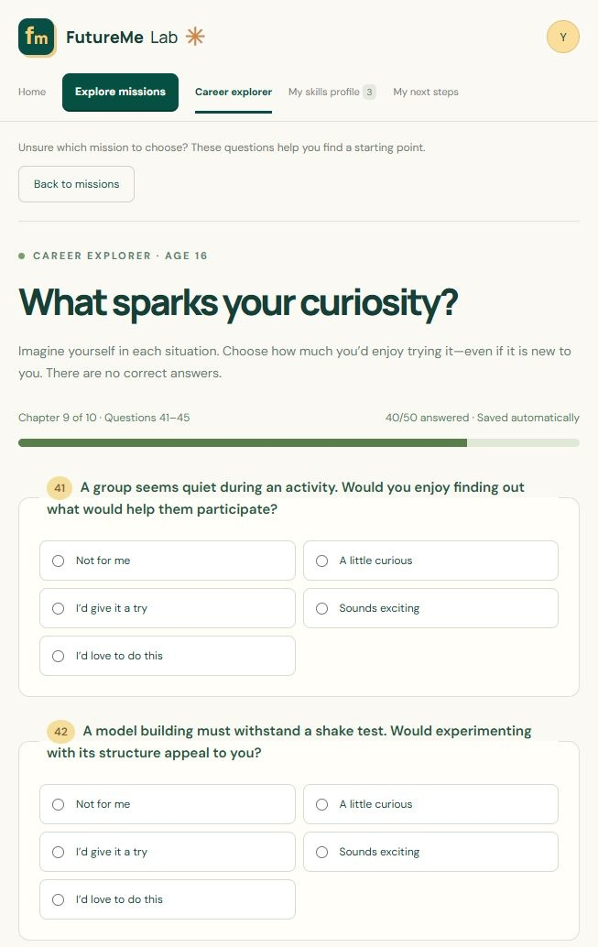

QUESTIONNAIRE SCREEN REFERENCE
Page 9 of 10: questions 41–45
TOP OF PAGE
CONTINUE SCROLLING
FutureMe Lab user manual
46
Notes:
Full captured questionnaire page 9, showing questions 41 through 45. The two excerpts overlap slightly at the split. Use the original full-page JPG in the screenshot archive for detail. This is a reference appendix, not an answer key. Source: https://github.com/dpjegankumar/futurelab

Slide 47
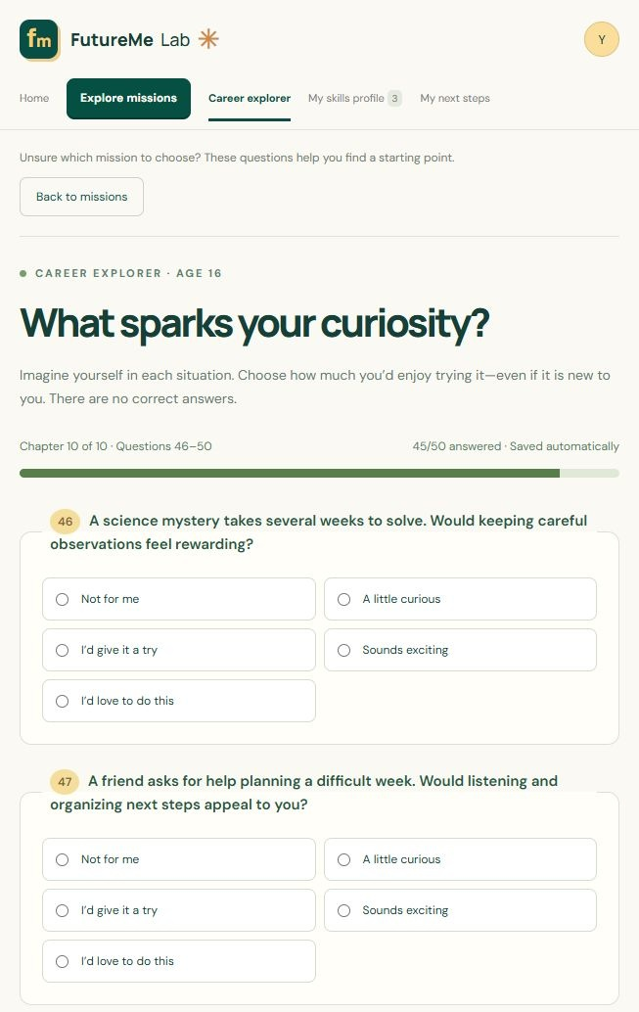

QUESTIONNAIRE SCREEN REFERENCE
Page 10 of 10: questions 46–50
TOP OF PAGE
CONTINUE SCROLLING
FutureMe Lab user manual
47
Notes:
Full captured questionnaire page 10, showing questions 46 through 50. The two excerpts overlap slightly at the split. Use the original full-page JPG in the screenshot archive for detail. This is a reference appendix, not an answer key. Source: https://github.com/dpjegankumar/futurelab

