Slide 1
Where we win, what it earns, and what to bid next
Bid intelligence for Weibee Steel. A working data-and-decisions loop, shown on synthetic data.
Deepak Reddy | Business Development Associate candidate
Notes:
Open with the one-line summary: every bid we send teaches us something. Today that lesson lives in people's heads. This puts it in a table, turns it into a ranked list every Monday, and tells us how full the shop will be next year. Say clearly: the data is made up, the method is real.

Slide 2



Every bid teaches us something. Today the lesson stays in people's heads
We know we 'do well on schools', but not the hit rate with a denominator, by type, size, distance and customer.
The estimate and the job's final cost never meet. We do not know which kinds of work keep their margin and which give it back.
Estimating hours go wherever the invitations come from. Nobody ranks the invitations before a week of takeoff starts.
The posting asks for someone to build exactly this loop: the GC database, bid results, pricing feedback, why we win or lose, and a bid/no-bid process.
Notes:
Three pains every fabricator recognises. Do not dwell; the point is that these are measurable.

Slide 3




What the pipeline does, in four steps
1. Collect
2. Measure
3. Rank
4. Decide
Every invitation, bid, result, low-bid number and job close-out in one place.
Hit rates with denominators. Estimated versus realised margin. Dollars won per estimating hour.
Every upcoming project scored: win odds, margin we really keep, estimating cost, shop load.
A Pursue / Review / Pass list for the Monday bid meeting. The room overrides; the override is logged.
Notes:
Collect, measure, rank, decide. Steps 1 and 2 are the first 60 days on real data; 3 and 4 come after, and only work if 1 is disciplined.

Slide 4
The business at a glance, trailing twelve months
25%
$19.4M
16 weeks
Hit rate
Value won
Won work waiting for the shop
20 of 80 decided bids; prior year 33%
5,088 tons
2,286 tons at 140 tons a week
50%
4.5 pts
29 of 90
How full the shop looks next year
Margin estimated but not kept
Upcoming projects worth chasing
won work plus upcoming work at its odds
estimated 22.9%, actually earned 18.3%
about 700 estimating hours to bid them
Notes:
Read left to right, one sentence each. Pause on the two orange ones: those are the numbers an owner feels every month.

Slide 5
Where the shop fits: hit rate by kind of project
Three kinds of work win 37 to 41% and keep their margin.
Three others win 12 to 15% and give back 7 to 10 points of margin once built.
The bottom three took 29% of estimating hours for 18% of the dollars won.
Action: default them to Review. Bid them when a relationship GC asks, not on a hard bid.
Notes:
Decided bids only, so cancelled projects do not drag the rate down. The action is not never bid them.

Slide 6


Who awards us work, and who only checks their numbers against us
Seven price shoppers
Four A-class accounts
Award us 18% of what we price for them
We are 11% high when we lose
2,650 estimating hours for $19.1M won
Award us 40% or more
Jobs earn at or above shop margin
1,920 estimating hours for $29.4M won
Bid them only when the shop needs fill-in work.
Spend the hours here, and on new GCs that look like them.
Notes:
The scorecard behind this has one row per GC: hit rate, value, price gap, realised margin, change-order approval, days to pay. The A/B/C class is a starting point for account planning, not a verdict.

Slide 7
The margin we estimated but did not keep
4.5 pts
Gross margin not kept
estimated 22.9%, earned 18.3%, 95 jobs
$4.3M
In the bid, not in the bank
complex, far-away and change-order-heavy work slips most
Action: put realised margin by project type back into the estimate as a line item, not a flat markup.
Notes:
Blue is what the bid assumed, orange is what the job earned, dollar-weighted over completed jobs. Three worst and three best kinds of work.

Slide 8
Can the shop take what we are chasing?
The shop does 140 tons a week.
Won work covers 16 weeks.
From the first quarter of next year the shop is less than half full unless the pipeline converts.
Target: roughly 9,000 more tons of identified opportunities at today's hit rate.
Notes:
Won work spread evenly over each job's fabrication weeks. Upcoming work counted at its win odds: a 400-ton job at 25% counts as 100 tons. This is the business-development target in tons.

Slide 9
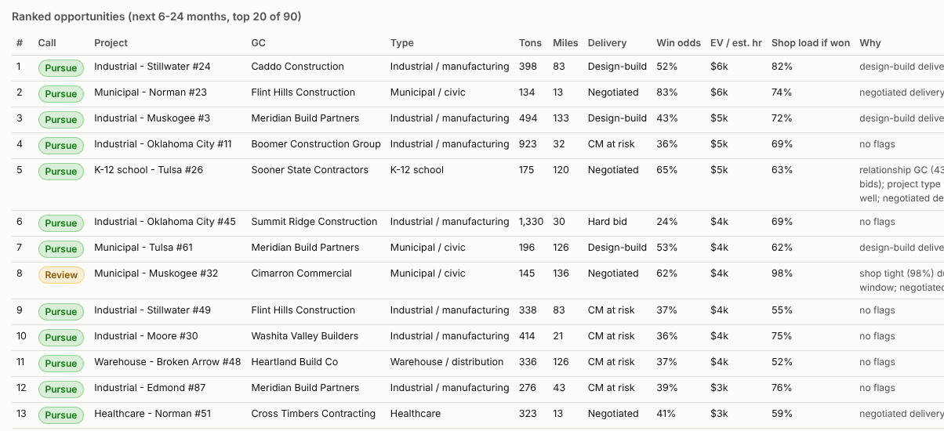
The Monday tool: every upcoming project, ranked, with a call and the reasons
Pursue
29 projects
698 estimating hours, 9,872 tons, $2.5M expected margin
Review
26 projects
451 estimating hours, 4,608 tons, $0.72M expected margin
Pass
35 projects
858 estimating hours, 9,961 tons, $0.53M expected margin
Win odds from our own history with that kind of job and that customer.
Expected value: odds x revenue x the margin we really keep, minus the cost of estimating it. Ranked per estimating hour.
Shop load if we win it, over the weeks it would be in the shop.
A starting point for the bid meeting, not a verdict. The room overrides it and the override is logged.
Notes:
Pick one Pursue row and one Pass row and read the Why column aloud. The reasons are plain words on purpose.

Slide 10
How much to trust the win odds
0.75
100 bids
Quarterly
Accuracy score (AUC)
Tested on bids it had never seen
Re-fit as results come in
0.5 is a coin flip, 1.0 is perfect
fitted on bids before July 2025, checked on the ones after
every decided bid and low-bid number makes it better
The rule we would run it under
Good enough to rank projects and budget estimating hours. Not good enough to overrule the room on one job. The report says this in its own words, and the scorecard shows every input next to the call so the room can argue with the number.
Notes:
This is a small statistical model, the kind an insurer uses, not a chatbot. Being honest about its limits is the point of the slide.

Slide 11
What it takes to run this on Weibee Steel's own numbers
Weeks 1 to 4
Weeks 5 to 8
Weeks 9 to 13
Learn the shop, build the intake
Get the numbers live
Turn on the Monday scorecard
Shadow estimating, PM, QC, shop and field. Load three years of bid logs and job closes. Phone the GCs we lost to for the low number.
Hit rate, customer and estimate-versus-actual pages on real history. Sit with estimators and PMs until the definitions are right.
Rank the pipeline, set the estimating-hour budget, log overrides. Review the capacity chart with shop leadership monthly.
What we would need: the bid log, job-cost close-outs and a list of general contractors. Most shops already have all three, in three different places. No licences: Python and a free database, one afternoon a quarter to re-fit.
Notes:
Intake first, numbers second, scorecard third. The slow part is collecting lost reasons and low-bid numbers, which is phone calls, not software.

Slide 12
Every bid teaches us something. This puts the lesson in a table and on the Monday agenda.
Report, PDF, data and code are in the repository. All data is synthetic; the method runs unchanged on real history.
Thank you
Notes:
Close with the one line and offer the PDF and the 90-day plan.

