Slide 1
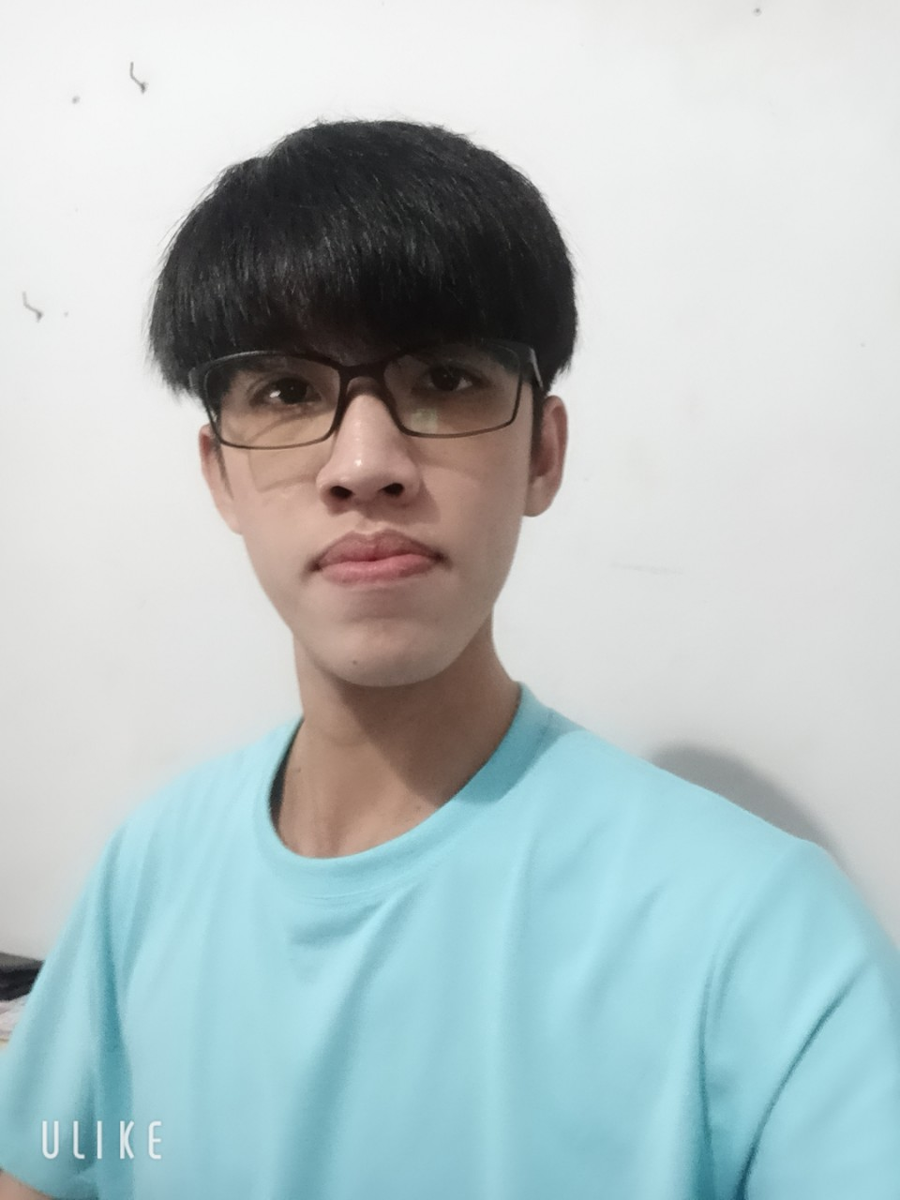

Front-end Developer
About myself
Being a calm person, careful at work and projects.
Integrating quickly with working environment, friendly with everyone easily .
Short-term: Look for a job and become a professional programmer. Hoping to be learned, practised and gained more experiences.
Long-term: Try my best to become a senior programmer for 3 years.
Graduated in Can Tho University:
Grade: Good
GPA: 3.4/4.0
DINH PHUC KHANG
Personal profile
Projects
Wow Foods Project (Fast foods website) is a project programed by a team of 4 members. 2 members for back end and the others for front end. The project uses React library for font end and NodeJS for back end. It use some library: Jquery, Axios, Node-sass, Jsonwebtoken,…
The source is attached:
https://github.com/richardannowit/wowfood-project.git
Hippo Movies Project (Films website) is a project programed by myself. The project uses React library for font end and NodeJS for back end. It use some library: Jquery, Axios, Node-sass, Jsonwebtoken, Googleapis, Nodemailer…
The source is attached:
https://github.com/dpkhang/film-project.git
Merry Chat Project (Chatting website) is a chatting website which is very friendly with people. To keep up with the times, Merry updated dark-mode function. Merry allow people calling and calling video. This website is programmed by 3 persons. It use React, NodeJS and some other popular libraries.
The source is attached:
https://github.com/maitrongnhan001/merry-project.git
Binh Tan, Vinh Long
093 930 5459
khangphuc1@gmail.com
https://github.com/dpkhang
08/06/2000
Foreign language
English
Beginner
More information
Honest and careful at work.
Love to learn and improve knowledge.
Unit and respect partner, colleagues.
Skills
Languages
JavaScript, TypeScript
Front end
React, Vue, CSS, SCSS
Back end
NodeJS
Databases
MySQL, SQL Server, MongoDB
Source management
GitHub

