Slide 1


Technical Services – WCEMPDG
Riser Torque Tool Failure and Exposure
1

Slide 2
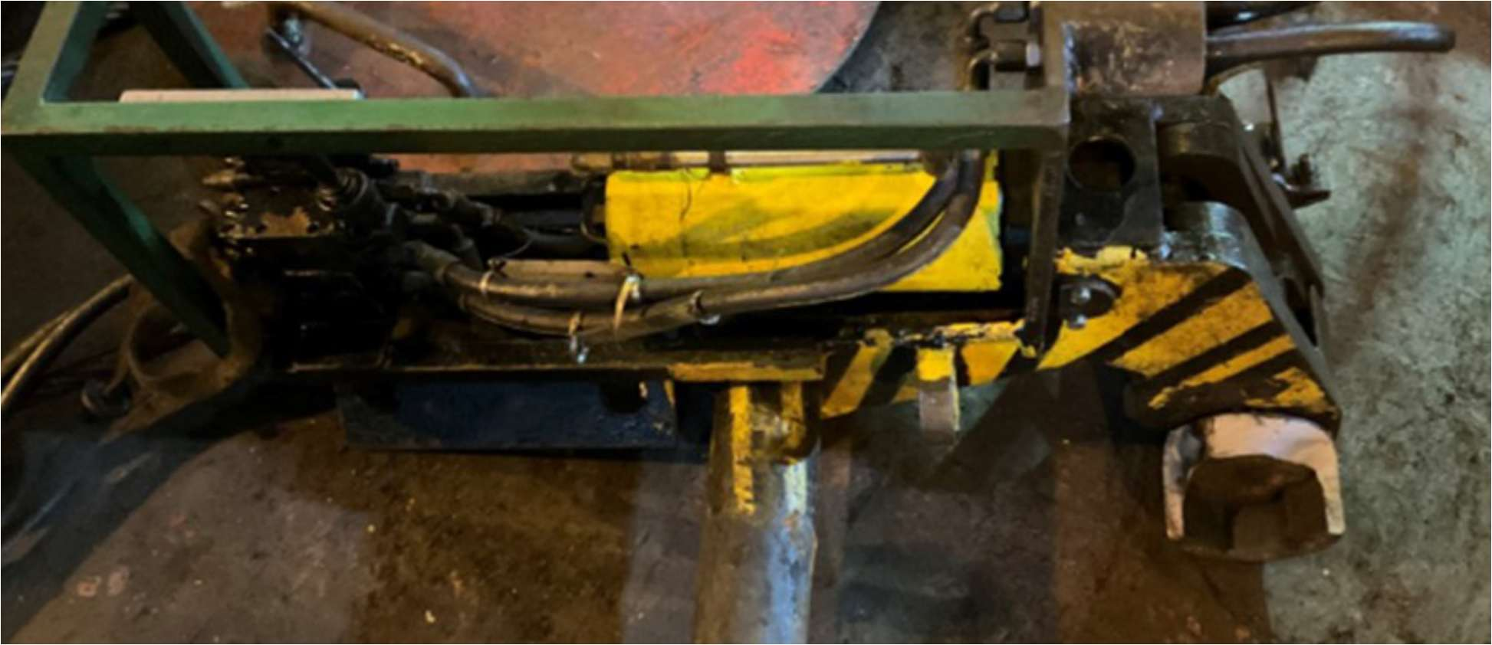
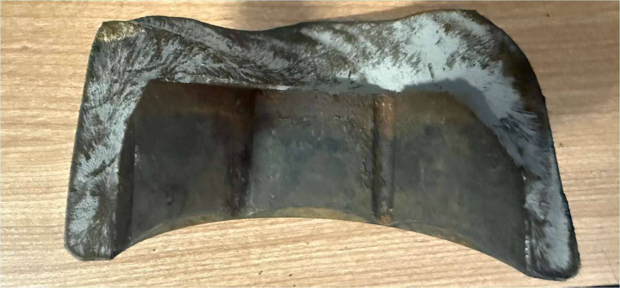
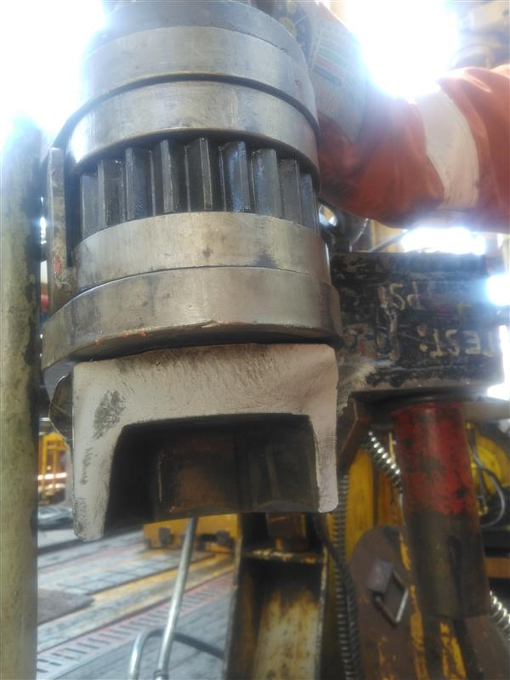
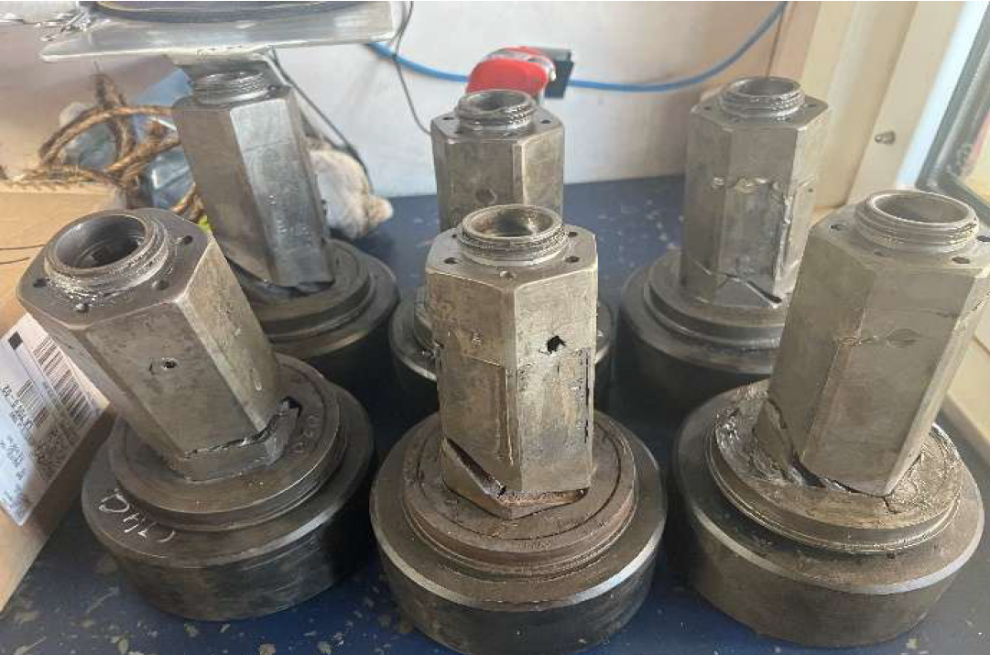
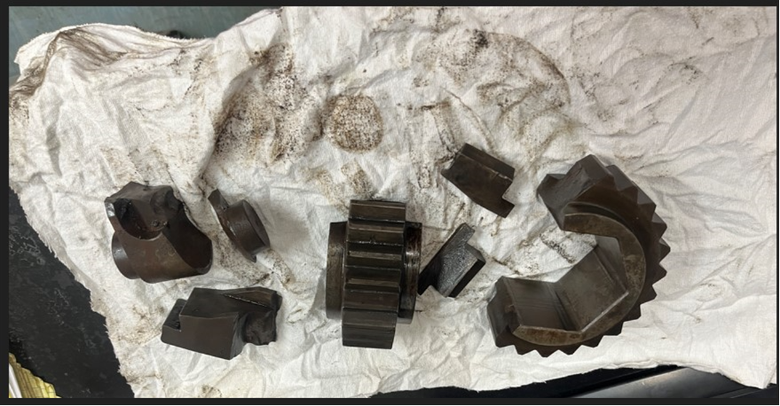

Riser torque tool failures: Events and HSE
West Tellus and West Neptune IR-WCE-335-009 Rev 3 eDOCS 11237290
WEST POLARIS
FLASH ALERT: DROPPED OBJECT
Date: 20 September 2025
Unit: West Tellus (floater)
Serious near miss / Synergi 1790819
WEST TELLUS
WEST NEPTUNE
During an attempt to break torque on a riser bolt, a 3¾-inch hex socket fractured. The broken segment bounced across the rig floor toward the riser catwalk, then fell onto the riser deck.
The fragment weighed approximately 1.3 kg and fell approximately 13.6 m from the catwalk to the deck.
Advanced riser-bolt corrosion required repeated torque-break attempts. The BOP had been in the water for 13 months.
Red-zone controls were in place on the riser deck during riser handling with the gantry crane.
21 September 2025
Socket failure during riser-bolt breakout
2 October 2025
New sockets failed on first use during riser pull
28 September 2026
10 sockets with broken bodies or sheared shafts. Only 1 RTT fully operational.
Gear failures and body/plate tolerance issues. Rebuilt gear failed after 1–2 runs.
Socket fracture and cracks. Newly received sockets failed on first use.
2
Notes:
CONSOLIDATED EVIDENCE AND REPORT ACTIONS
This slide combines the current content of former slides 3 and 4. All four photographs present in the current input are retained uncropped. Top left: West Tellus report photo, p. 1. Top right: West Neptune report photo, p. 2. Bottom left: user-supplied West Neptune damaged drive components. Bottom right: user-supplied socket-damage photo from former slide 4. Historical photo positions in original notes below refer to the earlier separate slides. Removed photos from earlier versions have not been restored.
Report actions reproduced on the slide: remove thick-wall sockets, NDE before each riser run/pull, measure plates using eDOCS 11242619 and report to WCEMPDG, replace affected components above 0.010 in permanent deformation. These are historical report directions. The following AAB slide provides more specific fleet direction, including inner/outer bolt-circle restrictions. The report investigation status does not establish present closure.
ORIGINAL SLIDE 3 SUPPORTING NOTES
Authentic photographs extracted from the controlled incident report. Left: page 1, West Tellus equipment after socket failure during breakout on 21 September (2025 chronology in the current deck). Right: page 2, West Neptune fractured socket from 2 October 2025, described as newly received and failing on first use. Images preserve original proportions with no alteration or added annotations. The report states that the manufacturer investigation is ongoing. These photographs do not independently establish root cause.
[Sources]
SEADRILL-#11237290-v4-Seadrill_-_Incident_Report_IR-WCE-335-009_-_West_Tellus___West_Neptune_-_Riser_Torque_Tool_Socket_Failure (2).pdf, IR-WCE-335-009 Rev 3, pages 1–2. Retrieved from user-specified Riser Torque Tools/Clover Reports folder. Internal/confidential source.
[/Sources]
Additional photograph supplied by Lee Arnold in this turn, identified by the user as West Neptune evidence to accompany the 2 October event. Placed at right alongside, not in place of, the existing report photographs. The photo visibly shows damaged drive components. No independent capture date or root-cause conclusion inferred.
[Sources]
User attachment image.png (image_25a0c6be), supplied 2 October 2026.
[/Sources]
ORIGINAL SLIDE 4 SUPPORTING NOTES
WEST NEPTUNE REPORT SUMMARY
Incident, page 2: On 2 October 2025, newly received Power Tork drive sockets broke on first use during a riser pull. Tool socket MPN 40/33C-DS, ICN 1977919.
Operating checks, page 4: reported RTT pressure 2400 psi, equating to approximately 26,000 ft-lbs. Crew inspected bolts/nuts to verify lubrication and checked thread integrity by ease of hand rotation.
Initial findings, page 5: manufacturer investigation ongoing to determine whether a manufacturing issue contributed; broken sockets were to return for root-cause failure analysis. This is the investigation status recorded in this report, not a statement about current closure.
Subsequent findings, page 7: report linked its reviewed failure population to thicker walls. Measurements 26.84 mm and 20.3 mm refer to West Tellus examples, not West Neptune measurements.
Conclusion, page 8: replace drive/body plate components if permanent hole deformation exceeds 0.010 in. The report describes 0.010 in socket-to-flange clearance separately. Measurement guide eDOCS 11242619. Do not infer that the numerical deformation threshold establishes the cause of the Neptune event.
Fleet actions, page 11: discontinue thicker-wall sockets; NDE before every run/pull; dimensional inspection and reporting to WCEMPDG; verify ICCP/ground faults and BOP anode mapping; use prescribed Moly 503, coefficient 0.067, on threads/shank/shoulder. Route identified thick-wall sockets to regional machining. These are report fleet controls, not findings unique to Neptune.
Related material: metallurgical analysis eDOCS 11242623 and measurement guide eDOCS 11242619 are listed attachments, not independently reviewed here. Torque calibration bench ICN 2285150 appears as a proposed calibration option at $46,000 in the report, not as part of the TorqLite quoted package.
Revision identification: document filename contains v4; report footer identifies IR-WCE-335-009 Rev 3, submitted 12 May 2026, Maximo C10247907.
[Sources]
SEADRILL-#11237290-v4-Seadrill_-_Incident_Report_IR-WCE-335-009_-_West_Tellus___West_Neptune_-_Riser_Torque_Tool_Socket_Failure (2).pdf, pages 2, 4–5, 7–11, user-specified Riser Torque Tools/Clover Reports folder. Created by Eric Rachall, approved by Ronnie Peeples. Internal/confidential.
[/Sources]
PHOTOGRAPHS ADDED TO SLIDE 4
Left: user-supplied replacement photograph of damaged sockets, received 2 October 2026. Capture date and provenance beyond user submission are not independently verified. Centre: internal thread inspection, report page 4 (West Neptune). Right: socket transition areas with original red annotations, report page 5 under West Neptune initial findings. The centre and right images are report photographs. The left image is supplied by the user. All preserve full original framing. Date stamps remain exactly as printed in the source photographs and are not interpreted as independently verified capture dates. Images document observed condition without establishing a manufacturing root cause. All previously recorded incident details, report controls and investigation caveats remain in these notes.
[Sources]
Same controlled report, pages 4–5, original embedded photographs.
[/Sources]
[Sources]
Left photograph: image.png supplied by Lee Arnold on 2 October 2026 as replacement for the selected photograph. No report page or independently verified capture date attributed to this image.
[/Sources]
ADDITIONAL WEST POLARIS EVIDENCE
User requested image 7 from the Polaris socket failure dated 28 September. The named source folder provides the year 2026. The photograph accompanies the existing West Tellus and West Neptune evidence, with all four previous photographs retained. Existing report actions remain attributed to IR-WCE-335-009 Rev 3 and are not presented as a newly established Polaris investigation conclusion. No root cause or new acceptance decision is inferred from the photograph.
[Sources]
User instruction, 2 October 2026. OneDrive: Documents/Copilot/Riser Torque Tools/Broken Sockets from Polaris 28SEPT26/image (7).jpg. Graph file graph_drive_item_e5767c0c. Original 600 x 800 photograph, unaltered and uncropped.
[/Sources]
DROPPED-OBJECT FLASH ALERT
The flash alert identifies West Tellus, 20 September 2025, Synergi 1790819, serious near miss with personal-injury loss potential. File name 1790817.PDF differs from the Synergi number printed inside the alert. The alert date differs from the 21 September date in the existing report caption. Both dates are retained with an explicit discrepancy note, without silently treating them as the same confirmed event date. Alert interim findings and recommendations do not establish a final root cause or investigation closure.
[Sources]
Documents/Copilot/Riser Torque Tools/flash alert/1790817.PDF, one-page flash alert, retrieved 2 October 2026. Graph entity graph_drive_item_92a152e3.
[/Sources]
FULL ALERT TEXT
Date :
FLASH ALERT 9/20/2025
Identified By Operating Units - Floater - LOSS POTENTIAL
West Tellus - Onboard
Management
For more info,contact West Tellus SSS Personal Injury X Loss of Containment
Synergi 1790819 Financial Loss Downtime
WTE-2025-Sep-20-Serious Near Miss-Dropped object
Description of incident : During to break the torque on one of the bolts, a 3 ¾” hex socket fractured and the broken segment bounced on
the rig floor towards the Riser catwalk, eventually falling onto the Riser deck.
The approximate height from the Riser catwalk to the point of impact on the deck is 13.6m. The weight of the socket fragment is
approximately 1.3 kg.
BOP has been in the water for 13 months and advanced corrosion is present on riser bolts.
At the time of the incident, red zone management is in place on the Riser deck area due to riser handling operations being carried out with
the Riser Gantry Crane.
OIM, DSL, RM and Company Man were immediately notified of the incident.
Interim Findings
High level of corrosion in the riser bolt required multiple torque break attempts. BOP in water for 13 months.
Interim Recommendations
Inspection in remaining riser torque tool sockets to identify possible damages.
Photos
IMG_8260 IMG_8281

Slide 3
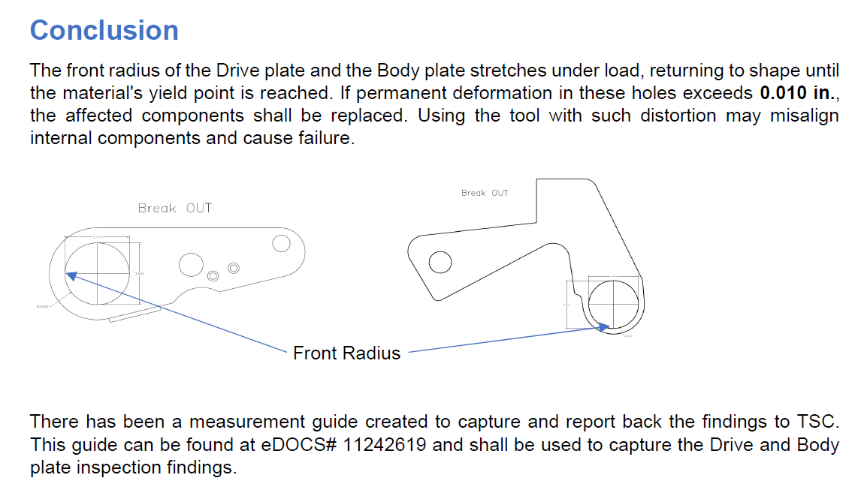
AAB C10247907: Mandatory fleet requirements
Effective immediately on all rigs. Summary of the supplied AAB direction.
SOCKET SELECTION AND USE
Inner bolt circle: ≈5.875 in OD sockets SHALL NOT be used. Use ≈5.375 in OD sockets.
If only thick sockets are onboard, use Hytorc for initial inner-bolt breaking. Contact TSC Well Control Equipment if the correct Hytorc is unavailable.
Thick sockets: OUTER bolt circle only, with sufficient clearance.
Verify tool selection before make-up/break-out. Escalate uncertainty to Technical Services before use.
Replace affected components when permanent deformation exceeds 0.010 in. Record drive/body plate measurements per eDOCS 11242619 and report to TSC.
Technical basis: all reviewed failures involved thick sockets on the inner circle. The ≈6.0 in spot-bore leaves little clearance. Deflection under load can cause interference, bending and cracking.
INSPECTION AND PROTECTION
NDE sockets for cracks before EVERY riser run or pull. Requirement added to BWM PM.
Verify ICCP operation. Investigate and document ground faults with TSC Electric.
Perform BOP cathodic protection survey per AX061682. Verify anodes against the latest mapping with TSC BOP Controls.
REGIONAL MACHINING AND OEM FOLLOW-UP
GOA / Africa: free Power Tork machining. Brazil: VRV, Macaé, R$ 2.628,00/socket. New Brazil sockets: 25% Clover discount. TSC/OEM machining and redesign continue. Full terms in notes.
3
Notes:
AAB C10247907
Source: comments supplied by Lee Arnold on 2 October 2026. This slide summarizes the supplied direction rather than independently confirming the controlled AAB revision or current commercial terms. Mandatory requirements below retain the source meaning. Consult the controlled AAB for execution.
FULL SUPPLIED COMMENTS
Since the 3rd quarter of last year, there have been several Power Tork Riser torque tool sockets fail due to several factors with the latest being on the West Polaris. You should have been contacted by now a few times by TSC requesting measurements of the tool bodies and associated parts as well as socket wall thicknesses.
This AAB provides mandatory fleet direction resulting from the ongoing investigation into riser drive socket failures associated with riser bolt make-up and break-out tooling. This guidance is effective immediately and shall be followed by all rigs going forward.
Background and Technical Basis
The investigation has confirmed that multiple socket outside diameters are currently in circulation across the fleet:
Thinner socket: approximately 5.375 in OD
Thicker socket: approximately 5.875 in OD (introduced into production circa 2022)
Key findings to date:
All reviewed socket failures have involved the thicker (≈5.875 in OD) socket variant.
Failures occurred exclusively while working on the inner riser bolt circle.
The inner bolt circle spot-bore is approximately 6.0 in, leaving minimal radial clearance.
Under high load, normal tool and socket deflection can cause interference between thicker sockets and the spot-bore, resulting in bending stresses, cracking, and socket failure.
MANDATORY FLEET REQUIREMENTS
The following requirements SHALL be implemented and enforced on all rigs:
Thicker drive sockets (≈5.875 in OD) SHALL NOT be used on the riser INNER bolt circle under any circumstances.
If only thicker sockets are available currently onboard, a Hytorc wrench shall be used for initial breaking if inner bolts. If the correct Hytorc isn’t available currently onboard, please contact TSC Well Control Equipment group for assistance.
Thicker drive sockets SHALL only be used on OUTER riser bolt circles, where sufficient clearance exists.
For inner bolt circle operations, rigs SHALL use thinner socket variants (≈5.375 in OD).
Tool selection SHALL be positively verified prior to riser bolt make-up or break-out activities.
Any uncertainty regarding socket type, suitability, or clearance SHALL be escalated to Technical Services prior to use.
Verify the Rig’s ICCP system is working properly as well as investigate and document onboard ground faults. TSC Electric department to be included in investigation.
Perform a BOP cathodic protection survey as per AX061682 and verify the BOPs have their anodes installed per the latest anode mapping. TSC BOP controls to be included in investigation.
NDE the drive sockets for cracks before each Riser run or pull. This requirement has been added to the BWM PM.
Failure to comply with the above requirements may result in equipment damage and increased safety risk.
Next Steps and Formalization
TSC is working with the OEM to turn down the existing thicker sockets and resolve the solution ASAP. TSC has also worked with the OEM to qualify revised socket designs and materials that maintain structural capacity while eliminating clearance-related failure modes.
GOA / African Region rigs: Sockets to be sent back to Power Tork to be machined down free of charge.
Brazilian Region: Sockets shall be sent to VRV in Macae' to be machined down with a cost of R$ 2.628,00 per socket. This is due to the import duty upon the sockets returning to Brazil if sent back to the manufacturer for machining. If any Brazil rigs opt to purchase new sockets, Clover has agreed to a 25% discount ($2,100 USD) to help alleviate part of the import duty.
Interpretation notes: The relative date “last year” remains as supplied. The parenthetical “$2,100 USD” remains as quoted, without interpreting whether this denotes the discounted price or the discount amount. The slide does not replace the controlled instruction. Earlier report slides retain their historical recommendations. This AAB supplies the more specific inner/outer bolt-circle restrictions described above.
[Sources]
User-provided AAB C10247907 comments, 2 October 2026.
[/Sources]
SUPPLIED TECHNICAL DIAGRAM
User supplied image.png on 2 October 2026 for placement on slide 5. Image retained in full without cropping or distortion. It describes elastic stretch at the front radius of the drive and body plates, replacement where permanent hole deformation exceeds 0.010 in, and measurement/reporting guide eDOCS 11242619. Diagram is reproduced as supplied, not generated or redrawn. It provides supplementary inspection detail alongside AAB socket-selection restrictions.
[Sources]
User-supplied image.png, received 2 October 2026, Conclusion / front-radius measurement diagram.
[/Sources]

Slide 4
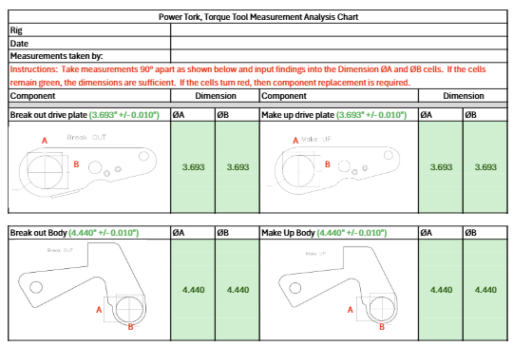
AAB measurement examples: drive and body plates
AAB C10247907 Measurement guide eDOCS 11242619
RECORD ØA AND ØB
Measure 90° apart for both make-up and break-out components.
Drive plate nominal: 3.693 in
Body nominal: 4.440 in
Template tolerance: ±0.010 in
Enter the rig, date and person taking measurements.
Green/red cells indicate the template result. Escalate conflicting readings or dispositions to TSC.
4
Notes:
User-supplied image.png received 2 October 2026, Power Tork Torque Tool Measurement Analysis Chart. Full supplied image preserved without cropping. The shown 3.693 and 4.440 values are nominal examples, not vessel submissions. Instructions call for measurements 90 degrees apart and entry into ØA/ØB cells. Green means sufficient dimensions and red calls for component replacement. Template headings specify ±0.010 in. AAB/report text elsewhere uses permanent deformation exceeding 0.010 in. Do not use this slide as independent equipment certification.
[Sources]
User-provided measurement example image, 2 October 2026. AAB C10247907 user-provided comments.
[/Sources]

Slide 5
Selected vessel results: findings and follow-up
“Seadrill Measurements 03-09-2026” BO = break-out MU = make-up
RED: rejected / outside tolerance GREEN: reading within ±0.010 in AMBER: conditional / recheck
Vessel / selected tool | Submitted dimensions (in) | Workbook disposition / follow-up
West Polaris Tool 1 | Plate BO: 3.745 / 3.662 / 3.700 | Replace plates. Tool 2 body also marked Replace.
Quenguela C154033C599 | Body MU: 4.446 / 4.453 / 4.454 Plate MU: 3.707 / 3.706 / 3.702 | Replace body and plates. Other records contain a reading/status conflict.
West Tellus Red tool | Body BO: 4.465 / 4.447 / 4.472 | Replace body and plates. Workbook calls for immediate removal from service.
West Carina First Green entry | Body BO: 4.455 / 4.452 / 4.456 Plate BO: 3.706 / 3.708 / 3.706 | Replace body and plates. Workbook calls for all parts to be replaced as soon as possible.
West Auriga Tools 2 and 3 | Tool 2 plate BO: 3.703 / 3.707 / 3.711 | Tool 2: Good with concession / backup advice. Tool 3: Replace plates.
Libongos Tool 3 | Body BO: 4.446 / 4.451 / 4.437 | Body: Good with 0.001 in concession. Recheck each run. Replace plates.
West Jupiter Black tool | Plate BO: 3.684 / 3.676 / 3.686 | Plates: Good, but remeasure low readings.
West Saturn Tool 1 | Body BO: 4.408 / 4.438 / 4.438 | Body and plates: Good, but repeat measurements. Other tools also need rechecks.
Green applies to individual readings, not tool approval. Amber requires review. Resolve concessions and conflicting readings with TSC. Details in notes.
5
Notes:
CONSOLIDATED SELECTED VESSEL RESULTS
All eight vessel entries and all selected dimension values from former slides 7 and 8 remain on this slide. Plate means drive plate. BO means break-out. MU means make-up. Dimensions remain in source column order. Workbook Good labels are qualified by concessions, low readings and remeasurement requests, and do not certify current serviceability.
ORIGINAL ON-SLIDE CONTENT
Vessel / selected tool | Submitted measurements | Workbook disposition / follow-up
West Polaris
Tool 1 | Drive plate break-out:
3.745 / 3.662 / 3.700 | Drive plates: Replace.
Tool 2 body also marked Replace.
Quenguela
C154033C599 | Body make-up: 4.446 / 4.453 / 4.454
Plate make-up: 3.707 / 3.706 / 3.702 | Body and drive plates: Replace.
Other records include a reading/status conflict.
West Tellus
Red tool | Body break-out:
4.465 / 4.447 / 4.472 | Body and drive plates: Replace.
Workbook says remove the Red tool from service now.
West Carina
First Green entry | Body break-out: 4.455 / 4.452 / 4.456
Plate break-out: 3.706 / 3.708 / 3.706 | Body and drive plates: Replace.
Workbook says replace all parts as soon as possible.
Vessel / selected tool | Submitted measurements | Workbook disposition / follow-up
West Auriga
Tools 2 and 3 | Tool 2 plate break-out:
3.703 / 3.707 / 3.711 | Tool 2 marked Good with tolerance concession / backup advice. Tool 3 plates: Replace.
Libongos
Tool 3 | Body break-out:
4.446 / 4.451 / 4.437 | Body marked Good with a 0.001 in concession. Recheck after each run. Drive plates: Replace.
West Jupiter
Black tool | Plate break-out:
3.684 / 3.676 / 3.686 | Drive plates marked Good, but workbook requests remeasurement of low readings.
West Saturn
Tool 1 | Body break-out:
4.408 / 4.438 / 4.438 | Body and plates marked Good, but workbook requests repeat measurements. Other tools also need rechecks.
PRESERVED SUPPORTING NOTES
Selected examples, not a fleet-wide pass/fail assessment. Workbook dispositions are reproduced as source labels and do not establish current serviceability or completed actions. H/V/A means Horizontal/Vertical/Angle, except the W. Polaris sheet labels both C and D as Vertical. This slide selects one or more pertinent records from each named vessel. Source filename date retained as written, without assuming day/month interpretation.
WORKSHEET: W. Polaris
A1: West Polaris
A3: Tool 1 | B3: Horizontal | C3: Vertical | D3: Vertical
A4: Tool Body | E4: Good
A5: Break Out | B5: 4.444 | C5: 4.447 | D5: 4.444
A6: Make Up | B6: 4.446 | C6: 4.444 | D6: 4.445
A7: Drive Plates | E7: Replace
A8: Break Out | B8: 3.745 | C8: 3.662 | D8: 3.7
A9: Make Up | B9: 3.695 | C9: 3.68 | D9: 3.684
A11: Tool 2
A12: Tool body | E12: Replace
A13: Break Out | B13: 4.449 | C13: 4.444 | D13: 4.443
A14: Make Up | B14: 4.453 | C14: 4.448 | D14: 4.454
A15: Drive Plates | E15: Good
A16: Break Out | B16: 3.7 | C16: 3.697 | D16: 3.7
A17: Make Up | B17: 3.7 | C17: 3.695 | D17: 3.695
A19: Tool 5
A20: Tool Body | E20: Good
A21: Break Out | B21: 4.444 | C21: 4.44 | D21: 4.435
A22: Make Up | B22: 4.44 | C22: 4.434 | D22: 4.442
A23: Drive plates | E23: Good
A24: Break Out | B24: 3.7 | C24: 3.7 | D24: 3.691
A25: Make Up | B25: 3.7 | C25: 3.7 | D25: 3.695
WORKSHEET: Quenguela
A1: Quenguela
A3: C154033C599 | B3: Horizontal | C3: Vertical | D3: Angle
A4: Tool Body | E4: Replace
A5: Break Out | B5: 4.442 | C5: 4.44 | D5: 4.447
A6: Make Up | B6: 4.446 | C6: 4.453 | D6: 4.454
A7: Drive Plates | E7: Replace
A8: Break Out | B8: 3.704 | C8: 3.705 | D8: 3.704
A9: Make Up | B9: 3.707 | C9: 3.706 | D9: 3.702
A11: 224033C012
A12: Tool Body | E12: Good
A13: Break Out | B13: 4.44 | C13: 4.442 | D13: 4.443
A14: Make Up | B14: 4.44 | C14: 4.444 | D14: 4.444
A15: Drive Plates | E15: Good
A16: Break Out | B16: 3.691 | C16: 3.695 | D16: 3.691
A17: Make Up | B17: 3.694 | C17: 3.692 | D17: 3.692
A19: K144033C565
A20: Tool Body | E20: Good
A21: Break Out | B21: 4.443 | C21: 4.445 | D21: 4.439
A22: Make Up | B22: 4.449 | C22: 4.443 | D22: 4.442
A23: Drive Plates | E23: Good
A24: Break Out | B24: 3.703 | C24: 3.798 | D24: 3.701
A25: Make Up | B25: 3.702 | C25: 3.702 | D25: 3.699
A27: H214033C700
A28: Tool Body | E28: Replace
A29: Break Out | B29: 4.447 | C29: 4.449 | D29: 4.447
A30: Make Up | B30: 4.453 | C30: 4.445 | D30: 4.44
A31: Drive Plates | E31: Good
A32: Break Out | B32: 3.692 | C32: 3.695 | D32: 3.693
A33: Make Up | B33: 3.695 | C33: 3.692 | D33: 3.693
WORKSHEET: West Tellus
A1: West Tellus
A3: Black | B3: Horizontal | C3: Vertical | D3: Angle
A4: Tool Body | E4: Good
A5: Break Out | B5: 4.447 | C5: 4.437 | D5: 4.436
A6: Make Up | B6: 4.436 | C6: 4.416 | D6: 4.44
A7: Drive Plates | E7: Replace
A8: Break Out | B8: 3.717 | C8: 3.711 | D8: 3.698
A9: Make Up | B9: 3.714 | C9: 3.706 | D9: 3.725
A11: On the Make Up side of the Tool Body the measurement is 4.416.
A12: This is smaller than the hub of the gear. I put good on the body
A13: because all of the other measurements are good. Next time
A14: you service the tool please measure that one again just to make sure.
A16: Blue
A17: Tool Body | E17: Good
A18: Break Out | B18: 4.43 | C18: 4.42 | D18: 4.44
A19: Make Up | B19: 4.434 | C19: 4.42 | D19: 4.44
A20: Drive Plates | E20: Replace
A21: Break Out | B21: 3.718 | C21: 3.708 | D21: 3.711
A22: Make Up | B22: 3.718 | C22: 3.707 | D22: 3.725
A24: Yellow
A25: Tool Body | E25: Replace
A26: Break Out | B26: 4.445 | C26: 4.453 | D26: 4.453
A27: Make Up | B27: 4.45 | C27: 4.453 | D27: 4.444
A28: Drive Plates | E28: Replace
A29: Break Out | B29: 3.372 | C29: 3.709 | D29: 3.69
A30: Make Up | B30: 3.732 | C30: 3.71 | D30: 3.693
A32: Red
A33: Tool Body | E33: Replace
A34: Break Out | B34: 4.465 | C34: 4.447 | D34: 4.472
A35: Make Up | B35: 4.459 | C35: 4.446 | D35: 4.445
A36: Drive Plates | E36: Replace
A37: Break Out | B37: 3.72 | C37: 3.685 | D37: 3.698
A38: Make Up | B38: 3.717 | C38: 3.7 | D38: 3.698
A40: The measurements on this Red Tool are so out of tolerance it
A41: should be taken out of service now.
WORKSHEET: West Carina
A1: West Carina
A3: Green | B3: Horizontal | C3: Vertical | D3: Angle
A4: Tool body | E4: Replace
A5: Break Out | B5: 4.455 | C5: 4.452 | D5: 4.456
A6: Make Up
A7: Drive Plates | E7: Replace
A8: Break Out | B8: 3.706 | C8: 3.708 | D8: 3.706
A9: Make Up
A11: Green | B11: Horizontal | C11: Vertical | D11: Angle
A12: Tool body | E12: Replace
A13: Break Out | B13: 4.452 | C13: 4.454 | D13: 4.456
A14: Make Up | E14: Replace
A15: Drive Plates | B15: 3.709 | C15: 3.711 | D15: 3.711
A16: Break Out
A17: Make Up
A19: Red | B19: Horizontal | C19: Vertical | D19: Angle
A20: Tool body | E20: Replace
A21: Break Out | B21: 4.447 | C21: 4.452 | D21: 4.457
A22: Make Up | E22: Replace
A23: Drive Plates | B23: 3.707 | C23: 3.7 | D23: 3.709
A24: Break Out
A25: Make Up
A27: All parts should be replaced as soon as you can.
Cautions: “Good” labels can conflict with recorded measurements or include concessions and remeasurement instructions. These are historical workbook judgments, not approval to bypass mandatory AAB controls. Quenguela K144033C565 has drive plate C24=3.798 with a Good label. West Auriga Tool 2 and Libongos Tool 3 include explicit tolerance concessions. West Tellus and other sheets contain low or unusual readings requiring confirmation. The workbook contains eight vessel worksheets and no West Neptune sheet.
[Sources]
https://sdrl-my.sharepoint.com/personal/lee_arnold_seadrill_com/Documents/Documents/Copilot/Riser%20Torque%20Tools/Clover%20Reports/Seadrill%20Measurements%2003-09-2026.xlsx
Microsoft Graph source entity: graph_drive_item_06314849. Worksheet/cell values reproduced above.
[/Sources]
Selected examples, not a fleet-wide pass/fail assessment. Workbook dispositions are reproduced as source labels and do not establish current serviceability or completed actions. H/V/A means Horizontal/Vertical/Angle, except the W. Polaris sheet labels both C and D as Vertical. This slide selects one or more pertinent records from each named vessel. Source filename date retained as written, without assuming day/month interpretation.
WORKSHEET: West Auriga
A1: West Auriga
A3: Tool 1
A4: Tool Body | B4: Horizontal | C4: vertical | D4: Angle | E4: Good
A5: Break Out | B5: 4.444 | C5: 4.439 | D5: 4.427
A6: Make Up | B6: 4.439 | C6: 4.415 | D6: 4.439
A7: Drive plates | E7: Good
A8: Break Out | B8: 3.69 | C8: 3.702 | D8: 3.672
A9: Make Up | B9: 3.702 | C9: 3.698 | D9: 3.693
A11: The measurements on the drive plates are very close to 0.010" out.
A12: You need to check these after the next riser run to make sure they are
A13: still good.
A15: Tool 2
A16: Tool Body | E16: Good
A17: Break Out | B17: 4.451 | C17: 4.423 | D17: 4.44
A18: Make up | B18: 4.444 | C18: 4.436 | D18: 4.439
A19: Drive Plates | E19: Good
A20: Break Out | B20: 3.703 | C20: 3.707 | D20: 3.711
A21: Make up | B21: 3.711 | C21: 3.701 | D21: 3.691
A23: The tool body is 0.010" over. I let that go. You only have three tools.
A24: The drive plates are only 0.002" from being out of tolerance. You need to keep
A25: a good eye on this one. This tool is so close to the tolerance I would use it as
A26: the back up.
A28: Tool 3
A29: Tool Body | E29: Good
A30: Break Out | B30: 4.44 | C30: 4.422 | D30: 4.431
A31: Make Up | B31: 4.439 | C31: 4.411 | D31: 4.441
A32: Drive Plates | E32: Replace
A33: Break Out | B33: 3.689 | C33: 3.696 | D33: 3.711
A34: Make Up | B34: 3.711 | C34: 3.701 | D34: 3.691
A36: The drive plates need to be replaced here. Tool 2 is very close. You need
A37: to order three sets for when these go out of tolernce.
WORKSHEET: Libongos
A1: Libongos
A3: Tool 1
A4: Tool Body | B4: Horizontal | C4: Vertical | D4: Angle | E4: Good
A5: Break Out | B5: 4.441 | C5: 4.445 | D5: 4.439
A6: Make Up | B6: 4.442 | C6: 4.45 | D6: 4.443
A7: Drive Plates | E7: Replace
A8: Break Out | B8: 3.71 | C8: 3.698 | D8: 3.7
A9: Make Up | B9: 3.71 | C9: 3.705 | D9: 3.7
A11: Tool 2
A12: Tool Body
A13: Break Out | B13: 4.442 | C13: 4.445 | D13: 4.447 | E13: Good
A14: Make up | B14: 4.447 | C14: 4.449 | D14: 4.44
A15: Drive Plates | E15: Replace
A16: Break Out | B16: 3.716 | C16: 3.7 | D16: 3.71
A17: Make up | B17: 3.716 | C17: 3.712 | D17: 3.69
A19: Tool 3
A20: Tool Body
A21: Break Out | B21: 4.446 | C21: 4.451 | D21: 4.437 | E21: Good
A22: Make Up | B22: 4.442 | C22: 4.45 | D22: 4.441
A23: Drive plates | E23: Replace
A24: Break Out | B24: 3.716 | C24: 3.7 | D24: 3.71
A25: Make Up | B25: 3.712 | C25: 3.708 | D25: 3.69
A27: The tool body is .001" over the .010' tolerance. I let that one go.
A28: you only have three tools. Keep a close eye on this one
A29: Measure it after every riser run and if it gets even 0.001 bigger, you need to
A30: order one. I would also order at least 2 sets of drive plates because there
A31: are a couple that will probably be out of tolerance soon.
WORKSHEET: West Jupiter
A1: West Jupiter
A3: Black | B3: Horizontal | C3: Vertical | D3: Angle
A4: Tool body | E4: Good
A5: Break Out | B5: 4.449 | C5: 4.447 | D5: 4.449
A6: Make Up | B6: 4.45 | C6: 4.449 | D6: 4.449
A7: Drive Plates | E7: Good
A8: Break Out | B8: 3.684 | C8: 3.676 | D8: 3.686
A9: Make Up | B9: 3.703 | C9: 3.7 | D9: 3.696
A11: There are a few measurements on the drive plates that are low. The hub of the
A12: gear is 3.685 It would not fit into the drive plates if the measurements are that low.
A13: You need to measure those again. The rest of the numbers on the drive plates are
A14: good so they are probably OK, but we need to know the real measurement.
A16: Blue
A17: Tool Body | E17: Good
A18: Break Out | B18: 4.43 | C18: 4.434 | D18: 4.44
A19: Make Up | B19: 4.442 | C19: 4.435 | D19: 4.449
A20: Drive Plates | E20: Good
A21: Break Out | B21: 3.7 | C21: 3.695 | D21: 3.651
A22: Make Up | B22: 3.689 | C22: 3.695 | D22: 3.697
A24: some of the drive plate measurements are low. The gear hub is 3.685. It would not fit.
A25: I called it good but they need to be measured again just to make sure. Same for the
A26: Body
A28: Yellow
A29: Tool Body | E29: Good
A30: Break Out | B30: 4.443 | C30: 4.441 | D30: 4.444
A31: Make Up | B31: 4.448 | C31: 4.431 | D31: 4.444
A32: Drive Plates | E32: Good
A33: Break Out | B33: 3.687 | C33: 3.682 | D33: 3.657
A34: Make Up | B34: 3.685 | C34: 3.686 | D34: 3.697
A36: The measurements of body and drive plates are low. You need to check them again.
A38: Red
A39: Tool Body | E39: Good
A40: Break Out | B40: 4.44 | C40: 4.432 | D40: 4.432
A41: Make Up | B41: 4.435 | C41: 4.436 | D41: 4.433
A42: Drive Plates | E42: Good
A43: Break Out | B43: 3.638 | C43: 3.688 | D43: 3.686
A44: Make Up | B44: 3.691 | C44: 3.701 | D44: 3.691
A46: The measurements are very low. You need to check them again.
WORKSHEET: West Saturn
A1: West Saturn
A3: Tool 1 | B3: Horizontal | C3: Vertical | D3: Angle
A4: Tool Body | E4: Good
A5: Break Out | B5: 4.408 | C5: 4.438 | D5: 4.438
A6: Make Up | B6: 4.44 | C6: 4.443 | D6: 4.438
A7: Drive pLates | E7: Good
A8: Break Out | B8: 3.696 | C8: 3.69 | D8: 3.69
A9: Make Up | B9: 3.699 | C9: 3.684 | D9: 3.69
A11: I gave it all Good but the measurements are very low. They need to be taken
A12: again just to make sure. If they are within 0.010 of the dimension they are
A13: Good. Toool Body 4.440". Drive plates 3.693.
A15: Tool 2
A16: Tol body | E16: Good
A17: Break Out | B17: 4.44 | C17: 4.443 | D17: 4.438
A18: make Up | B18: 4.443 | C18: 4.44 | D18: 4.434
A19: Drive pLates | E19: Good
A20: Break Uot | B20: 3.697 | C20: 3.693 | D20: 3.688
A21: make Up | B21: 3.698 | C21: 3.689 | D21: 3.686
A23: Again the measurements are A little low. Take them again just to make sure.
A25: Tool 3
A26: Tol body | E26: Good
A27: Break Out | B27: 4.439 | C27: 4.437 | D27: 4.432
A28: Make Up | B28: 4.434 | C28: 4.425 | D28: 4.438
A29: Drive Plates | E29: Good
A30: Break Out | B30: 3.698 | C30: 3.691 | D30: 3.692
A31: Make Up | B31: 3.695 | C31: 3.702 | D31: 3.69
A33: Low measurements. They need to be taken again.
A35: Tool 4
A36: Tool Body | E36: Good
A37: Break Out | B37: 4.437 | C37: 4.443 | D37: 4.436
A38: Make up | B38: 4.437 | C38: 4.434 | D38: 4.436
A39: Drive Plates | E39: Good
A40: Break Out | B40: 3.698 | C40: 3.691 | D40: 3.691
A41: Make up | B41: 3.692 | C41: 3.694 | D41: 3.686
A43: Low Measurements. They need to be taken again.
Cautions: “Good” labels can conflict with recorded measurements or include concessions and remeasurement instructions. These are historical workbook judgments, not approval to bypass mandatory AAB controls. Quenguela K144033C565 has drive plate C24=3.798 with a Good label. West Auriga Tool 2 and Libongos Tool 3 include explicit tolerance concessions. West Tellus and other sheets contain low or unusual readings requiring confirmation. The workbook contains eight vessel worksheets and no West Neptune sheet.
[Sources]
https://sdrl-my.sharepoint.com/personal/lee_arnold_seadrill_com/Documents/Documents/Copilot/Riser%20Torque%20Tools/Clover%20Reports/Seadrill%20Measurements%2003-09-2026.xlsx
Microsoft Graph source entity: graph_drive_item_06314849. Worksheet/cell values reproduced above.
[/Sources]
COLOUR KEY
Red: source rejection/replacement instructions, or individual recorded dimensions outside the stated template band. Green: individual recorded dimensions within the inclusive nominal ±0.010 in band (drive plates 3.683–3.703 in, bodies 4.430–4.450 in). Amber: conditional Good dispositions, concessions, remeasurement requests or conflicting evidence. No conditional Good component has been certified in specification or approved for service by this formatting change. Individual green readings do not overrule other red readings, workbook replacement instructions, repeat-measurement requirements or AAB controls. Source numbers and dispositions remain unchanged.

Slide 6
Fleet spend: Power Tork vs TorqLite
Source-workbook comparison of two rigs per group, labelled as a two-year period
Purchasing population | Power Tork / Clover | TorqLite - Proposed
Rig 1 | West Neptune: $357,609.38 | West Auriga: $62,925.00
Rig 2 | West Tellus: $173,516.04 | Sevan Louisiana: $23,574.00
Two-year workbook total | $531,125.42 | $86,499.00
Observed two-year difference | $444,626.42 | 83.7% lower PO spend
6
Notes:
CORRECTED COST BASIS: Source workbook Neptune K30 = $357,609.38 and Tellus I13 = $173,516.04, combined $531,125.42. TorqLite summary: West Auriga $62,925 plus Sevan Louisiana $23,574 = $86,499. Difference $444,626.42 / $531,125.42 = 83.71396%. Annualized totals divide the labelled two-year period by two. Annualized per rig: Clover $132,781.36 and TorqLite $21,624.75. Historical purchasing includes stock, repairs, urgent orders and reorders, not failure-only consumption. No common operating-day/run/deployment denominator. Do not extrapolate as guaranteed annual savings or payback. Prior deck cost numbers and the $439,166.57 failed-parts claim are superseded or unverified.
DOWNTIME LIMITATION: Original slide 13 headline says 2.5 h Clover vs 2.0 h TorqLite, but its rig rows show Neptune 7.0 h plus Tellus 6.5 h = 13.5 h. No underlying Synergi report was present in the supplied root folder. Neither the 0.5 h/20% claim nor a derived 11.5 h reduction should be used until event scope is reconciled. Original values retained below solely as an audit trail.
[Sources]
West Neptune and Tellus Torque Tool Repair Parts Spend to Clover for last 2 years.xlsx, Neptune and Tellus sheets.
Auriga and Sevan Louisiana 2 year POs to TorqLite.xlsx, WAU AND SLO 2 YEAR PO TOTALS. Retrieved from specified folder.
SUPPORTING DETAIL FROM ORIGINAL DECK
Original slide 12
Two-Year Cost Comparison: Power Tork / Clover vs. TorqLite
West Neptune and West Tellus documented Power Tork / Clover PO line costs compared with West Auriga and Sevan Louisiana Torqlite purchase orders.
$530,442.04
WNE + WTE Power Tork / Clover combined two-year cost
$439,166.57 in failed parts relating to drive gears, pawls, sockets, bearings, and frames
$86,499.00
WAU + SLO TorqLite all PO line costs 2 years
$443,943.04
Two-Year cost difference
Cost basis | WNE Power Tork / Clover | TorqLite - WAU and SLO
Two-year total | $530,422.04 | $86,499.00
Rig allocation | West Neptune: $356,926.04 | West Tellus: $173,516.00 | West Auriga: $62,925 | Sevan Louisiana: $23,574
Cost population | West Neptune all PO line costs plus West Tellus total Clover Tool spend | All listed TorqLite POs worldwide
Operating context | West Neptune PO activity and West Tellus two-year Clover spend | Auriga: 10 BOP deployments since rejoining Seadrill
Equipment history | Combined Power Tork / Clover cost basis for the last two years | Auriga TorqLite wrenches in service since 2022
The combined TorqLite PO total is $443,943.04 lower than the complete Power Tork / Clover PO line-cost total, a 84% difference.
Sources: Attached Maximo Purchase Order Details report; Auriga and Sevan Louisiana 2 year POs to TorqLite.xlsx, “WAU AND SLO 2 YEAR PO TOTALS”; operating-history notes provided by Eric Rachall.
CONFIDENTIAL - EXCO BUSINESS CASE
12
$530,442.04 $443,943.04
Power Tork / Clover combined two-year cost Two-Year Cost Difference
Original slide 13
RTT Downtime Comparison: Power Tork / Clover vs. TorqLite
Synergi downtime events directly involving riser torque tooling or riser-bolt breakout.
2.5 HOURS
Neptune + Tellus
2.0 HOURS
Auriga + Sevan Louisiana
.5 HOURS
Lower TorqLite-group downtime
Equipment group / rig | RTT-related downtime | Supported events
Power Tork / Clover | West Neptune | 7.0 h | RRT would not unlock; stem required corrective torque
Power Tork / Clover | West Tellus | 6.5 h | Riser-bolt breakout issue; RTT socket broke during breakout
TorqLite | West Auriga | 2.0 h | Unable to release riser torque tool from riser bolt during spin-out
TorqLite | Sevan Louisiana | 0.0 h | No RTT-related downtime event identified
COMPARISON | 2.5 h vs. 2.0 h | TorqLite-group downtime is .5 h lower
EXCO TAKEAWAY: Within the reviewed Synergi records, the TorqLite-equipped comparison group recorded 2.0 hours of RTT-related downtime versus 2.5 hours for the Power Tork / Clover group. This is a .5-hour reduction, or approximately 20% lower recorded RTT-related downtime.
Source: Synergi Life.pdf, downtime cases for West Tellus and Sevan Louisiana, May 2024 through 2 October 2026
CONFIDENTIAL - EXCO BUSINESS CASE
13
[Sources]
Synergi Life.pdf: West Neptune and West Tellus downtime cases.
Synergi Life Auriga and Sevan.pdf: West Auriga and Sevan Louisiana downtime cases.
[/Sources]
[Sources]
Current presentation, original slides 12, 13.
Reference design: Seadrill CBM specific & Cost Presentation.pptx, specified Example of PPT required and template folder.
West Neptune and Tellus Torque Tool Repair Parts Spend to Clover for last 2 years.xlsx, Neptune and Tellus sheets.
Auriga and Sevan Louisiana 2 year POs to TorqLite.xlsx, WAU AND SLO 2 YEAR PO TOTALS. Retrieved from specified folder.
[/Sources]

Slide 7
The proposed package standardizes tooling on 11 rigs
3 RT-24-S tools per vessel with all quoted spares S39960-GOA-R2, 25 Aug 2026 USD
PER VESSEL
TOTAL FOR ALL 11 VESSELS
$247,034
$2,717,374
3 tools + ancillary equipment + full spares
33 tools + 11 ancillary sets + 11 spares packages
Cost breakdown | Per vessel | All 11 vessels
RT-24-S tools (3 per vessel) | $133,962 | $1,473,582
Ancillary equipment | $75,648 | $832,128
Full quoted spares package | $37,424 | $411,664
TOTAL | $247,034 | $2,717,374
RT-24-S: $44,654 each Maximo ICN: 4085835
Calculated 3-tool configuration using quoted rates, subject to supplier confirmation.
7
Notes:
RT-24 modified tool has hydraulic motor, 2½ in square drive, reversible drop-down reaction bar and extended low-profile quad gearbox for Shaffer FT-H risers. Socket is 95 mm / 3¾ in ATF, 6-point, Z-40M60-RT. Four 30 ft hoses and fittings per IDCC. Rig dimensional checks, training, spares, procedures and PMS/Maximo integration remain required.
[Sources]
Original deck technical scope and quotations S39960-GOA-R2, S39960-INTL-R1 and S40003 as cited there.
SUPPORTING DETAIL FROM ORIGINAL DECK
Original slide 6
TorqLite Technical Basis
Current quote scope clarifies the single-rig equipment configuration.
4 x RT-24-S
Modified Riser Torque tools
4 x Z-40M60-RT
2 ½” Square Drive 95 mm impact sockets
2 x IDCC
Dual-control consoles
2 x CATB
Oil-bath toolboxes
APPLICATION
RT-24 modified tool with hydraulic motor, 2-1/2 in square drive, reversible drop-down reaction bar and extended low-profile quad gearbox for Shaffer FT-H risers.
SOCKET / HOSES
2-1/2 in square drive x 95 mm (3-3/4 in) ATF, 6-point impact socket. Each IDCC includes four 30 ft hoses with fittings.
READINESS
Rig-specific dimensional checks, onboard training, spares, procedures and PMS/Maximo integration remain deployment controls.
[Sources]
Torq/Lite S39960-GOA-R2, item lines 1-4.
Torq/Lite S39960-INTL-R1, item lines 1-4.
Original EXCO presentation, slide 6.
[/Sources]
Original slide 9
Options Assessment
Purchase provides the strongest long-term strategic alignment; rental remains a contingency.
Option | Reliability concern | Operational complexity | Commercial profile | Assessment
Continue Power Tork | High | High | Low immediate | Not recommended
Rent alternatives | Medium | Medium-high | Recurring | Contingency only
Purchase TorqLite | Lower target | Medium during rollout | Capital required | RECOMMENDED
Mixed / phased fleet | Medium | High complexity | Staged capital | Funding fallback
Preferred path: purchase and phase deployment by technical risk and operating schedule.
[Sources]
Original EXCO presentation, slide 8.
Current Torq/Lite quotations.
[/Sources]
[Sources]
Current presentation, original slides 6, 9.
Reference design: Seadrill CBM specific & Cost Presentation.pptx, specified Example of PPT required and template folder.
Original deck technical scope and quotations S39960-GOA-R2, S39960-INTL-R1 and S40003 as cited there.
[/Sources]
CURRENT FULL-FLEET PURCHASE BASIS, 2 OCTOBER 2026
The user removed the Brazil phased option. The active plan is three RT24-S tools per vessel for all 11 vessels, plus the complete quoted ancillary equipment and full spares package for EACH vessel. All prior Brazil pool scenarios and earlier USD 32,752 unit-rate estimates are superseded.
Verified quote S39960-GOA-R2 dated 25 August 2026: RT24-S USD 44,654 each. Maximo ICN 4085835 supplied by user. Per vessel: 3 tools = USD 133,962. Ancillary scope: 4 sockets x USD 1,006 = USD 4,024; 2 IDCC x USD 20,458 = USD 40,916; 2 CATB x USD 15,354 = USD 30,708. Ancillary sum USD 75,648. Full quoted spares (items 6–25) USD 37,424 per vessel, without reductions or sharing across vessels. Total USD 247,034 per vessel.
Full 11-vessel allocation: 33 tools USD 1,473,582 + ancillary equipment USD 832,128 + 11 full spares packages USD 411,664 = USD 2,717,374. Cross-check: 11 x USD 247,034 = USD 2,717,374. This total is unchanged from the previous three-tool calculation because that calculation already included full spares per vessel; the optional Brazil allocation is now removed.
Supplier quote originally has 4 tools, equipment subtotal USD 254,264 plus spares USD 37,424 = USD 291,688. Planned configuration subtracts one USD 44,654 tool and retains all other quoted quantities. This is calculated scope pending supplier confirmation, not a revised supplier-issued quotation. Maintenance USD 42,180 less 100% quoted discount USD 42,180 = net zero. Trade-in credit unapplied: conditional USD 4,465.40 per eligible tool, minimum three rig packages, 30-day validity from quote date has expired. EXW origin. Freight, insurance, duties and taxes excluded from the planning total. Reconfirm price, configuration and maintenance terms before purchase.
[Sources]
TLSQ39960-GOA-R2 Seadrill 08252026.pdf, pages 1–3, retrieved from Documents/Copilot/Riser Torque Tools/RT 24 quotes on 2 October 2026. Graph entity graph_drive_item_5e9aaf64. User instruction, 2 October 2026: remove Brazil option, retain three tools per vessel and all quoted spares, calculate all 11 vessels.
[/Sources]

