Slide 1
WCE Reporting Tools — Day 2
Tuesday 20 October 2026 · Precharge, the SACRED dashboards, Argo Navis, the loop
Dan Plant, Technical Services – Subsea
Lee Arnold, WCE Manager
Notes:
Welcome back. Yesterday was about getting a report from blank to posted. Today is about what happens to it after that: the precharge loop, the dashboards that read your posts, Argo Navis for Between Well Maintenance, and how the pieces connect.
The one thing we must leave with today is the agreement at the 13:00 hold point on daily reporting.

Slide 2
Day 2 agenda
Tuesday 20 October 2026
Time | Module | Session | Who
08:00–10:00 | 5 | The precharge process | Dan
10:00–10:15 |  | Break
10:15–12:00 | 6 | The SACRED dashboards | Dan
12:00–13:00 |  | Lunch
13:00–14:30 | 7 | Argo Navis: planning and executing BWM, with the daily reporting hold point | Dan, Lee
14:30–14:45 |  | Break
14:45–15:30 | 8 | The loop | Dan, Lee
15:30–16:15 | 9 | What is coming | Dan
16:15–17:00 | 10 | Feedback | All
Today is a demonstration. Follow along on your laptop — don’t post. The Training Manual has every step.
Notes:
Today is demonstration and follow-along only. I drive everything on the projector; you follow on your laptops, but you post nothing, save nothing to the server and press no Post buttons. The Training Manual has every step as a how-to guide.
Walk the day. Point out the hold point inside Module 7: that is where we agree the daily reporting requirement for the fleet, and we do not move on until we have.
Breaks are at 10:00 and 14:30, lunch at 12:00. Feedback at the end goes straight onto the action list.

Slide 3
Module 5
The precharge process · 08:00–10:00
Notes:
Module 5. Two hours on the precharge: how a request becomes an issued sheet and a PDF, who is told, and who signs.

Slide 4
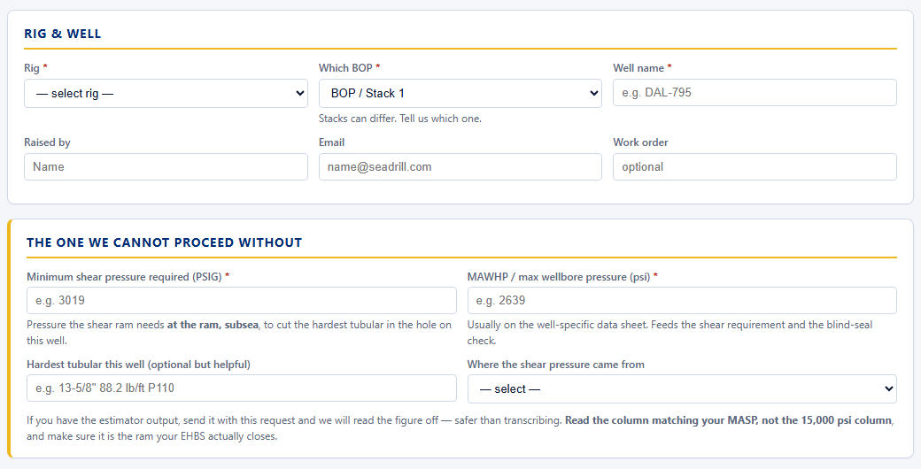
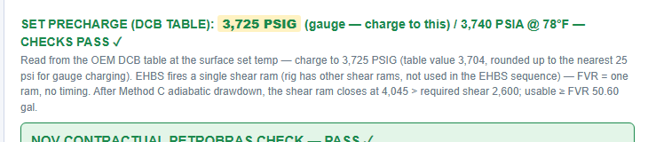
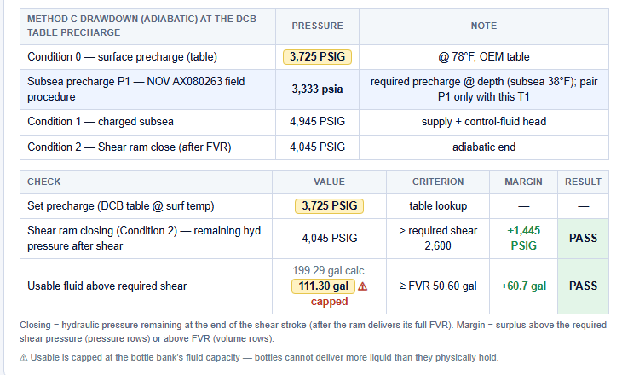
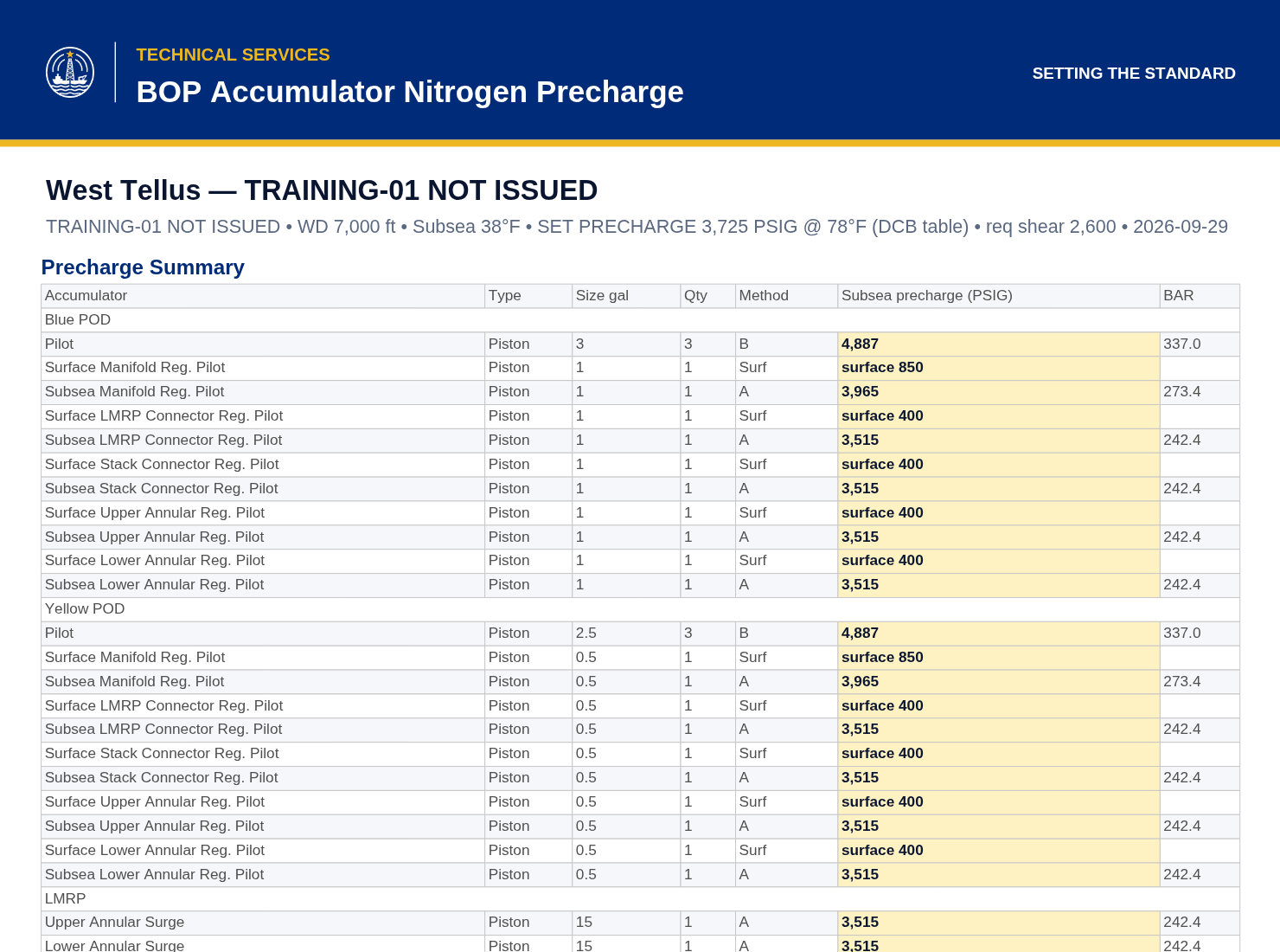
Precharge: from request to issued PDF
Four steps, one record
1
The request
2
The calculation
3
The issued sheet
4
The PDF
The rig fills in the BOP Precharge Request: rig, BOP, well name, minimum shear pressure, well conditions.
Technical Services loads the request into the calculator. Rig preset, OEM table or API method, every check shown.
Figures per accumulator, the drawdown, PASS or FAIL against shear and FVR. A sheet that fails cannot be posted.
The controlled document. Not the screen, not the email, not a screenshot.
Notes:
Four steps, left to right. The rig asks, we calculate, the calculator produces the issued sheet, and the sheet prints to a PDF.
The request carries the one figure we cannot proceed without: the minimum shear pressure at the ram, subsea.
Say it out loud: the PDF issued by Technical Services is the controlled document. If anyone is charging from a screenshot or an email body, stop them.

Slide 5
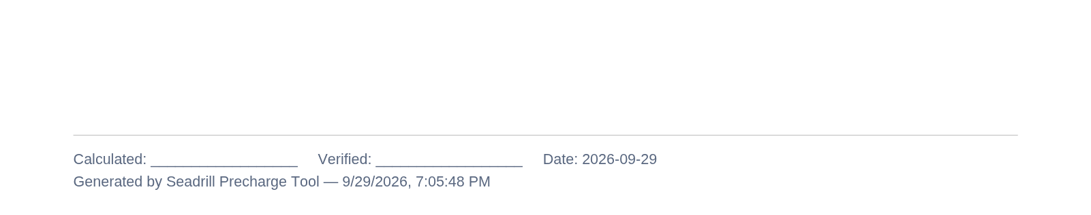
Precharge: who is told, where it lives, who signs
The notification loop
Where the record lives
The two signatures
The rig posts the request. The office is emailed.
We post the issued sheet. The rig is emailed: Subsea Supervisor, TSL, ARM and Rig Manager.
Rig people are always on To, never Cc, so a precharge is never missed. The office is on Cc.
Both posts land in PostedReports, matched by rig and well name.
The dashboard shows the issued sheet against the original request.
The PDF inside the post is the controlled document.
Calculated: one person works it up.
Verified: a second person checks it.
The tool’s timestamp is its own record, not a signature. It replaces neither name.
Everything is under MOC.
Notes:
The loop: request goes to the office, the issued sheet goes to the rig's people on To, the office on Cc. We put the rig on To deliberately: rigs filter Cc.
The record is the post in PostedReports and the PDF inside it; the dashboard pairs the sheet with its request by rig and well name.
Two signatures at the foot of the PDF: calculated and verified, two different people. The timestamp is not a signature.
Everything is under MOC: the calculator, the rig presets and every change to them.

Slide 6

Precharge, worked through on screen
How it runs
The three training requests
Dan works the three training requests on the projector, one at a time.
You follow on your laptop. Post nothing, save nothing to the server.
Verified rigs, training well names. The marker shows on the sheet, the PDF and the filename.
The Training Manual has the how-to, step by step.
Well | Rig | What it is | What to notice
TRAINING-01 | West Tellus | DCB dedicated shear, single stack | Read from the OEM DCB table
TRAINING-02 | West Neptune | DCB, split 4+4, dual stack | Change BOP 1 to BOP 2: only the header changes
TRAINING-03 | West Gemini | Piston dedicated shear | No OEM table: the tool works out an API optimum
The training marker on the issued sheet header
Notes:
I work all three requests on the projector; the room follows on their laptops and posts nothing. I load each one with Load .json from the training files.
What the room should see: Tellus sets 3,725 PSIG, checks pass. Neptune gives a per-accumulator table, identical for BOP 1 and BOP 2. Gemini gives an API optimum of 4,750 PSIG.
If time allows, show Tellus with shear 4,105: the sheet fails and the post is refused. The Training Manual has each step.
Nothing is posted from this class. Not one file.

Slide 7
Module 6
The SACRED dashboards · 10:15–12:00
Notes:
Module 6. Everything you posted yesterday is read by the scanner and shown here. This is where other people see your work.

Slide 8
The Rig Visit Dashboard
Eight tabs, one place
Report list
Every posted report, by rig and date.
Rig monitoring
What each rig has posted, and what is missing.
CBM heatmap
Component condition across the fleet.
Compliance
What is required against what has arrived.
Investigations
Open investigations and their records.
Failures
Equipment failures taken from the reports.
Lessons learned
Captured on the rig, open to everyone.
AABs
Advisories, acknowledgements and close-out.
Dan shows, you follow. Report list, rig SSCE Equipment, Monday’s date: open Monday’s demonstration report.
Notes:
Open the dashboard on the screen and go through the tabs left to right, one sentence each.
Then open Monday's demonstration report on SSCE Equipment from the Report list while the room follows on their laptops. If it were not there, that is the Errors button, next slide.
Make the point: if it is on the dashboard, everyone can see it. That is the difference between posted and on the dashboard.

Slide 9
CBM heatmap, the full-report viewer and the Errors button
CBM heatmap
Full-report viewer
The Errors button
Rows are components, columns are rigs.
The colour is the latest grade.
Click a cell to open the inspection behind it.
A blank cell means no inspection on record, not a good one.
Opens the whole report as it was posted: entries, photographs, captions, tests.
It is the same record the PDF prints from.
If it is not in the viewer, it was not posted.
Lists every file the scanner could not read, and why.
A file in Errors is on the server but not on the dashboard.
Check it before you post again.
Notes:
The heatmap is the fleet view of CBM: one glance shows where the poor grades are. Stress that a blank cell is missing evidence, not good news.
The full-report viewer shows exactly what was posted. Captions and photographs are part of the record.
The Errors button: if your report is missing, look here first. Do not post the same file again until you know why.

Slide 10
The BOP Fleet Planning page
One tile per rig and BOP
West Vela · BOP1
BOP ready date
When the BOP will be ready to deploy, from the plan’s BOP work only.
BOP need date
When the well needs it.
Float
Need date minus ready date. Green is time in hand. Red means the BOP will be late.
Argo Navis plans
Each tile links to its plan. The tile updates every time the rig posts a daily report.
BOP ready
25 Oct 05:10
BOP need
26 Oct
Float +1 day
Open the Argo Navis plan
Example rig · BOP2
BOP ready
02 Nov 14:00
BOP need
01 Nov
Float −1 day
Open the Argo Navis plan
Illustration. The first tile uses the West Vela sample plan.
Notes:
This is the page managers look at first. One tile per rig and BOP: ready date, need date, and the float between them.
The ready date comes from BOP work only, which we will see in Argo Navis this afternoon.
Every daily report the rig posts updates the tile. If the tile is stale, the report is late.

Slide 11
The WCE CoC dashboard and SSCE requests
What it holds
How to use it on the rig
SSCE requests
Every WCE Certificate of Conformance, by rig and by equipment.
Search by rig, part number or serial number.
Find the certificate before you ask for it.
Check the serial number on the certificate against the equipment in front of you.
Raise a request when a certificate is missing or wrong.
It goes through the TSC Help Centre, so it is tracked and answered on the page.
Notes:
Open the CoC dashboard and search for one certificate live. The habit we want: look here before emailing the office.
If a certificate is missing or wrong, raise an SSCE request. It goes through the Help Centre, so it is tracked and has a receipt; I demonstrate one in Module 8.

Slide 12
The AAB tab and the Seadrill Bulletin Board
Every advisory follows the same four steps
Advisory
Acknowledgement
Review
Close
Issued by the office to the rigs it affects, on the Bulletin Board.
Each rig confirms it has read it. The AAB tab shows who has not.
The rig checks its equipment against the advisory and records what it found.
Closed when every affected rig has reviewed. The record stays.
On the rig: acknowledge means read it. Review means checked the kit. They are not the same step.
Notes:
Advisory, acknowledgement, review, close. Show one advisory on the Bulletin Board and its row on the AAB tab.
The trap: a rig acknowledges and thinks it is done. Acknowledging only says you read it; the review is the check on your own equipment.
The office closes it only when every affected rig has reviewed.

Slide 13
Ask SACRED AI
Questions in plain words, answered from the posted reports
Today: demonstrated by Dan
Ask a question about the fleet in plain words.
The answer names the reports it came from.
Open the source before you act on an answer.
Coming: for everyone
The same tool, open to every superintendent.
It reads what has been posted, and nothing else.
Good reports make good answers.
Try asking: “Which rigs have a CBM grade 4 or 5 on the annulars this year?”
Notes:
I demonstrate this live; the room watches. Ask two or three questions the room suggests.
Point out that every answer names the reports it came from. Open one and check it.
It is coming for everyone. It only knows what has been posted, so the quality of the answers is the quality of your reports.

Slide 14
Module 7
Argo Navis — planning and executing Between Well Maintenance · 13:00–14:30
Notes:
Module 7, with Lee. Argo Navis is how a BWM plan is built, reviewed, frozen, executed and closed out. Inside this module is the hold point on daily reporting.

Slide 15
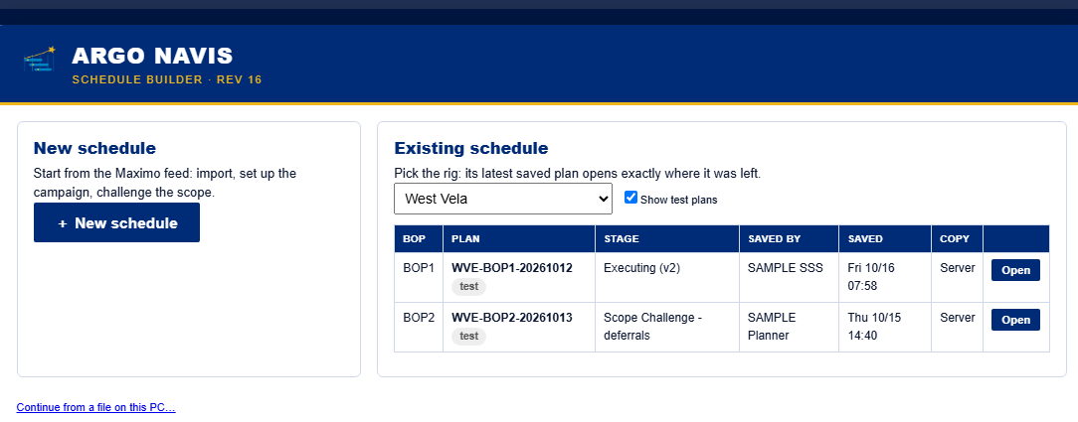
The life of a plan
From the landing page to close-out · Dan shows, you follow
1
Landing page New or Existing, by rig
2
Scope challenge Challenge every work order
3
Post for review
4
Reviewers verify
5
Freeze scope Hold 1
6
Execute
REV 16 landing page: New schedule, or an existing plan by rig
7
Post daily report Twice a day
8
Post close-out
Save at any stage. It also saves itself at every step and every 30 minutes.
Notes:
Eight steps. Open the landing page: New, or Existing by rig. Existing opens the latest saved plan exactly where it was left.
The freeze is Hold 1, in yellow: nothing is executed before the scope is frozen.
Save whenever you like; it also saves itself at every step and every 30 minutes, so a closed browser does not lose the plan.

Slide 16
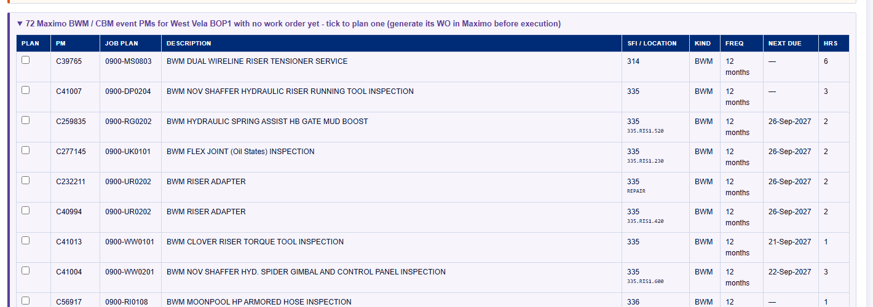
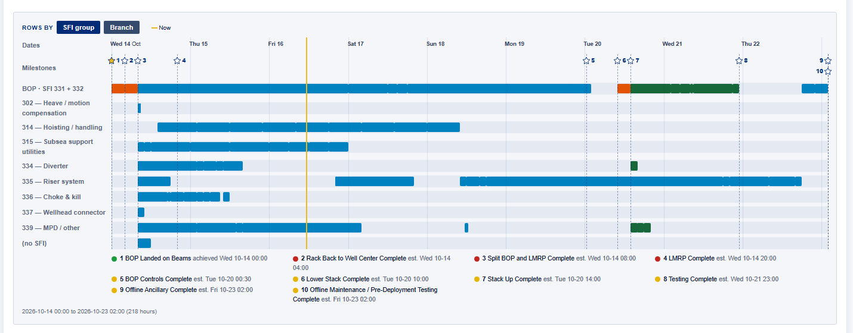
SFI groups, BOP % and the BOP ready date
The BOP group is SFI 331 + 332 · Dan shows, you follow
SFI groups
Every work order sits in an SFI group. 331 and 332 together are the BOP group.
BOP %
BOP work only. The rest of the plan does not move it.
The BOP ready date, from BOP work only
BOP on beams
Float
Time from the BOP ready date to the BOP need date.
Testing complete
Drifted
Pre-deployment call
BOP ready to deploy
Notes:
Every work order belongs to an SFI group. 331 and 332 are the BOP group; that is the line at the top of the chronology.
BOP % and the BOP ready date come from BOP work only: on beams, testing complete, drifted, the pre-deployment call, ready to deploy.
Float is the gap to the BOP need date. That is the number on the Fleet Planning tile this morning.

Slide 17
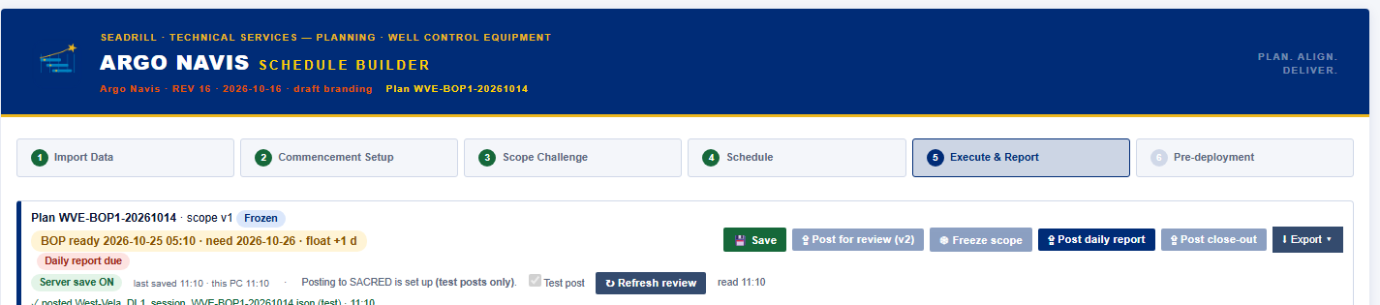
Review and the scope freeze
Review
Freeze
After the freeze
Reviewers verify in the TSC Help Centre, on the Plans tab.
Refresh review re-reads who has verified.
Freeze only when every required reviewer has verified.
An override needs a name and a reason, and shows red.
The scope is locked.
New work comes in as break-in work, in the open.
Dan shows, you follow.
The plan bar: Save, Post for review, Freeze scope, Refresh review, Post daily report, Post close-out.
Notes:
Post for review sends the plan to the reviewers; they verify in the Help Centre, Plans tab. Refresh review re-reads that state into the plan.
Freeze only when every required reviewer has verified. You can override, but it needs your name and a reason, and the plan shows it in red for everyone.
After the freeze the scope is locked. Anything new is break-in work, next slide.

Slide 18
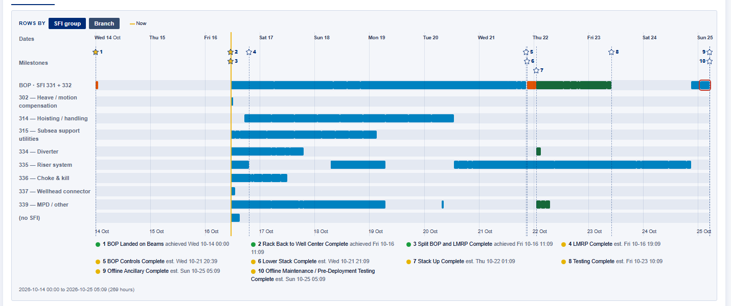
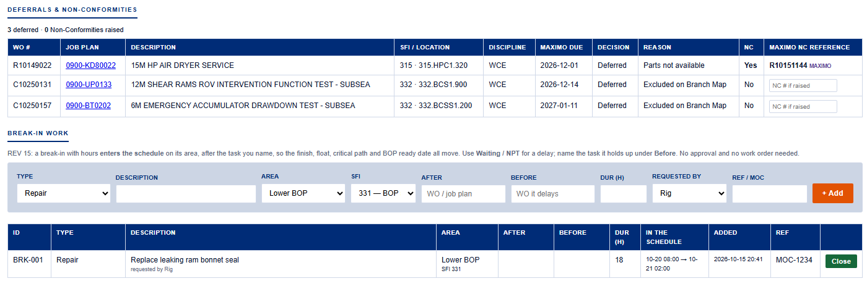
Executing the plan
What the rig does every shift · Dan shows, you follow
Complete means 100% at the time marked.
Mark it when it is done, not later.
Break-in work: BRK-nnn.
The rig controls it. It moves the schedule and the critical path, and shows in the daily report.
Deferrals need a reason.
Job plan checklists are built in.
Done, N/A or Not OK for each step.
The chronology.
Real dates, the Now line and milestone stars.
Notes:
Complete means 100% at the time you mark it, so mark it when it is done.
Break-in work gets a BRK number. The rig controls it, it moves the finish, the float, the critical path and the BOP ready date, and it shows up in the next daily report.
A deferral without a reason is not accepted. Open one job plan checklist and show Done, N/A and Not OK.
The chronology shows real dates, the Now line and the milestone stars.

Slide 19
Daily reporting requirement: when and by whom
HOLD POINT · we agree this today
Twice a day
After each shift handover.
Posted by the rig
From Argo Navis, with Post daily report.
Not the planner
The planner no longer issues it.
The rig’s time
The report time is the rig’s own, for example 0700 and 1900.
We do not move on until the room has agreed this.
Notes:
This is the hold point. Lee leads it.
The Daily Summary Report is posted twice a day by the rig, from Argo Navis, after each shift handover. The planner no longer issues it.
The report time is the rig's own: most will use 0700 and 1900, but it is their handover that sets it.
We do not move on from this until we have agreed it.

Slide 20
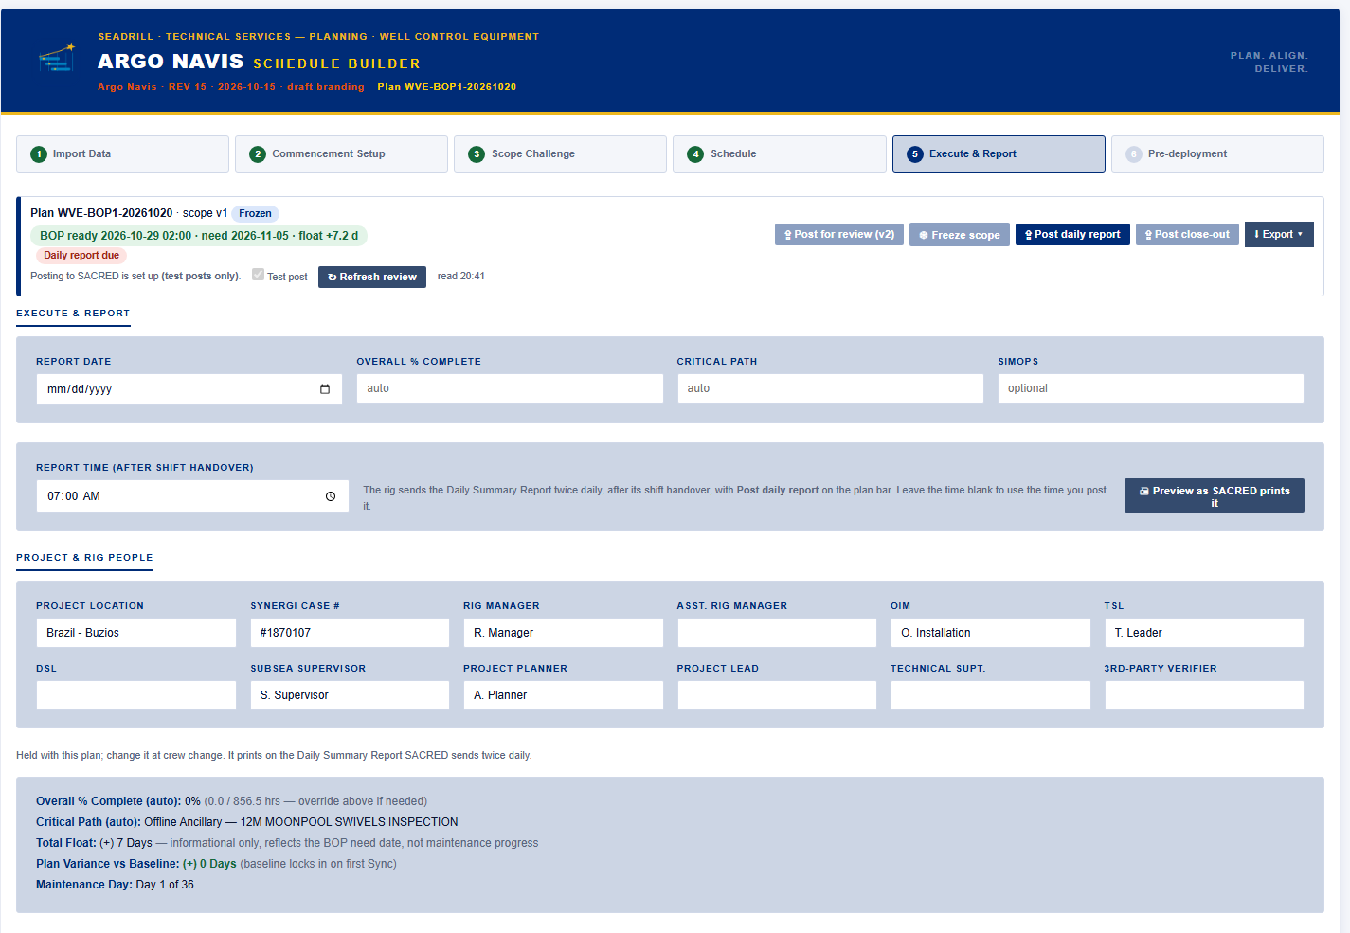
Daily Summary Report: what is inside, who it goes to
HOLD POINT
What is inside
Who it goes to
Project header
Maintenance day
Original and current finish
Variance and float, in hours
Critical path and SIMOPS
Project % and BOP %
Milestones: baseline, estimated, actual
Break-ins and delays
Quality and rig reliability
Lessons learned
Last cycle and next cycle
Comments
An automatic email with the PDF and a dashboard link.
To: the rig’s RM, ARM, SSS, TSL, DSL, ESV and MPD, and the WCE office leads.
Cc: all TSC WCE managers, superintendents and planners.
And: a line in the plan’s Teams chat.
Report time and project people in Argo Navis
Notes:
Walk down the contents. These are the same headings the planner's Word report had, now filled from the plan itself.
Variance and float are in hours. BOP % is BOP work only.
Nobody has to send it: posting it sends the email with the PDF and a dashboard link to the rig's leadership and the office leads, Cc the TSC WCE managers, superintendents and planners, and adds a line to the plan's Teams chat.

Slide 21
To agree today
HOLD POINT
Question | Agreed | Owner
Who on each rig posts it
The two report times per rig
What must be correct before posting
What happens when a report is late
The planner’s role once the rig posts
Form control: PPDSR030918 at a new revision?
Notes:
Fill this in live with the room; Lee owns the decisions, I write them down.
For each row: what we agreed, and one named owner.
Form control: does the report keep PPDSR030918 at a new revision, or does it get a new number? Leave with an owner for that.

Slide 22
Two routes, one report
The same Daily Summary Report, whichever tool holds the plan
Argo Navis
Between Well Maintenance
The plan is built and run in Argo Navis.
Post daily report from the plan bar.
The numbers come from the plan itself.
WCGRRT Planning Report
P6 projects
Discipline: Planning, then Planning Report.
Import ERT fills the lists, milestones, critical path, % and finish.
Quick buttons for 0600, 0700, 1800 and 1900.
Same rules · same print · same email
Notes:
Argo Navis is the route for BWM. P6 projects stay in P6, and the rig posts the same report from WCGRRT's Planning Report, importing the ERT for the numbers.
Both print the same Daily Summary Report from the same code, follow the same rules and send the same email.
The filename carries the report time, so two reports a day never overwrite each other.

Slide 23
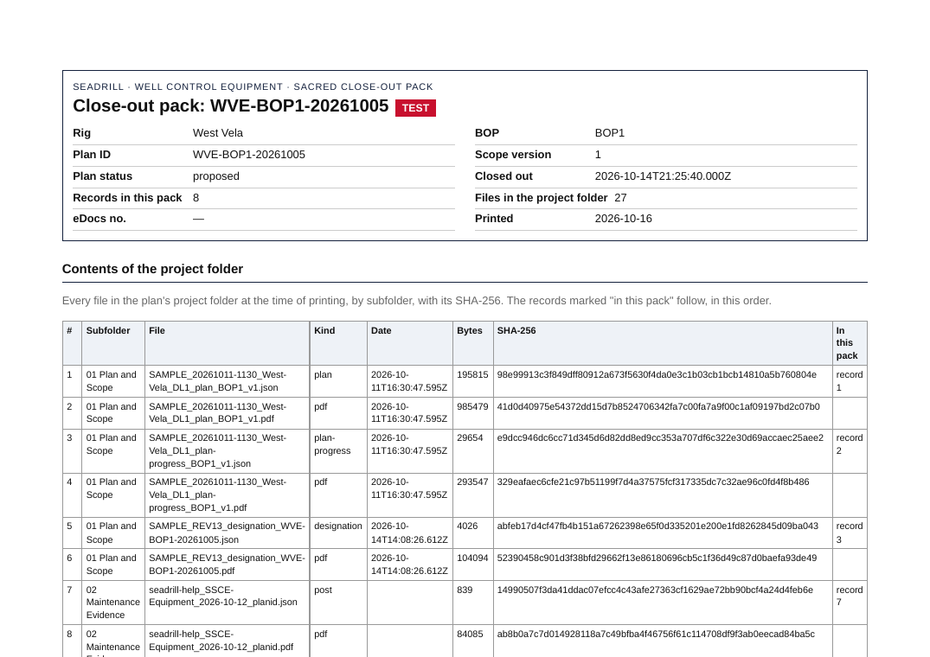
Close-out and the close-out pack
One PDF for the whole plan
Post close-out
When the work is done, the rig posts the close-out from the plan bar.
The close-out pack
One PDF that joins every record for the plan: plan and scope, maintenance evidence, testing, CBM, the pre-deployment checklist, photographs.
A contents page
Lists every file in the project folder with its checksum.
Filed for eDocs
One document, one eDocs number.
Sample close-out pack, page 1 (West Vela test plan)
Notes:
Close-out is the last post on the plan.
The close-out pack joins every record for the plan into one PDF, with a contents page listing every file in the project folder.
That one PDF is what goes to eDocs. Today it is filed by hand; automatic filing is on the What is coming slide.

Slide 24
Module 8
The loop · 14:45–15:30
Notes:
Module 8, with Lee. How the tools connect, what a failure looks like at each step, and the Help Centre demonstrated.

Slide 25
How the tools connect
WCGRRT
Dashboards
SSORT
Intake
PostedReports
SACRED scanner
every 10 minutes
PDFs
Argo Navis
Notifications
Precharge
TSC Help Centre
Requests, reviews and receipts. Its posts travel the same road.
Fabric database
Being built: every posted record in one database, for reporting across the fleet.
Notes:
Draw it on the whiteboard as you talk. Four tools post through one intake into PostedReports.
The SACRED scanner reads PostedReports every ten minutes and produces the dashboards, the PDFs and the notifications.
The Help Centre uses the same road. The Fabric database is being built underneath, so the whole fleet's records can be queried in one place.

Slide 26
What a failure looks like at each step, and who sees it
Step | If it fails | What you see | Who sees it
Post | No connection, or the server refuses | The tool says NOT posted. The outbox waits on the laptop and sends itself later. | The person posting
Scan | The scanner is late or stopped | The status page shows the time of the last scan. | Everyone
Read | The scanner cannot read the file | The file is listed under the Errors button, with the reason. | Everyone
Flow | A notification flow fails | No email goes out. The run history shows the failure. | Dan
Email | An email is filtered or missed | The report is still on the dashboard. Check there. | The rig and the office
Notes:
Go row by row. The key message: at every step there is somewhere you can look.
If the tool says NOT posted, do not post again: the outbox sends it when the connection is back.
If it posted but is not on the dashboard, check the status page and then the Errors button. Flow failures land with me in the run history.

Slide 27
The TSC Help Centre — demonstrated
Dan posts one request on SSCE Equipment; the room follows it round
1
2
3
4
5
Dan posts
The email
The Teams chat
The receipt
Acknowledge
One request, on SSCE Equipment. Notifications stay in the office.
Arrives with the request and a link back to it.
A line appears in the channel.
A receipt comes back to say it was received.
Dan acknowledges from the page, not by replying to the email.
Watch, don’t post. Only Dan posts, on SSCE Equipment, so nothing reaches a rig or a vendor.
Notes:
I post one request on SSCE Equipment on the projector; the room watches and posts nothing. That asset keeps every notification inside the office.
Then follow it round together: the email, the line in the Teams chat, the receipt, and I acknowledge it from the page.
Make the point that acknowledging is done on the page, so it is recorded; a reply to the email is not.

Slide 28
What is coming in the next six months
Module 9 · 15:30–16:15
eDocs filing
Automatic. Waiting on ISIT.
BOP PMs under NC
Flagged at the scope freeze.
Maximo CM work orders
And their planned dates, in the plan.
PLATO
Cycle counts.
Tablets offline
Once the server is HTTPS.
The scanner
Running on the server.
The Fabric database
Every record in one place.
Seadrill CORE
Technical standards by rig, region and SFI.
Notes:
Eight things over the next six months. Go quickly; the detail is for questions.
eDocs filing becomes automatic once ISIT give us access. Tablets can work offline once the server is on HTTPS.
Seadrill CORE puts the technical standards beside the tools, by rig, region and SFI.

Slide 29
Module 10: Feedback
What is hard on the rig today
What the tools should do next
Straight onto the action list
Where do the tools slow you down?
What do you still do on paper or in Excel?
What one change would save you the most time?
What would you want on the dashboard?
Every point gets an owner and a date before we leave.
You will see it on the action list.
Notes:
Forty-five minutes, everyone speaks. Start with what is hard on the rig today, then what the tools should do next.
Write each point straight onto the action list on screen, with an owner and a date.
Close by reading the list back.

Slide 30
Thank you
Dan Plant daniel.plant@seadrill.com
Where things live
Dashboards http://sdrlazneuiis01d.corp.local:8080/sacred/
Argo Navis http://sdrlazneuiis01d.corp.local:8080/sacred/dl1/
SSORT http://sdrlazneuiis01d.corp.local:8080/SSORT/index.html
WCGRRT http://sdrlazneuiis01d.corp.local:8080/sacred/WCE%20Rig%20Vist%20Reporting%20Tool%20V0.html
Notes:
Thank you. These are the four links; they are also in your Training Manual.
Anything that goes wrong with a tool, or anything you want it to do, comes to me.

