Slide 1
CBM lessons learned and the CBM workshop
Thursday 22 October 2026 · 08:00–09:00 · WCE SME Workshop, Houston
Dan Plant, Technical Services – Subsea
With the Subsea Superintendents, Lee Arnold and the group
Notes:
Good morning. One hour on condition-based maintenance: what putting CBM into SSORT and SACRED taught us, and then a workshop on the two things we have not yet agreed: who signs what, and where the record lives.
The output is not a discussion. It is lines on the action list, each with an owner and a date.

Slide 2
The hour
What implementation taught us; who signs what, where the record lives, and the one change that removes the most double handling
Time | Part | What we do
08:00–08:05 | Start | Why CBM, and what we want from the hour
08:05–08:35 | Part 1 | What implementation taught us: the path, the grades, what went wrong, what we fixed
08:35–08:45 | Part 2 | Who signs what, and where the record lives
08:45–08:57 | Part 2 | The one change that removes the most double handling
08:57–09:00 | Close | Onto the action list, with owners and dates
Part 2 is yours. Your answers go straight onto the action list.
Notes:
Thirty minutes of what we learned, then twenty-five minutes of your answers.
Part 1 is me. Part 2 is you: I will fill in the tables on screen as we go.
If we run long in Part 1, I cut Part 1, not Part 2.

Slide 3
The CBM path today
From the unit on the rig to NOV, the dashboard and the database: one press
NOV email
The report and its test records, as attachments.
1 Inspect
SSORT. Grade, photograph, model and serial, test records.
2 Post
One button: Post to OEM + Dashboard.
3 PostedReports
The master record. Everything else is built from it.
Dashboard
Heatmap, report viewer, "Sent to NOV" chip.
SACRED DATA
cbm_grades, cbm_usage, oem_copies.
Coming: the CBM event PMs from Maximo inside the Argo Navis plan.
One press, three copies. The file in PostedReports is the one to trust.
Notes:
This is the path as it runs today on SSORT 169.
The crew inspects in SSORT, then one button posts to the dashboard and emails NOV. NOV asked for this (Dave Cargill, 15 September): they cannot see our dashboard, so the report goes to them.
Everything lands first in PostedReports. That file is the record; the email, the dashboard and the database are copies built from it.
Coming: the CBM programme PMs from Maximo inside the Argo Navis plan, so the inspection is planned, not remembered.

Slide 4
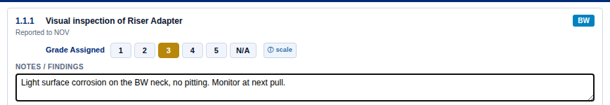
Two kinds of grade on one report
NOV's five-level scale for condition; NOV's pass or fail for tests
Condition: the inspection tasks
Tests: pass or fail
No middle grade. Every Testing and Intrusive task, 21 classes (SSORT 156).
1
As new. No action.
2
Slight wear. No action.
1 Passed
5 Failed
3
Monitor. Acceptable with findings.
4
Poor. Immediate repair.
5
Not fit for continued use.
Grade 3 is where you found something. Put 3 and write what you saw.
The crew's grade row in SSORT: Riser Adapter, task 1.1.1
Notes:
One report now carries two different kinds of grade.
On inspection tasks it is a condition, NOV's five levels. Green 1 and 2, amber 3, red 4 and 5.
Grade 3 is not a fail: NOV call it acceptable with findings. If you are tempted to put 2 because the unit is going back in, put 3 and write it down. The grade history per component is how the fleet spots a component going off.
On tests NOV grade 1 for pass and 5 for fail, nothing in between. We applied that to every Testing and Intrusive task on 2 October.
Lesson: a test is an outcome, not a condition. Read the note under each task before you grade.

Slide 5
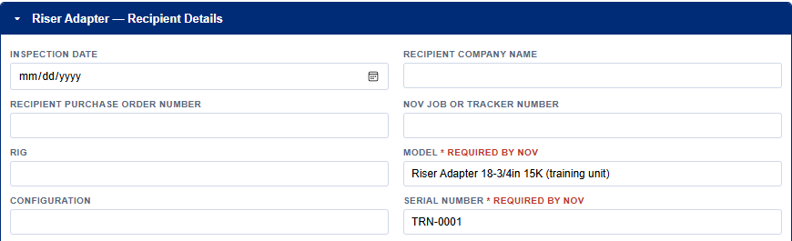
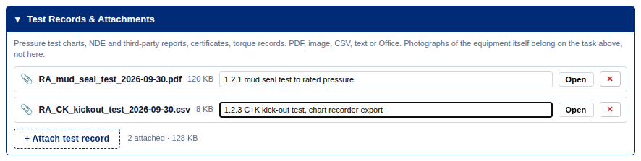
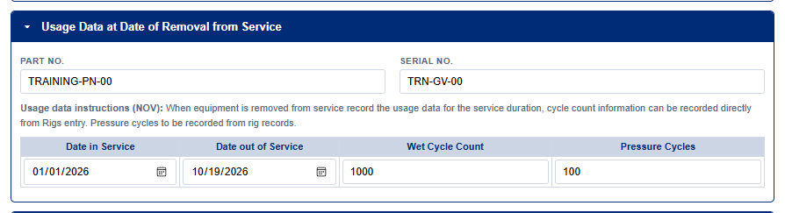
One unit, one record
What NOV needs on every CBM, and what we added to give it to them
1
Model and serial, per unit
Required by NOV. Never copied to the next unit. Post to OEM asks if blank.
SSORT 160
2
Test records attached
Charts, NDE reports, certificates. Sent to NOV as attachments.
SSORT 152–153
3
NOV usage data
SBOPs, gate valves, Poslock and U2B doors: dates in and out, wet and pressure cycles.
SSORT 169
Notes:
Three things NOV need that the first version did not give them.
Model and serial: NOV cannot review a CBM without knowing which unit it is. Since SSORT 160 they are per unit, marked required by NOV, and never copied across. The serial also names the file, which matters on the next slide.
Test records: NOV's own task wording says 'attach test graph'. Until SSORT 152 there was nowhere to put one, so charts went in as photographs of a screen.
Usage data: NOV's own table, section 8.1, on five classes, added on 15 October. Today the crew types the cycles; PLATO should fill them later.

Slide 6
What went wrong, and what we fixed
Found by crews, by NOV and by the office; fixed at source, in the tool
What went wrong | What we fixed | When
Riser Adapter: no photographs and no grades, on any report | Photo slots and grades on all 22 tasks. Brad found it from the rig. | SSORT 150–151
Grades stored by position: 38 of 65 changed meaning when the schedule moved | Named grade keys, a key map, and the build stamped on every post | SSORT 148
Test charts photographed off a screen | Attachments on every equipment, sent to NOV | SSORT 152–153
Two CBMs, one rig, one day: the second overwrote the first | Files named by equipment and serial | SSORT 158–159
A serial copied onto the next unit | Model and serial per unit, required by NOV | SSORT 160
The Upper SBOP file arrived cut short | The crew's saved copy was whole. Cut in transfer; restored. | 9 Oct
Two West Jupiter CBMs dated December 2025, hidden by the date filter | Nothing in the tool. Check the inspection date before you post. | Open
Notes:
Seven things, in the order we met them. Every one was fixed in the tool, not by asking people to be more careful, except the last.
Riser Adapter: the only class with no photographs and no grades. Brad Waldron reported it on 29 September; fixed the same week.
Positional keys: grades were stored by their place in the list. When NOV's schedule changed, 38 of 65 posted grade keys meant something else. Now every grade has a name and every post says which build made it.
The truncated Upper SBOP: the tool was not at fault. The copy that reached us was cut in transfer; Brad's own saved file was complete. Lesson: send files through the tool, not through Teams or email.
The open one: an inspection date in the wrong year hides a report from the dashboard's date window. That is a check for the crew and the reviewer.

Slide 7
The file-name collision, in numbers
West Capella, 29 September to 6 October
13
CBMs sent to NOV
4
kept on the dashboard
8
recovered from saved copies and version history
0
lost at NOV: their copies had unique names
Lesson: a file name is a record's identity. Name it by the unit, not by the day.
Notes:
This is the one that cost us the most.
SSORT named every CBM post by rig and date. The second component inspected on the same day overwrote the first. West Capella sent 13 CBMs to NOV in a week; the dashboard kept 4.
NOV had everything, because the OEM copies were named uniquely. We recovered 8 from Brad's saved copies and SharePoint version history.
SSORT 158 and 159 name every CBM by equipment and serial, so two units on one day are two files.
Lesson for any tool that joins SACRED: decide what makes a record unique before the first post.

Slide 8
What the office sees
The CBM heatmap on the dashboard, and the database behind it
Rig A
Rig B
Rig C
Rig D
The heatmap
Rows are components, columns are rigs. The colour is the latest grade.
A blank cell means no inspection on record, not a good one.
Upper SBOP
2
1
3
Lower SBOP
1
2
2
Gate Valves
3
2
4
1
Riser Adapter
3
2
The database export
cbm_grades and cbm_usage for every posted grade and usage table; oem_copies for every send to NOV.
The view v_cbm_latest_grade answers "where are the 4s and 5s?".
BOP Mandrel
1
1
2
C&K Stabs
2
3
1
Illustration of the layout, not live grades.
On every CBM row: a green "Sent to NOV" chip with the time it went.
Notes:
This is what the office sees. Rows are components, columns are rigs, the colour is the latest grade. Click a cell and the inspection behind it opens.
The grid here is an illustration of the layout; I will show the live one if there is time.
A blank is not good news. It means nothing has been posted for that component.
Behind the page is the database: every grade, every usage table, every send to NOV, loaded into SACRED DATA. The question 'which rigs have a 4 or 5 on the annulars' is one query, not a hunt through PDFs.

Slide 9
What is coming for CBM
Three changes, each waiting on someone outside this room
CBM event PMs in the plan
Maximo holds 422 CBM programme PMs, mostly Tellus, Jupiter and Capella.
They go into the Argo Navis plan, CBM box ticked by default on CBM rigs. Never in GOM or GOA.
PLATO cycle counts
Wet and pressure cycles into NOV's usage table from PLATO, not typed by hand.
Needs an export from PLATO's Grafana and an ISIT account.
Photo review
Compares each photograph with the last inspection of the same unit and flags a change.
It suggests. It never changes a grade. Needs IT approval first.
Designing
Needs the feed
Later
For the action list: each of the three needs a name in this room to chase it.
Notes:
Three things on the way.
Event PMs: Lee is designing the CBM programme PMs into Argo Navis plans. 422 in Maximo, mostly Tellus, Jupiter and Capella. CBM rigs get the box ticked by default; GOM and GOA never, because of BSEE. Carina's CBM PMs are not in Maximo yet; Manpreet is checking.
PLATO: the cycle counts already exist in PLATO. The usage table should fill from it, not from a crew member reading a counter.
Photo review: an agent that compares this inspection's photographs with the last. It flags; the crew's grade stands.

Slide 10
Part 2 · The CBM workshop
Who signs what · where the record lives · the one change · 08:35–08:57
Notes:
Part 2. Twenty-two minutes, and it is your answers that matter. I have a proposal on the next slide; correct it.

Slide 11
Who signs what, and where the record lives
PROPOSED · the room corrects it
Step | Who | Signs or confirms | Where the record lives | Agreed?
Inspect and grade | Rig crew | Grades, notes, photographs; model and serial off the plate | SSORT, saved file on the rig
Check and post | Subsea Supervisor (SSS) | Presses Post to OEM + Dashboard | PostedReports: the master record
Rig awareness | TSL | Copied on the NOV email | The OEM email
Office review | Subsea Superintendent | Follows up 4s and 5s; raises the CM work order | Dashboard, SACRED DATA, Maximo
OEM review | NOV | Reviews; replies to Seadrill in copy | NOV's email: report and test records
Controlled filing | Office | The eDocs number | eDocs (the connector waits on ISIT)
Notes:
This is my proposal, built from how the tools run today. It is not agreed. Go row by row and ask: is that right on your rigs?
The point of the second column is that the crew who grades is not the person who posts. The SSS checks before it goes to NOV.
The fourth column is the important one: PostedReports is the master record. The dashboard, the email and the database are copies of it. eDocs is where the controlled copy should end up; the connector is waiting on ISIT.
Tick the Agreed column as the room agrees each row. Anything not agreed goes on the action list with an owner.

Slide 12
The one change that removes the most double handling
One answer each, then we pick one
Where we see it today
# | Double handling today | The one change | Owner | Date
Cycle counts typed by hand that PLATO already holds?
A grade entered in SSORT, then again in Maximo?
Reports re-sent to NOV by email or Teams?
The same unit described in three places?
The vote: one change goes to the top of the action list.
Notes:
Go round the room. One answer each: where do you, or your crews, do the same work twice?
The prompts on the left are my guesses, not the answer. Strike them out if they are wrong.
Write each answer in the table as it is said, in the person's words. Then a show of hands for the one that removes the most work. That one goes to the top of the action list with an owner and a date before we leave this slide.

Slide 13
Thank you
Dan Plant daniel.plant@seadrill.com
What goes on the action list
– The sign-off table, as agreed, with owners for the rows we did not agree
– The one change, with an owner and a date
– Any CBM class, task or grade that is still wrong: tell Dan, as Brad did
Notes:
To close: three things go on the action list. The sign-off table, the one change, and anything in a CBM class that is still wrong.
Riser Adapter was fixed because Brad told us from the rig. That is how the rest gets fixed too.

