Slide 1

Final Project: Diabetes Health Indicators
By Ironhacker:
Health Advisor:
Diego Plaza
Dr. Isabella Mantellini

Slide 2
Index
01 The puzzle
02 Exploratory Data Analysis
03 Benchmark
04 Optimizing the model
05 Final model
06 Results
07 Business case

Slide 3
Goals of the project

Slide 4

01 Goals of the project
Goal
Considerations
The objective of the project is to create a predictive model that can predict users who will accept the Credit Card offer, in order to achieve more efficient mailing campaigns.
The data used from 28 thousand lines is only a sample of all the bank's customers, which are 1 million in total.
We estimate that the cost to the bank of sending an offer by mail is 5$
In addition, we estimate that if a customer accepts the offer the bank makes a profit of 100$
Who is here today?
From the bank:
Bank Business Director
Bank Marketing Manager
Bank BI Manager (Decision maker)
From Ironhack:
Ironhackers x3

Slide 5
Exploratory Data Analysis

Slide 6
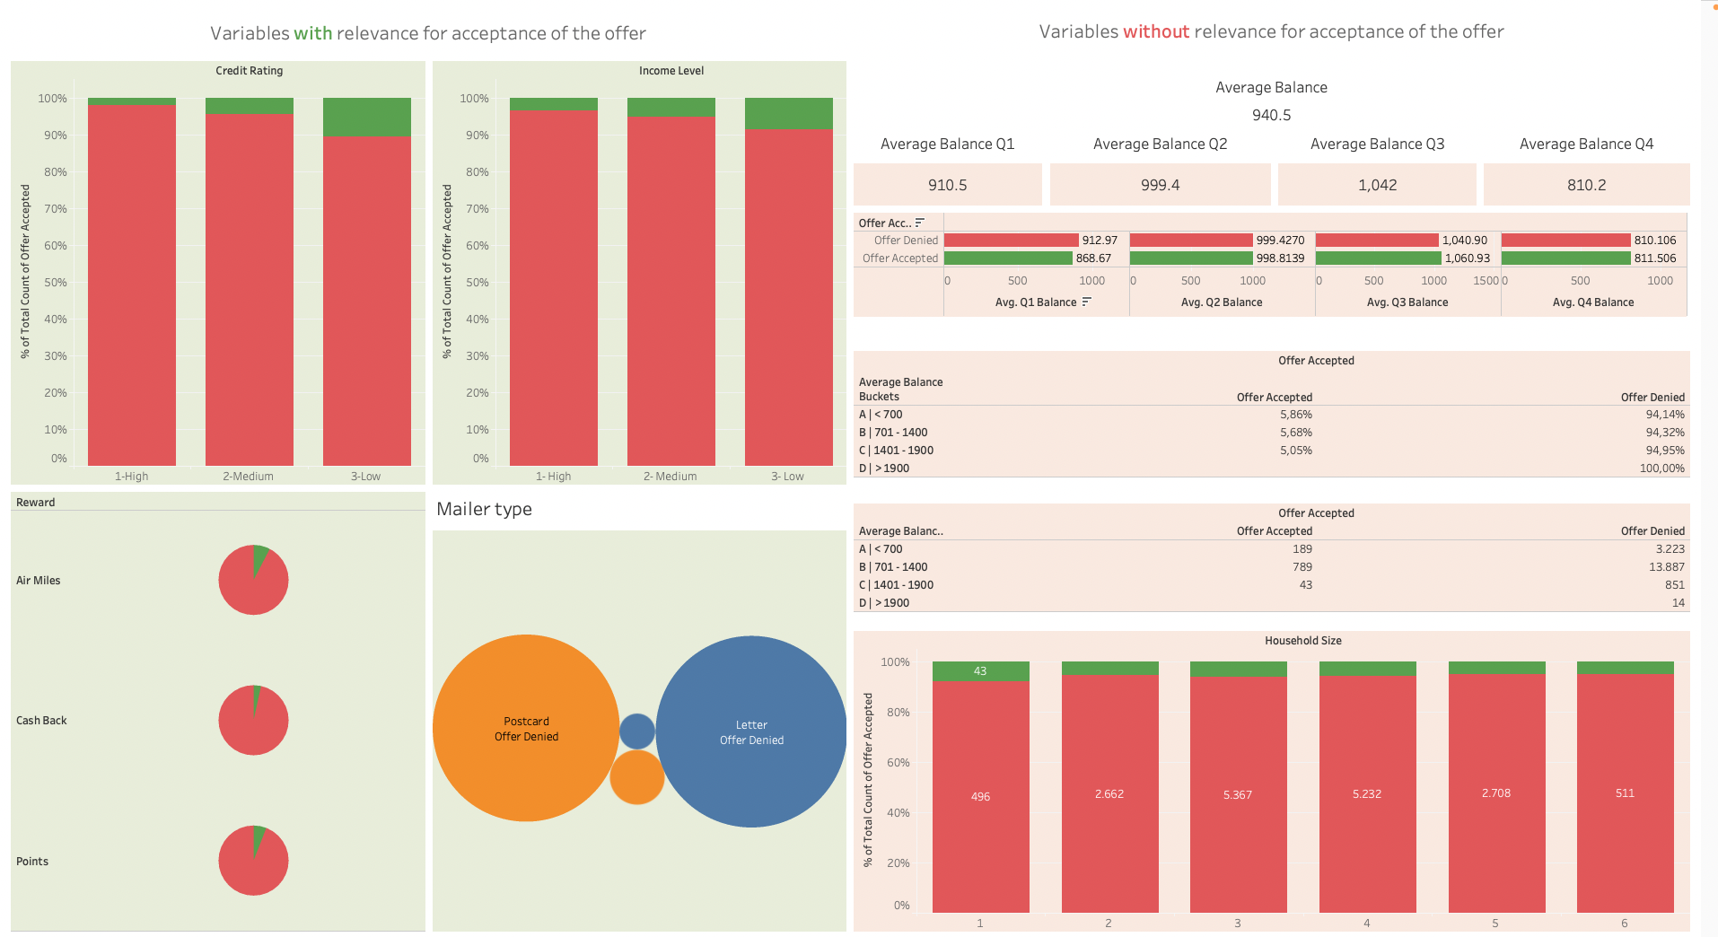
02 Exploratory Data Analysis
The first step it’s to understand the data

Slide 7
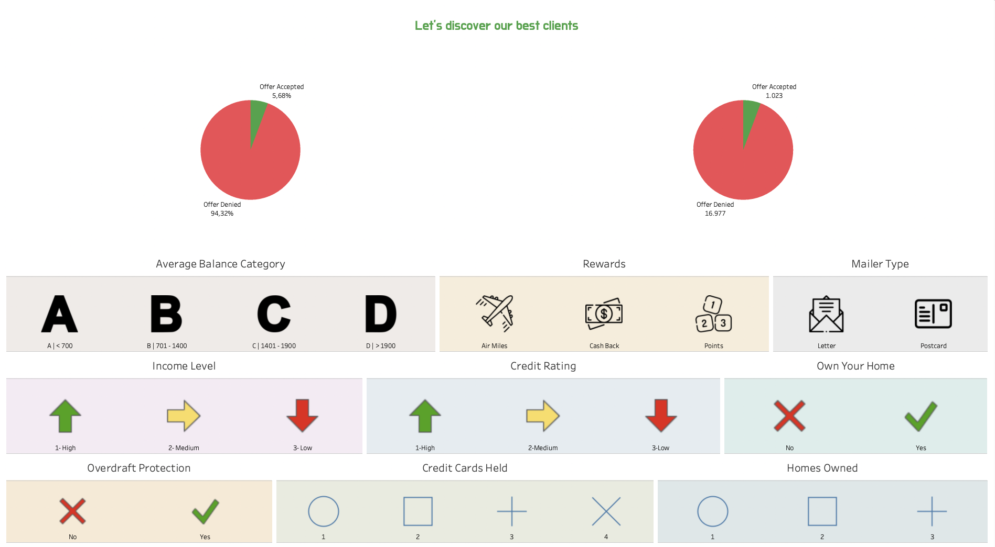
02 Exploratory Data Analysis
But the most important thing it’s to understand which are the clients who will accept our offer.

Slide 8
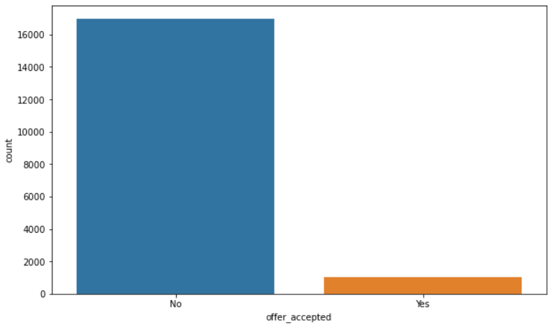
02 Exploratory Data Analysis
Countplot of accepted and rejected offers
This imbalance caught the team's attention. The team hypothesized that there would be problems with the accuracy of the models.

Slide 9
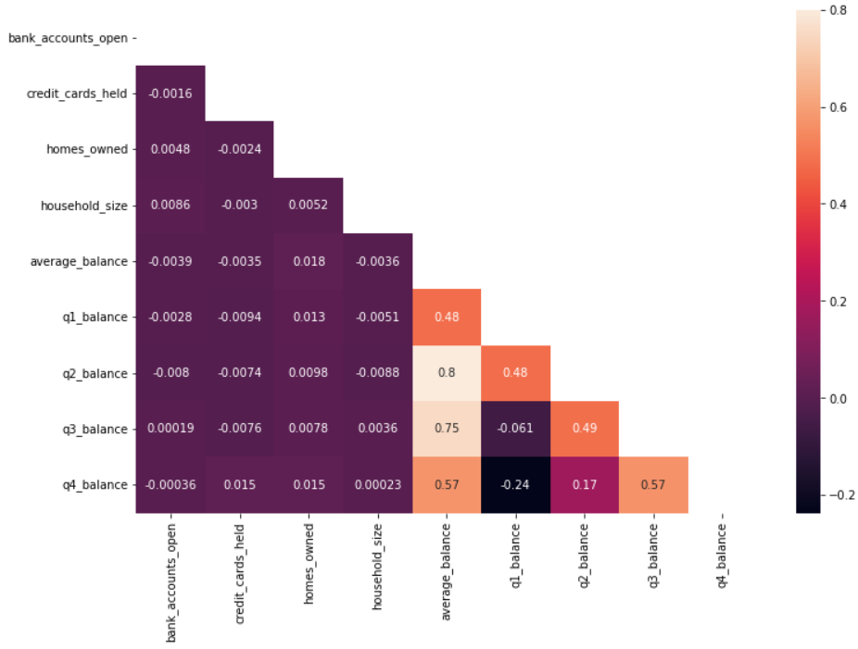
02 Exploratory Data Analysis
Correlation Heatmap

Slide 10
Benchmark

Slide 11
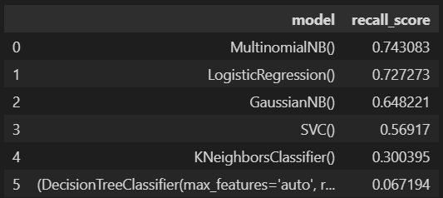
03 Benchmark
How can we measure our model’s performance?
With a high recall on the 'Yes' class, we want to be sure to target all possible customers that will accept the card offer. However after the analysis the 'high' recall gives a low 'precision' on the 'Yes' class. Let's take a look of the recall for these benchmark models:
Initial Benchmarks’ conditions:
- MinMax applied to numerical data
- One Hot Encoder applied to categorical data
- No feature engineer/reduction
- No consideration of Multicollinearity
- Yes to balanced Dataset (high imbalance)
- No outliers dropped
- No parameters tuning on the models

Slide 12
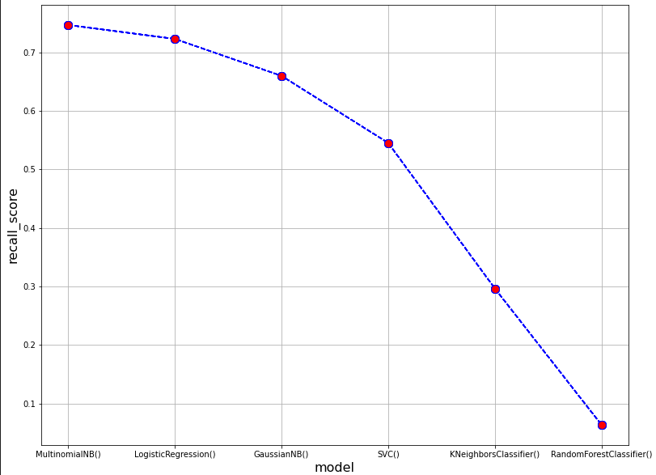
03 Benchmark

Slide 13
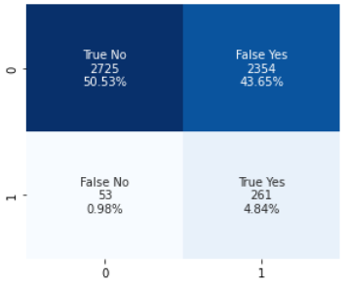
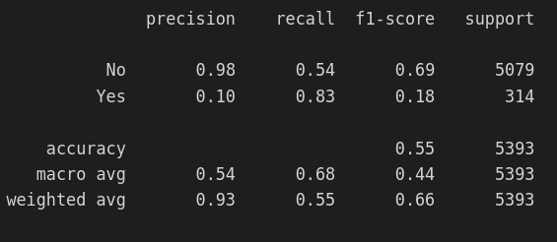
03 Benchmark
Before optimizing we must understand what it is we want to optimize given the high level of imbalance in the dataset:
Specificity
Precision
Recall or Sensitivity
|
Because the goal of the test is to identify everyone who accepted or could accept the offer, the number of false negatives should be low, which requires high recall.

Slide 14
03 Benchmark
In this case Precision tells us what percentage of clients that accepted the offer were correctly identified.
Precision(P) = TP/(TP+FP)
In information retrieval, recall is the fraction of the relevant documents that are successfully retrieved.
Recall(P) (Sensitivity) = TP/(TP+FN)
If the goal of the test is to accurately identify people who rejected the offer then the number of false positives should be very low, which requires a high specificity.
TNR or Specificity = TN/(TN+FP)
Balanced accuracy = (sensitivity + specificity) / 2

Slide 15
Optimizing the model

Slide 16
04 Optimizing the model
Logistic Regression and Naive Bayes (Multinomial):
These models seem to have the best performance on the classification for this reason they will now be optimized in this way:
Scalers
Encoders
Handling Multicollinearity
Outliers
Balancer

Slide 17
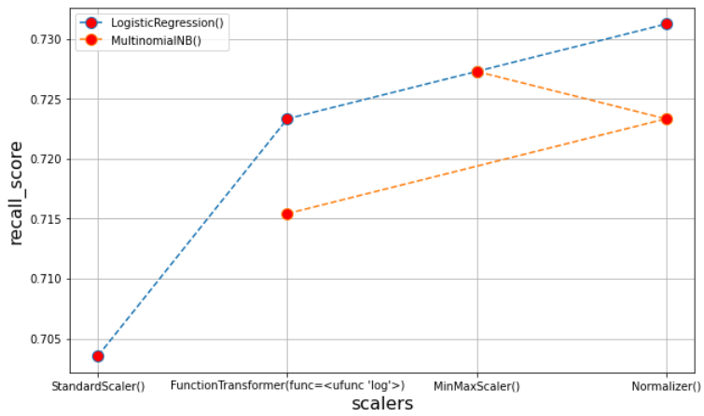
04 Optimizing the model

Slide 18
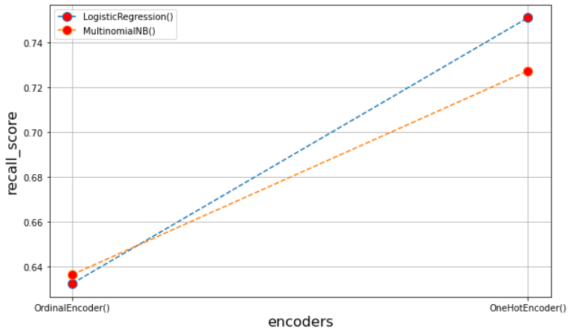
04 Optimizing the model

Slide 19
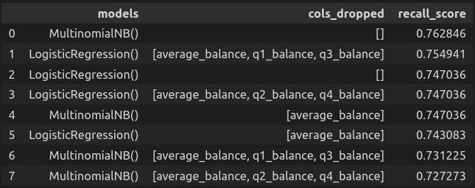
04 Optimizing the model
High multicollinearity

Slide 20
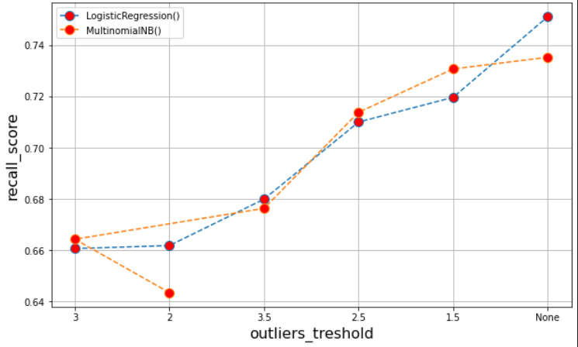
04 Optimizing the model

Slide 21
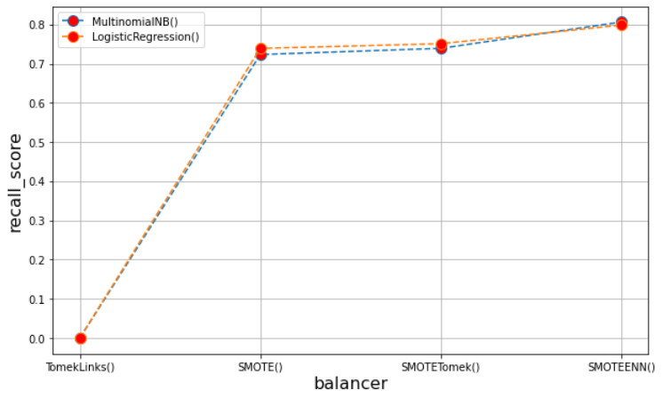
04 Optimizing the model

Slide 22
Final model

Slide 23
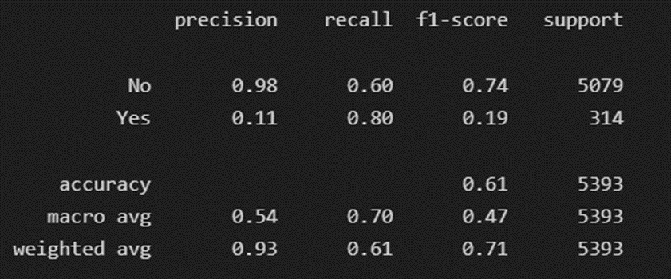
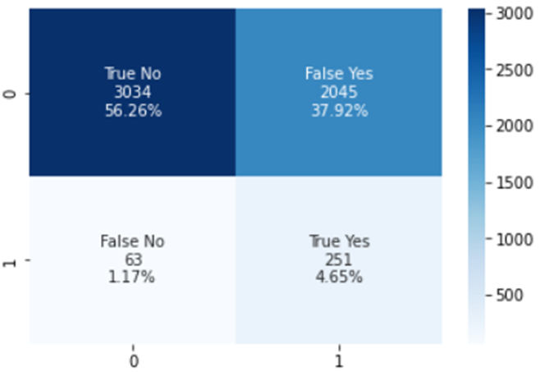
05 Final model
Mathematically optimised model
TPR - FPR is maximized

Slide 24
Results

Slide 25
06 Results
Our final model managed to optimize both the specificity and the recall which allowed to correctly identify customers that will accept the offer and customers that will reject the offer. The balanced accuracy was also maximized which is another indicator of the quality of the model.
Up next we will implement the final model onto a business case and analyze the results

Slide 26
Business Case

Slide 27
07 Business Case
Let’s suppose the management team now give us the following information:
The database contains 1 M of customers.
The cost of sending an mail is 5 $.
The offer acceptance brings to the company 100$
Every true positive means we have encountered the potential customer and he/she will accept offer bringing to the company (+100$ - 5$)
Every true negative mean we have correctly not send an email to a customer that will not accept the offer (0$)
Every false negative mean we have lost an opportunity with a potential customer (-100$)
Every false positive mean we sent an email to a customer that will not accept the offer (-5$)

Slide 28
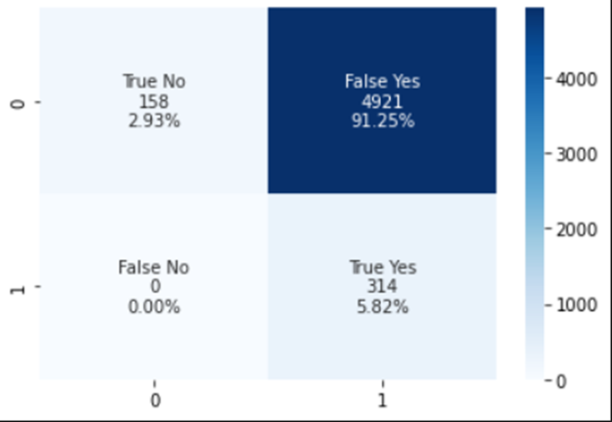
07 Business Case
Business Case Results
Confusion Matrix
Threshold
Max Profit

Slide 29
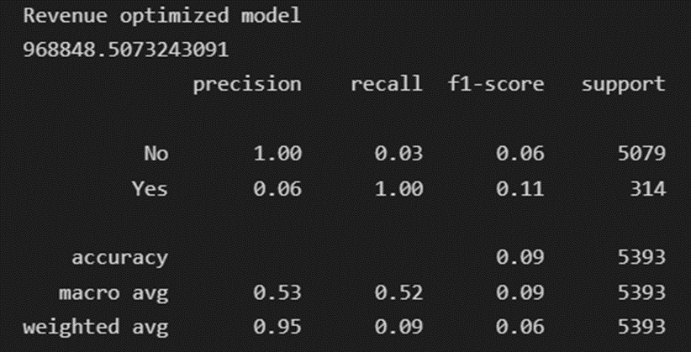
07 Business Case
Model optimised for max revenue
Revenue with no ML model = 679.795 $
Revenue with classification model = 968.848 $
Savings = 289.053 $
+ 42,5% of benefit

Slide 30
Thanks!
Hope you liked it

