Slide 1

Final Project: Diabetes Health Indicators
By Ironhacker:
Health Advisor:
Diego Plaza
Dr. Isabella Mantellini

Slide 2
Index
01 Goals of the project
02 Exploratory Data Analysis
03 Benchmark
04 Optimizing the model
05 Final model
06 Results
07 Business case

Slide 3
Goals of the project

Slide 4

01 Goals of the project
Goal
Considerations
The objective of the project is to create a predictive model that can diagnose patients who have diabetes or are likely to have it and need more tests.
About the dataset:
Link
We estimate that Diabetes tests costs for the Health Institutions is about 25$
In addition, we estimate that if a patient is misdiagnosed as not diabetic when in fact is, it can cost the health system up to 5000$
Who is here today?
From the Hospital:
Dr(s).
Public Health Officials
From Ironhack:
Data Scientist x 1

Slide 5
Exploratory Data Analysis

Slide 6
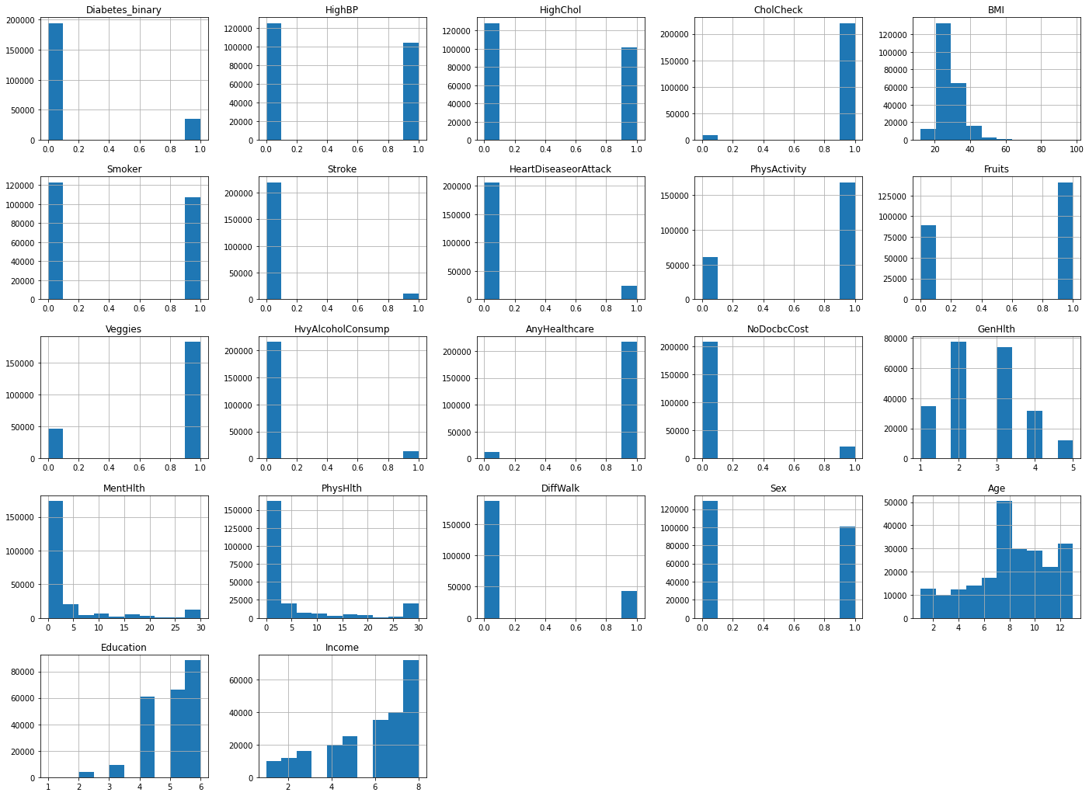
02 Exploratory Data Analysis
Countplot of Diabetes Diagnosis
This imbalance caught the team's attention. The team hypothesized that there would be problems with the accuracy of the models.

Slide 8

02 Exploratory Data Analysis
Let’s see more in tableau!

Slide 9
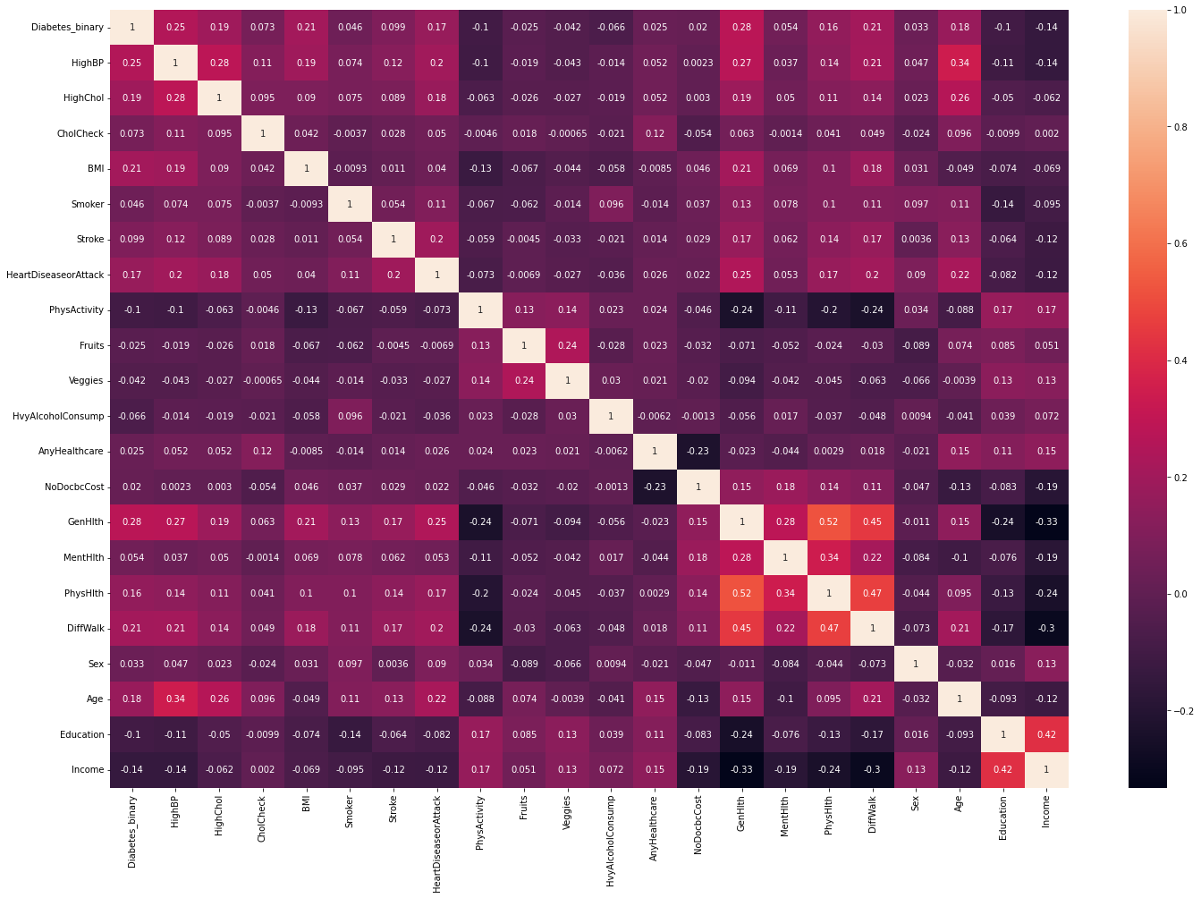
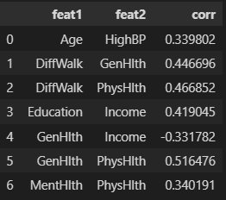
02 Exploratory Data Analysis
Correlation Heatmap

Slide 10
Benchmark

Slide 11
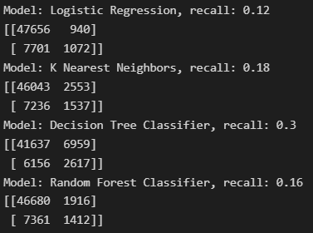
03 Benchmark
How can we measure our model’s performance?
With a high recall on the 'Negative' class, we want to be sure to avoid misdiagnosing patients as Negative for Diabetes when in fact they did have the disease. However after the analysis the 'high' recall gives a low 'precision' on the 'Positive' class. Let's take a look at the recall for these benchmark models:
Initial Benchmarks’ conditions:
- No scaler applied
- No encoding needed
- No feature engineer/reduction
- Consideration of Multicollinearity
- No balancer applied
- No outliers dropped
- No parameters tuning on the models

Slide 12
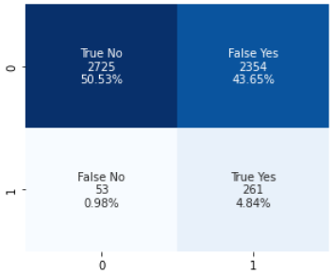
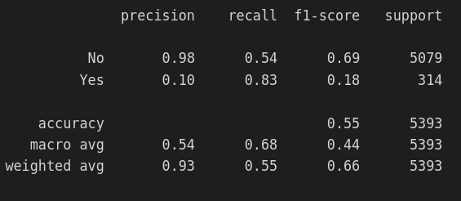
03 Benchmark
Before optimizing we must understand what it is we want to optimize given the high level of imbalance in the dataset:
Specificity
Precision
Recall or Sensitivity
|
Because the goal of the test is to identify everyone who has the disease or could have it, the number of false negatives should be low, which requires high recall.

Slide 13
03 Benchmark
In this case Precision tells us what percentage of patients were correctly diagnosed.
Precision(P) = TP/(TP+FP)
In information retrieval, recall is the fraction of the relevant documents that are successfully retrieved.
Recall(P) (Sensitivity) = TP/(TP+FN)
If the goal of the test is to accurately identify people had negative diagnosis then the number of false positives should be very low, which requires a high specificity.
TNR or Specificity = TN/(TN+FP)

Slide 14
Optimizing the model

Slide 15
04 Optimizing the model
During the benchmark no significat difference could be seen from the analysis further research was necessary:
The data will now be optimized in this way:
Scalers
Encoders
Handling Multicollinearity
Balancer

Slide 16
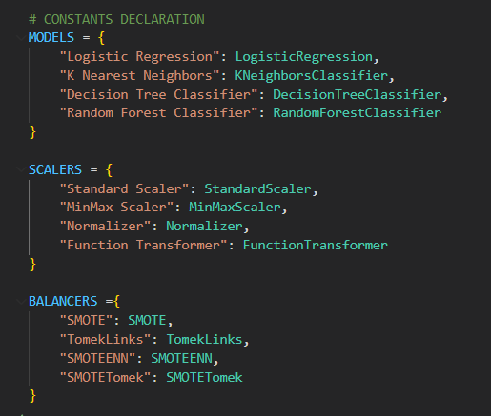
04 Optimizing the model

Slide 17
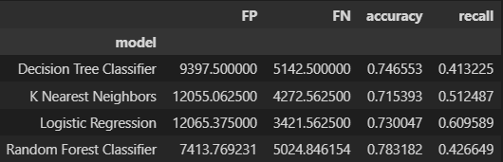
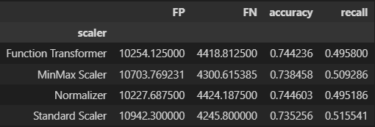
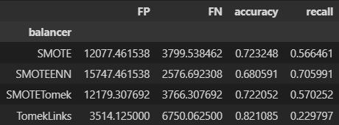
04 Optimizing the model

Slide 18
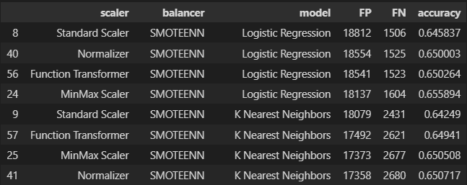
04 Optimizing the model

Slide 19
Final model

Slide 20
05 Final model

Slide 21
Results

Slide 22
06 Results
Our final model managed to optimize both the specificity and the recall which allowed to correctly identify people with diabetes or who could have the disease.
Up next we will implement the final model onto a real worl scenario and explain the results

Slide 23
Real world scenario

Slide 24
07 Business Case
Let’s suppose the management team now give us the following information:
The database contains 1 M of customers.
The cost of sending an mail is 5 $.
The offer acceptance brings to the company 100$
Every true positive means we have encountered the potential customer and he/she will accept offer bringing to the company (+100$ - 5$)
Every true negative mean we have correctly not send an email to a customer that will not accept the offer (0$)
Every false negative mean we have lost an opportunity with a potential customer (-100$)
Every false positive mean we sent an email to a customer that will not accept the offer (-5$)

Slide 25
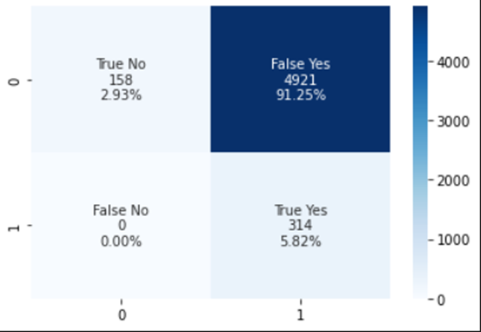
07 Business Case
Business Case Results
Confusion Matrix
Threshold
Max Profit

Slide 26
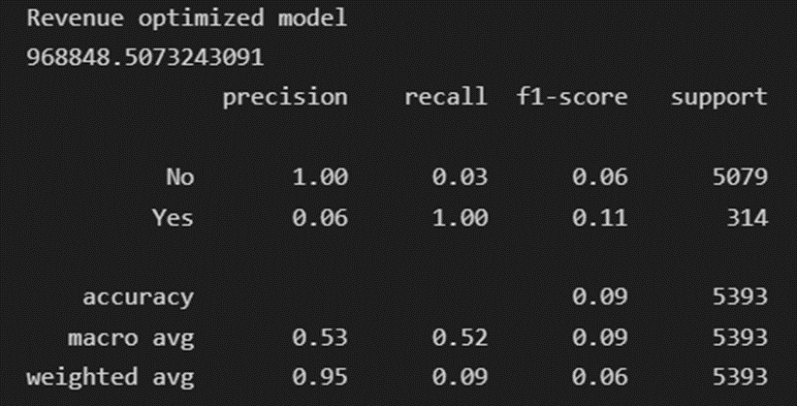
07 Business Case
Model optimised for max revenue
Revenue with no ML model = 679.795 $
Revenue with classification model = 968.848 $
Savings = 289.053 $
+ 42,5% of benefit

Slide 27
Thanks!
Hope you liked it

