Slide 1


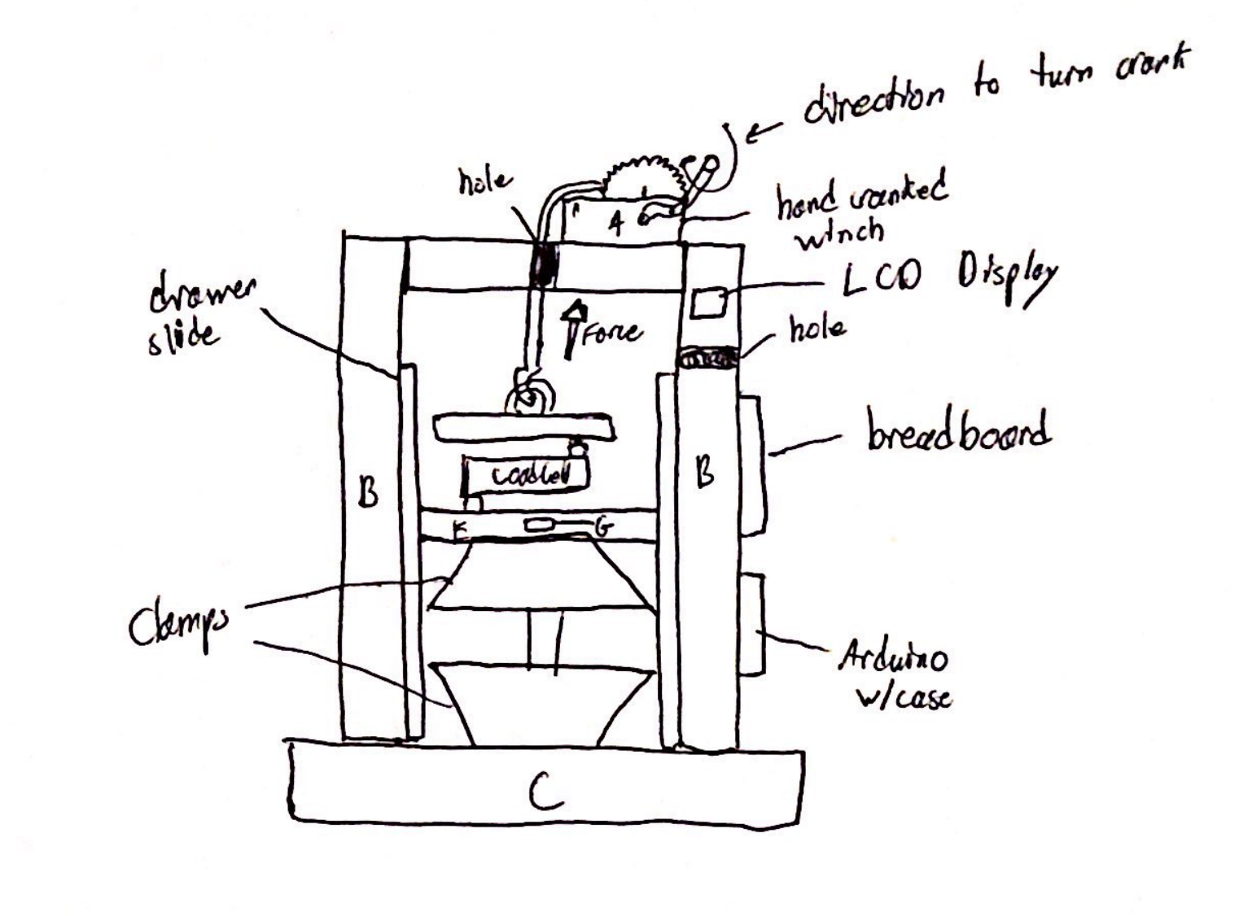
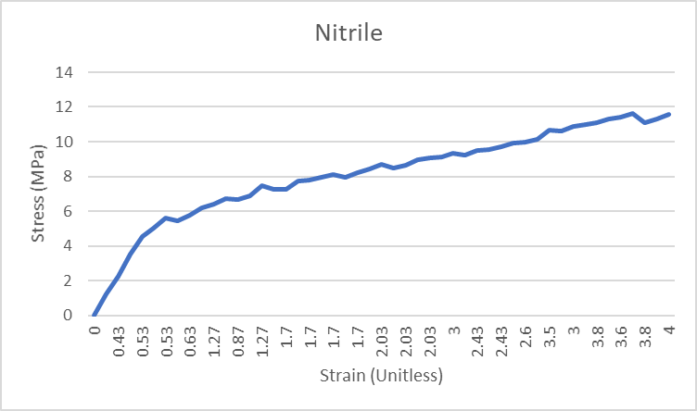
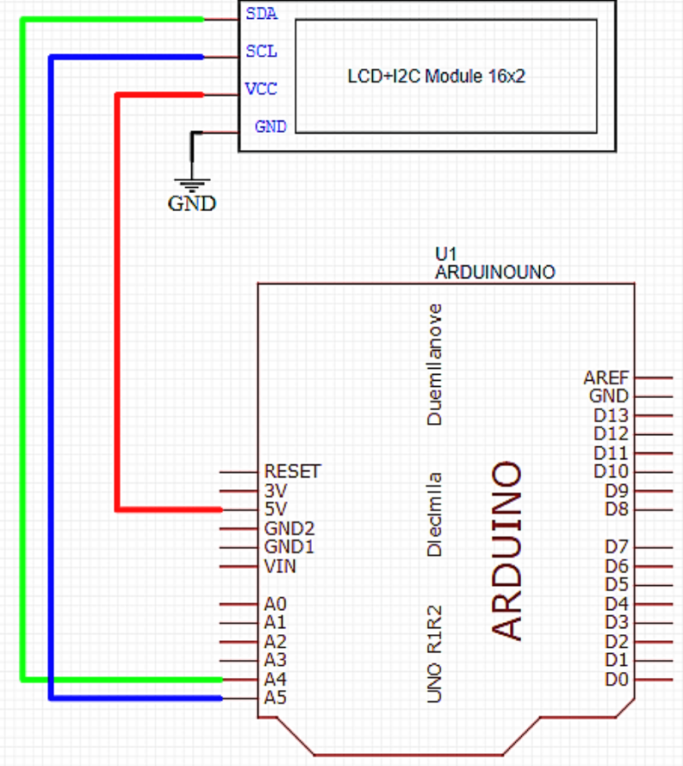
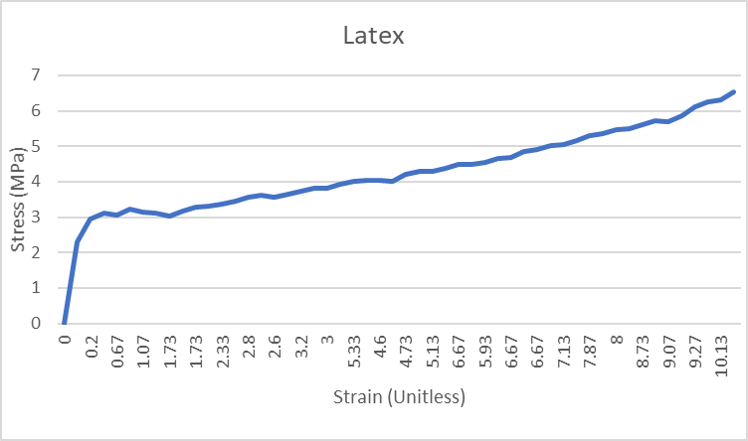
Tensiometer Design Derren Lyons, Bailey McElhinney Department of Electrical & Computer Engineering, University at Albany
Problem Statement
Experimental Results
System Design
The University at Albany’s chemistry department, as part of their educational mission, intends to build a laboratory for undergraduate students where they can gain hands on experience testing various material properties (including tensile strength). However, due to the extremely high cost of commercial products they have been unable to equip such a laboratory.
The goal of this project is to build an accurate, low cost, easy to use uniaxial tensile strength tester to support this educational mission.
System Accuracy
Key System Features
Metric | Sample | Our System | Known Value | Error
Young’s Modulus | Latex | 730 ± 10 kPa | 740 ± 10 kPa | 1.35%
… | Nitrile | 9.5 ± 0.1 MPa | 2.4 ± 0.2 MPa | 295.8%
Ult. Tensile Strength | Latex | 6.1 ± 0.1 MPa | 3.3 ± 0.1 MPa | 84.84%
… | Nitrile | 12.7 ± 0.1 Mpa | 4.4 ± 0.1 MPa | 188.63%
To satisfy system requirements, we incorporated the following design modifications:
Item #1: Heavy duty hand winch with steel wire rope
Item #2: Various software improvements on the original code
Item #3: Improved ultrasonic range sensor
Item #4: LCD display module
Experimental results after implementation
of our system design.
Physical Model
System Requirements
Stress-Strain Curve
System Accuracy: The system should be able to accurately measure the stress-strain curve, such that Young’s Modulus and Ultimate Tensile Strength can be calculated to within two significant figures.
System Ease-of-Use: The system should be easy to calibrate and operate by undergraduate students without requiring knowledge of electronics or software programming.
System Components & Budget
New and improved physical design model. Uniaxial application of force alongside real-time measurement data of force and distance displayed on display module.
Part | Purpose | Cost
US-100 Ultrasonic Range Sensor | Measures Distance | $7
Capacity Hand Winch | Applies Force | $25
I2C 1602 LCD Display Module | Displays current measurement data | $10
TOTAL | TOTAL | $42
Stress-Strain curve of a Nitrile sample obtained from our Arduino-based tester versus a commercial grade tester.
Circuit Schematic
Stress-Strain Curve
Project Partners
Special thanks for Professor Chen, Feldblyun, Yeung, and the University at Albany’s Chemistry Department for sponsoring this project.
This project was developed in ECE442: Systems Analysis & Design in the Electrical & Computer Engineering Department.
Stress-Strain curve of a Latex sample obtained from our Arduino-based tester versus a commercial grade tester.
Circuit schematic of I2C LCD display module electronics (4 wires)

