Slide 3
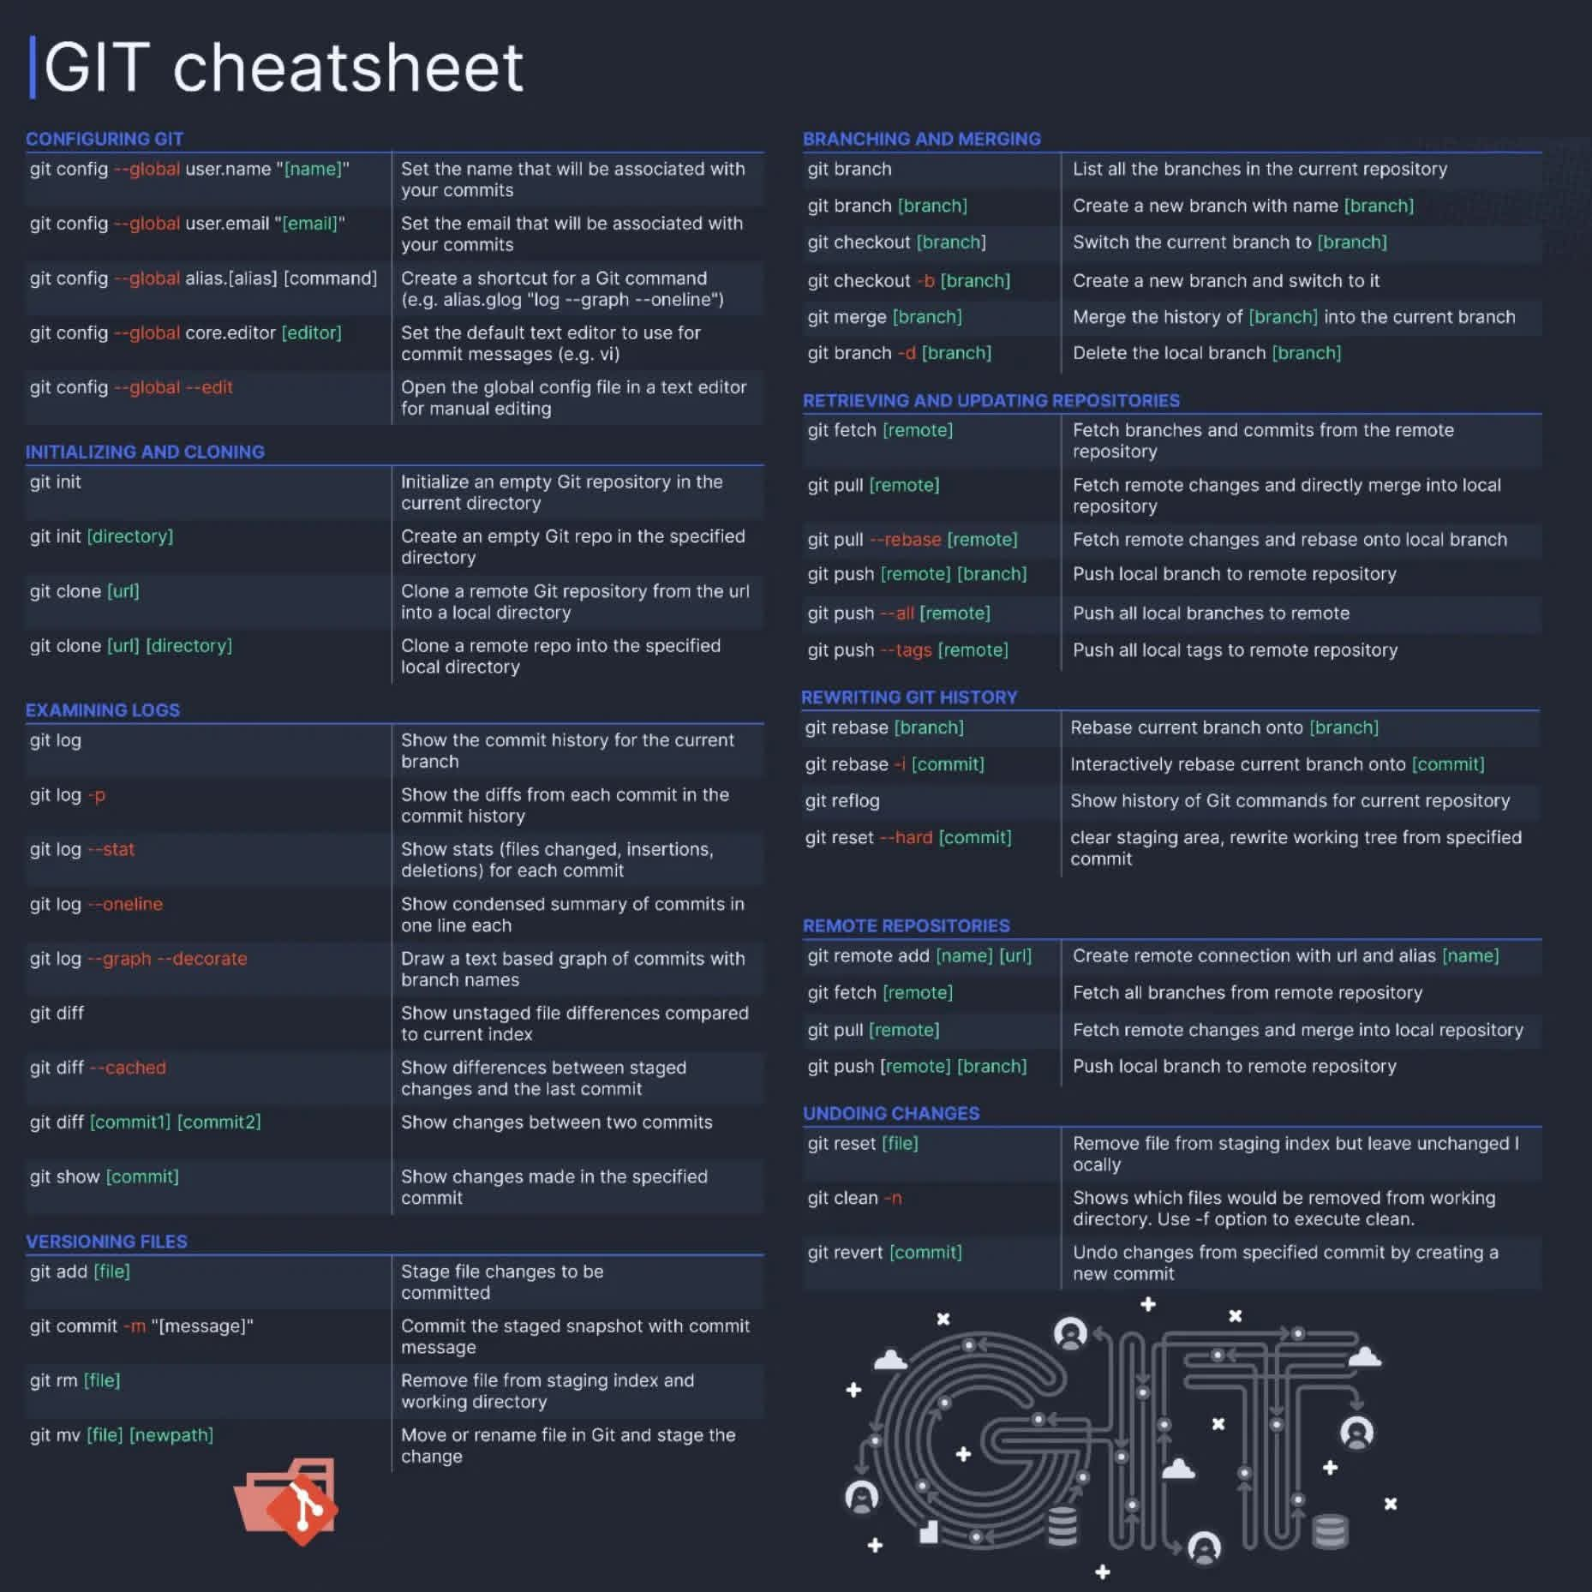

Slide 4
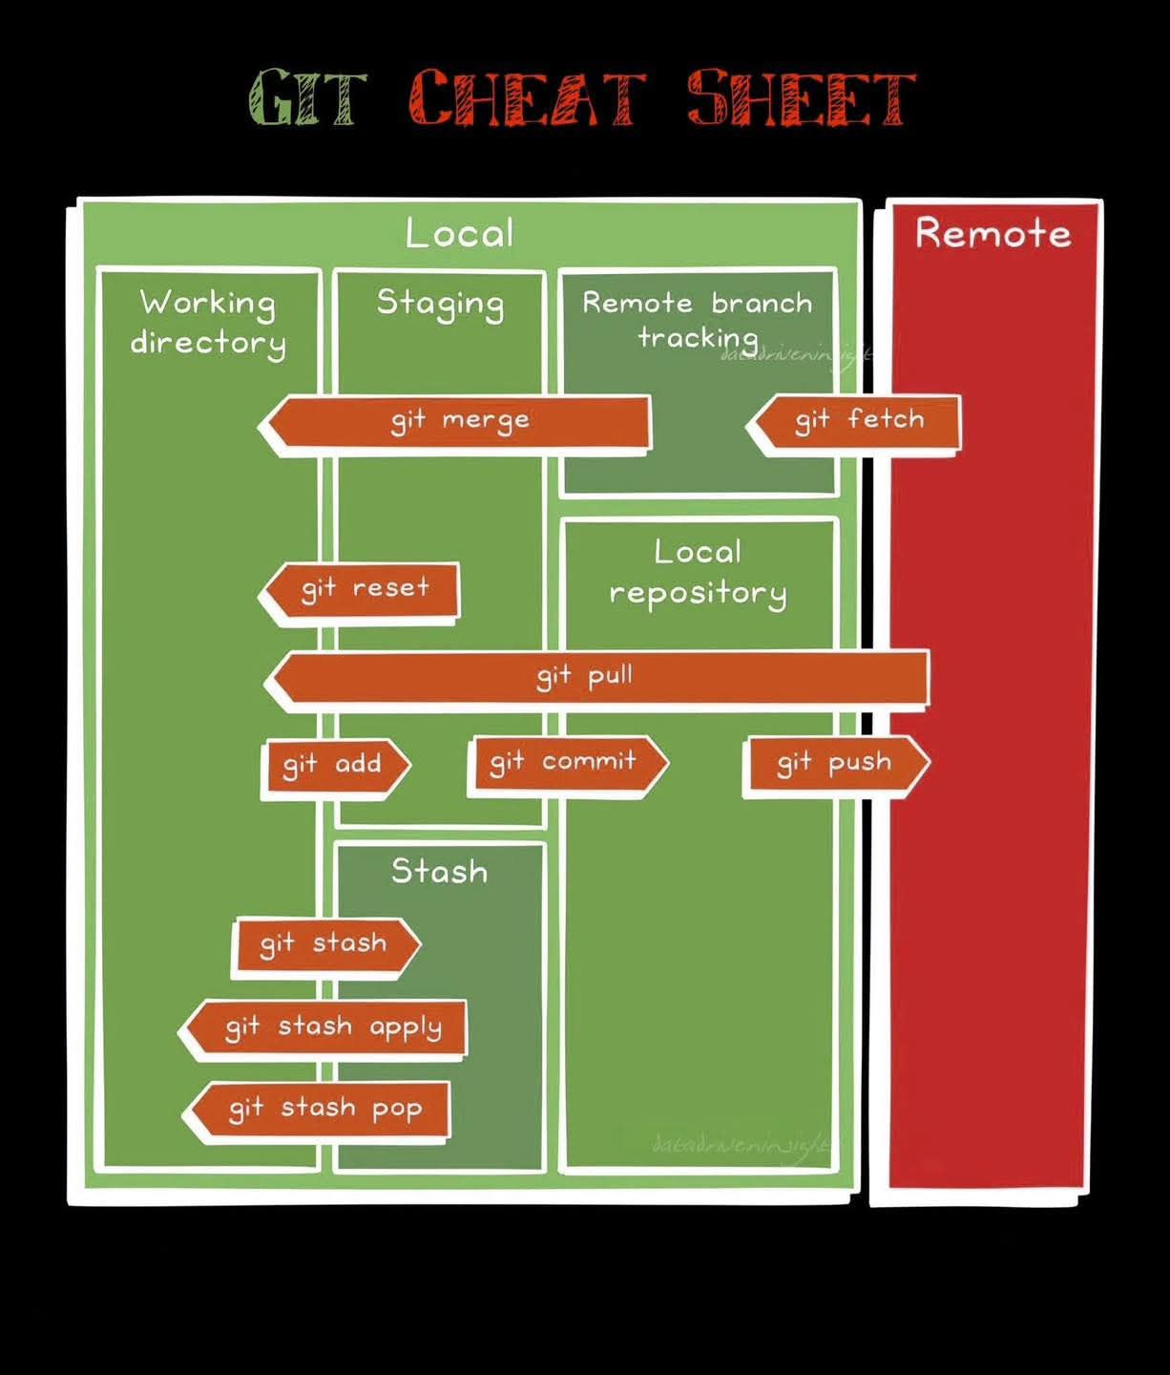

Slide 5


Slide 6
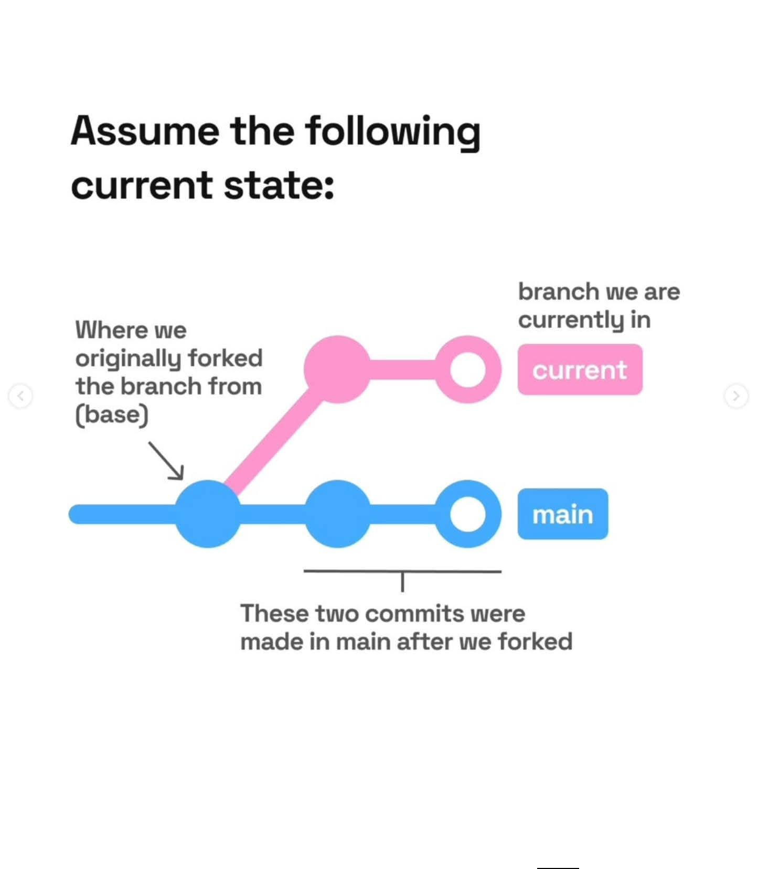

Slide 7
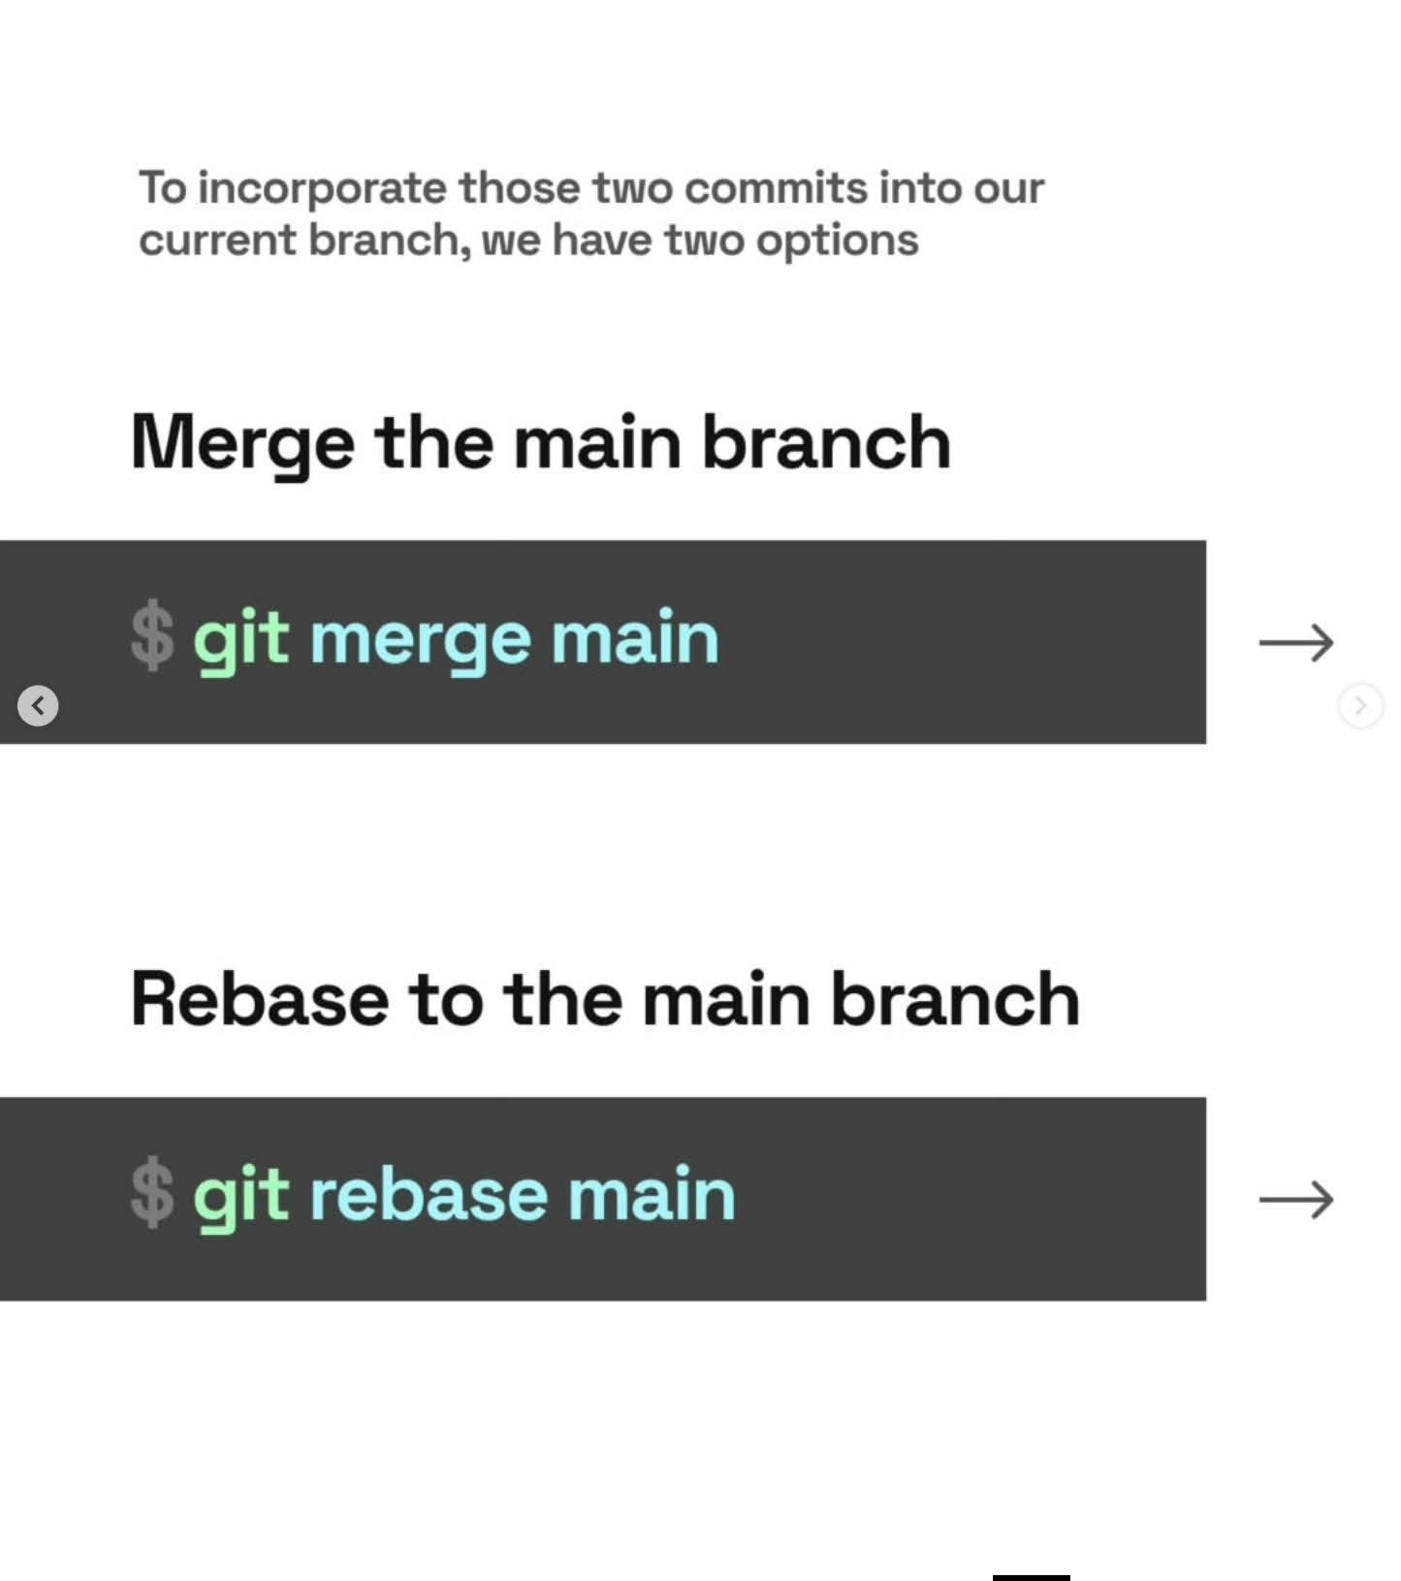

Slide 8


Slide 9
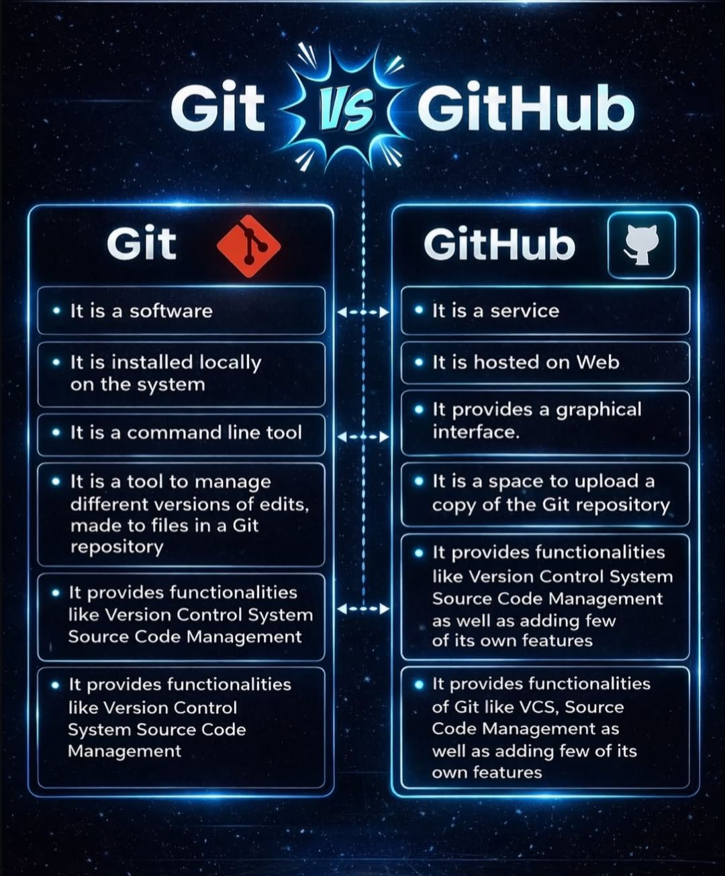

Slide 10


Git vs GitHub
Git is a software.
Git is a version control system to manage source code history.
Git is maintained by linux.
Git is installed locally on the system.
Git has no user management feature.
Git is open-source licensed.
Git has minimal external tool configuration.
GitHub is a service.
GitHub is a hosting service for Git repositories.
GitHub is maintained by Microsoft.
GitHub is hosted on the web.
GitHub has a built-in user management feature.
GitHub includes a free- tier and pay-for-use tier.
GitHub has an active marketplace for tool integration.

Slide 11

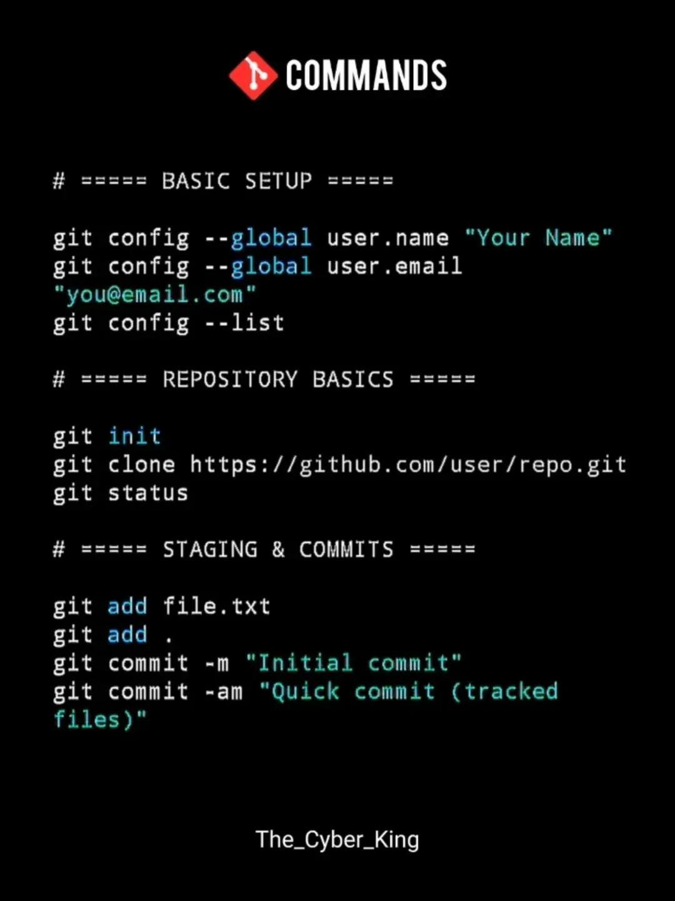

Slide 12
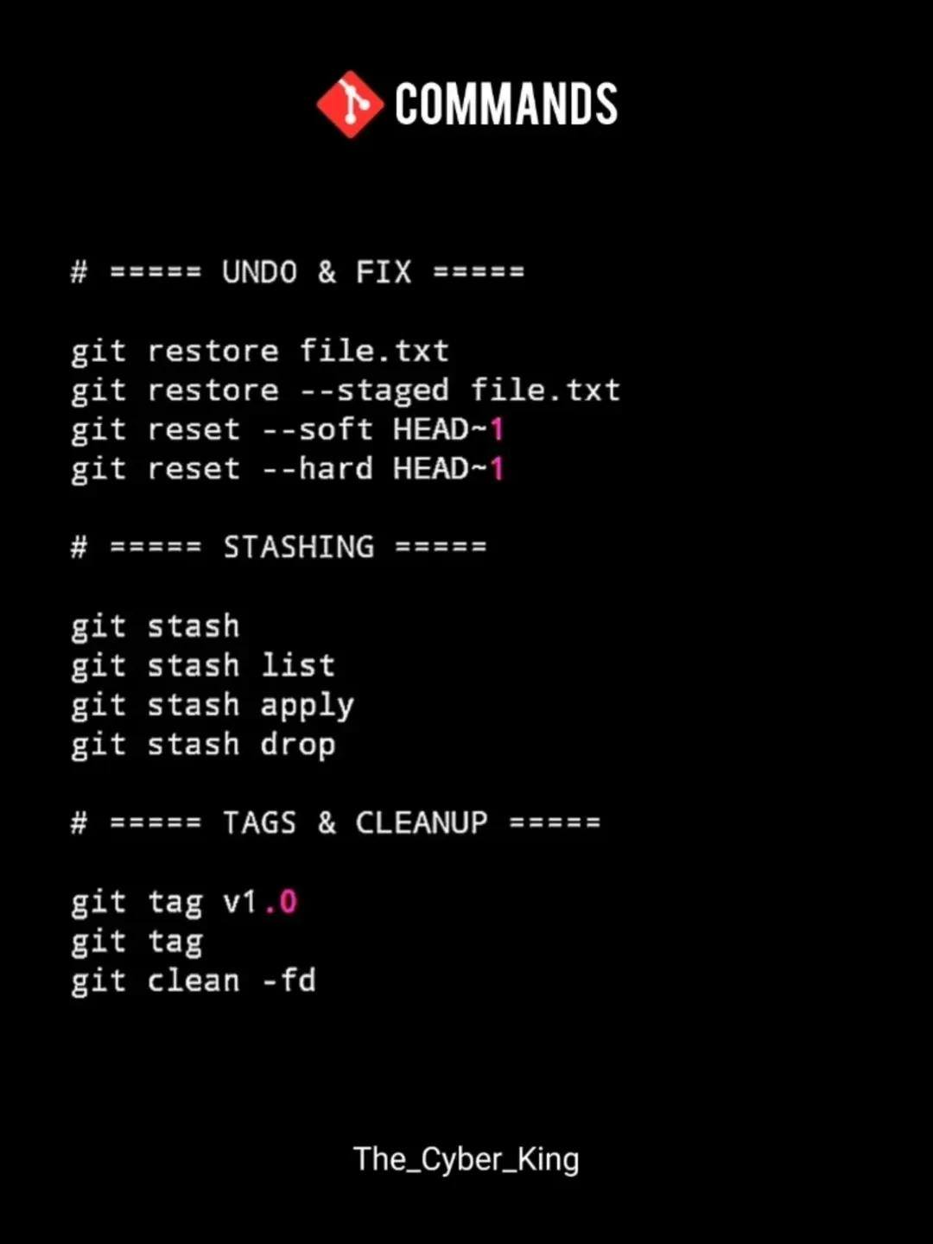
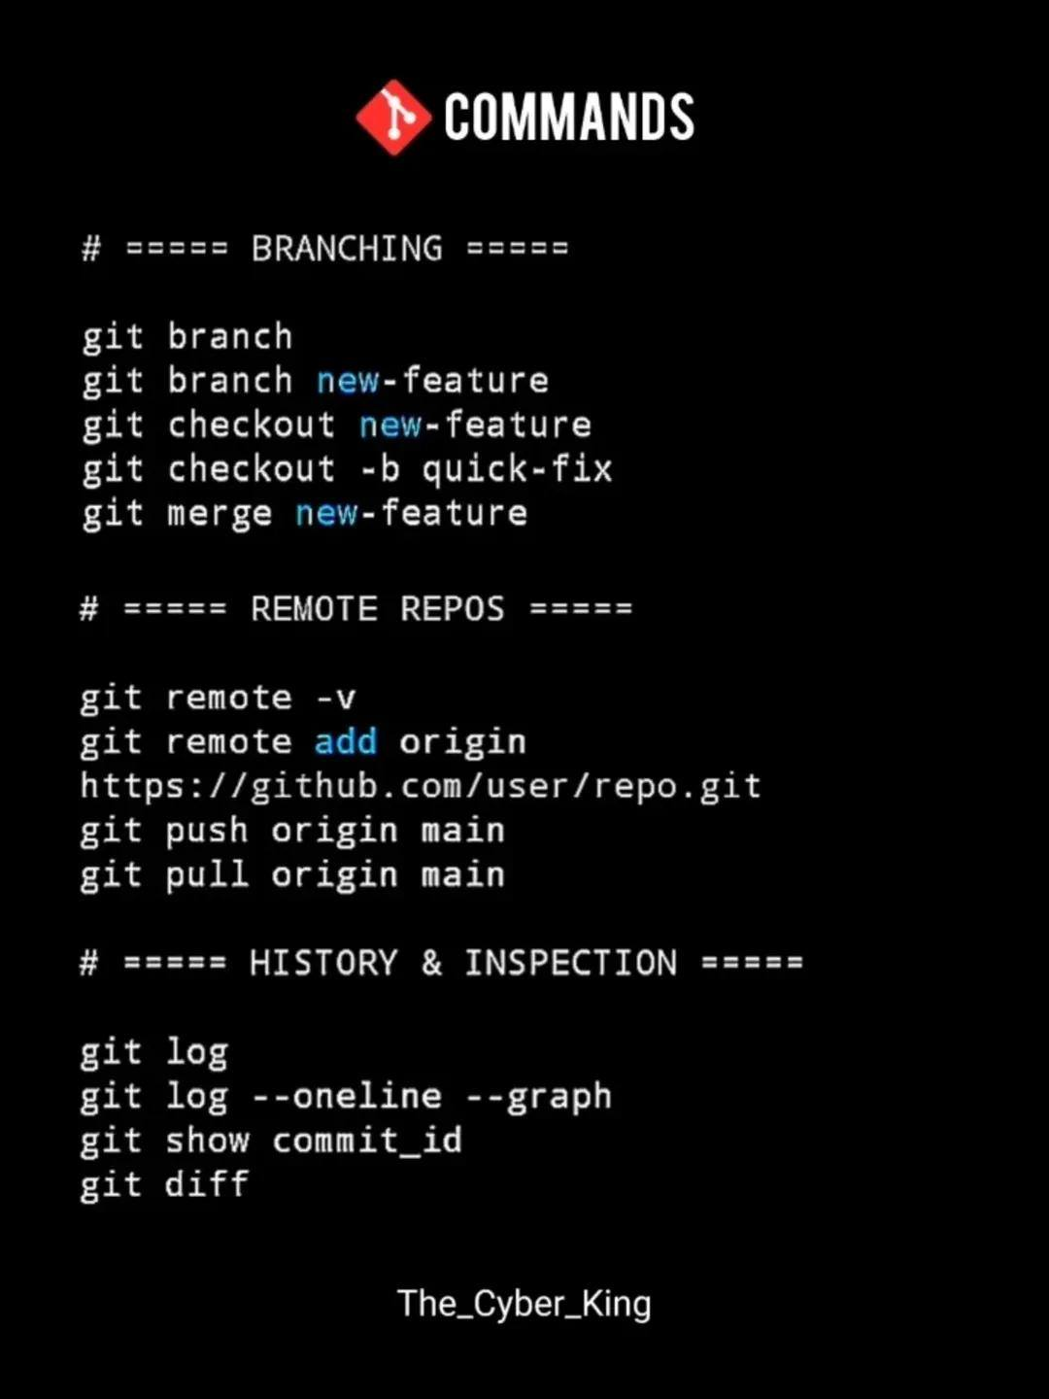

Slide 13
