Slide 2

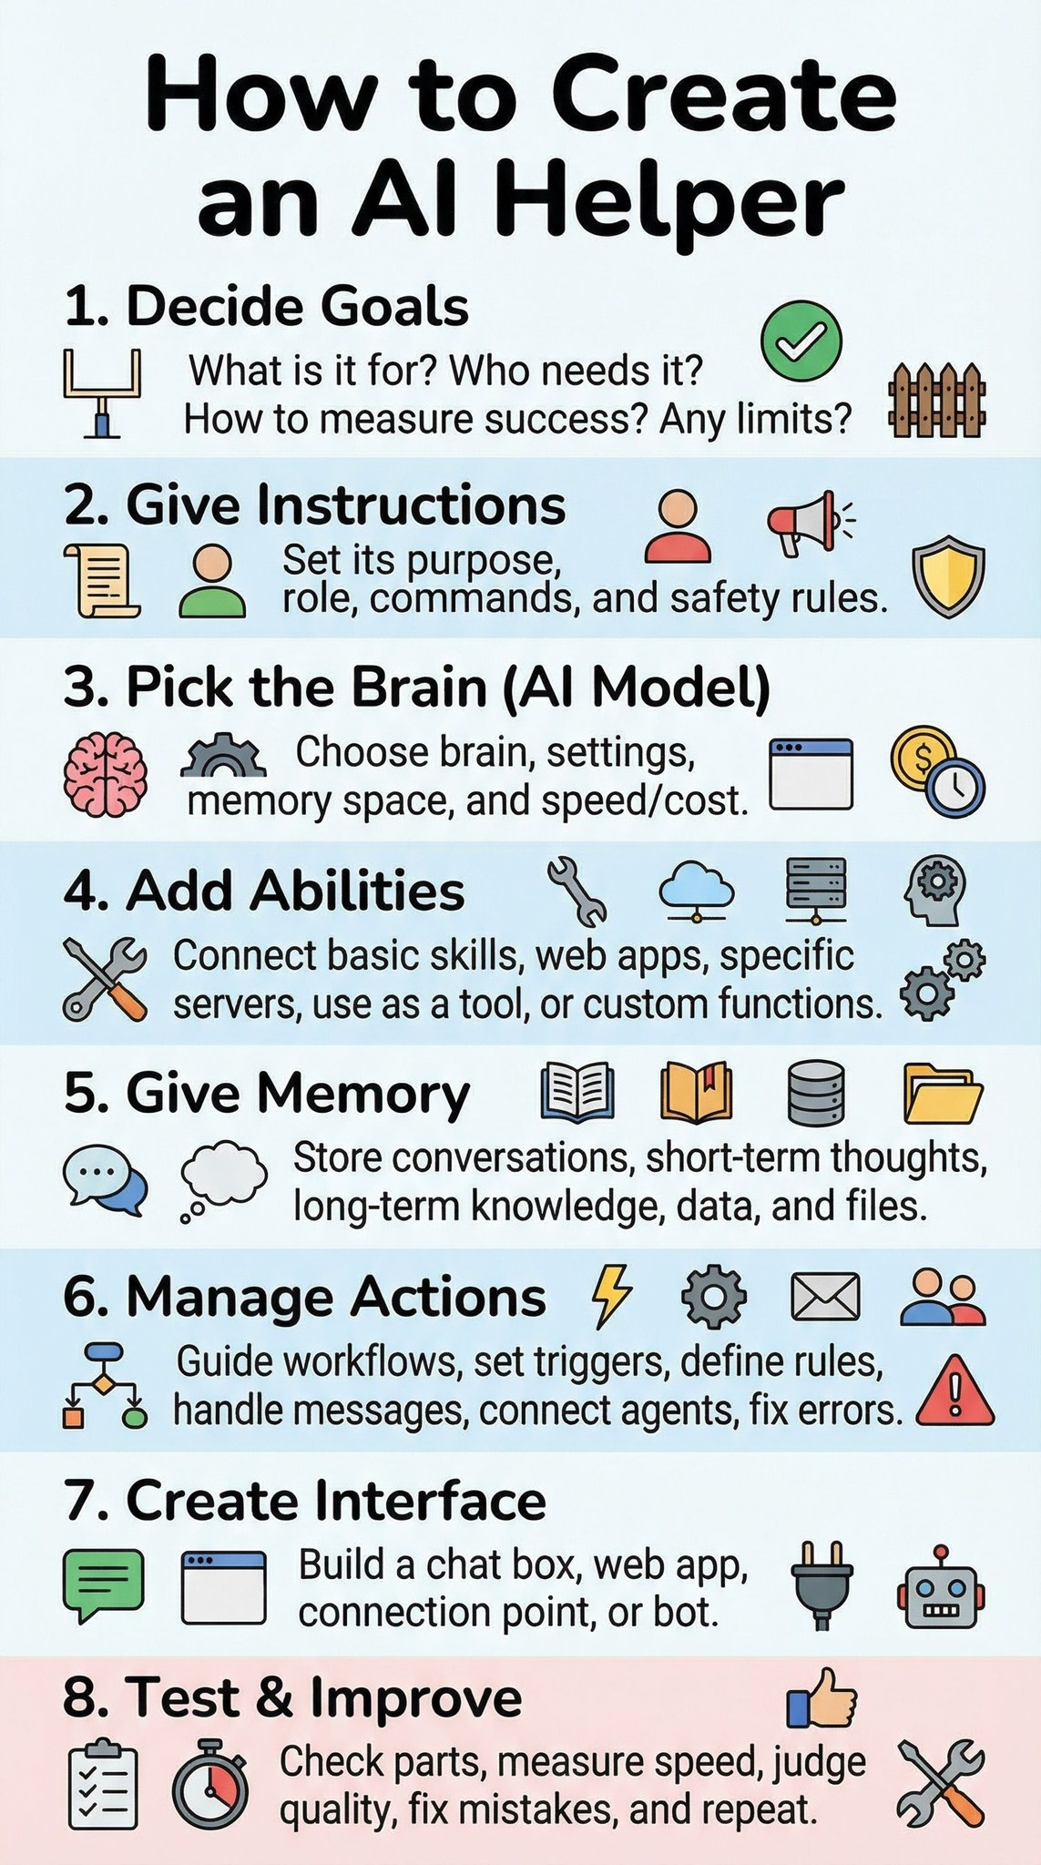

Slide 3
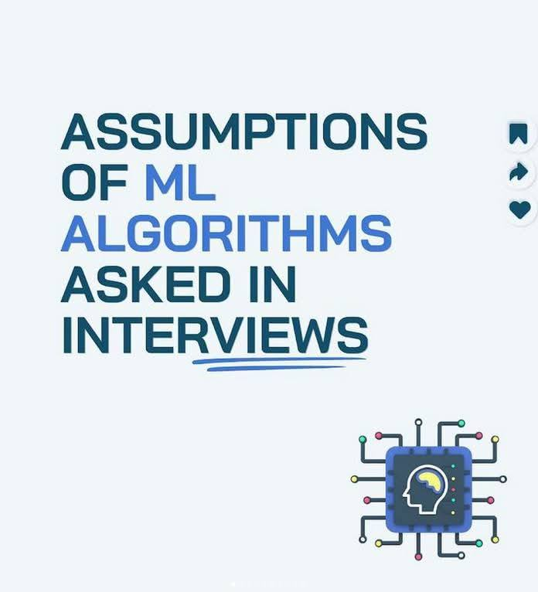

Slide 4
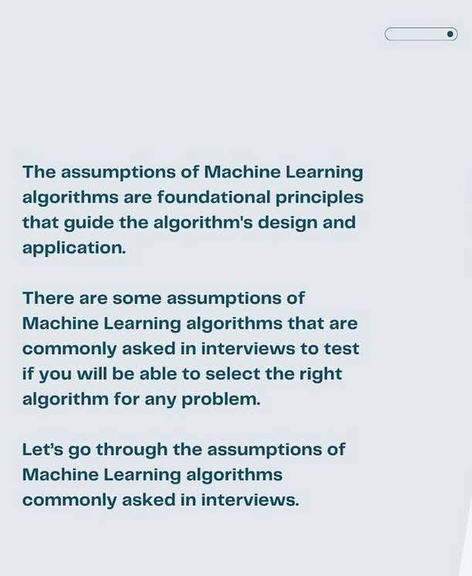
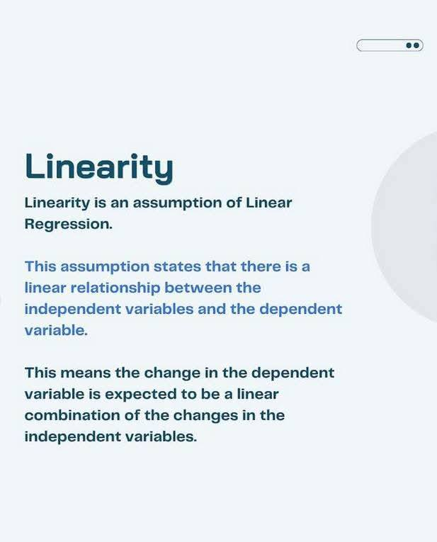

Slide 5
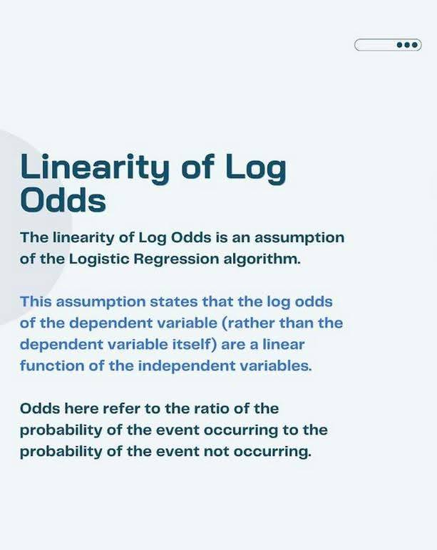
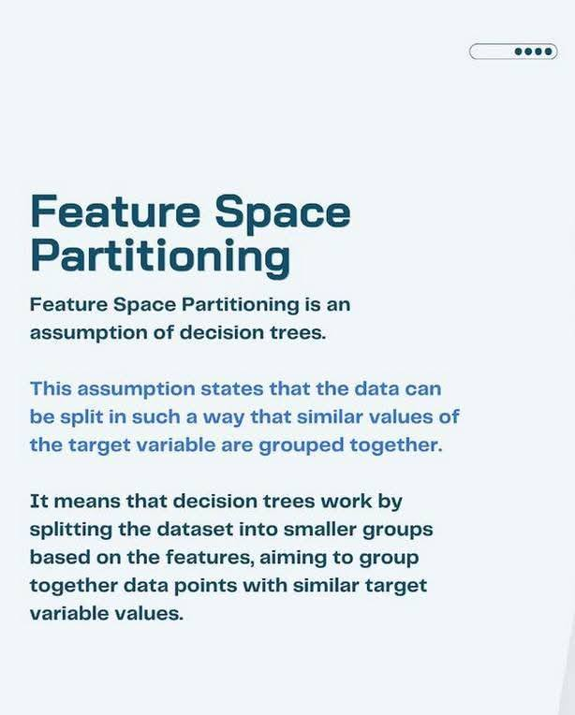

Slide 6
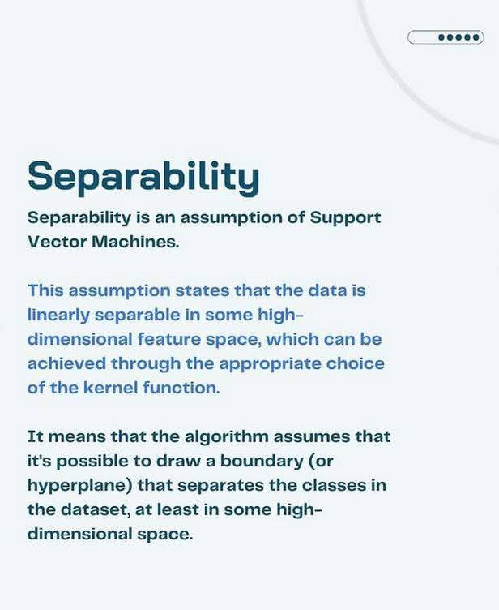
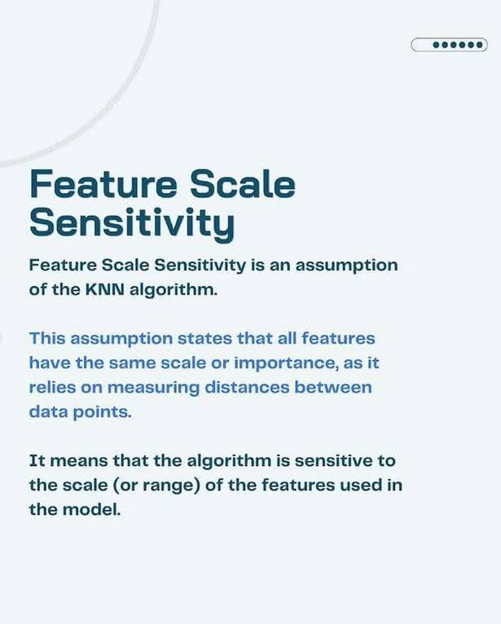

Slide 7
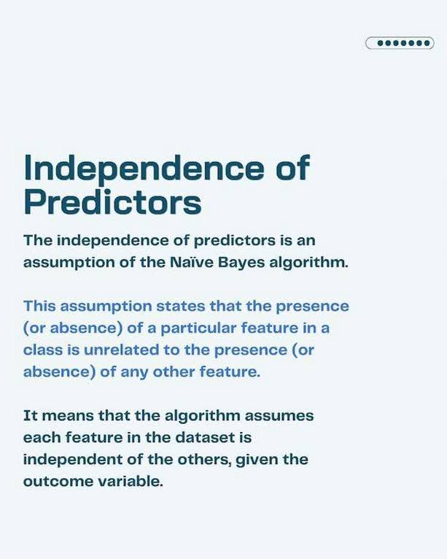


Slide 8
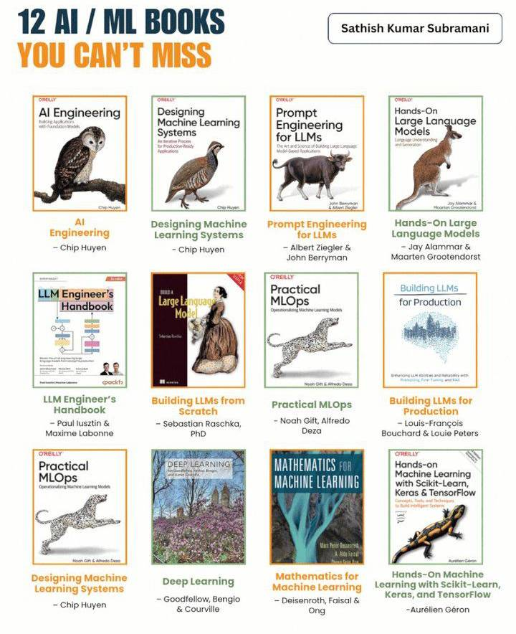

Slide 9
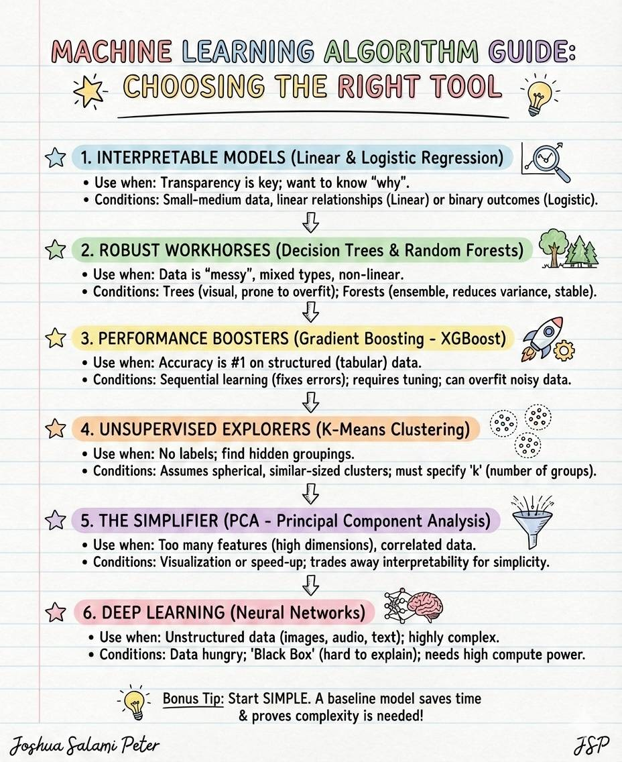

Slide 10
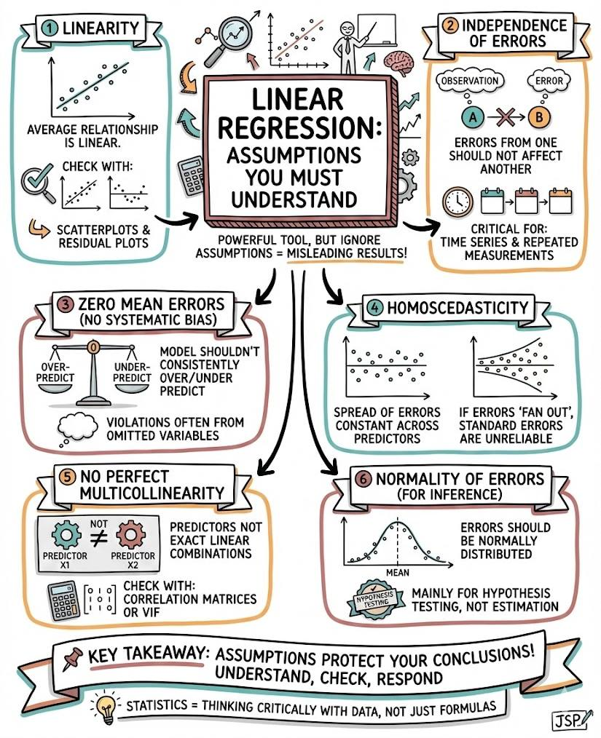
Notes:
Linear Regression: The Assumptions You Must Understand
Linear regression is one of the most powerful tools in statistics; but it only works properly when its assumptions are (reasonably) satisfied. If you ignore them, your results can be misleading, no matter how good your data looks.
Here’s a simple breakdown
Linearity
The average relationship between predictors and the response is linear.
Check with scatterplots and residual plots.
Independence of Errors
Errors from one observation should not affect another.
Very important for time series and repeated measurements.
Zero Mean Errors (No Systematic Bias)
Your model shouldn’t consistently over- or under-predict.
Violations often come from omitted variables.
Homoscedasticity
The spread of errors should be constant across all values of the predictors.
If errors “fan out”, your standard errors are unreliable.
No Perfect Multicollinearity
Predictors should not be exact linear combinations of each other.
Use correlation matrices or VIF to check.
Normality of Errors (for Inference)
Errors should be normally distributed, mainly for hypothesis testing, not estimation.
Key takeaway:
Assumptions are not just theory; they protect your conclusions.
Understand them, check them, and know how to respond when they fail.
P.S. Statistics is not about memorising formulas, it’s about thinking critically with data.
Joshua Salami Peter
#datascience #Statistics #AI

Slide 21
