Slide 1


PRODUCT RECOMMENDATION
DEBOPRIYO MALLICK | PRAXIS BUSINESS SCHOOL

Slide 2
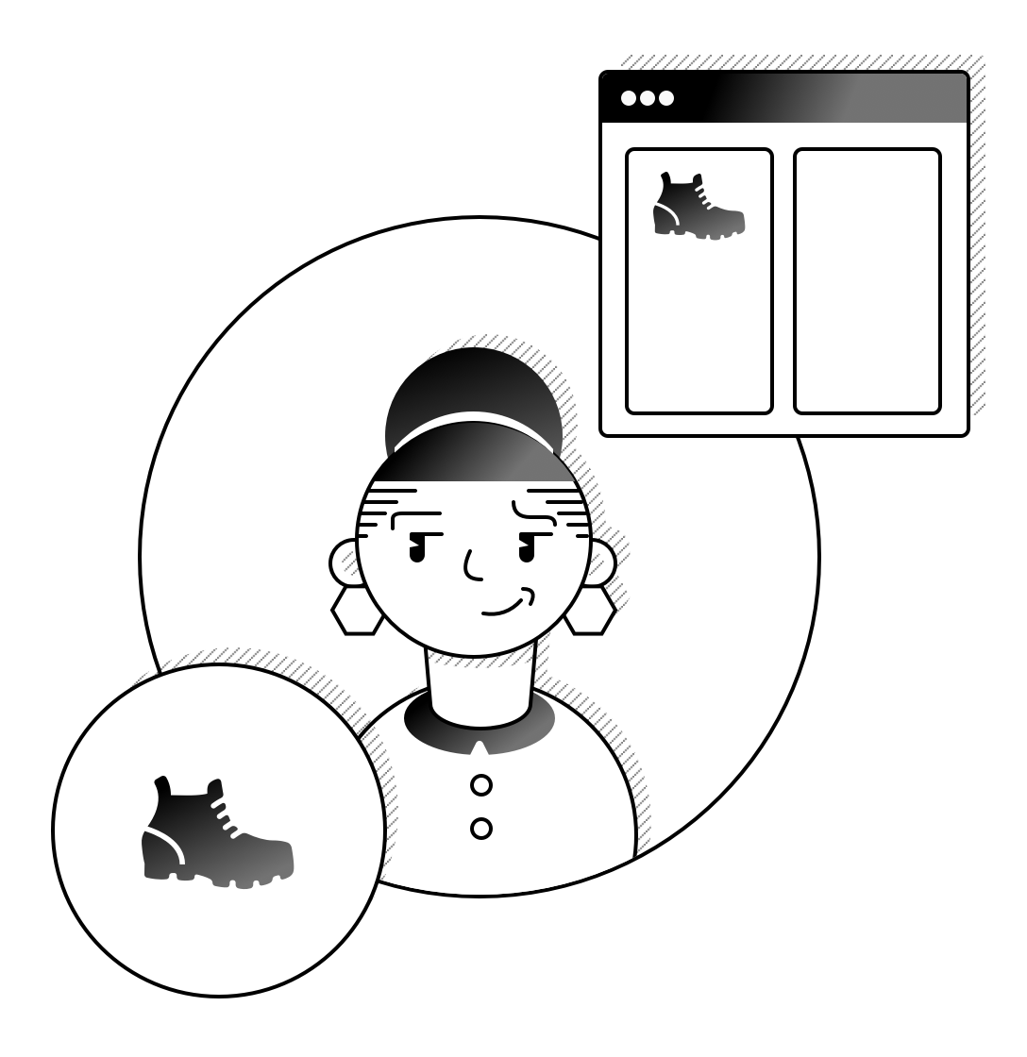
BACKGROUND
Objective
Objective is to build a recommendation engine that will recommend products to users during black Friday sales.
This recommender engine will help company engage with its customers and improve their sales. My interest in this project was because I have seen companies doing it, now I know the theory wanted to apply it with live or simulated data.

Slide 3

BUSINESS PROBLEM
All over the world, retail companies have to deal with stagnancy in sales. Sales Managers are in huge pressure to increase the revenue. Gaining new customers takes time and it generally grows at snail’s pace. They have to find ways on how to increase the sales to existing customers using cross selling and up selling.
To connect and engage with the customer they need a platform which will bring them together and which will led to win-win situation for both.

Slide 4
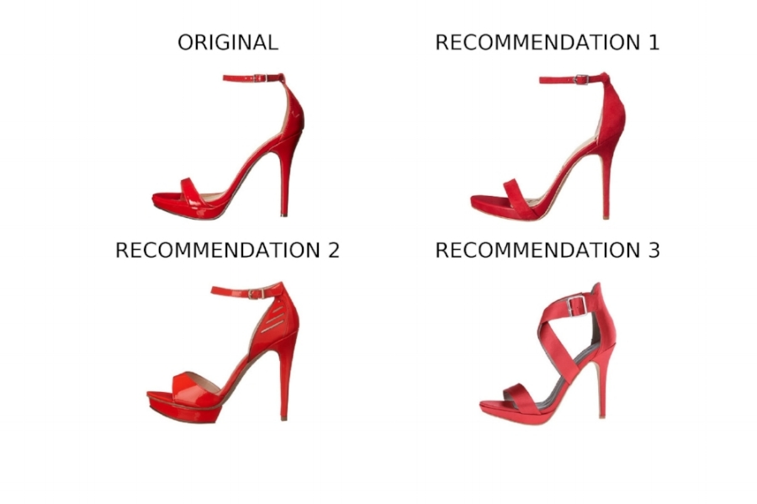
PROBLEM STATEMENT
Problem
Traditionally, businesses struggle to increase their revenue. They need some means to cross-sell and up sell their products and boost the revenue.
Consumers are inundated with choices. If given good offers and proposal, they are willing to spend more.
Build a recommender system that will help companies to showcase personalized products to consumers.
Help Consumers to select the products they like or intend to buy.
Solution

Slide 5
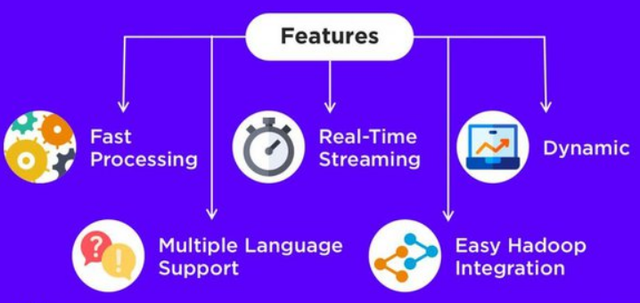
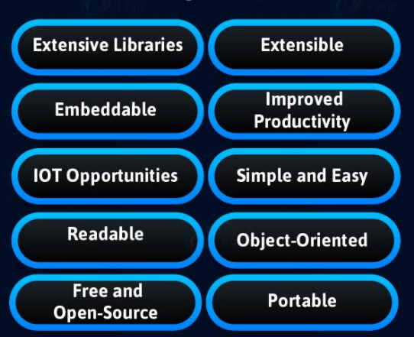
TOOLS USED
1) Apache SPARK
2) Python
Dynamic
Easy Hadoop Integration
Multiple Language Processing
Reusable
Lazy Evaluation

Slide 6
TECHNIQUE - ALS ALGORITM
Original Ratings Matrix
Factor Matrices
 | Product1 | Product2 | Product3 | Product4
User1
User2
User3
User4
User5
 | LF1 | LF2
User1
User2
User3
User4
 | Product1 | Product2 | Product3 | Product4
LF1
LF2
ALS

Slide 7
RECOMMENDATION ENGINE ARCHITECTURE USING PYSPARK
Product Data
User Data
Spark MlLib
Recommendation Engine
Database
Ratings Data
Alternating Least Squares (ALS)

Slide 8
ML Process flow
Labelled Data
Data Preprocessing
Cleaning
Data Transformation
Integrity
Recommendation Engine
Evaluation (RMSE)
Validate the Rating
Convert Product ID and User ID to integer
Unlabeled
Data
Data Preprocessing
Model
Data Transformation
Rating
MODEL BUILDING
MODEL EVALUATION
MODEL BUILDING

Slide 9
DATA DESCRIPTION
1000001 | P00069042 | F | 0-17 | 10 | A | 2 | 0 | 3 |  |  | 8370
1000001 | P00248942 | F | 0-17 | 10 | A | 2 | 0 | 1 | 6 | 14 | 15200
1000001 | P00087842 | F | 0-17 | 10 | A | 2 | 0 | 12 |  |  | 1422
1000001 | P00085442 | F | 0-17 | 10 | A | 2 | 0 | 12 | 14 |  | 1057
1000002 | P00285442 | M | 55+ | 16 | C | 4+ | 0 | 8 |  |  | 7969
1000003 | P00193542 | M | 26-35 | 15 | A | 3 | 0 | 1 | 2 |  | 15227
1000001 | P00069042 | F | 0-17 | 10 | A | 2 | 0 | 3 |  |  | 8370
User_ID
Product_ID
Gender
Age
Occupation
City_Category
Stay_In_Current_City_Years
Marital_Status
Product Category 1
Product Category 2
Product Category 3
Purchase

Slide 10
DATA PREPROCESSING
User | User_int
1000001 | 1
1000002 | 2
1000003 | 3
UserId | Product_id | Rating
1000001 | P0006904 | 8.3
1000001 | P0024894 | 15.2
1000001 | P0008784 | 1.4
1000002 | P0028544 | 7.9
1000003 | P0019354 | 15.2
Product | Product_int
P0006904 | 1
P0024894 | 2
P0019354 | 3
For ALS to work, product and user has to be integer. If product or user id is not integer converted them using monotonic function

Slide 11
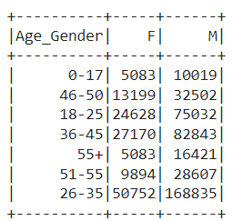
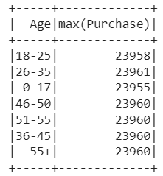
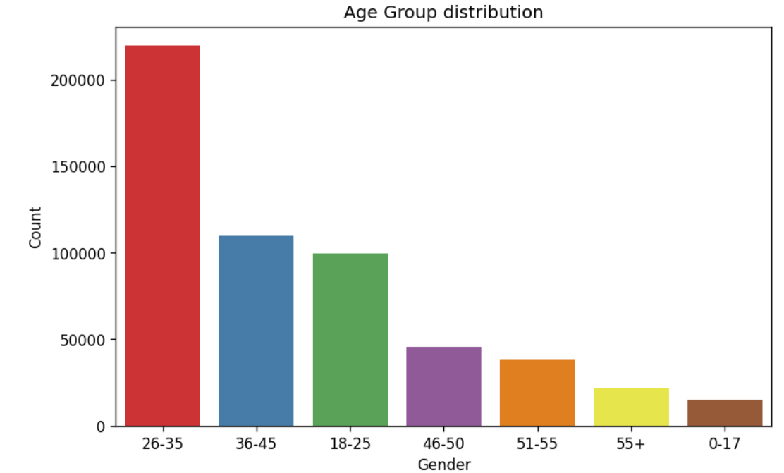
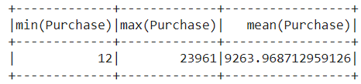
EXPLORATORY DATA ANALYSIS

Slide 12
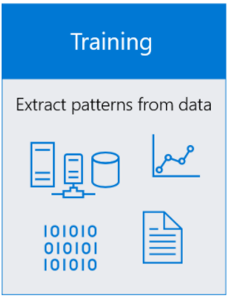
TRAINING THE MODEL
Training the model means ML algorithm finds patterns in the training data and use this knowledge to map the input data attributes/features to the target i.e the answer that it wants to predict. After training, output of the model captures these patterns.
Once model is trained, it has to be evaluated in terms of how well it has managed to predict the correct result. In this case, we will check the RMSE (root mean squared error) score. First the difference between the actual value and predicted value is calculated. Then, it is squared and the then the mean of the square root is found. Best model is the one with lowest RMSE score and which does not have performance issue with minimum set of parameters so that it does not overfit or underfit.

Slide 13
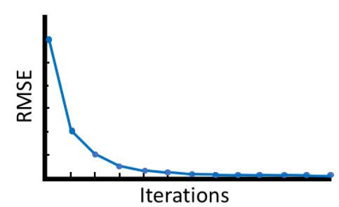
EVALUATING THE MODEL
ALS model will be evaluated based on the RMSE score. Model with the lowest RMSE and with good performance will be preferred.
Generally, if we increase number of iterations, more time it takes to predict.

Slide 14
HYPERPARAMETER TUNING
Tune the hyperparameters of ALS so that the optimal parameters are used for prediction.
Hyperparameter of ALS are:
rank – Number of latent features
maxIter – Number of iterations
regParam - to control the fitting parameters
userCol – Column containing user ids
itemCol - Column containing product ids
ratingCol – Column containing rating
final_als = ALS(maxIter=20,
regParam=0.1,
rank=4,
userCol="user_id",
itemCol = 'product_id’,
ratingCol="rating")

Slide 15










MATRIX FACTORIZATION
0.9
-1
1
1
-0.9
-0.2
-0.8
-1
0.9
1.0
  
✓
1
0.1
0.88
-1.08
0.9
1.09
-0.8
✓
✓
-1
0
-0.9
1.0
-1.0
-1.0
0.9
✓
✓
✓
✓
-0.2
-1
0.38
0.60
1.2
-0.7
-1.18
✓
✓
✓
0.1
1
-0.11
-0.9
-0.9
1.0
0.91

Slide 16
PREDICTION USING ALS
ALS works on the following two iterable steps:
Matrix Factorization - Ratings of user with products is decomposed to User with Ratings matrices and Products with rating matrices such that all the rows and columns are filled in the factors. Initially a random value is assigned and one of the factored matrices is changed keep the other two matrices constant and RMSE is calculated between the actual rating and the predicted rating. Next the other factored matrices is changed keeping the other two matrices constant and then the product is calculated and RMSE is determined. Factorization is non negative and rows and columns of the original matrix in the factors won’t be same as the original matrix. Number of columns in one of the factors is the latent parameter rank.
ii) Matrix Multiplication –It is generally a sparse matrix as not all the users will buy all the products.

Slide 17
PREDICTION USING ALS ALGORITM
Ratings Matrix
User Matrices
Product Matrices
 | Product1 | Product2 | Product3 | Product4
User1 | 10 |  |  | 14
User2 |  | 9
User3 |  |  | 8
User4 |  |  |  | 20
User5 |  | 11
 | LF1 | LF2
User1 | 5 | 2
User2 | 3 | 3
User3 | 5 | 4
User4 | 6 | 3
 | Product1 | Product2 | Product3 | Product4
LF1 | 2 | 3 | 3 | 1
LF2 | 1 | 2 | 2 | 1
CONSTANT
Changed
CONSTANT
User matrices is changed, keeping other two matrices constant and check the predicted rating. Then, change the Product matrices keeping other two constant and calculate RMSE. Continue till iteration is completed.

Slide 18
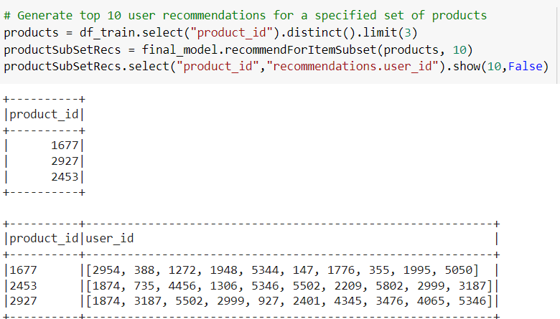
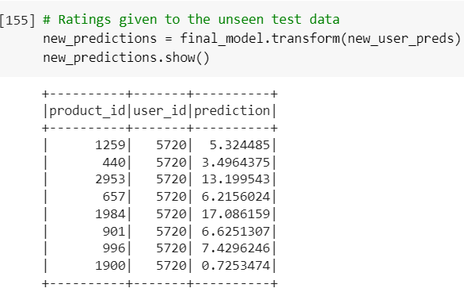
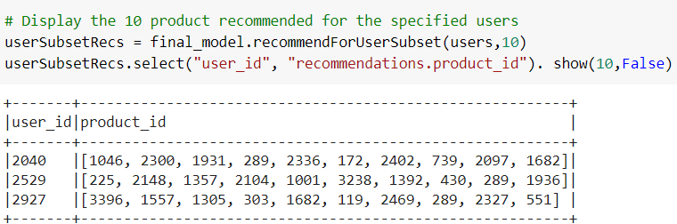
PREDICTED OUTPUTS
Output predictions

Slide 19
BENEFITS OF RECOMMENDATION SYSTEM
Engage with Customers
Increase Average Bill Value
Benefits
Better inventory Control
Increase in number of items

Slide 20
CHALLENGES IN IMPLEMENTING RECOMMENDATION SYSTEM

