Slide 1
Disease Detection Using Symptoms

Slide 2
Introduction
Disease Detection Using Symptoms
With big data growth in biomedical and healthcare communities, accurate analysis of medical data benefits early disease detection, patient care and community services.
Detection of disease through some technique is beneficial as it reduces a large work of monitoring every symptom for disease, and at very early stage itself it detects the disease that is appear on person’s body and their internal conditions.
Artificial neural network models were developed to perform disease detection and diagnosis using different symptoms of person’s through deep learning methodologies. So that appropriate medicine can be used to prevent further damage to health from different viruses.

Slide 3
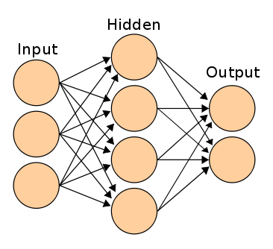
Artificial Neural Network
Disease Detection Using Symptoms
Artificial neural networks (ANN) are used for modelling non-linear problems and to predict the output values for given input parameters from their training values.

Slide 4
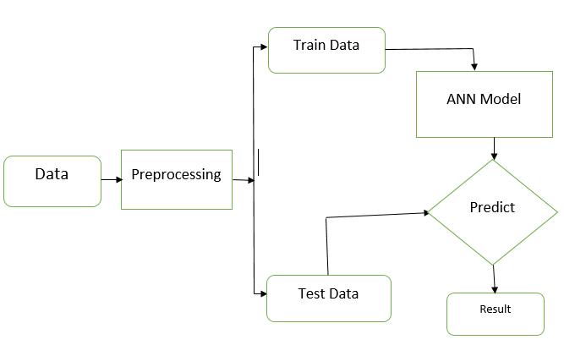
Proposed Methodology
Disease Detection Using Symptoms

Slide 5
Dataset
Disease Detection Using Symptoms
Independent Data | Target Data
‘itching', 'skin_rash', 'nodal_skin_eruptions', 'continuous_sneezing', 'shivering', 'chills', 'joint_pain', 'stomach_pain', 'acidity', ……., 'red_sore_around_nose', 'yellow_crust_ooze' | 'prognosis'
Data is in non-metric format i.e. 0 and 1. | There are 41 classes for target data.

Slide 6
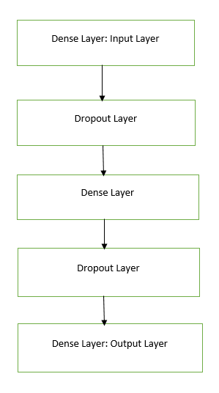
ANN Operation:
Disease Detection Using Symptoms
Dense Layer
ReLU Layer (Rectified Linear Unit)
Dropout layer

Slide 7
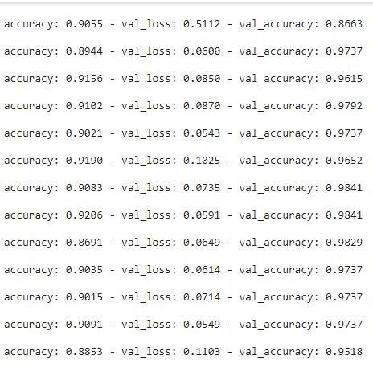
Accuracy
Disease Detection Using Symptoms
Training Accuracy is 88%
Testing accuracy 95%

Slide 8
SNAPSHOTS
Disease Detection Using Symptoms

Slide 9
SNAPSHOTS
Disease Detection Using Symptoms

Slide 10
SNAPSHOTS
Disease Detection Using Symptoms

Slide 11
SNAPSHOTS
Disease Detection Using Symptoms

Slide 12
SNAPSHOTS
Disease Detection Using Symptoms

Slide 13
SNAPSHOTS
Disease Detection Using Symptoms

Slide 14
Conclusion :
Disease Detection Using Symptoms
This system has utilized deep learning capabilities to achieve human disease detection system. This system is based on a simple classification mechanism which exploits the feature extraction functionalities of ANN. For prediction finally, the model utilizes the fully connected layers
The system has achieved an overall 95% testing accuracy on publically accessible dataset.
It is concluded from accuracy that ANN is highly suitable for human disease detection. This system can be used in hospitals and medical centres for easily disease detection.

Slide 15
Future Aspects
Disease Detection Using Symptoms
Ordering Medicine from ecommerce site.
Mobile application for personalized use
Setting reminder for Medicine intake.

Slide 16
Thank You
Disease Detection Using Symptoms

