Slide 1
Accuracy Prediction using Machine Learning Techniques for Patient Liver Disease

Slide 2
Agenda
Abstract
Introduction
Aim & Scope
Existing System
Proposed System
System Architecture
System Development
Testing
Conclusion
References

Slide 3
Abstract
Machine Learning in Health care applications.
Dataset is liver disease-related health care data. .
ML techniques, i.e., Naïve Bayes, K-means, SVM, ANN to compare their prediction accuracy.
Proposed technique amazingly enhances the illnesses expectation precision.

Slide 4
Introduction
The liver plays an important role in bodily functions .
When liver is infected with a virus , attack immune system.
a machine learning calculation will be prepared to foresee a liver ailment in patients.
We have utilized Naïve Bayes, SVM to make a model.
we are anticipating if the patient can have Liver Disease and the precision of the ailment.

Slide 5
Aim
Use classification algorithms to identify the liver patients from healthy individuals.
Three classification algorithms SVM, KM and Bayes have been used for comparing their performance based on the liver patient data.
The GUI can be readily utilized by doctors and medical practitioners as a screening tool for liver disease.

Slide 6
Scope
The application must provide user interface for doctors input object of the prescription.
The application should have the capability for preprocessing of the given input.
The System should be capable to detect the chances of lever disease using past patient data.

Slide 7
Existing System
There is no real time identity verification.
Not using data-mining technique to detect chances of getting lever disease.
Time intense.

Slide 8
Proposed System
Proposed system will allow people to get early prediction of getting chances of lever disease.
It didn’t require medical expertise.
Early prediction of liver disease can save human life and take proper steps to control the disease.

Slide 9
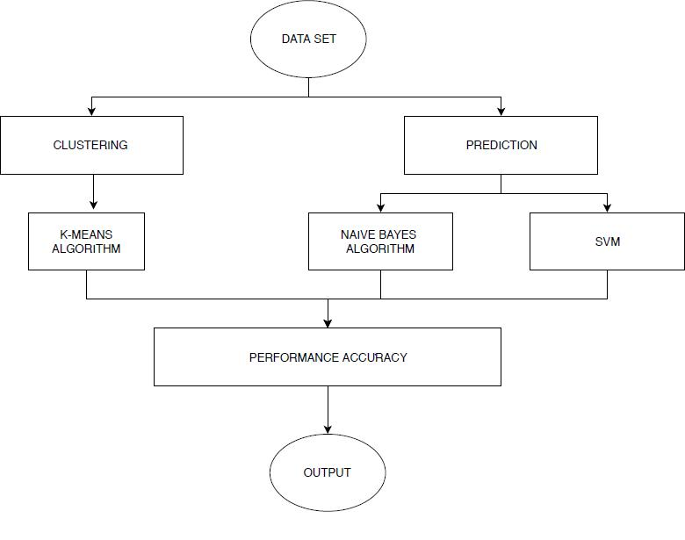
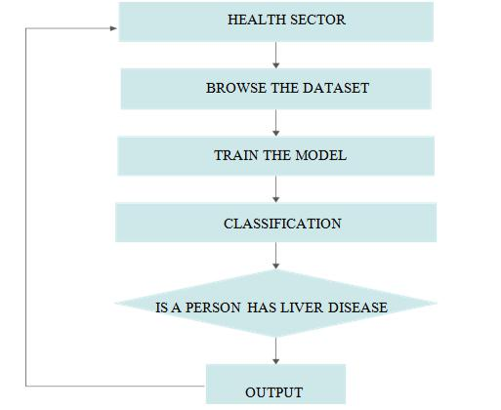
System Architecture

Slide 10
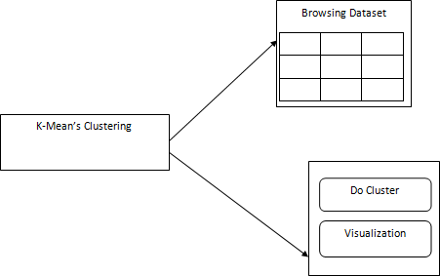
System Development
K-Means: For Clustering

Slide 11
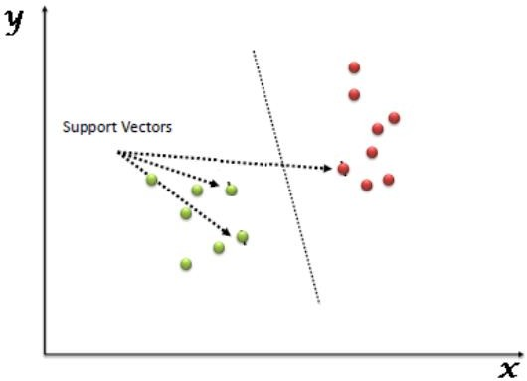
System Development
SVM: For Prediction of Test Cases

Slide 12
System Testing
Test Case ID | Test Objective | Precondition | Steps | Expected result | Post Condition
TC_001 | Clustering | Browse the file | Add the dataset which include personnel details | User details are clustered | Success
TC_002 | Detection | Browse Train & Testing Dataset | Files are browsed successfully | Data should be tested | Success
TC_003 | Liver diseaase status | Based on sample data set | Dataset should be checked | Chance of getting liver disease detected on basis of health data | Success

Slide 13
Conclusion
Classification is the major data mining technique which is primarily used in healthcare sectors for medical diagnosis and predicting diseases. .
Comparisons of these algorithms are done, based on the performance factors like accuracy and execution time.

Slide 14
References
Kalyan Nagaraj and Amulyashree Sridhar, “NeuroSVM: A Graphical User Interface
Kotsiantis. S.B, “Increasing the Classification Accuracy of Simple Bayesian
Esraa M Hashem, Mai S Mabrouk (2014). “A Study of Support Vector Machine Algorithm for Liver Disease Diagnosis”, American Journal of Intelligent Systems.
Anju Gulia, Dr. Rajan Vohra , Praveen Rani “Liver Patient Classification Using Intelligent Techniques”, International Journal of Computer Science and Information Technologies, Vol. 5 (4), 2014,

Slide 15
THANK YOU

